Slide 1
Algorithm Design & Analysis Introduction to Algorithm
Chapter 1: The Role of Algorithms in Computing
《算法分析与设计》课程组
重庆大学计算机学院
Notes:
Chapter 1 is an overview of algorithms and their place in modern computing systems. This chapter defines what an algorithm is and lists some examples. It also makes a case that algorithms are a technology, just as are fast hardware, graphical user interfaces, object-oriented systems, and networks.

Slide 2
The Role of Algorithms in Computing
OUTLINE
1.1 What are algorithms?
1.2 Why is the study of algorithms worthwhile?
1.3 Algorithms as a technology: How?
1.4 Textbook selected: What & Why?
1.5 Exercise & Mark

Slide 3
1.1 What are algorithm
What are algorithm?
Definition{computational procedure, computational problem, Input, Output}
Examples with instance — sorting problem
Requirement: correct, precise description
Notes:
Algorithm: broad answer “a set of steps to accomplish a task”, you have alrogithm s that you run in your everday life,exp: brush your teeth;
Algotihem for computer: a set of steps to accomplish a task that is described precisely enough that a computer can run it.

Slide 4
What is an algorithm?
algorithms that you run in your everyday life: brush your teeth
algorithms that run on computers or computational devices:
GPS:shortest-path\Taobao:encryption\Delivery:assign ackages
Your car\microwave oven\climate-contro systems
A computer algorithm is a set of steps to accomplish a task that is described precisely enough that a computer can run it

Slide 5
Definition of algorithm
Definition:
An algorithm is any well-defined computational procedure that
takes some value, or set of values, as input and
produces some value, or set of values, as output.
An algorithm is thus a sequence of computational steps that transform the input into the output.
Notes:
We want two things from a computer algorithm: given an input to a problem, it should always produce a correct solution to the problem, and it should use computational resources efficiently while doing so.

Slide 6
Relationship: algorithm and problem
Problem:
The statement of the problem specifies the desired input/output relationship.
Algorithm:
The algorithm describes a specific computational procedure for achieving that input/output relationship.
Relationship:
We can also view an algorithm as a tool for solving a well-specified computational problem

Slide 7
Problem description: sorting problem
Sorting problem:
Input: A sequence of n numbers a₁, a₂, ..., a_{n}
Output: A permutation (reordering) a'₁, a'₂, ..., a'_{n} of the input sequence such that
a'₁≤ a'₂ ≤ ... ≤ a'_{n}
An instance of the sorting problem
Input: 31, 41, 59, 26, 41, 58 or <8 2 4 9 3 6>
Output: 26, 31, 41, 41, 58, 59
Notation:
Sorting is a fundamental operation in CS
A large number of good sorting algorithms have been D&R

Slide 8
Algorithm description
Specification:
Natural language, computer program, hardware design
An algorithm can be specified in English | Chinese, as a computer program, or even as a hardware design.
Requirement
Precise description
The only requirement is that the specification must provide a precise description of the computational procedure to be followed.

Slide 9
Correctness of algorithm
Correctness:
An algorithm is said to be correct if, for every input instance, it halts with the correct output.
Incorrect algorithm
An incorrect algorithm might not halt at all on some input instances, or it might halt with an answer other than the desired one.
Incorrect algorithms can sometimes be useful, if their error rate can be controlled.

Slide 10

Examples :
Correctness:
GPS(real-time): tolls? congested?
pixel image :
Encryption: RSA algorithm
Approximation algorithm

Slide 11
Resource usage
Resource usage:
time
computer memory
network communication
random bits
disk operations

Slide 12
We alluded to one measure of efficiency in the algorithms: time.
The actual running time of an algorithm depends on several factors extrinsic to the algorithm itself
First, we determine how long the algorithm takes as a function of the size of its input: route-finding,searching
Second,we focus on how fast the function that characterizes the running time grows with the input size—the rate of the growth of the running time—the order of growth :
50n+125n, 20n³ +100n² +300n+200
Notes:
Exp: 50n+125;

Slide 13
1.2 Why is the study of algorithms w…?
Why is the study of algorithms worthwhile?
What is the role of algorithms?
What kinds of problems are solved by algorithms?
The Human Genome Project:100,000 genes in human DNA, sequences of the 3 billion chemical base pairs
Internet: finding good routes.
Electronic commerce: Public-key cryptography
Road map: shortest path
Product of a sequence of n matrices A₁ A₂ A_{n}
Equation ax ≡ b (mod n): integers
n points in the plane: find the convex hull
Know the strengths and limitations of data structures
Hard problems: NP-complete, efficient algorithm, good | best

Slide 14
1.3 Algorithms as a technology
Algorithms as a technology
infinitely fast: Terminates, with the correct answer
not infinitely fast: Computing time is therefore a bounded resource, algorithms that are efficient in terms of time or space

Slide 15
1.3 Algorithms as a technology
Procedure LINEAR-SEARCH.A; n; x/
Inputs: A: an array.
n: the number of elements in A to search through.
x: the value being searched for.
Output: Either an index i for which A[i]=x, or the special value
NOT-FOUND, which could be any invalid index into the array, such as
0 or any negative integer.
1. Set answer to NOT-FOUND.
2. For each index i , going from 1 to n, in order:
A. If A[i]=x, then set answer to the value of i .
3. Return the value of answer as the output.

Slide 16
1.3 Algorithms as a technology
Procedure BETTER-LINEAR-SEARCH.A; n; x/
Inputs and Output: Same as LINEAR-SEARCH.
1. For i = 1 to n:
A. If A[i]=x, then return the value of i as the output.
2. Return NOT-FOUND as the output.

Slide 17
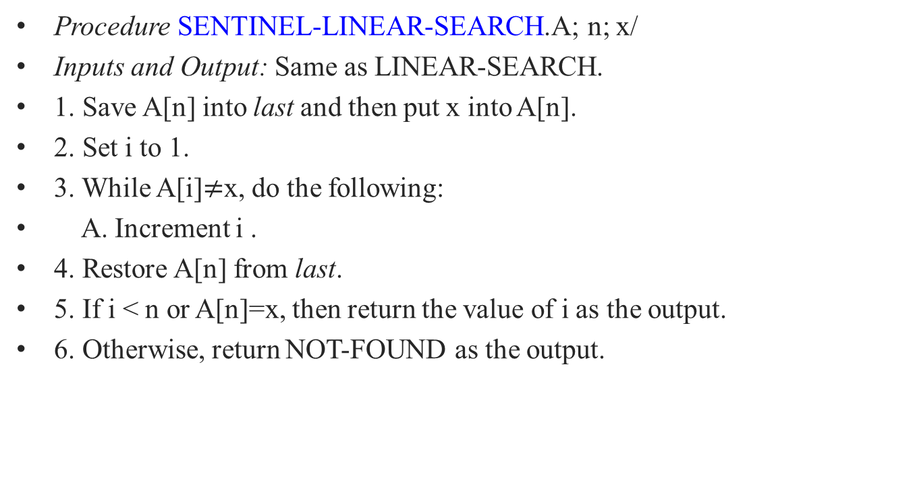
1.3 Algorithms as a technology
Procedure SENTINEL-LINEAR-SEARCH.A; n; x/
Inputs and Output: Same as LINEAR-SEARCH.
1. Save A[n] into last and then put x into A[n].
2. Set i to 1.
3. While A[i]$≠$x, do the following:
A. Increment i .
4. Restore A[n] from last.
5. If i < n or A[n]=x, then return the value of i as the output.
6. Otherwise, return NOT-FOUND as the output.

Slide 18
1.3 Algorithms as a technology
Efficiency: algorithms-T, hardware-v, Software-c
Algorithms for sorting:
Insertion sort, Merge sort
c₁=2, c₂=50; T_{A}=2n², T_{B}=50nlgn
Computer: Av=10billions/s, Bv=10millions/s
n=10million: t_{A}=?20,000s(5.5h) t_{B}≈? 1163s n=100million: t_{A}≈?23d t_{B}=? <4h

Slide 19
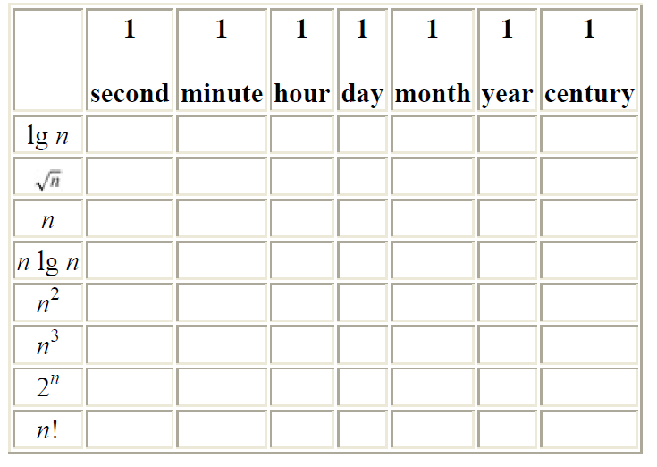
Problem: Comparison of running times
Determine the largest size n : For each function f(n) and time t in the following table, determine the largest size n of a problem that can be solved in time t, assuming that the algorithm to solve the problem takes f(n) microseconds
Notes:
Milli-, Micro-,Nano-

Slide 20
1.4 Textbook selected: What & Why?
Textbook:CLRS
Thomas H. Cormen, Charles E. Leiserson, Ronald L. Rivest, Clifford Stein.
Introduction to Algorithms.
3rd Edition, the MIT Press, 2009.
Famous Classical Book in CS:TAOCP
Donald Ervin Knuth, 1938.1.10-
Donald E. Knuth. The Art of Computer Programming, Volumes 1-4A,1st edition. Addison-Wesley Professional, March 13, 2011.
Notes:
Editorial Reviews
From the Back Cover
This boxed set consists of the following four volumes:
0201896834 / 9780201896831 Art of Computer Programming, Volume 1: Fundamental Algorithms
0201896842 / 9780201896848 Art of Computer Programming, Volume 2: Seminumerical Algorithms
0201896850 / 9780201896855 Art of Computer Programming, Volume 3: Sorting and Searching
0201038048 / 9780201038040 Art of Computer Programming, Volume 4A: Combinatorial Algorithms
About the Author
Donald E. Knuth was born on January 10, 1938 in Milwaukee, Wisconsin. He studied mathematics as an undergraduate at Case Institute of Technology, where he also wrote software at the Computing Center. The Case faculty took the unprecedented step of awarding him a Master's degree together with the B.S. he received in 1960. After graduate studies at California Institute of Technology, he received a Ph.D. in Mathematics in 1963 and then remained on the mathematics faculty. Throughout this period he continued to be involved with software development, serving as consultant to Burroughs Corporation from 1960-1968 and as editor of Programming Languages for ACM publications from 1964-1967.
He joined Stanford University as Professor of Computer Science in 1968, and was appointed to Stanford's first endowed chair in computer science nine years later. As a university professor he introduced a variety of new courses into the curriculum, notably Data Structures and Concrete Mathematics. In 1993 he became Professor Emeritus of The Art of Computer Programming. He has supervised the dissertations of 28 students.
Knuth began in 1962 to prepare textbooks about programming techniques, and this work evolved into a projected seven-volume series entitled The Art of Computer Programming. Volumes 1-3 first appeared in 1968, 1969, and 1973. Having revised these three in 1997, he is now working full time on the remaining volumes. Volume 4A appeared at the beginning of 2011. More than one million copies have already been printed, including translations into ten languages.
He took ten years off from that project to work on digital typography, developing the TeX system for document preparation and the METAFONT system for alphabet design. Noteworthy by-products of those activities were the WEB and CWEB languages for structured documentation, and the accompanying methodology of Literate Programming. TeX is now used to produce most of the world's scientific literature in physics and mathematics.
His research papers have been instrumental in establishing several subareas of computer science and software engineering: LR(k) parsing; attribute grammars; the Knuth-Bendix algorithm for axiomatic reasoning; empirical studies of user programs and profiles; analysis of algorithms. In general, his works have been directed towards the search for a proper balance between theory and practice.
Professor Knuth received the ACM Turing Award in 1974 and became a Fellow of the British Computer Society in 1980, an Honorary Member of the IEEE in 1982. He is a member of the American Academy of Arts and Sciences, the National Academy of Sciences, and the National Academy of Engineering; he is also a foreign associate of l'Academie des Sciences (Paris), Det Norske Videnskaps-Akademi (Oslo), Bayerische Akademie der Wissenschaften (Munich), the Royal Society (London), and Rossiiskaya Akademia Nauk (Moscow). He holds five patents and has published approximately 160 papers in addition to his 28 books. He received the Medal of Science from President Carter in 1979, the American Mathematical Society's Steele Prize for expository writing in 1986, the New York Academy of Sciences Award in 1987, the J.D. Warnier Prize for software methodology in 1989, the Adelskøld Medal from the Swedish Academy of Sciences in 1994, the Harvey Prize from the Technion in 1995, and the Kyoto Prize for advanced technology in 1996. He was a charter recipient of the IEEE Computer Pioneer Award in 1982, after having received the IEEE Computer Society's W. Wallace McDowell Award in 1980; he received the IEEE's John von Neumann Medal in 1995. He holds honorary doctorates from Oxford University, the University of Paris, St. Petersburg University, and more than a dozen colleges and universities in America.
Professor Knuth lives on the Stanford campus with his wife, Jill. They have two children, John and Jennifer. Music is his main avocation.

Slide 21
1.5 Exercise & Mark
See 《算法分析与设计》课程介绍与要求.ppt

Slide 22
Exercises for Chapter 1
Exercises: 1.2-3: Find the smallest value of n…
Problems 1-1: Comparison of running times…

Slide 23
Exercises for Chapter 1
1. 1-3. Select a data structure that you have seen previously, and discuss its strengths and limitations.
1.1-4 How are the shortest-path and traveling-salesman problems given above similar? How are
they different?
1.1-5 Come up with a real-world problem in which only the best solution will do. Then come up with one in which a solution that is "approximately" the best is good enough.

Slide 24
Exercises
Exercises 1.2-3 What is the smallest value of n such that an algorithm whose running time is 100n² runs faster than an algorithm whose running time is 2^{n} on the same machine?
Problems 1-1: Comparison of running times
For each function f(n) and time t in the following table, determine the largest size n of a problem that can be solved in time t, assuming that the algorithm to solve the problem takes f(n) microseconds.

Slide 25
End of Chapter
《算法分析与设计》课程组
重庆大学计算机学院

