Slide 1
Algorithm Analysis & Design Introduction to Algorithm
T&R Team of Algorithm Design
College of Computer Science and Engineering, CQU
Notes:
本人是国际视觉电生理学会(ISCEV)的会员。

Slide 2
Chapter 24: Single-Source Shortest Paths

Slide 3
Outlines
Shortest paths
Dijkstra’s algorithm
Bellman-Ford algorithm
Shortest paths in DAGs

Slide 4
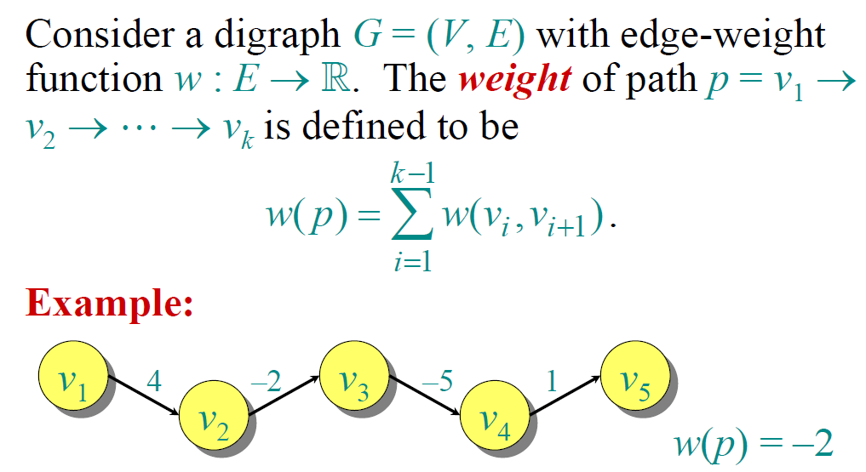
Paths in Graphs

Slide 5
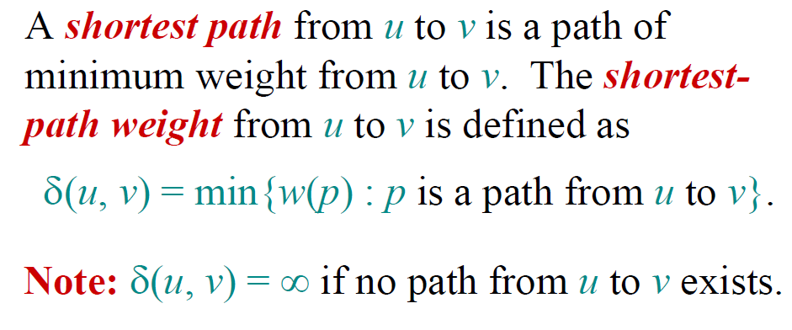
Shortest Paths

Slide 6
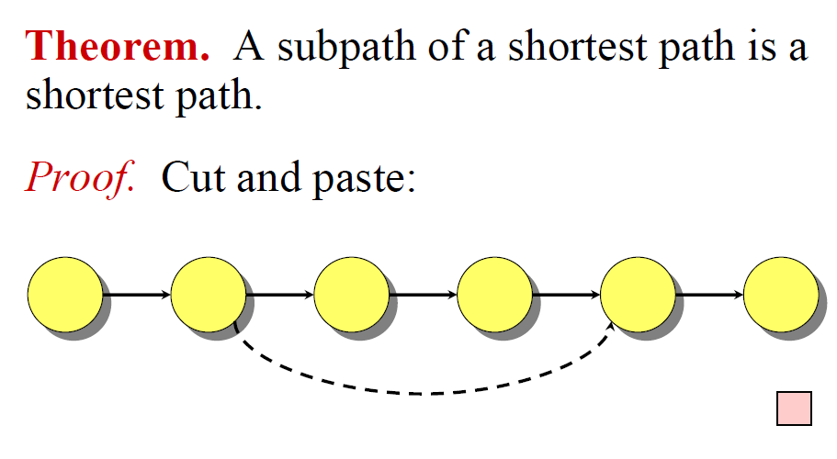
Optimal Sub-Structure

Slide 7
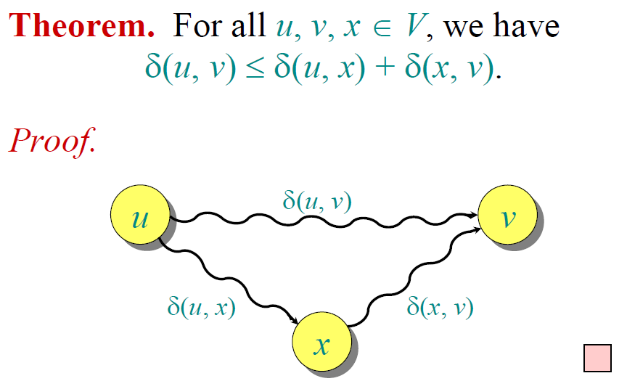
Triangle Inequality

Slide 8
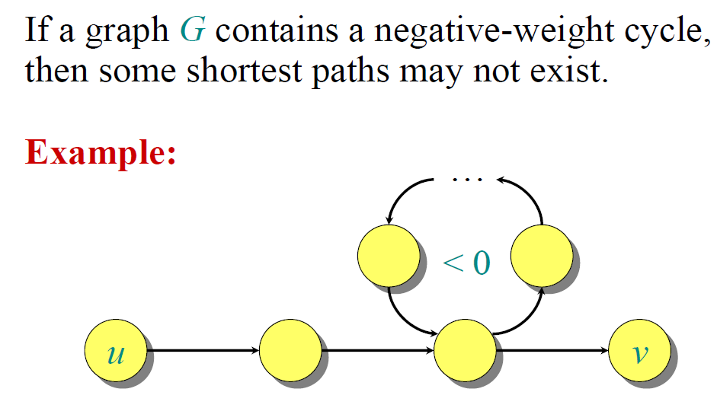
Well-Definedness of SP

Slide 9
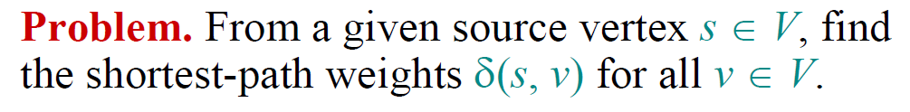
Single-Source Shortest Paths

Slide 10
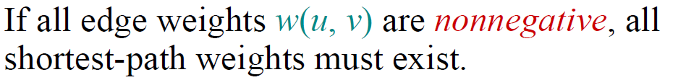
Single-Source Shortest Paths

Slide 11
Dijkstra’s Algorithm

Slide 12
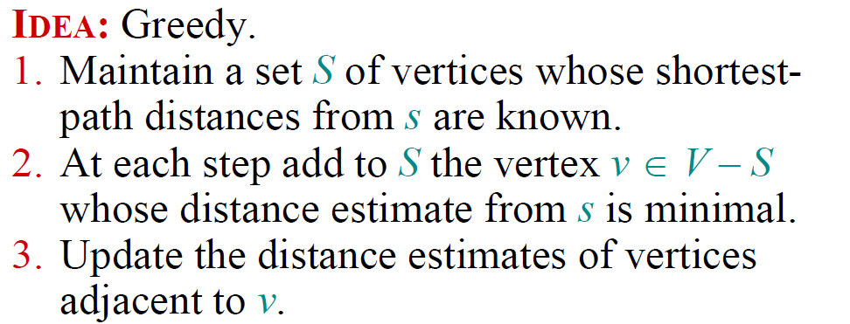
Single-Source Shortest Paths

Slide 13
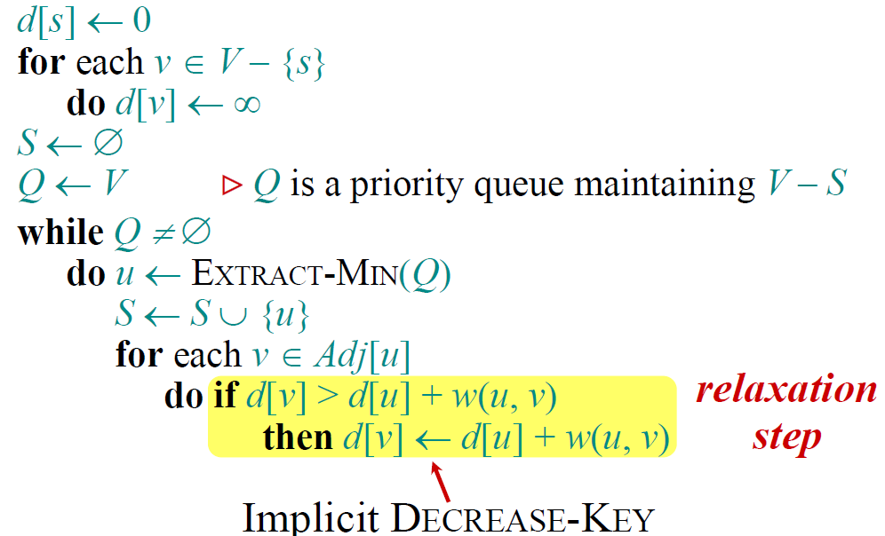
Dijkstra’s Algorithm

Slide 14
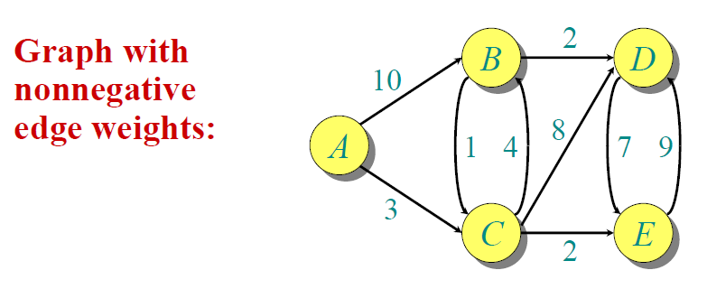
Example

Slide 15
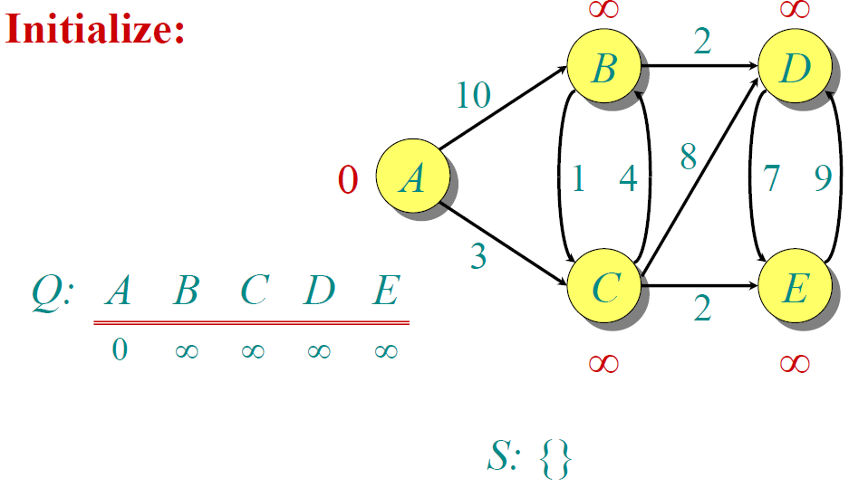
Example

Slide 16
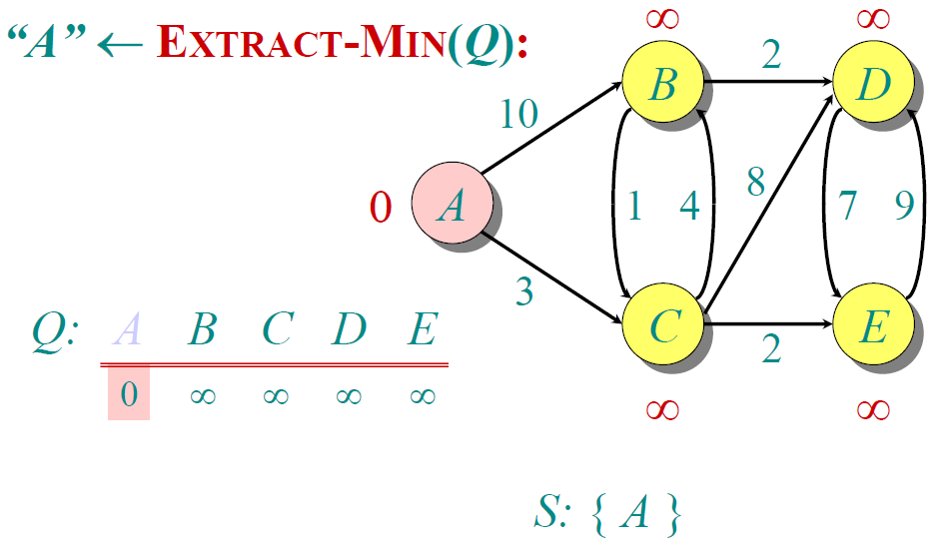
Example

Slide 17
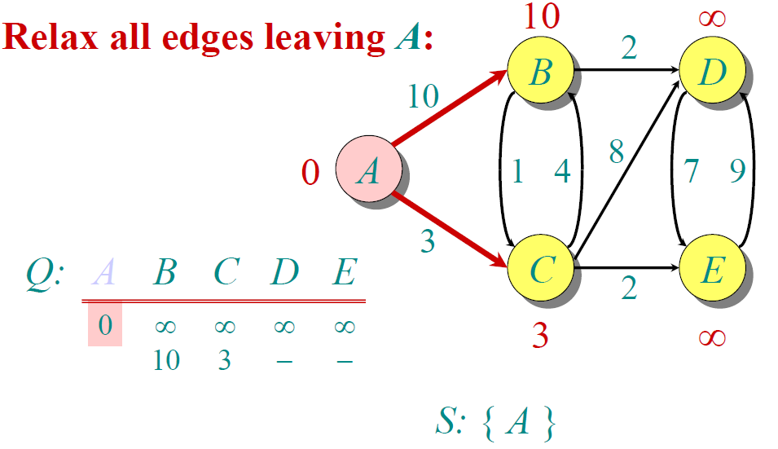
Example

Slide 18
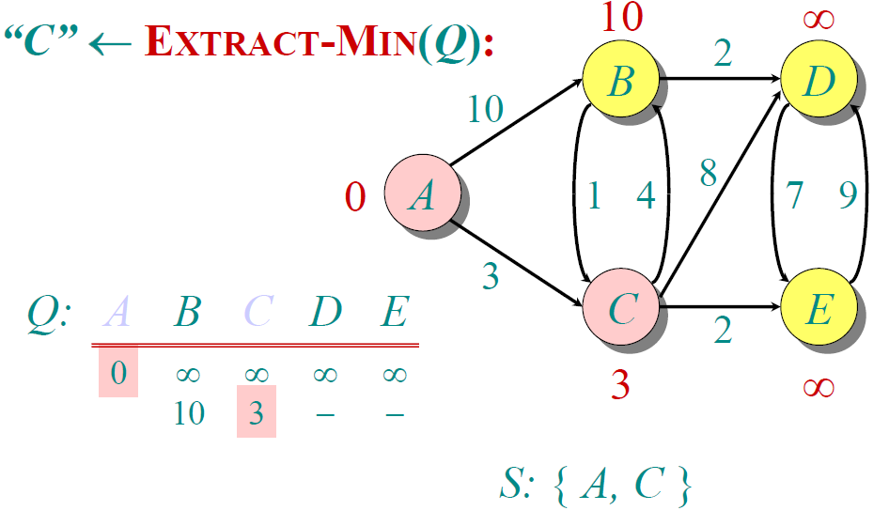
Example

Slide 19
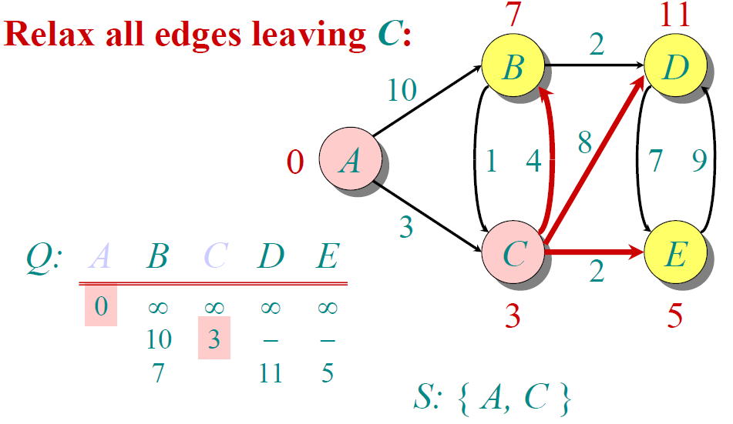
Example

Slide 20
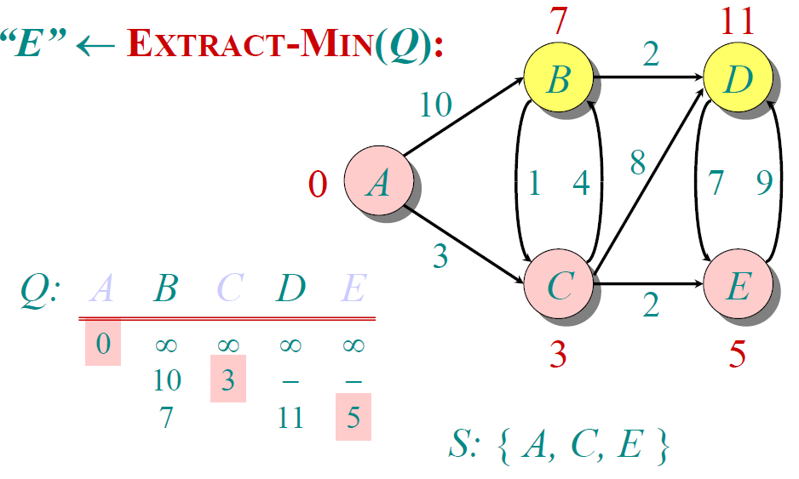
Example

Slide 21
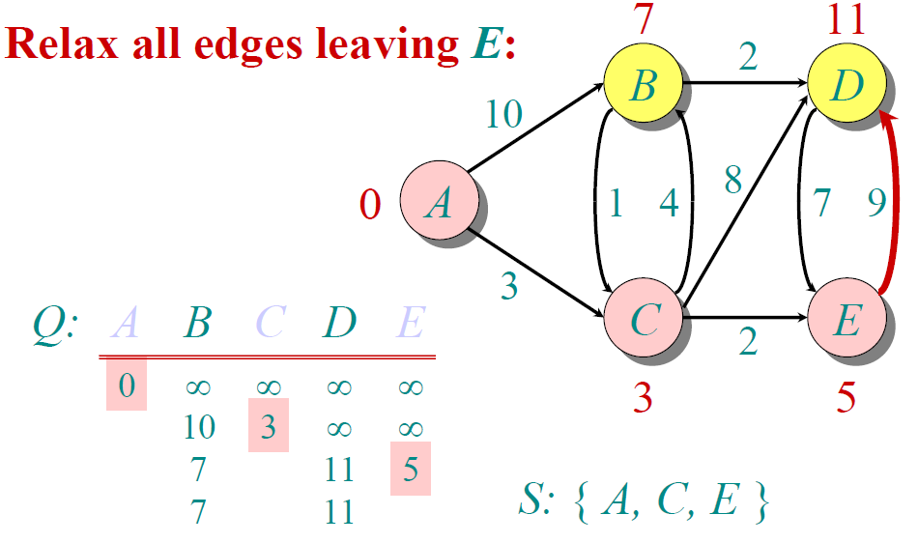
Example

Slide 22
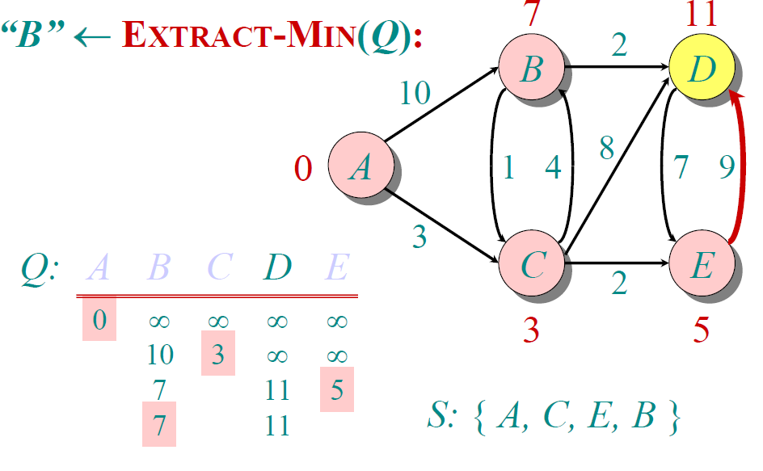
Example

Slide 23
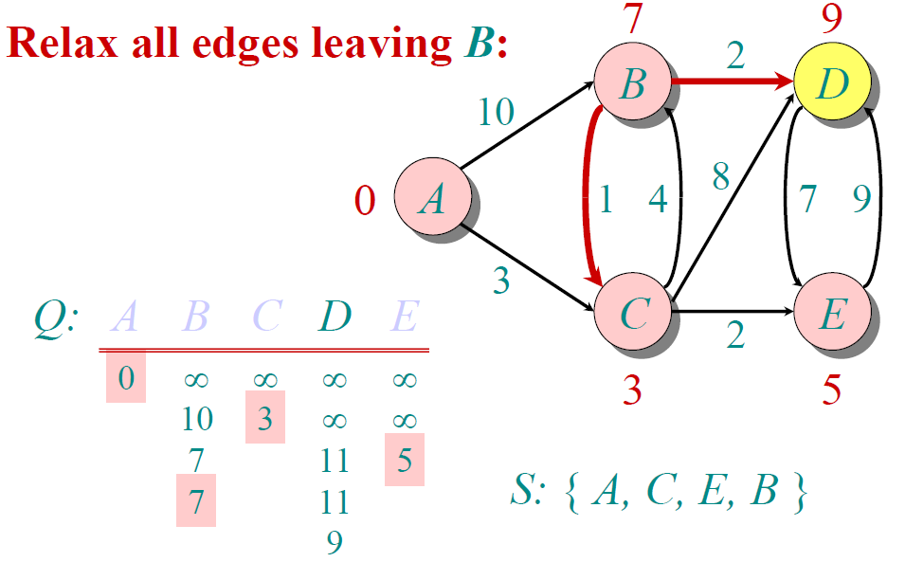
Example

Slide 24
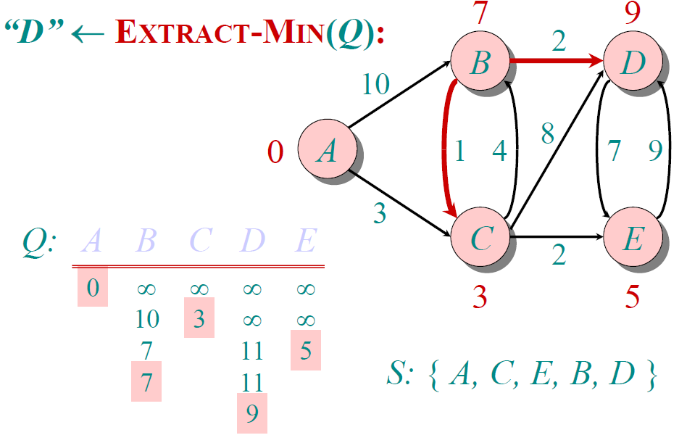
Example

Slide 25
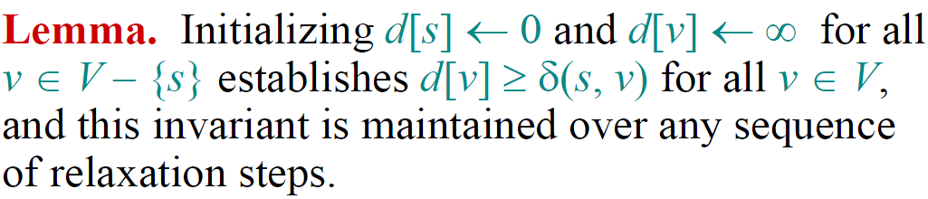
Correctness-I

Slide 26
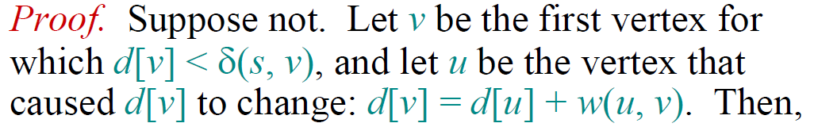
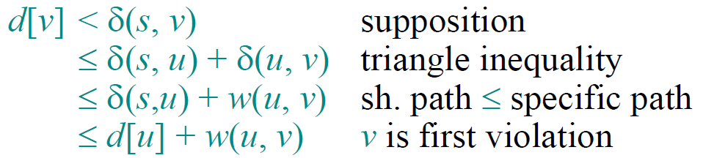
Correctness-I

Slide 27
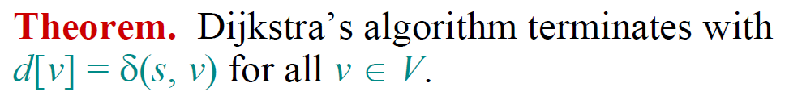
Correctness-II

Slide 28
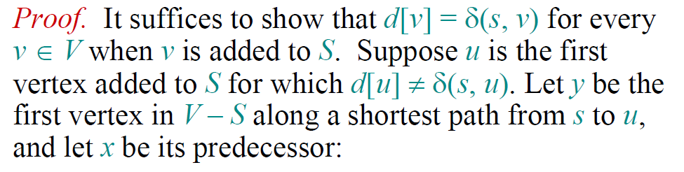
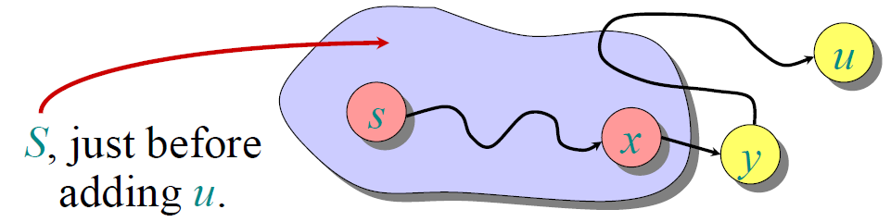
Correctness-II

Slide 29










Correctness-II
Non-negative weight

Slide 30
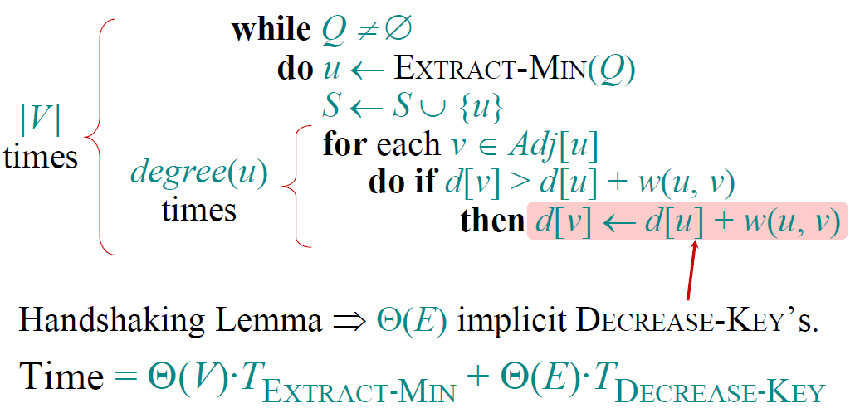
Analysis of Dijkstra

Slide 31
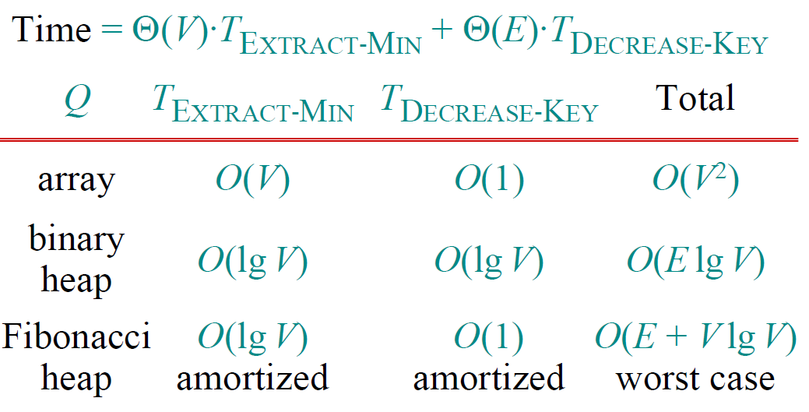
Analysis of Dijkstra

Slide 32
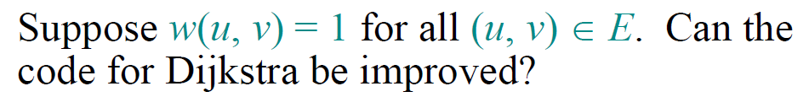
Dijkstra for Unweighted Graphs

Slide 33
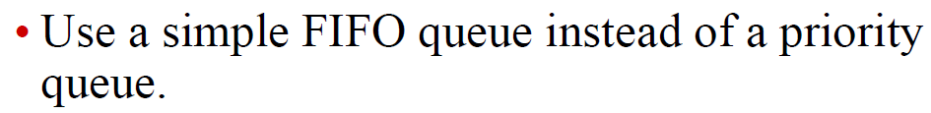
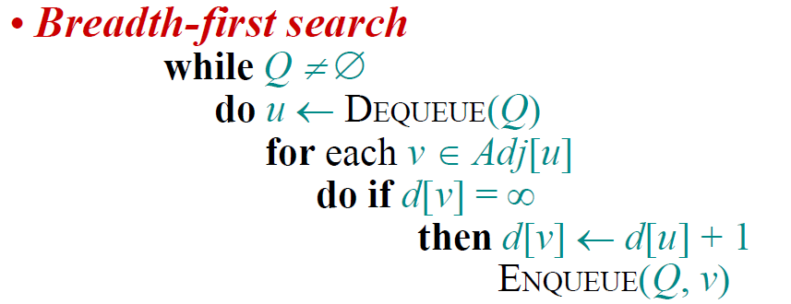

Dijkstra for Unweighted Graphs

Slide 34
Exercises
24.3-1
24.3-2
24.3-8

Slide 35
Bellman-Ford Algorithm

Slide 36
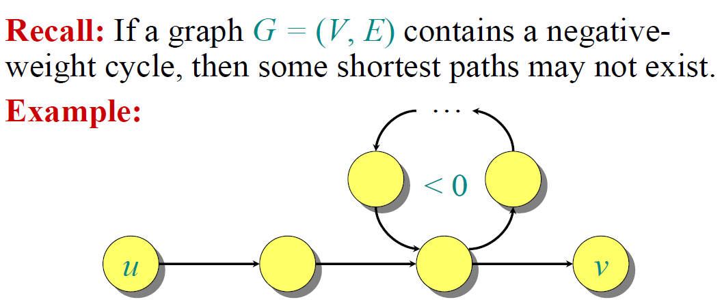
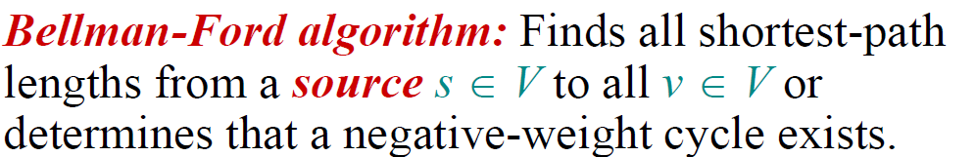
Negative-Weight Cycles

Slide 37
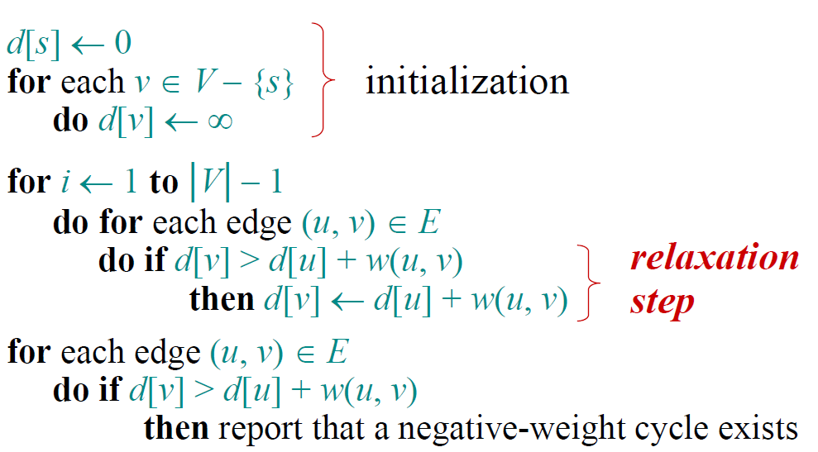
Bellman-Ford Algorithm

Slide 38
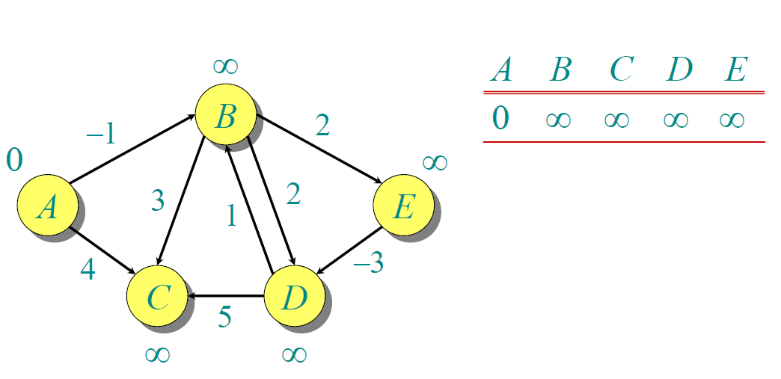
Example

Slide 39
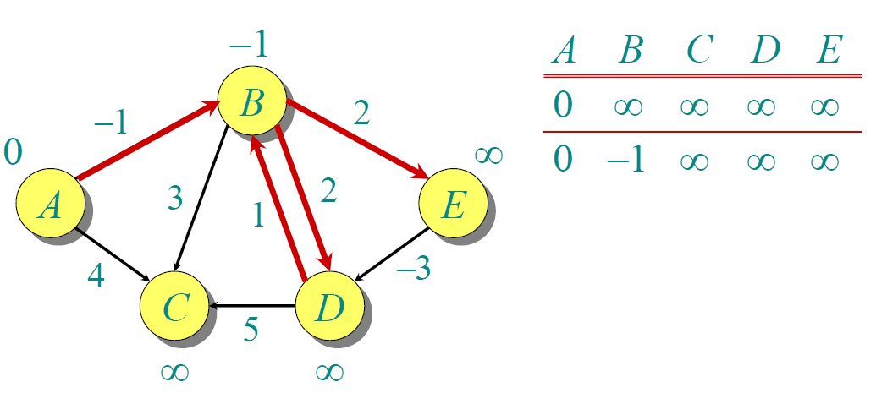
Example

Slide 40
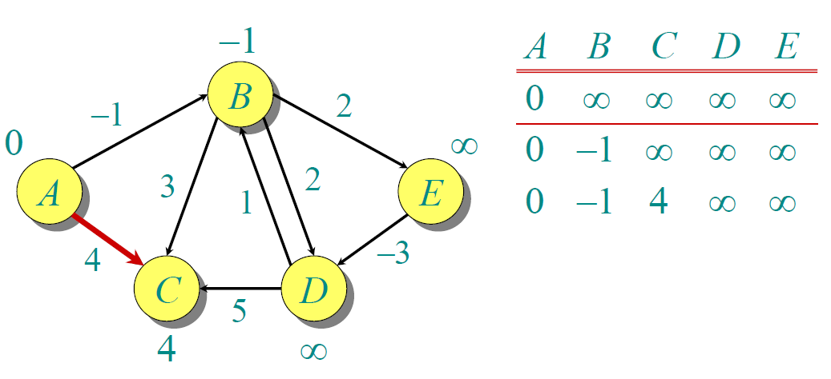
Example

Slide 41
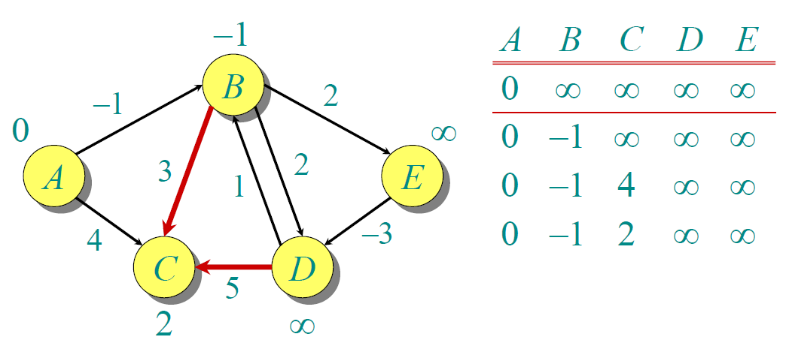
Example

Slide 42
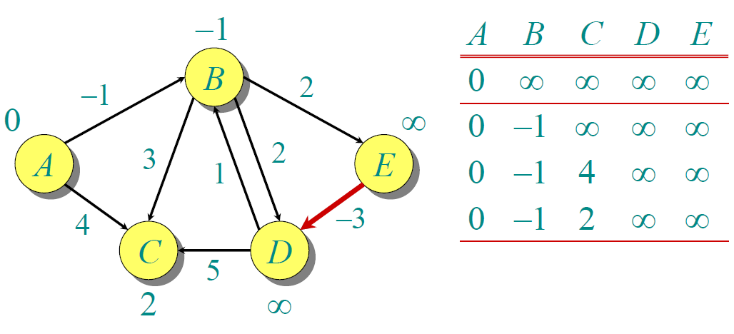
Example

Slide 43
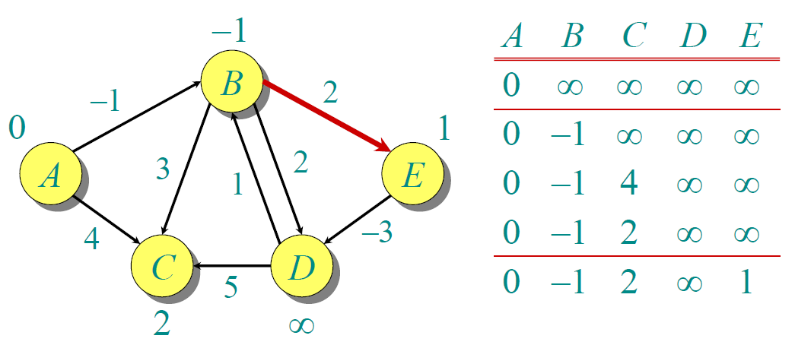
Example

Slide 44
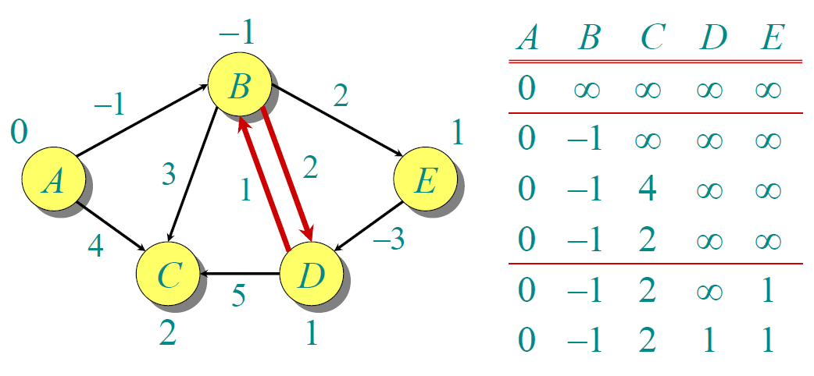
Example

Slide 45
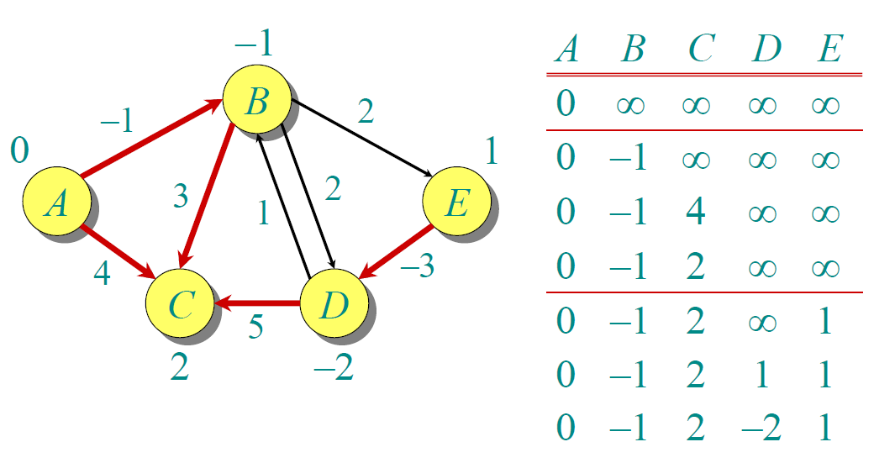
Example

Slide 46
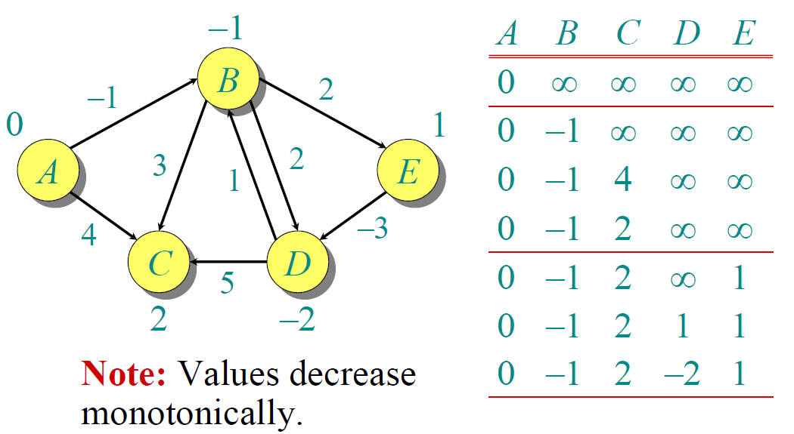
Example

Slide 47
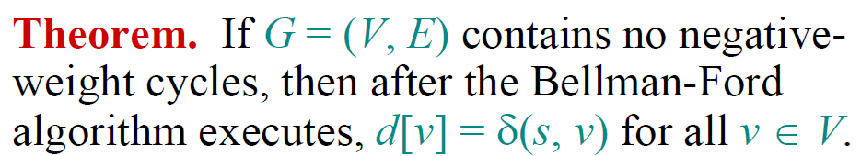
Correctness

Slide 48
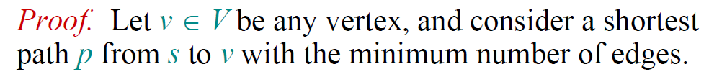
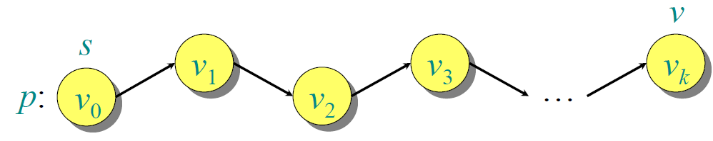
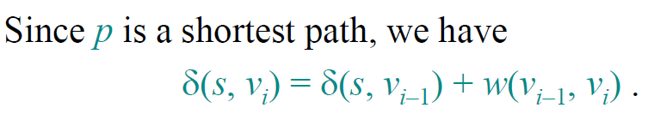
Correctness

Slide 49
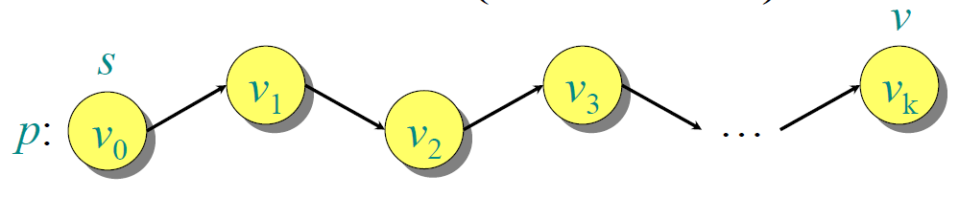

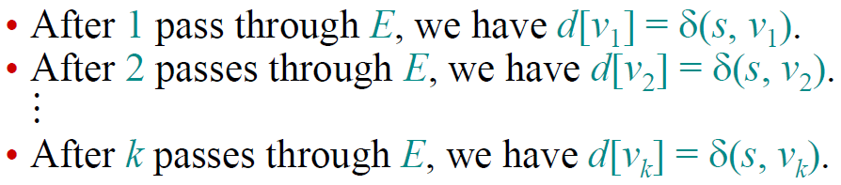
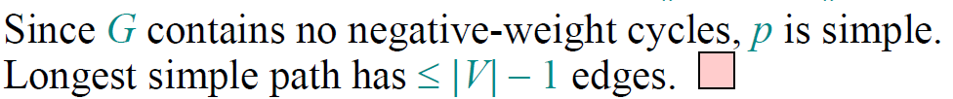
Correctness

Slide 50

Detection of Negative-Weighted Cycles

Slide 51
Exercises
24.1-1
24.1-3

Slide 52

Short Test in Class
Work out the shortest distances of each vertex from vertex 1.

Slide 53
Shortest Paths in DAGs

Slide 54




DAG Shortest Paths

Slide 55
Example
6
1
r
s
t
u
v
w
∞
5
0
2
∞
7
∞
–1
∞
–2
∞
4
3
2

Slide 56
Example
6
1
r
s
t
u
v
w
∞
5
0
2
∞
7
∞
–1
∞
–2
∞
4
3
2

Slide 57
Example
6
1
r
s
t
u
v
w
∞
5
0
2
2
7
6
–1
∞
–2
∞
4
3
2

Slide 58
Example
6
1
r
s
t
u
v
w
∞
5
0
2
2
7
6
–1
6
–2
4
4
3
2

Slide 59
Example
6
1
r
s
t
u
v
w
∞
5
0
2
2
7
6
–1
5
–2
4
4
3
2

Slide 60
Example
6
1
r
s
t
u
v
w
∞
5
0
2
2
7
6
–1
5
–2
3
4
3
2

Slide 61
Example
6
1
r
s
t
u
v
w
∞
5
0
2
2
7
6
–1
5
–2
3
4
3
2

Slide 62
Exercises
24.2-1
24.2-2

Slide 63
End of Section.
算法分析课程组
重庆大学计算机学院
Notes:
本人是国际视觉电生理学会(ISCEV)的会员。

