Slide 1
Algorithm Analysis & Design Introduction to Algorithm
T&R Team of Algorithm Design
College of Computer Science and Engineering, CQU
Notes:
本人是国际视觉电生理学会(ISCEV)的会员。

Slide 2
Chapter 4: Merge Sort and Recursion

Slide 3
Outline
2.1 Merge Sort
2.2 Recursion Analyzing

Slide 4
2.1 Merge Sort

Slide 5
Merging Sort
A typical algorithm based on divide-and-conquer
Divide: divide the given n-element-array into two sub arrays of about n/2 elements either
Conquer: sort the two sub arrays recursively
Merge: merge the two sorted sub arrays to generate the final output

Slide 6
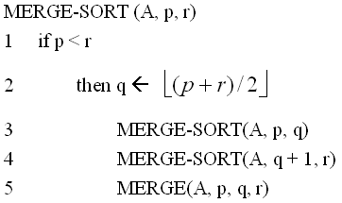
Merging Sort Pseudo Code
Input: the unsorted array A[p…r]
Output: the sorted array A’

Slide 7
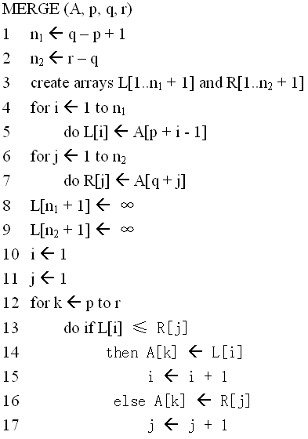
Pseudo Code of the Merge Procedure
R

Slide 8
Merge Sort - Split
L
A
R
O
G
I
T
M
H
S
Initial Input
split
L
A
R
O
G
I
T
M
H
S
split
split
L
A
R
O
G
I
T
M
H
S
split
split
split
split
L
A
R
O
G
I
T
M
H
S
split
split
L
A
I
T

Slide 9
Merge Sort - Merge
L
A
I
T
merge
merge
A
L
R
O
G
I
T
M
H
S
merge
merge
merge
merge
A
L
R
G
O
I
M
T
H
S
merge
merge
A
G
L
O
R
H
I
M
S
T
merge
Final Output
A
G
H
I
L
M
O
R
S
T

Slide 10
Merging Example
Merge.
Keep track of smallest element in each sorted half.
Insert smallest of two elements into auxiliary array.
Repeat until done.
smallest
smallest
A
G
L
O
R
H
I
M
S
T
A
auxiliary array

Slide 11
Merging Example
Merge.
Keep track of smallest element in each sorted half.
Insert smallest of two elements into auxiliary array.
Repeat until done.
smallest
smallest
A
G
L
O
R
H
I
M
S
T
A
G
auxiliary array

Slide 12
Merging Example
Merge.
Keep track of smallest element in each sorted half.
Insert smallest of two elements into auxiliary array.
Repeat until done.
smallest
smallest
A
G
L
O
R
H
I
M
S
T
A
G
H
auxiliary array

Slide 13
Merging Example
Merge.
Keep track of smallest element in each sorted half.
Insert smallest of two elements into auxiliary array.
Repeat until done.
smallest
smallest
A
G
L
O
R
H
I
M
S
T
A
G
H
I
auxiliary array

Slide 14
Merging Example
Merge.
Keep track of smallest element in each sorted half.
Insert smallest of two elements into auxiliary array.
Repeat until done.
smallest
smallest
A
G
L
O
R
H
I
M
S
T
A
G
H
I
L
auxiliary array

Slide 15
Merging Example
Merge.
Keep track of smallest element in each sorted half.
Insert smallest of two elements into auxiliary array.
Repeat until done.
smallest
smallest
A
G
L
O
R
H
I
M
S
T
A
G
H
I
L
M
auxiliary array

Slide 16
Merging Example
Merge.
Keep track of smallest element in each sorted half.
Insert smallest of two elements into auxiliary array.
Repeat until done.
smallest
smallest
A
G
L
O
R
H
I
M
S
T
A
G
H
I
L
M
O
auxiliary array

Slide 17
Merging Example
Merge.
Keep track of smallest element in each sorted half.
Insert smallest of two elements into auxiliary array.
Repeat until done.
smallest
smallest
A
G
L
O
R
H
I
M
S
T
A
G
H
I
L
M
O
R
auxiliary array

Slide 18
Merging Example
Merge.
Keep track of smallest element in each sorted half.
Insert smallest of two elements into auxiliary array.
Repeat until done.
first half exhausted
smallest
A
G
L
O
R
H
I
M
S
T
A
G
H
I
L
M
O
R
S
auxiliary array

Slide 19
Merging Example
Merge.
Keep track of smallest element in each sorted half.
Insert smallest of two elements into auxiliary array.
Repeat until done.
first half exhausted
smallest
A
G
L
O
R
H
I
M
S
T
A
G
H
I
L
M
O
R
S
T
auxiliary array

Slide 20
Merging Example
Merge.
Keep track of smallest element in each sorted half.
Insert smallest of two elements into auxiliary array.
Repeat until done.
first half exhausted
second half exhausted
A
G
L
O
R
H
I
M
S
T
A
G
H
I
L
M
O
R
S
T
auxiliary array

Slide 21
Merge Sort – Combine with Insertion Sort
Consider the following is of unsorted array of 23 entries
We will call insertion sort if the list being sorted is less than n = 8
13 | 77 | 49 | 35 | 61 | 48 | 3 | 23 | 95 | 73 | 89 | 37 | 57 | 99 | 94 | 28 | 15 | 55 | 7 | 51 | 88 | 97 | 62

Slide 22
Merge Sort – Combine with Insertion Sort
Consider the following is of unsorted array of 23 entries
The first and last entries are at indices first = 0 and last = 22
We will split the list at midpoint = (0 + 22)/2, which equals 11 and recursively call merge sort on entries 0 through 11 and 12 through 22
13 | 77 | 49 | 35 | 61 | 48 | 3 | 23 | 95 | 73 | 89 | 37 | 57 | 99 | 94 | 28 | 15 | 55 | 7 | 51 | 88 | 97 | 62

Slide 23
Merge Sort – Combine with Insertion Sort
We are now sorting positions 0 through 11, inclusive
Again, we calculate midpoint = (0 + 11)/2, which equals 5 and recursively sort entries 0 through 5 and 6 through 11
13 | 77 | 49 | 35 | 61 | 48 | 3 | 23 | 95 | 73 | 89 | 37 | 57 | 99 | 94 | 28 | 15 | 55 | 7 | 51 | 88 | 97 | 62

Slide 24
Merge Sort – Combine with Insertion Sort
This sub-list has only 6 entries, so we call insertion sort
13 | 77 | 49 | 35 | 61 | 48 | 3 | 23 | 95 | 73 | 89 | 37 | 57 | 99 | 94 | 28 | 15 | 55 | 7 | 51 | 88 | 97 | 62
13 | 35 | 48 | 49 | 61 | 77 | 3 | 23 | 95 | 73 | 89 | 37 | 57 | 99 | 94 | 28 | 15 | 55 | 7 | 51 | 88 | 97 | 62

Slide 25
Merge Sort – Combine with Insertion Sort
This sub-list also has only 6 entries: call insertion sort
13 | 35 | 48 | 49 | 61 | 77 | 3 | 23 | 95 | 73 | 89 | 37 | 57 | 99 | 94 | 28 | 15 | 55 | 7 | 51 | 88 | 97 | 62
13 | 35 | 48 | 49 | 61 | 77 | 3 | 23 | 37 | 73 | 89 | 95 | 57 | 99 | 94 | 28 | 15 | 55 | 7 | 51 | 88 | 97 | 62

Slide 26
Merge Sort – Combine with Insertion Sort
These first two lists are now sorted, so we merge them:
13 | 35 | 48 | 49 | 61 | 77 | 3 | 23 | 37 | 73 | 89 | 95 | 57 | 99 | 94 | 28 | 15 | 55 | 7 | 51 | 88 | 97 | 62
3 | 13 | 23 | 35 | 37 | 48 | 49 | 61 | 73 | 77 | 89 | 95 | 57 | 99 | 94 | 28 | 15 | 55 | 7 | 51 | 88 | 97 | 62

Slide 27
Merge Sort – Combine with Insertion Sort
We now proceed to the second half at positions 12 through 23
The midpoint is at midpoint = (12 + 23)/2, which equals 17 and recursively call merge sort on entries 12 through 17 and 18 through 22
3 | 13 | 23 | 35 | 37 | 48 | 49 | 61 | 73 | 77 | 89 | 95 | 57 | 99 | 94 | 28 | 15 | 55 | 7 | 51 | 88 | 97 | 62

Slide 28
Merge Sort – Combine with Insertion Sort
The sub-list from 12 through 17 has 6 entries: call insertion sort
3 | 13 | 23 | 35 | 37 | 48 | 49 | 61 | 73 | 77 | 89 | 95 | 57 | 99 | 94 | 28 | 15 | 55 | 7 | 51 | 88 | 97 | 62
3 | 13 | 23 | 35 | 37 | 48 | 49 | 61 | 73 | 77 | 89 | 95 | 15 | 28 | 55 | 57 | 94 | 99 | 7 | 51 | 88 | 97 | 62

Slide 29
Merge Sort – Combine with Insertion Sort
The sub-list from 18 through 22 has 5 entries: call insertion sort
3 | 13 | 23 | 35 | 37 | 48 | 49 | 61 | 73 | 77 | 89 | 95 | 15 | 28 | 55 | 57 | 94 | 99 | 7 | 51 | 88 | 97 | 62
3 | 13 | 23 | 35 | 37 | 48 | 49 | 61 | 73 | 77 | 89 | 95 | 15 | 28 | 55 | 57 | 94 | 99 | 7 | 51 | 62 | 88 | 97

Slide 30
Merge Sort – Combine with Insertion Sort
Merge the two lists together:
3 | 13 | 23 | 35 | 37 | 48 | 49 | 61 | 73 | 77 | 89 | 95 | 15 | 28 | 55 | 57 | 94 | 99 | 7 | 51 | 62 | 88 | 97
3 | 13 | 23 | 35 | 37 | 48 | 49 | 61 | 73 | 77 | 89 | 95 | 7 | 15 | 28 | 51 | 55 | 57 | 62 | 88 | 94 | 97 | 99

Slide 31
Merge Sort – Combine with Insertion Sort
Finally, merge both lists together:
3 | 13 | 23 | 35 | 37 | 48 | 49 | 61 | 73 | 77 | 89 | 95 | 7 | 15 | 28 | 51 | 55 | 57 | 62 | 88 | 94 | 97 | 99
3 | 7 | 13 | 15 | 23 | 28 | 35 | 37 | 48 | 49 | 51 | 55 | 57 | 61 | 62 | 73 | 77 | 88 | 89 | 94 | 95 | 97 | 99

Slide 32
Exercise
1. Write the pseudo code of the merge-insertion sort described above.
2. What is the computational complexity of merge-insertion sort?

Slide 33
2.2 Recursion Analyzing

Slide 34
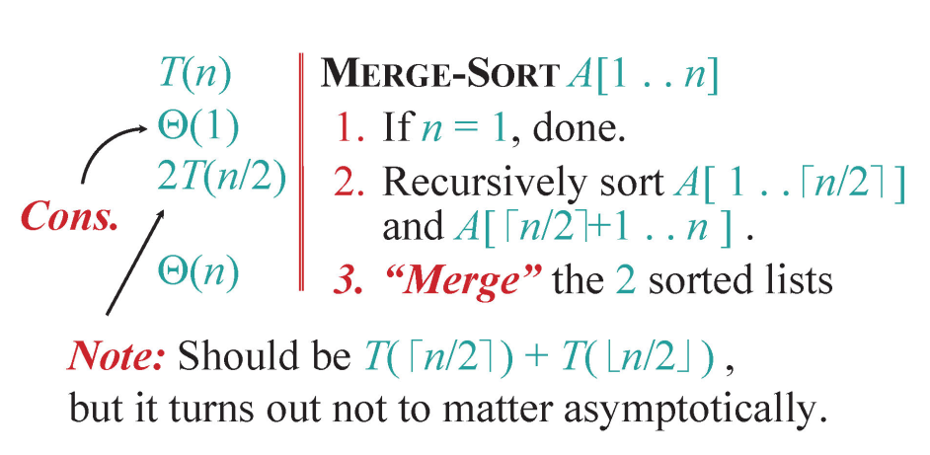
Analyzing Merge Sort

Slide 35
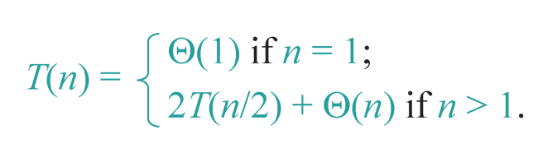
Recurrence for Merge Sort
Solution: the asymptotic running time of Merge Sort is T(n) = Θ(n log n).
We have several ways to prove this recurrence.

Slide 36
Contents
2.2.1 Expansion
2.2.2 Substitution
2.2.3 Recursion Tree

Slide 37
2.2.1 Expansion

Slide 38
Expansion Method
Sometimes the expression of the recurrence is very simple.
Thus, we can expand the recurrence expression by replacing the current term with the decreasing-input-terms directly.

Slide 39
Expansion Method
E.g., given the following recurrence :
T(n) = T(n – 1) + Θ(n), T(1) = Θ(1)

Slide 40
Expansion Method
What if T(n) = T(n – 1) + Ο(n), T(1) = Ο(1)?
Thus, we can only get the upper bound.

Slide 41
Apply Expansion to Merge Sort

Slide 42
Apply Expansion to Merge Sort

Slide 43
Exercise in Class
T(n) = 4T(n/2) + Θ(n), T(1) = Θ(1)
Solve the above recurrence through expansion.

Slide 44
2.2.2 Substitution

Slide 45
Substitution method
The most general method.
1. Guess the form of the solution.
2. Verify by induction.
3. Solve for constants.

Slide 46
Example of substitution
Example: T(n) = 4T(n/2) + Θ(n), T(1) = Θ(1)
Guess Ο(n³) .
Assume that T(n) ≤ c₁n³ for n ≥ n₀ .
Prove T(n) ≤ c₁n³ by induction.

Slide 47
Example of substitution
This is not a tight bound: We cannot prove the tightness!

Slide 48
Example of substitution
T(n) = 4T(n/2) + Θ(n), T(1) = Θ(1)
Ο(n³) is proven.
How about we want to prove Θ(n³)?
We need to prove Ω(n³) and Ο(n³)
Prove T(n) ≤ c₁n³ and T(n) ≥ c₃n³ for n ≥ n₀ simultaneously.

Slide 49
Example of substitution

Slide 50
Example of substitution
Then for T(n) = 4T(n/2) + Θ(n), T(1) = Θ(1)
Can we prove T(n) = Θ(n²) ?
Then we should prove T(n) = O(n²) and T(n) = Ω(n²) for n ≥ n₀
We firstly prove T(n) = O(n²) , and we choose to prove T(n) ≤ cn²

Slide 51
Example of substitution
Can we say that we have proven our inductive hypothesis (I.H.) which is denoted by T(n) ≤ cn² ?
NO, WE CANNOT
Since we have to prove the EXACT form of the I.H! cn²+dn is larger than cn²
Thus, the above proof fails!

Slide 52
Example of substitution
Idea: strengthen the inductive hypothesis,
by subtracting a low-order term.
I.H.: T(n) ≤ c₁n² – c₂n for n ≥ n₀.
Proof :

Slide 53
Example of substitution
Then for T(n) = 4T(n/2) + Θ(n), T(1) = Θ(1)
We prove T(n) = Ω(n²) by proving T(n) ≥ c₃n² – c₄n for n ≥ n₀

Slide 54
Example of substitution
Thus, for T(n) = 4T(n/2) + Θ(n), T(1) = Θ(1),
We achieve that T(n) = Θ(n²)

Slide 55
Apply Substitution to Merge Sort
Guess Θ(n log n) .
Assume that T(n) ≤ c₁ · n log n and T(n) ≥ c₂ · n log n for n ≥ n₀ .
Prove T(n) ≤ c₁ · n log n and T(n) ≥ c₂ · n log n by induction.

Slide 56
Apply Substitution to Merge Sort
Proof :
T(n) = 2T(n/2) + dn
≤ 2c₁ · (n/2) · log(n/2) + dn
= c₁n · (log n-1) + dn
= c₁nlog n - (c₁ - d)n
→ if T(n) ≤ c₁nlog n for n ≥ n₀
then (c₁ - d)n ≥ 0
→ holds for c₁ ≥ d
→ T(n) = O(n log n) is proven.

Slide 57
Apply Substitution to Merge Sort
T(n) = 2T(n/2) + dn
≥ 2c₂ · (n/2) · log(n/2) + dn
= c₂n · (log n-1) + dn
= c₂nlog n - (c₂ - d)n
→ if T(n) ≥ c₂nlog n for n ≥ n₀
then (c₂ - d)n ≤ 0
→ holds for c₂ ≤ d
→ T(n) = Ω(n log n) is proven.
Thus, we have achieved that T(n) = Θ(n log n)

Slide 58
Exercise in Class
For T(n) = 4T(n/2) + Θ(n), T(1) = Θ(1)
Can we prove that T(n) = O(n)?

Slide 59
2.2.3 Recursion Tree

Slide 60
Recursion-tree Method
Sometimes a good I.H. is intractable through guessing.
Fortunately, we can draw the recursion tree to help us obtain the I.H.
However, after achieving the I.H., we still need to prove the correctness of this I.H. by substitution.

Slide 61
Example of Recursion-tree
Solve T(n) = T(n/4) + T(n/2) + Θ(n²), T(1) =Θ(1)

Slide 62

Example of Recursion-tree
Solve T(n) = T(n/4) + T(n/2) + Θ(n²), T(1) =Θ(1)

Slide 63
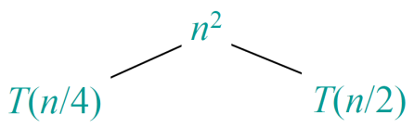
Example of Recursion-tree
Solve T(n) = T(n/4) + T(n/2) + Θ(n²), T(1) =Θ(1)

Slide 64
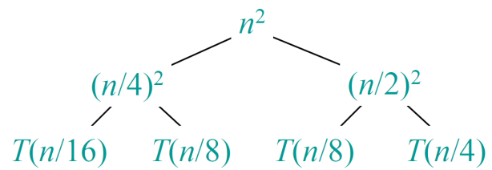
Example of Recursion-tree
Solve T(n) = T(n/4) + T(n/2) + Θ(n²), T(1) =Θ(1)

Slide 65
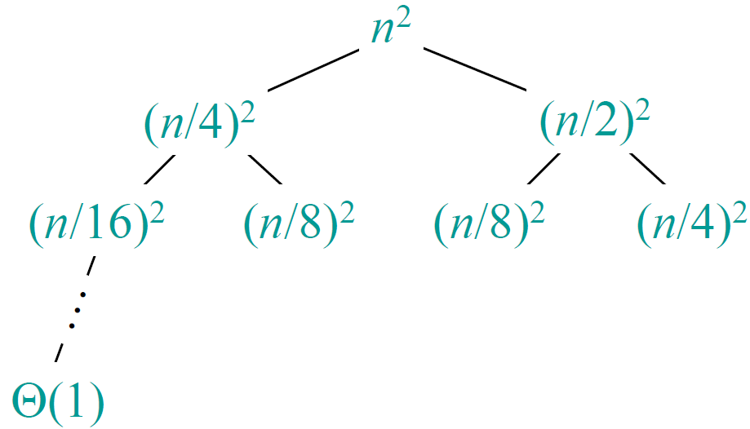
Example of Recursion-tree
Solve T(n) = T(n/4) + T(n/2) + Θ(n²), T(1) =Θ(1)

Slide 66
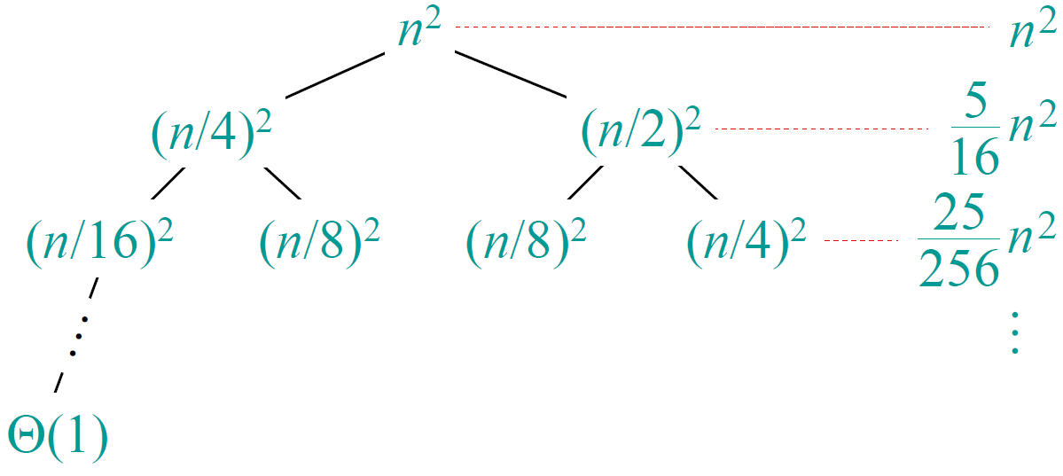
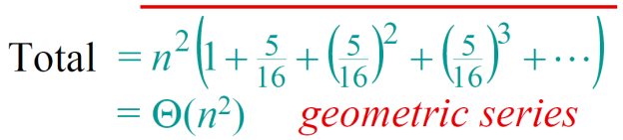
Example of Recursion-tree
Solve T(n) = T(n/4) + T(n/2) + Θ(n²), T(1) =Θ(1)

Slide 67
Exercise in Class
For
T(n) = T(n/4) + T(n/2) + Θ(n²), T(1) = Θ(1)
Prove that T(n) = Θ(n²) through substitution.

Slide 68
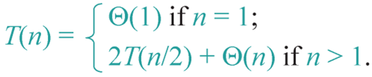
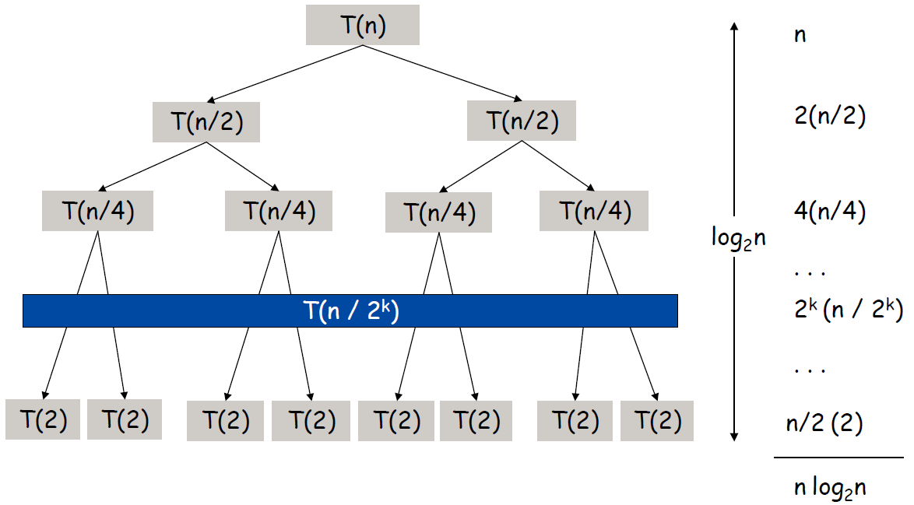
Apply Recursion-tree to Merge Sort

Slide 69
Run-time Summary of Merge Sort
The following table summarizes the run-times of merge sort
Case | Run Time | Comments
Worst | Θ(n log(n)) | No worst case
Average | Θ(n log(n))
Best | Θ(n log(n)) | No best case

Slide 70
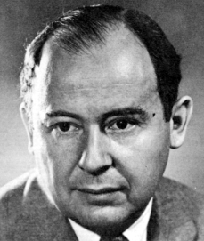
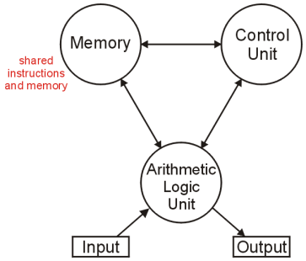
Aside
The (likely) first implementation of merge sort was on the ENIAC in 1945 by John von Neumann
The creator of the von Neumann architecture used by all modern computers:

Slide 71
Master定理

Slide 72
证明
k=log_{b}n

Slide 73
Case 1
分母常数扔掉，换底公式

Slide 74
Case 2

Slide 75
Case 3
C小于一则合式收敛为常数
后者阶高于前者

Slide 76
Master定理的应用： Case 1
例

Slide 77
Master定理应用：Case 2
例

Slide 78
Master定理应用：Case 3
例

Slide 79
递推方程中 ⎣x⎦ 和 ⎡x⎤ 的处理
先猜想解，然后用数学归纳法证明
例 估计以下递推关系的阶
根据
猜想原递推方程的解的阶是O(n log n)
证明：用数学归纳法T(n) ≤ cn log n,

Slide 80
证明
归纳基础
对于T(1)=1，显然没有T(1)≤ c 1 log1=0.
考虑T(2)
T(2) = 2T(⎣1⎦)+2 = 4 ≤ 2×2 log2，c=2
归纳步骤
假设对于小于n的正整数命题为真，那么

Slide 81
App1 Strassen‘s Matrix Multiplication
Introduction
Volker Strassen is a German mathematician born in 1936. Strassen firstly published this algorithm in 1969 and proved that the n^3 algorithm isn't the optimal one.
Actually the given solution by Strassen is slightly better (log7), but that led to some faster approaches, i.e. the Coppersmith-Winograd algorithm with O(n^2,3737).

Slide 82
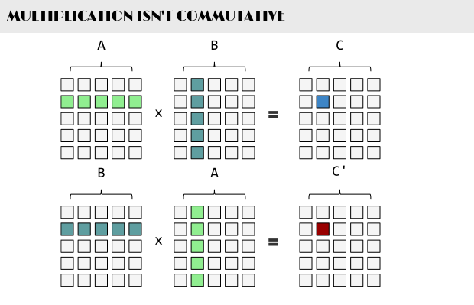
Overview

Slide 83
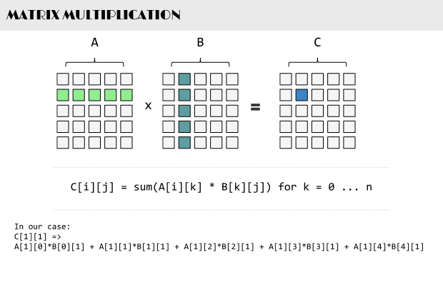

Slide 84
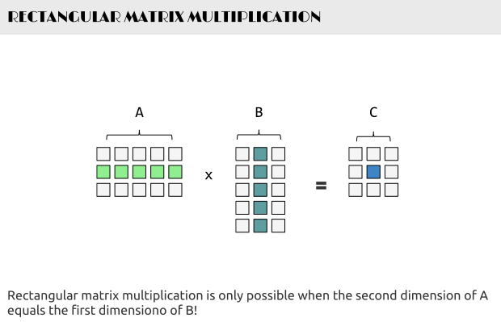

Slide 85
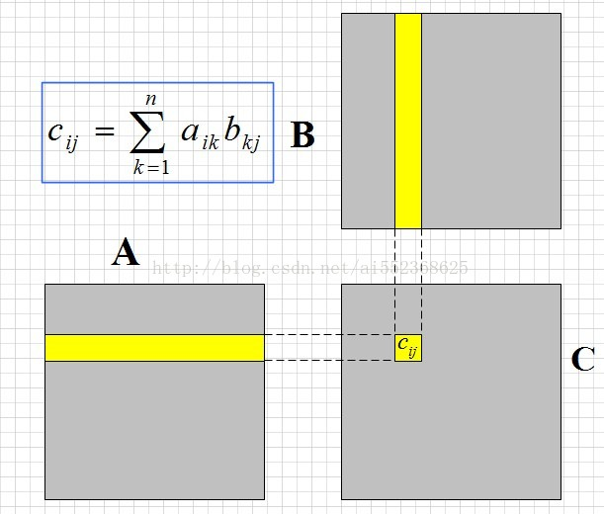

Slide 86
1.for i = 1 to col // row
2. for j = 1 to row // col
3. tmp = 0
4. for k = 1 to col
5. tmp += A[i*col + k]*B[j + k*row]
6. end for
7. C[i*col + j] = tmp
8. end for
9.end for
在row = col = n 的情况下，那么很容易看出上面的代码由三个for循环来构成的，那么这个代码的时间复杂度为O(n^3)。

Slide 87
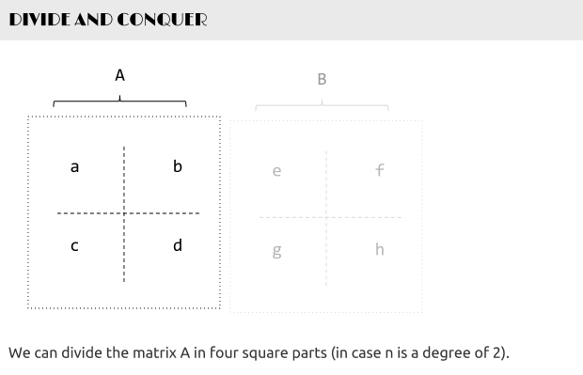

Slide 88
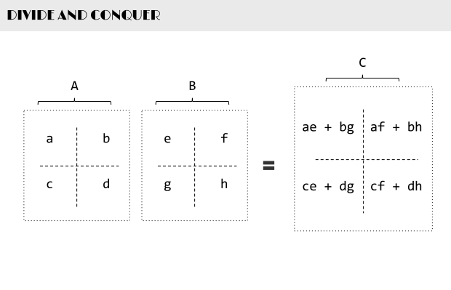

Slide 89
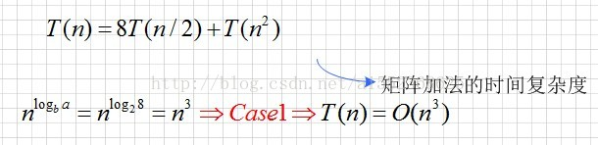
一共有8个(n/2)*(n/2)的矩阵乘法和，4个(n/2)*(n/2)的矩阵加法。再次使用以前的Master Method，
T(n) = 8T(n/2) + T(n^2)

Slide 90
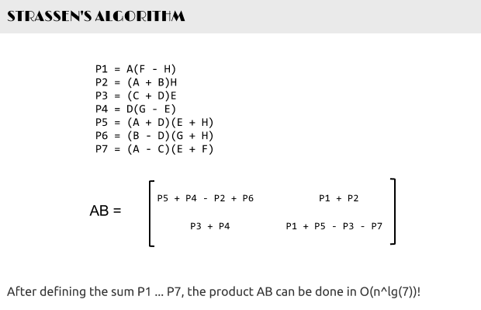

Slide 91
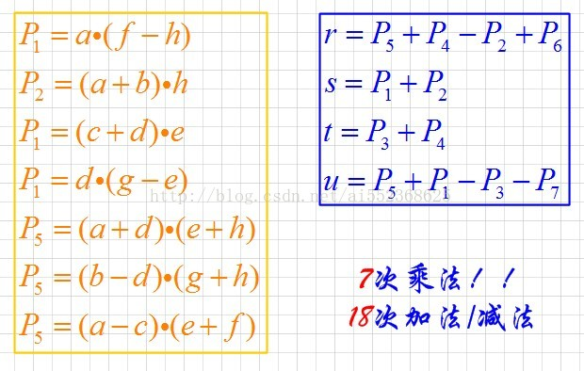
Complexity

Slide 92
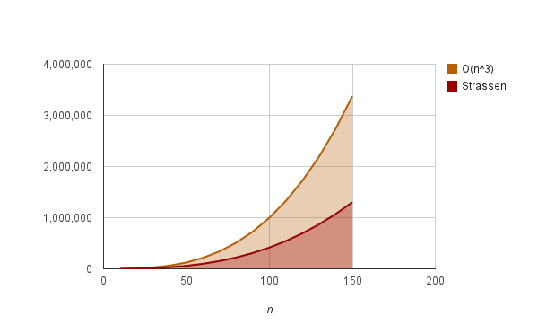
Complexity
n>30时会显示出效果，但是这要跟编程方法有关的，算法好不等于实现性能好。

Slide 93
App2 VLSI layout
问题描述：
怎样将一个n个叶子的完全二叉树布局，使得所占用面积最小？

Slide 94
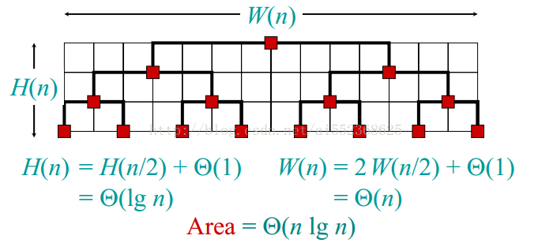
基本实现方法

Slide 95
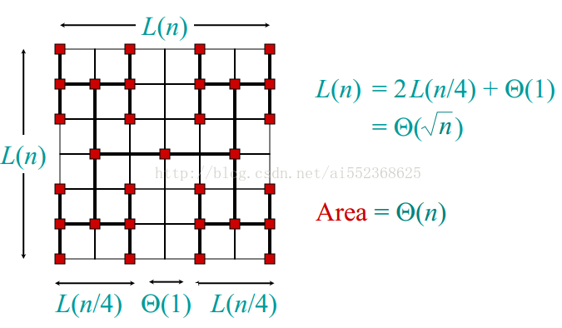
H布线法

Slide 96
要想得到一个线性复杂度的面积，则需要长宽(假设为矩形)的复杂度之乘积为线性的，那么最基本的想法是：
W(n) = H(n) = Theta(sqrt(n))
有了这个目标函数(也可以说Area =Theta(n)为目标函数)，怎么计算呢？？这便用到了上一讲的Master Method，即
T(n)= aT(n/2a) + O(n^(1/2-e))
式中，e为一个小的数，第二项表示的意思是时间复杂度小于n^(1/2)
根据Master Method，case1，上式的时间复杂度显然为Theta(n)，那么，最简单的a=2，这便得到了上图中的方法
当然由该公式得到上面布线的idea还需要经验等等，但是这种由目标函数来反推解决方法总比盲目地尝试要来得快得多。

Slide 97
Exercises
CLRS 4.2-2
CLRS 4.2-5

Slide 98
End of Section.
算法分析课程组
重庆大学计算机学院
Notes:
本人是国际视觉电生理学会(ISCEV)的会员。

