Slide 1
Algorithm Analysis & Design Introduction to Algorithm
T&R Team of Algorithm Design
College of Computer Science and Engineering, CQU
Notes:
本人是国际视觉电生理学会(ISCEV)的会员。

Slide 2
Chapter 6: Heap Sort

Slide 3
Outline
6.1 The Max (Min) Heap
6.2 Constructing the Max Heap
6.3 Heap Sort
6.4 Heap Sort Analysis

Slide 4
Why Study HEAP-SORT
It is a well-known, traditional sorting algorithm you will be expected to know.
Heap Sort is in-place
Heap-sort is always O(n log n):
Quicksort is usually O(n log n) but in the worst case slows to O(n²);
Quicksort is generally faster, but Heapsort is better in time-critical applications.
Heap-sort is a really cool algorithm!

Slide 5
6.1 The Max (Min) Heap

Slide 6
What is a “Heap”
Definitions of “Heap”
1. A large area of memory from which the programmer can allocate blocks as needed, and deallocate them when no longer needed
2. A balanced, left-justified binary tree (or complete tree) in which no node has a value greater than the value in its parent
Heapsort uses the second definition

Slide 7
Balanced Binary Trees
Recall the binary trees
The depth of a node is its distance from the root
The depth of a tree is the depth of the deepest node
A binary tree of depth n is balanced if all the nodes at depths 0 through n-2 have two children

Slide 8
Example of Balanced Binary Trees
n-2
n-1
n
Balanced
Balanced
n-2
n-1
n
Not balanced
Not balanced

Slide 9
Left-justified Binary Trees (HEAP)
A balanced binary tree is left-justified if:
all the leaves are at the same depth, or
all the leaves at depth n are to the left of all the nodes at depth n-1
n-1
n
Left-justified
Not left-justified

Slide 10
The Max Heap
A heap where the maximum element is at the top of the heap and the next to be popped.
The max-heap property: the value in the node is as large as or larger than the values in its children.
12
12
12
8
3
8
12
8
14
Red node has the max-heap property
Red node has the max heap property
Red node does not have the max heap property

Slide 11
The Max-heap Property
All leaf nodes automatically have the heap property
A binary tree is a max-heap if all nodes in it have the max-heap property
11
This is not a max heap!
Leaf Nodes
16
18
Max-heap Property
14
All Nodes Have the Max-heap Property
12
5
8
10

Slide 12
Percolating Down
Give a node the max-heap property by exchanging its value with the value of the larger child
Notice that this may lead to the lost of the child’s max-heap property
12
14
8
14
8
12
Red node does not have the max-heap property
Red node has the max-heap property

Slide 13
6.2 Constructing the Max Heap

Slide 14

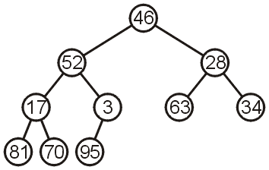
Constructing a Max-heap
Consider this unsorted array with starting index at 1:
We can transform this array into the following complete tree:
Where for each node:
The children of the kth element are the (2k)th and (2k+1)th elements
The parent node of the kth element is the ⌊k/2⌋
HOW TO TRANSFORM this array into a max-heap?
This is NOT a max-heap

Slide 15
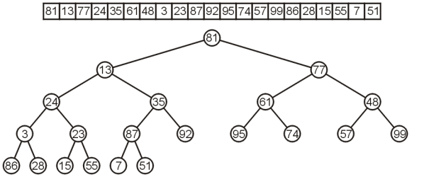
Constructing a Max-heap
To see if this can be done, consider the following array:
It would be exceptionally difficult to start by determining what should be in the root.
We can work bottom-up instead: each LEAF node is a max-heap on its own.

Slide 16
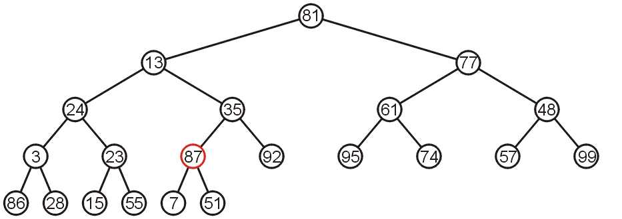
Constructing a Max-heap
Starting at the back, we note that all leaf nodes are trivial heaps.
Also, the sub-tree with the node 87 as the root is a max-heap.

Slide 17
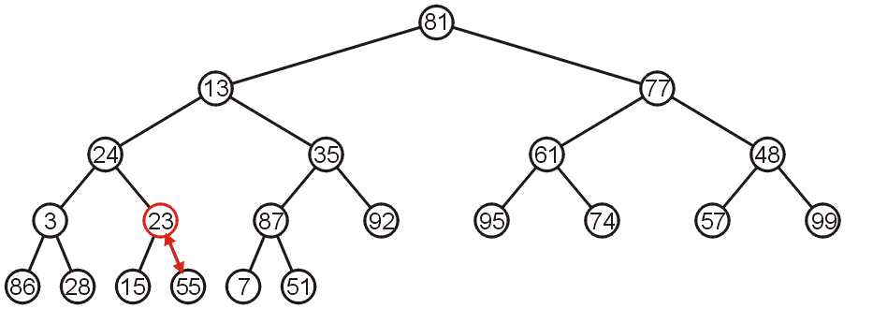
Constructing a Max-heap
The sub-tree with node 23 is not a max-heap, but swapping it with 55 creates a max-heap.
This process is the aforementioned percolating down.

Slide 18
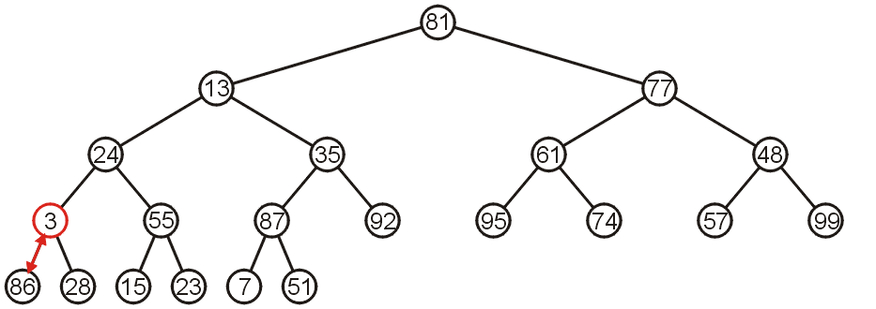
Constructing a Max-heap
The sub-tree with 3 as the root is not max-heap, but we can swap 3 and the maximum of its children: 86.

Slide 19
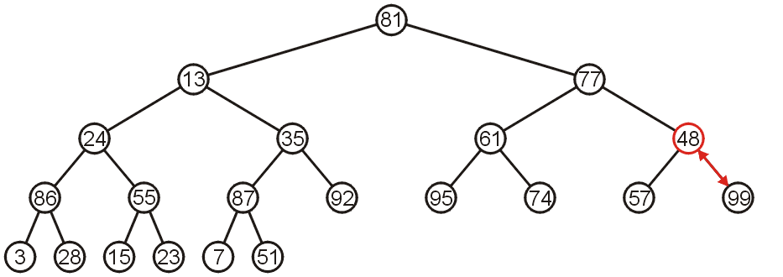
Constructing a Max-heap
Starting with the next higher level, the sub-tree with root 48 can be turned into a max-heap by swapping 48 and 99.

Slide 20
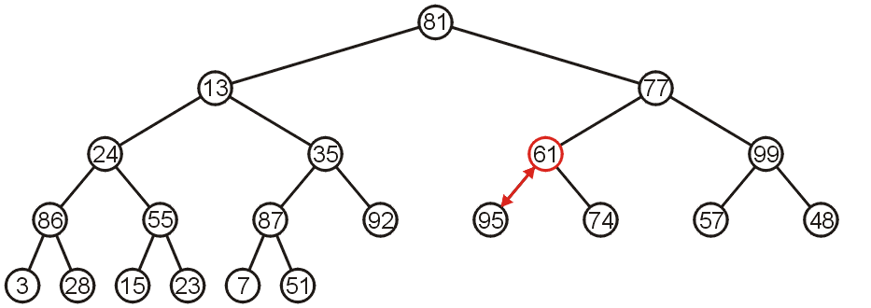
Constructing a Max-heap
Similarly, swapping 61 and 95 creates a max-heap of the next sub-tree.

Slide 21
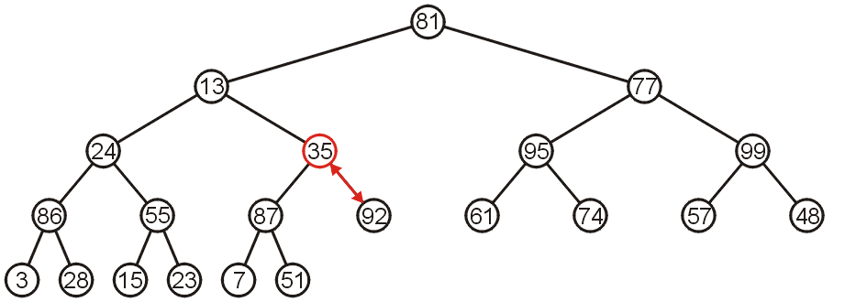
Constructing a Max-heap
As does swapping 35 and 92.

Slide 22
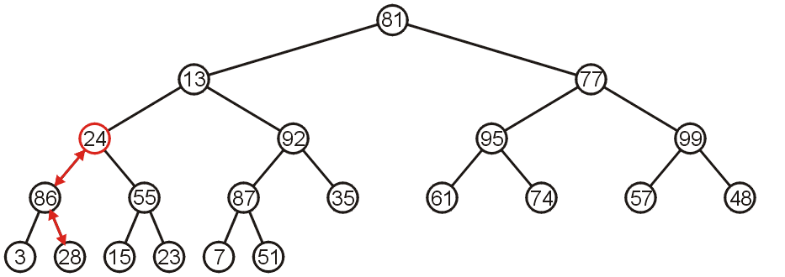
Constructing a Max-heap
The sub-tree with root 24 may be converted into a max-heap by first swapping 24 and 86 and then swapping 24 and 28.

Slide 23
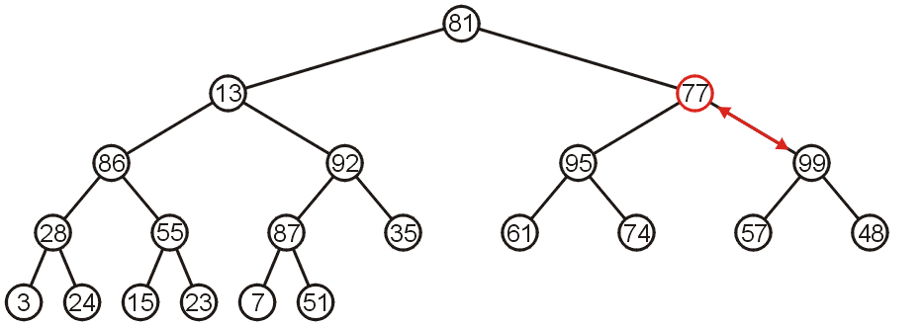
Constructing a Max-heap
The right-most sub-tree of the next higher level may be turned into a max-heap by swapping 77 and 99.

Slide 24
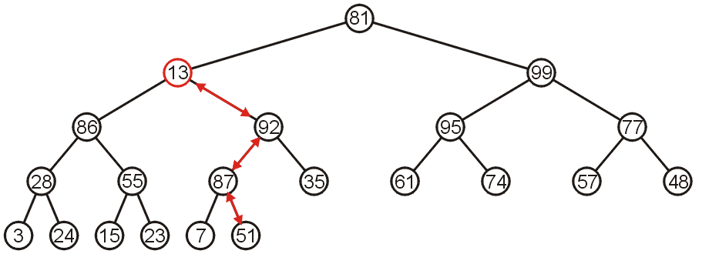
Constructing a Max-heap
However, to turn the next sub-tree into a max-heap requires that 13 be percolated down to a leaf node.

Slide 25
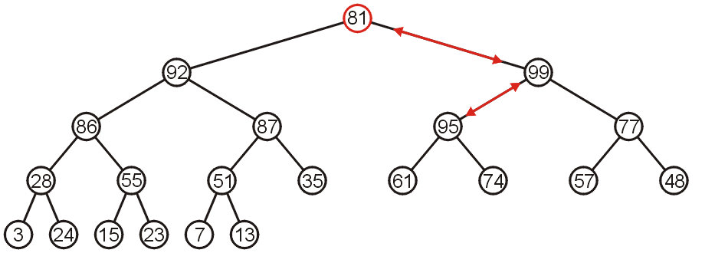
Constructing a Max-heap
The root need only be percolated down by two levels.

Slide 26
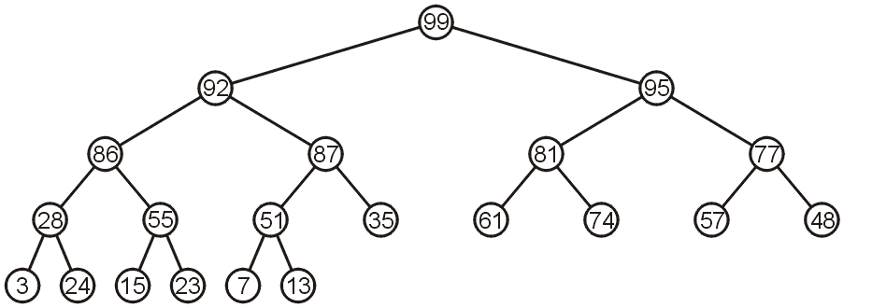
Constructing a Max-heap
The final product is a max-heap.

Slide 27
The General Idea of the Max-Heap-Construction
A bottom-up approach
Starting from the last element of the given array
To ensure that the checked nodes all posses the max-heap property
For each node, find the max node of the triple {current-node, left-child, right-child}
Adjust the structure of the triple by percolating down
Note that the percolating down could violate the max-heap-property of the SUB-TREE by the current node.
It is the most important to maintain the max-heap property of the sub-tree, which is done by recursion.
But note that to implement the percolating down, we only have to swap the current node with its larger child; thus, we only have to examine the max-heap-property of this sub-tree.

Slide 28
The Pseudo Code of Constructing a Max-heap
MAX_HEAPIFY(A, i)
l ← left(i)
r ← right(i)
IF l ≤ heap-size(A) AND A[l] >A[i]
THEN largest←l
ELSE largest ← i
IF r ≤ heap-size(A) AND A[r] > largest
THEN largest ← r
IF largest ≠ i
THEN exchange A[i] and A[largest]
MAX_HEAPIFY(A, largest)

Slide 29
The Pseudo Code of Constructing a Max-heap
BUILD_MAX_HEAP(A)
heap_size(A) = length(A)
FOR i ←⌊length[A]/2⌋ DOWNTO 1
MAX_HEAPIFY(A, i)

Slide 30
6.3 Heap Sort

Slide 31
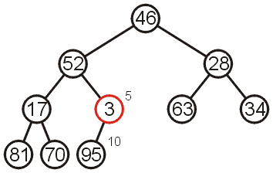
Example Heap-sort
Recall the aforementioned array:
We must convert the unordered array with n = 10 elements into a max-heap
None of the leaf nodes needs to be percolated down, and the first non-leaf node is in position ⌊n/2⌋
Thus we start with position ⌊10/2⌋ = 5

Slide 32
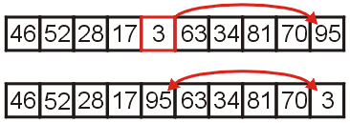
Example Heap-sort
We compare 3 with its child 95 and swap them.

Slide 33
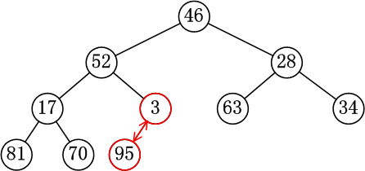
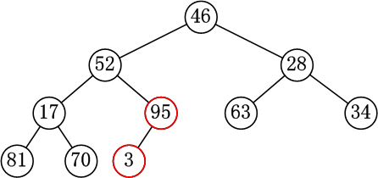
Example Heap-sort
We compare 3 with its child 95 and swap them.

Slide 34
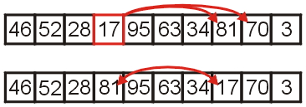
Example Heap-sort
We compare 17 with its two children and swap it with the maximum child 81.

Slide 35
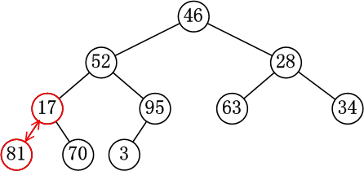
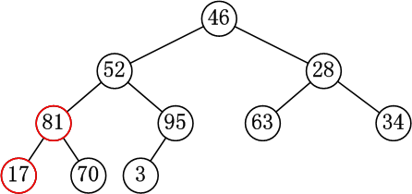
Example Heap-sort
We compare 17 with its two children and swap it with the maximum child 81.

Slide 36
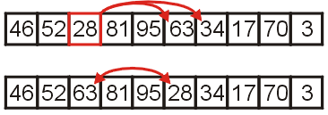
Example Heap-sort
We compare 28 with its two children, 63 and 34, and swap it with the largest child.

Slide 37
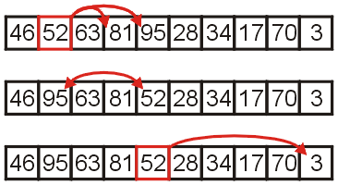
Example Heap-sort
We compare 52 with its children, swap it with the largest
Recursion, till no further swaps are needed

Slide 38
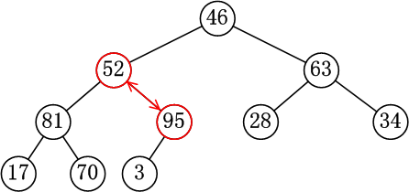

Example Heap-sort
We compare 52 with its children, swap it with the largest
Recursion, till no further swaps are needed

Slide 39
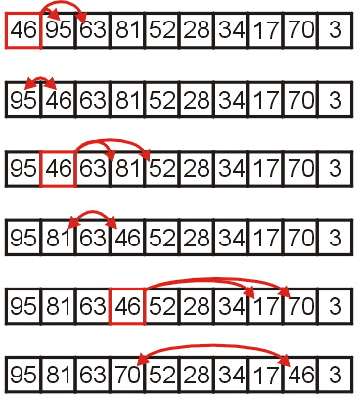
Example Heap-sort
Finally, we swap the root with its largest child 95, and recurse, swapping 46 again with 81, and then again with 70.

Slide 40
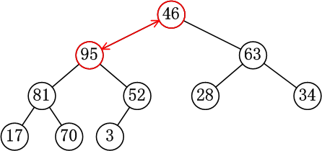
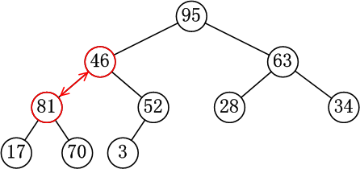
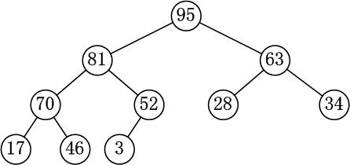
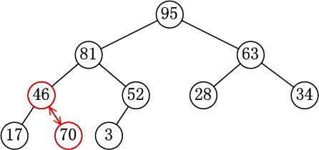
Example Heap-sort
Finally, we swap the root with its largest child 95, and recurse, swapping 46 again with 81, and then again with 70.

Slide 41
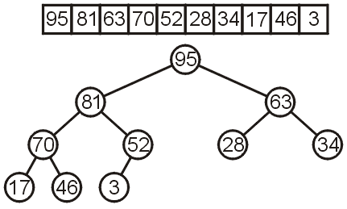
Example Heap-sort
We have now converted the unsorted array
into a max-heap:

Slide 42
Example Heap-sort
Sorting Strategy:
Build max heap from unordered array
Find maximum element (A[1])
Put it in correct position A[n],A[n] goes to A[1] P.S.: New root could violate max heap property but children remain max heaps
Discard node n from heap (decrement heap size)

Slide 43
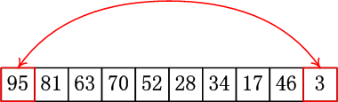

Example Heap-sort
Suppose we swap the maximum element of this heap with the last element, and then pop it.

Slide 44
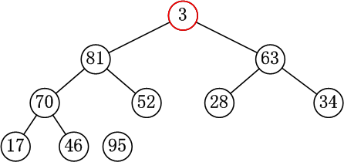
Example Heap-sort
The sub trees of this heap are still max-heaps
However, the new root might violate the max-heap property.

Slide 45
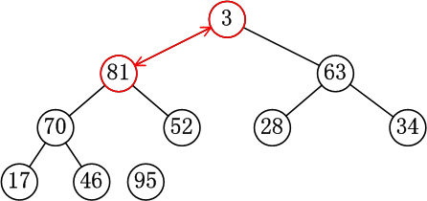
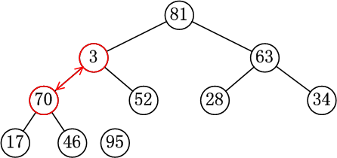
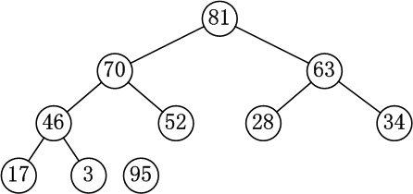
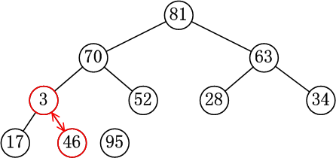
Example Heap-sort
It would not matter, since we can call MAX-HEAPIFY again!
Note that we only have to call MAX-HEAPIFY on the sub tree which is rooted by the larger child.

Slide 46
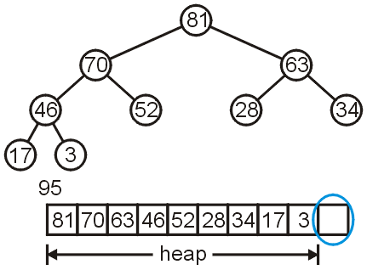

Example Heap-sort
Pop the current-max-element which is always the root of this heap, and call the max-heap-construction process to remain the max-heap-property.

Slide 47

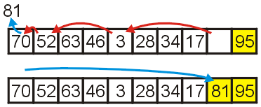
Example Heap-sort
Place the largest element at the end of the array, which is out of the range of the current heap.
Repeat this process of popping the maximum element and then swapping it with the last element:

Slide 48
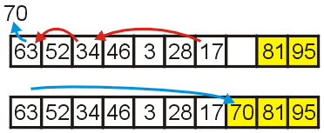
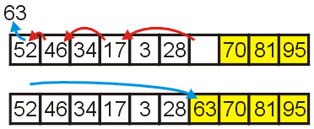
Example Heap-sort
Repeat this process
Pop and append 70
Pop and append 63

Slide 49
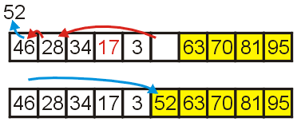
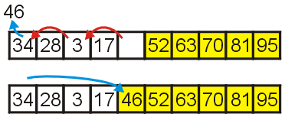
Example Heap-sort
We have the 4 largest elements in order
Pop and append 52
Pop and append 40

Slide 50
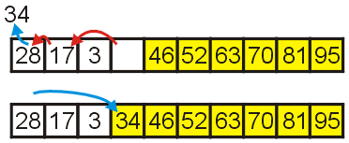
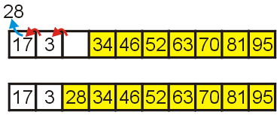
Example Heap-sort
Continuing
Pop and append 34
Pop and append 28

Slide 51
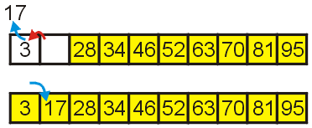
Example Heap-sort
Finally
pop 17, swapping with 3
The given array is sorted.

Slide 52
The Pseudo Code of Heap-sort
HEAP_SORT(A)
BUILD MAX HEAP(A)
FOR i =length[A] DOWNTO 2
exchange A[1] and A[i]
heap_size[A] = heap_size[A] − 1
MAX_HEAPIFY(A, 1)

Slide 53
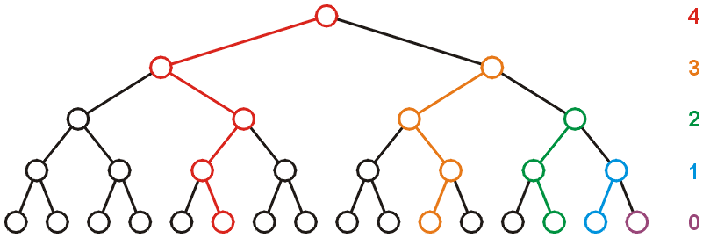
Run-time Analysis of Heapify
Considering a perfect tree of height h:
The maximum number of swaps which a second-lowest level would experience is 1; the next higher level, 2; and so on.

Slide 54
Run-time Analysis of Heapify
At depth k, there are 2^{k} nodes and in the worst case, all of these nodes would have to percolated down h – k levels
In the worst case, this would requiring a total of 2^{k}(h – k) swaps
the mathematical expression of this sum comes to:

Slide 55
Run-time Analysis of Heapify
Recall that for a perfect tree, n = 2^{h+1} – 1 and h + 1 = log(n + 1), therefore
Each swap requires two comparisons (which child is greatest), so there is a maximum of 2n (or O(n)) comparisons

Slide 56
Analyzing Heap-sort
BUILD_MAX_HEAP(A) runs in O(n)
MAX_HEAPIFY(A, 1) runs in O(log(n))
Popping n items from a heap of size n, as we saw, runs in O(n log(n)) time
Therefore, the total algorithm will run in O(n log(n)) time

Slide 57
Analyzing Heap-sort
There are no best-case and worst-case scenarios for heap sort.
Dequeuing from the heap will always require the same number of operations regardless of the distribution of values in the heap.
The original order may speed up the BUILD_MAX_HEAP(A), however, this would only speed up an O(n) portion of the algorithm.

Slide 58
Analyzing Heap-sort
The following table summarizes the run-times of heap sort.
In-Place
Case | Run Time | Comments
Worst | Θ(n ln(n)) | No worst case
Average | Θ(n ln(n))
Best | Θ(n ln(n)) | No best case

Slide 59
扩展：TopK问题
top K问题是这样的，给定一组任意顺序的数，假设有n个。如何尽快地找到它们的前K个最大/小的数？
在海量数据中找出出现频率最高的前K个数，或者从海量数据中找出最大的前K个数，这类问题通常称为“top K”问题。

Slide 60
应用背景：
由于内存限制，长度为一亿的某类型的数组无法全部放入内存进行排序，进而无法取出前100的元素（多见于搜索排名，更恶劣的情况是这一亿条数据还分布在多台机器上 。）
在搜索引擎中，统计搜索最热门的10个查询词；在歌曲库中统计下载率最高的前10首歌等等。

Slide 61
首先，既然是找前K个最大的数，那么最直观的办法是，n个数全部都排序，然后挑出前K个最大数。但是这样显然做了一些不必要的事儿。
利用堆这种数据结构，借助维护堆的函数, min_heapify( )，就可以轻松解决top K问题。

Slide 62
原理与简化：遍历长度为N的数组的前K个元素构建最小堆，对于剩余的N-K的元素：小于其根节点的过滤掉，大于根节点则替换之并heapify该最小堆 ！
step 1. 随意选出K个数，挑出这K个数的最小的数。这个过程可以用最小堆完成。
step 2. 在剩下的n – K个数中，挑出任意一个数m，和最小堆的堆顶进行比较，如果比最小堆的堆顶大，那么说明此数可以入围前K的队伍，于是将最小堆的堆顶置为当前的数m。
step 3. 调整最小堆。时间复杂度为Olg(K)，由于K是constant(常数级别)，所以时间复杂度可以认为是常数级别。
step 4. 重复进行step 2 ~ step 3，直到剩下的n – K个数完成。进行了n –constant次，时间复杂度为O(n lgK).

Slide 63
常见解决方案
针对top k类问题，通常比较好的方案是【分治+trie树/hash+小顶堆】，即先将数据集按照hash方法分解成多个小数据集，然后使用trie树或者hash统计每个小数据集中的query词频，之后用小顶堆统计出每个数据集中出频率最高的前K个数，最后在所有top K中求出最终的top K。
在实际应用中，可能有足够大的内存，那么直接将数据扔到内存中一次性处理即可，也可能机器有多个核，这样可以采用多线程处理整个数据集。

Slide 64
Exercises
CLRS 6.1-1
CLRS 6.1-2
CLRS 6.5-2
CLRS 6-1

Slide 65
End of Section.
算法分析课程组
重庆大学计算机学院
Notes:
本人是国际视觉电生理学会(ISCEV)的会员。

