Slide 1
Algorithm Analysis & Design Introduction to Algorithm
T&R Team of Algorithm Design
College of Computer Science and Engineering, CQU
Notes:
本人是国际视觉电生理学会(ISCEV)的会员。

Slide 2
Chapter 7: Quick Sort

Slide 3
Outline
6.1 Basic Quick Sort
6.2 Improving Quick Sort with Medians

Slide 4
7.1 Basic Quick Sort

Slide 5
QUICK SORT
We have seen two O(n log n) sorting algorithms:
Merge sort which is faster but requires more memory
Heap sort which allows in-place sorting
We will now look at a recursive algorithm which may be done almost in place and usually faster than heap sort
Use an object in the array (a pivot) to divide the two
Average case: O(n log n) time and O(log n) memory
Worst case: O(n²) time and O(n) memory

Slide 6
QUICK SORT
Merge sort splits the array sub-lists and sorts them
The larger problem is split into two sub-problems based on location in the array
Consider the following alternative:
Chose an object in the array and partition the remaining objects into two groups relative to the chosen entry

Slide 7
QUICK SORT
For example, given an unsorted array:
We can select the last entry, 4, and sort the remaining entries into two groups, those less than 4 and those greater than 4:
Note that 4 is now in the correct location once the list is sorted
Proceed by applying the algorithm to the first 3 and last 4 entries
2 | 8 | 7 | 1 | 3 | 5 | 6 | 4
2 | 1 | 3 | 4 | 7 | 5 | 6 | 8

Slide 8
A Simple Implementation – PARTITION
PARTITION (A, p, r)
x ← A[r]
i ← p-1
FOR j ← p TO r-1
IF A[ j] ≤ x
THEN i ← i + 1
exchange A[i] ↔ A[ j]
exchange A[i+1] ↔ A[r]
RETURN i+1
找到小于pivot才做

Slide 9
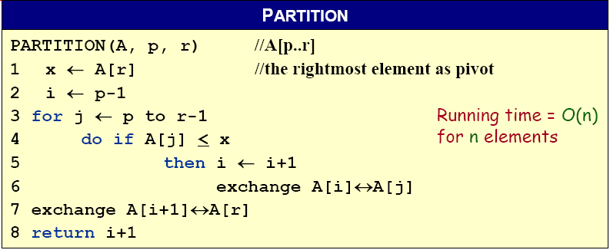
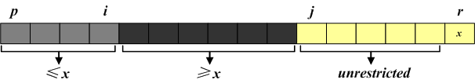
A Simple Implementation – PARTITION
当前最后一个小于pivot的元素位置
A[p, … , i]: known to be ≤ pivot
A[j … r-1]: not yet examined
A[i+1, … , j-1]: known to be > pivot
A[r]: pivot

Slide 10










A Simple Implementation – PARTITION
The operation of Partition on the sample array. Lightly shaded array elements are all with values no greater than x (the pivot). Heavily shaded array elements are all with values greater than x.

Slide 11
A Simple Implementation – QUICKSORT
QUICKSORT (A, p, r)
IF p < r
THEN q ← PARTITION (A, p, r)
QUICKSORT (A, p, q–1)
QUICKSORT (A, q+1, r)
Initial call: QUICKSORT(A, 1, n)

Slide 12
Run-time Analysis
In the best case, the list will be split into two approximately equal sub-lists, and thus, the run time could be very similar to that of merge sort: Θ(n log n)

Slide 13
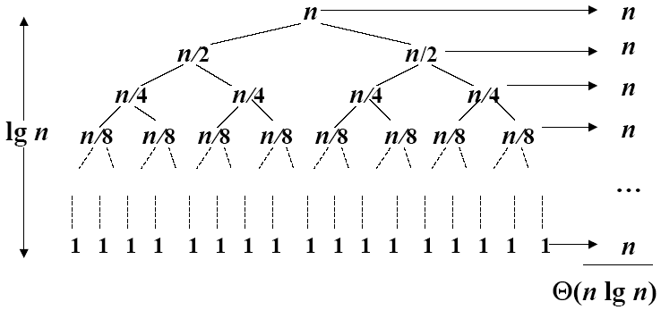
Recursive Tree of the Best Case
A recursion tree for quick sort in which the partition always balances the two sides of the partition equally. The resulting running time is Θ(n log n)
The question is: WHAT happens if we don’t get that lucky?

Slide 14
Worst-case Scenario
Suppose we choose the smallest element as our pivot and we try ordering a sorted list:
Using 2, we partition the original list into
We still have to sort a list of size n – 1
The run time is T(n) = T(n – 1) + Θ(n) = Θ(n²)
Thus, the run time drops from Θ(n log n) to Θ(n²)
80 | 38 | 95 | 84 | 66 | 10 | 79 | 2 | 26 | 87 | 96 | 12 | 43 | 81 | 3
2 | 80 | 38 | 95 | 84 | 66 | 10 | 79 | 26 | 87 | 96 | 12 | 43 | 81 | 3

Slide 15
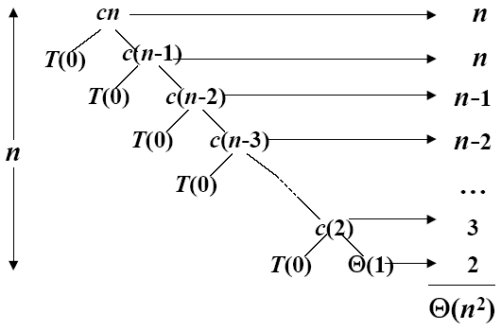
Recursive Tree of the Worst Case
A recursion tree for quick sort in which the partition always puts only a single element on one side of the partition. The resulting running time is Θ(n²)

Slide 16
Recursive Tree of the Balanced Case
What if the split is always 1:9?
T(n) = T(9n/10) + T(n/10) + Θ(n)
What is the solution to this recurrence?

Slide 17
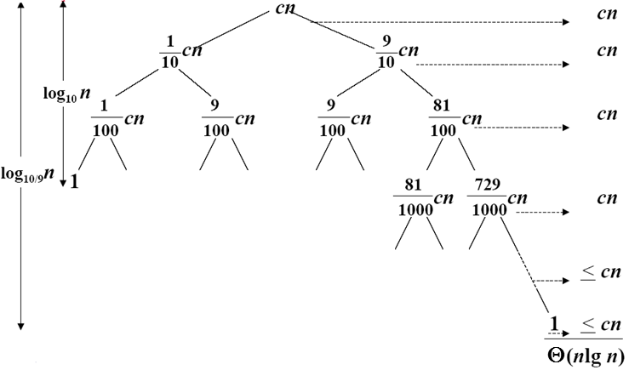
Recursive Tree of the Balanced Case
A recursion tree for quick sort in which partition always produces a 9-to-1 split, yielding a running time of Θ(n log n)

Slide 18
7.2 Improving Quick Sort with Medians

Slide 19
Alternate Strategy
Our goal is to choose the median element in the list as our pivot:
Unfortunately, it’s DIFFICULT to find
Alternate strategy: take the median of a subset of entries
For example, take the median of the first, middle, and last entries
80 | 38 | 95 | 84 | 66 | 10 | 79 | 2 | 26 | 87 | 96 | 12 | 43 | 81 | 3

Slide 20
Choose the Median-of-Three
It is difficult to find the median so consider another strategy:
Choose the median of the first, middle, and last entries in the list
This will usually give a much better approximation of the actual median

Slide 21
Choose the Median-of-Three
Sorting the elements based on 44 results in two sub-lists, each of which must be sorted (again, using quicksort)
We select the 26 to partition the first sub-list:
and 81 to partition the second sub-list:

Slide 22
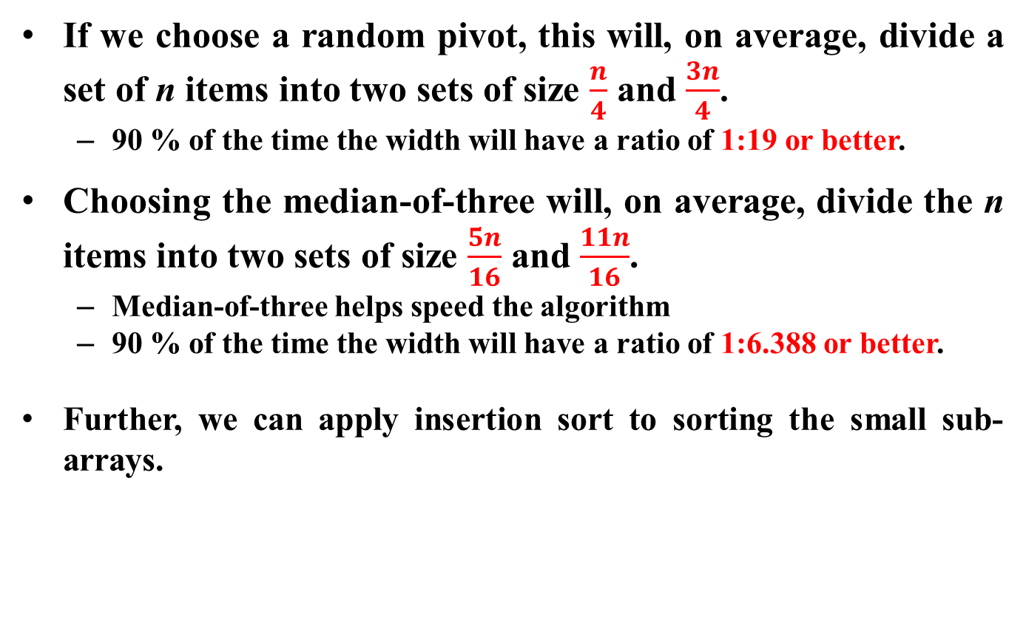
Choose the Median-of-Three

Slide 23
Improved Quick Sort Example
First, we examine the first, middle, and last entries of the full list
The span below will indicate which list we are currently sorting

Slide 24

Improved Quick Sort Example
We select 57 to be our pivot
We move 24 into the first location

Slide 25
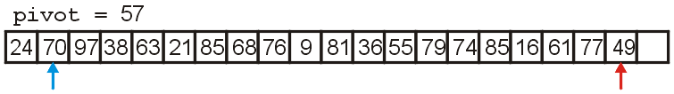
Improved Quick Sort Example
Starting at the 2nd and 2nd-last locations:
we search forward till we find 70 > 57
we search backward till we find 49 < 57

Slide 26
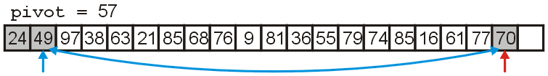
Improved Quick Sort Example
We swap 70 and 49, placing them in order with respect to each other

Slide 27
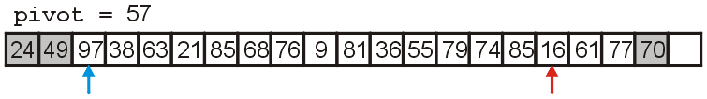
Improved Quick Sort Example
We search forward until we find 97 > 57
We search backward until we find 16 < 57

Slide 28
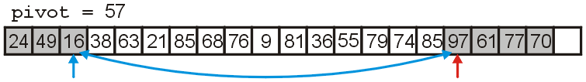
Improved Quick Sort Example
We swap 16 and 97 which are now in order with respect to each other

Slide 29
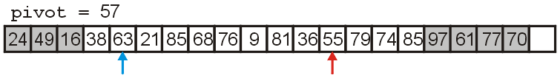
Improved Quick Sort Example
We search forward till we find 63 > 57
We search backward till we find 55 < 57

Slide 30
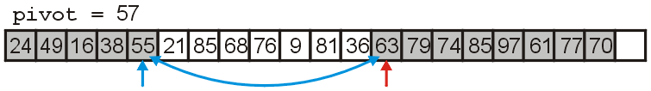
Improved Quick Sort Example
We swap 63 and 55

Slide 31
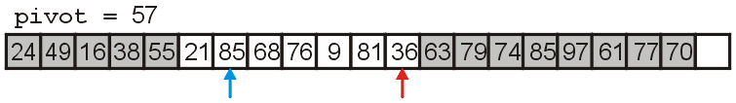
Improved Quick Sort Example
We search forward till we find 85 > 57
We search backward till we find 36 < 57

Slide 32
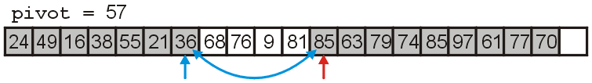
Improved Quick Sort Example
We swap 85 and 36, placing them in order with respect to each other

Slide 33
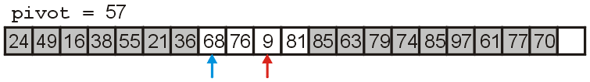
Improved Quick Sort Example
We search forward until we find 68 > 57
We search backward until we find 9 < 57

Slide 34
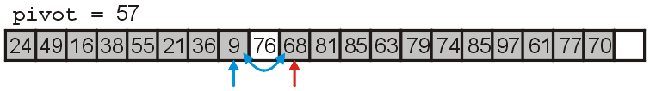
Improved Quick Sort Example
We swap 68 and 9

Slide 35
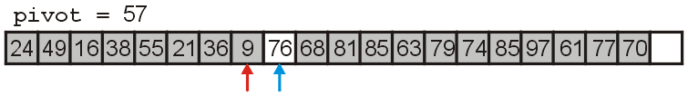
Improved Quick Sort Example
We search forward until we find 76 > 57
We search backward until we find 9 < 57
The indices are out of order, so we stop

Slide 36
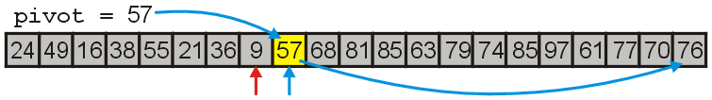
Improved Quick Sort Example
We move the larger indexed item to the vacancy at the end of the array
We fill the empty location with the pivot, 57
The pivot is now in the correct location

Slide 37
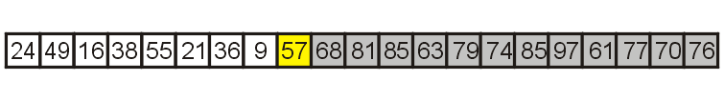
Improved Quick Sort Example
We will now recursively call quick sort on the first half of the list
When we are finished, all entries < 57 will be sorted

Slide 38
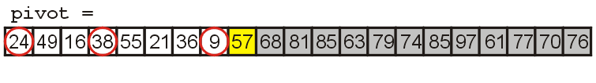
Improved Quick Sort Example
We examine the first, middle, and last elements of this sub list

Slide 39
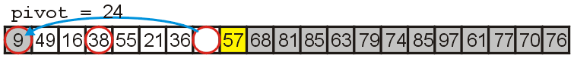
Improved Quick Sort Example
We choose 24 to be our pivot
We move 9 into the first location in this sub-list

Slide 40
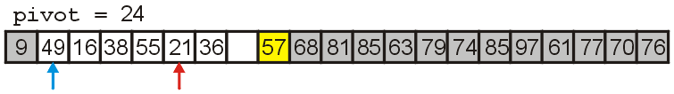
Improved Quick Sort Example
We search forward till we find 49 > 24
We search backward till we find 21 < 24

Slide 41
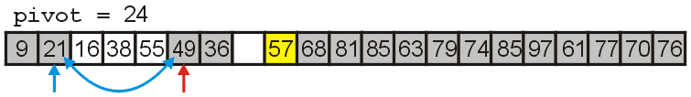
Improved Quick Sort Example
We swap 49 and 21, placing them in order with respect to each other

Slide 42
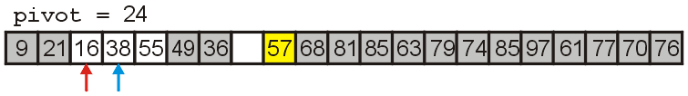
Improved Quick Sort Example
We search forward till we find 38 > 24
We search backward till we find 16 < 24
The indices are reversed, so we stop

Slide 43
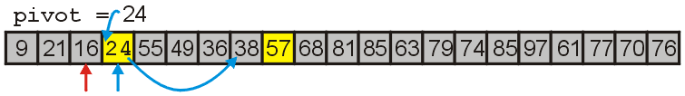
Improved Quick Sort Example
We move 38 to the vacant location and move the pivot 24 into the previous location of 38
24 is now in the correct location

Slide 44
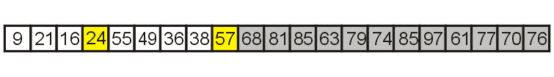
Improved Quick Sort Example
We will now recursively call quick sort on the left and right halves of those entries which are < 57

Slide 45
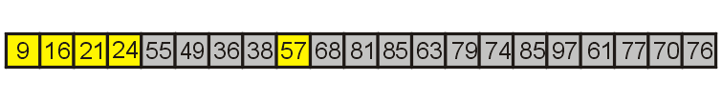
Improved Quick Sort Example
The first partition has three entries, so we sort it using insertion sort

Slide 46
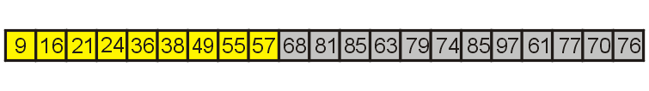
Improved Quick Sort Example
The second partition also has only four entries, so again, we use insertion sort

Slide 47
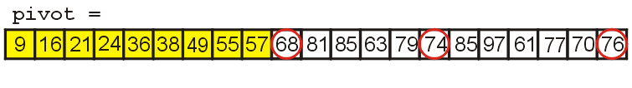
Improved Quick Sort Example
First we examine the first, middle, and last entries of the sub-list

Slide 48
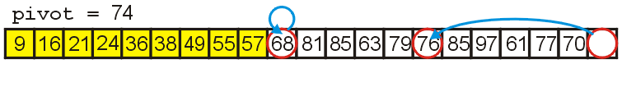
Improved Quick Sort Example
We choose 74 to be our pivot
We move 76 to the vacancy left by 74

Slide 49
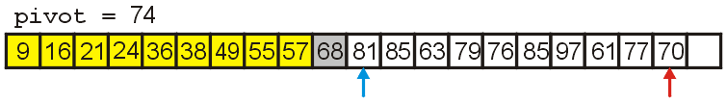
Improved Quick Sort Example
We search forward till we find 81 > 74
We search backward till we find 70 < 74

Slide 50
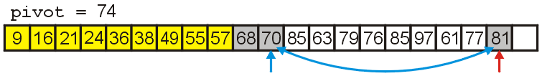
Improved Quick Sort Example
We swap 70 and 84 placing them in order

Slide 51
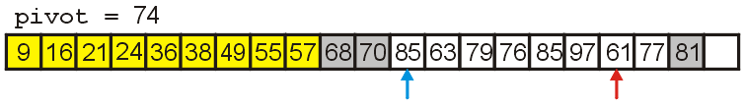
Improved Quick Sort Example
We search forward till we find 85 > 74
We search backward till we find 61 < 74

Slide 52
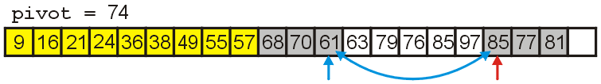
Improved Quick Sort Example
We swap 85 and 61 placing them in order

Slide 53
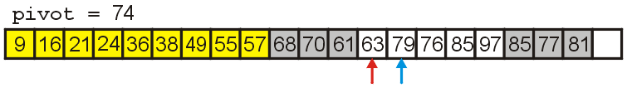
Improved Quick Sort Example
We search forward till we find 79 > 74
We search backward till we find 63 < 74
The indices are reversed, so we stop

Slide 54
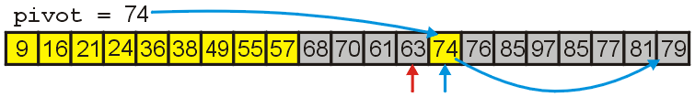
Improved Quick Sort Example
We move 79 to the vacant location and move the pivot 74 into previous location of 79
74 is now in the correct location

Slide 55
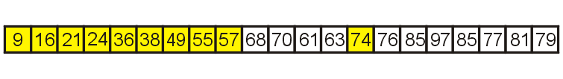
Improved Quick Sort Example
We sort the left sub-list first
It has 4 elements, so we simply use insertion sort

Slide 56
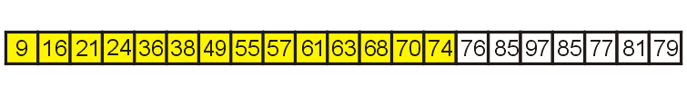
Improved Quick Sort Example
Having sorted the four elements, we focus on the remaining sub-list of seven entries

Slide 57
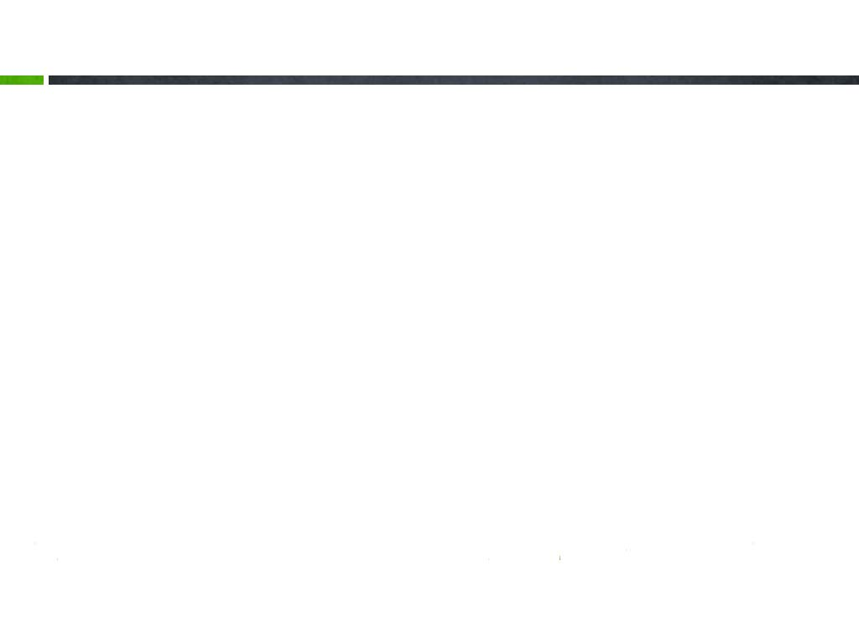
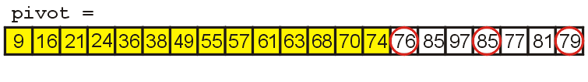
Improved Quick Sort Example
To sort the next sub-list, we examine the first, middle, and last entries

Slide 58
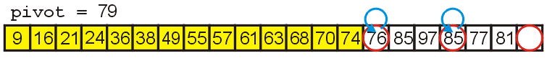
Improved Quick Sort Example
We select 79 as our pivot and move:
76 into the lowest position
85 into the highest position

Slide 59
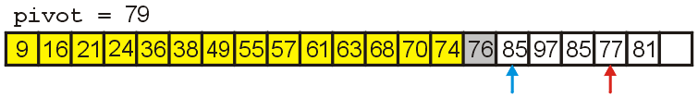
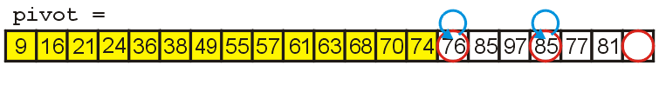
Improved Quick Sort Example
We search forward till we find 85 > 79
We search backward till we find 77 < 79

Slide 60
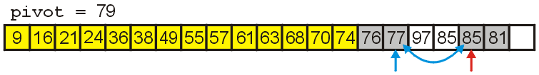
Improved Quick Sort Example
We swap 85 and 77, placing them in order

Slide 61
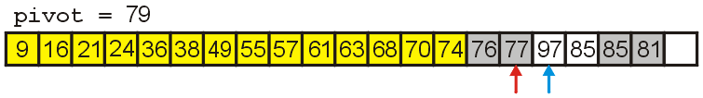
Improved Quick Sort Example
We search forward till we find 97 > 79
We search backward till we find 77 < 79
The indices are reversed, so we stop

Slide 62
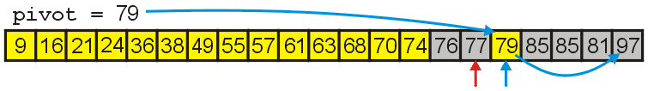
Improved Quick Sort Example
Finally, we move 97 to the vacant location and copy 79 into the appropriate location
79 is now in the correct location

Slide 63
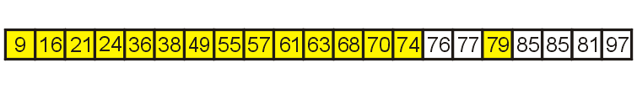
Improved Quick Sort Example
This splits the sub-list into two sub-lists of size 2 and 4
We use insertion sort for the first sub-list

Slide 64
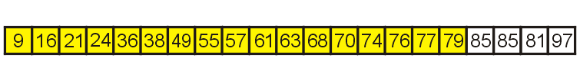
Improved Quick Sort Example
We are left with one sub-list with four entries, so again, we use insertion sort

Slide 65
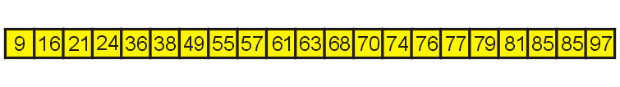
Improved Quick Sort Example
Sorting the last sub-list, we arrive at an ordered list

Slide 66
The Memory Requirement
The additional memory required is O(log n)
Each recursive function call places its local variables, parameters, etc., on a stack
The depth of the recursion tree is O(log n)
Unfortunately, if the run time is O(n²), the memory use is O(n)

Slide 67
Run Time Summery
To summarize all three O(n log n) algorithms
 | Average Run Time | Worst-case Run Time | Average Memory | Worst-case Memory
Heap Sort | O(n log n) |  | O(1)
Merge Sort | O(n log n) |  | O(n)
Quick Sort | O(n log n) | O(n²) | O(log n) | O(n)
归并排序每次递归都要用到一个辅助表，长度与待排序的表长度相同，虽然递归次数是O(logn)，但每次递归都会释放掉所占的辅助空间，所以下次递归的栈空间和辅助空间与这部分释放的空间就不相关了，此外用于递归的栈空间需要O(logn)【每次递归c常数空间，递归深度O(logn)】 ，因而总空间复杂度还是O（n）。而，快速排序没有辅助表，只有用于递归的栈空间需要O(logn)

Slide 68

其他快速排序的优化
对于分治算法，当每次划分时，算法若都能分成两个等长的子序列时，那么分治算法效率会达到最大。也就是说，基准的选择是很重要的。选择基准的方式决定了两个分割后两个子序列的长度，进而对整个算法的效率产生决定性影响。最理想的方法是，选择的基准恰好能把待排序序列分成两个等长的子序列。
方法一：固定基准元（基本的快速排序）
思想：取序列的第一个或最后一个元素作为基准元。
测试数据：

Slide 69
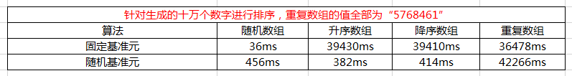
方法二：随机基准元
思想：取待排序列中任意一个元素作为基准元。
引入的原因：在待排序列是部分有序时，固定选取基准元使快排效率底下，要缓解这种情况，就引入了随机选取基准元。实际上，随机化快速排序得到理论最坏情况的可能性仅为1/(2^n）。
测试数据：

Slide 70

方法三：三数取中
引入的原因：虽然随机选取基准时，减少出现不好分割的几率，但是还是最坏情况下还是O(n^2），要缓解这种情况，就引入了三数取中选取基准。具体思想：对待排序序列中low、mid、high三个位置上数据进行排序，取他们中间的那个数据作为基准，并用0下标元素存储基准。
测试数据：

Slide 71

方法四：当待排序序列的长度分割到一定大小后，使用插入排序
原因：对于很小和部分有序的数组，快排不如插排好。当待排序序列的长度分割到一定大小后，继续分割的效率比插入排序要差，此时可以使用插排而不是快排。
截止范围：待排序序列长度N = 10，虽然在5~20之间任一截止范围都有可能产生类似的结果，这种做法也避免了一些有害的退化情形。
—-摘自《数据结构与算法分析》Mark Allen Weiness 著
测试数据：

Slide 72

方法五：在一次分割结束后，可以把与Key相等的元素聚在一起，继续下次分割时，不用再对与key相等元素分割。
具体过程：在处理过程中，会有两个步骤
第一步，在划分过程中，把与key相等元素放入数组的两端
第二步，划分结束后，把与key相等的元素移到枢轴周围
测试数据:

Slide 73
End of Section.
算法分析课程组
重庆大学计算机学院
Notes:
本人是国际视觉电生理学会(ISCEV)的会员。

