Slide 1
Algorithm Design & Analysis Introduction to Algorithm
Chapter 8: Sorting in linear time
《算法分析与设计》课程组
重庆大学计算机学院

Slide 2
8.1 lower bound for sort
8.2 Counting sort
8.3 Radix sort
8.4 Bucket sort

Slide 3
8.1 Sorting in linear time
All the sorting algorithms we have seen so far are comparison sorts: only use comparisons to determine the relative order of elements比较排序算法
--E.g., insertion sort, merge sort, quicksort, heapsort.
--The best worst-case running time that we’ve seen for comparison sorting is O(n lgn).
Q: Is O(n lgn) the best we can do?
A: Yes, as long as we use comparison sorts
TODAY: Prove any comparison sort has Ω(n lgn) worst case running time.

Slide 4
Decision-tree example
Sort <a₁,a₂,…,a_{n}>
Each internal node is labelled i:j for i,j∈{1,2,…,n}
--The left subtree shows subsequent comparisons if a_{i}≤a_{j}
--The right subtree show subsequent comparisons if a_{i}>a_{j}

Slide 5
Decision-tree example
Sort <a₁,a₂, a₃>=<9,4,6>
Each internal node is labelled i:j for i,j∈{1,2,…,n}
--The left subtree shows subsequent comparisons if a_{i}≤a_{j}
--The right subtree show subsequent comparisons if a_{i}>a_{j}

Slide 6
Decision-tree example
Sort <a₁,a₂, a₃>=<9,4,6>
Each internal node is labelled i:j for i,j∈{1,2,…,n}
--The left subtree shows subsequent comparisons if a_{i}≤a_{j}
--The right subtree show subsequent comparisons if a_{i} > a_{j}

Slide 7
Decision-tree example
Sort <a₁,a₂, a₃>=<9,4,6>
Each internal node is labelled i:j for i,j∈{1,2,…,n}
--The left subtree shows subsequent comparisons if a_{i}≤a_{j}
--The right subtree show subsequent comparisons if a_{i}>a_{j}

Slide 8
Decision-tree example
Sort <a₁,a₂, a₃>=<9,4,6>
Each internal node is labelled i:j for i,j∈{1,2,…,n}
--The left subtree shows subsequent comparisons if a_{i}≤a_{j}
--The right subtree show subsequent comparisons if a_{i}>a_{j}

Slide 9
Decision-tree example
A decision tree can model the execution of any comparison sort:
--One tree for each input size n.
--View the algorithm as splitting whenever it compares two elements.
-- The tree contains the comparisons along all possible instruction traces.
--The running time of the algorithm = the length of the path taken.
-- Worst-case running time = height of tree.
Sort <a₁,a₂, a₃>=<9,4,6>
Each leaf contains a permutation <π(1), π(2),…, π(n)>to indicate that the ordering a_{π(1)}≤ a_{π(2)}≤…≤ a_{π(n)} has been established.

Slide 10
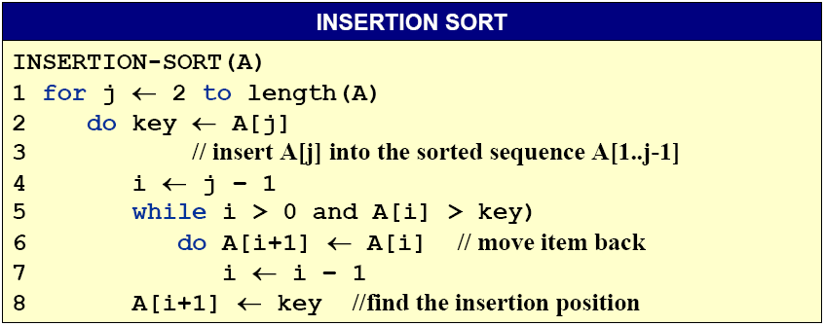
Any comparison sort
Can be turned into a Decision tree

Slide 11
Lower Bound for decision-tree Sorting
Theorem. Any comparison sorting algorithm requires Ω(n lgn) comparisons in the worst case
Proof. Worst case dictated by tree height h
--n! different orderings
--One (or more) leaves corresponding to each ordering
--Binary tree with n! leaves must have height
lg is mono. increasing
∴ h ≥ lg (n!)
≥ lg (n/e)^{n}
= n lg n - n lg e
=Ω(n lg n)
Stirling’s formula

Slide 12
Lower Bound for Comparison Sorting
Corollary. Heapsort and merge sort are asymptotically optimal comparison sorting algorithms.

Slide 13
Sorting Lower bound
Is there a faster algorithm?
How if using a different model of computation, …

Slide 14
8.2 Counting Sort计数排序
Counting sort: No comparisons between elements
Input: A[1..n], where A[j] ∈{1,2,…,k}
Output: B[1..n], sorted
Auxiliary storage: C[1..k]
For x in A, if there are 17 elements less than x in A, then x belongs in output position 18(值为ｘ的元素唯一)
How if several elements in A have the same value? (值为ｘ的元素不唯一)
Put the 1st in position 18, 2nd in position 19,3rd in position 20,…
How if there are 17 elements not greater than x in A? (值为ｘ的元素可能不唯一)
Put the last one in position 17, the penultimate one in position 16,…

Slide 15
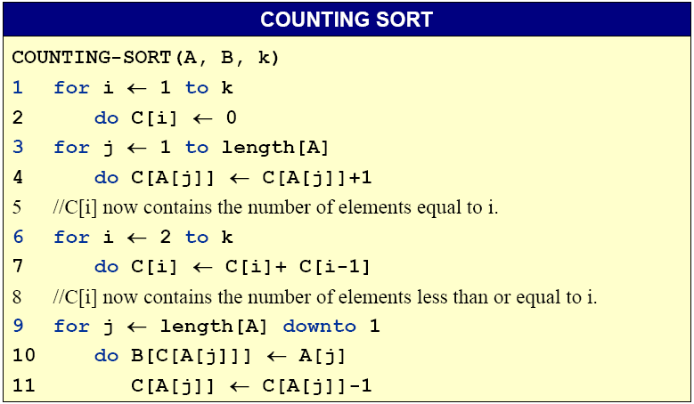
Counting Sort

Slide 16
Counting-sort example
n=5,k=4
1 | 2 | 3 | 4 | 5
1 | 2 | 3 | 4
A:
4 | 1 | 3 | 4 | 3
C:
1 | 2 | 3 | 4 | 5
B:

Slide 17
Counting-sort example
1 | 2 | 3 | 4 | 5
1 | 2 | 3 | 4
A:
4 | 1 | 3 | 4 | 3
C:
1 | 2 | 3 | 4 | 5
B:

Slide 18
Counting-sort example
1 | 2 | 3 | 4 | 5
1 | 2 | 3 | 4
A:
4 | 1 | 3 | 4 | 3
C:
0 | 0 | 0 | 0
1 | 2 | 3 | 4 | 5
B:

Slide 19
Counting-sort example
1 | 2 | 3 | 4 | 5
1 | 2 | 3 | 4
A:
4 | 1 | 3 | 4 | 3
C:
0 | 0 | 0 | 0
1 | 2 | 3 | 4 | 5
B:

Slide 20
Counting-sort example
1 | 2 | 3 | 4 | 5
1 | 2 | 3 | 4
4
1
3
4
3
0
0
0
1
A:
C:
0
1 | 2 | 3 | 4 | 5
B:

Slide 21
Counting-sort example
1 | 2 | 3 | 4 | 5
1 | 2 | 3 | 4
4
1
3
4
3
0
0
0
A:
C:
1
1
1 | 2 | 3 | 4 | 5
B:

Slide 22
Counting-sort example
1 | 2 | 3 | 4 | 5
1 | 2 | 3 | 4
4
1
3
4
3
1
0
0
A:
C:
1
1
1 | 2 | 3 | 4 | 5
B:

Slide 23
Counting-sort example
1 | 2 | 3 | 4 | 5
1 | 2 | 3 | 4
4
1
3
4
3
1
0
1
2
A:
C:
1
1 | 2 | 3 | 4 | 5
B:

Slide 24
Counting-sort example
1 | 2 | 3 | 4 | 5
1 | 2 | 3 | 4
4
1
3
4
3
1
0
1
A:
C:
2
2
1 | 2 | 3 | 4 | 5
B:

Slide 25
Counting-sort example
1 | 2 | 3 | 4 | 5
1 | 2 | 3 | 4
4
1
3
4
3
1
0
1
A:
C:
2
2
1 | 2 | 3 | 4 | 5
B:

Slide 26
Counting-sort example
1 | 2 | 3 | 4 | 5
1 | 2 | 3 | 4
4
1
3
4
3
1
0
2
A:
C:
0
2
1 | 2 | 3 | 4 | 5
B:

Slide 27
Counting-sort example
1 | 2 | 3 | 4 | 5
1 | 2 | 3 | 4
4
1
3
4
3
1
0
2
A:
C:
1
2
1 | 2 | 3 | 4 | 5
B:

Slide 28
Counting-sort example
1 | 2 | 3 | 4 | 5
1 | 2 | 3 | 4
4
1
3
4
3
1
1
2
A:
C:
3
2
1 | 2 | 3 | 4 | 5
B:

Slide 29
Counting-sort example
1 | 2 | 3 | 4 | 5
1 | 2 | 3 | 4
4
1
3
4
3
1
1
3
5
A:
C:
2
1 | 2 | 3 | 4 | 5
B:

Slide 30
Counting-sort example
1 | 2 | 3 | 4 | 5
1 | 2 | 3 | 4
4
1
3
4
3
1
1
1
A:
C:
3
5
1 | 2 | 3 | 4 | 5
B:

Slide 31
Counting-sort example
1 | 2 | 3 | 4 | 5
1 | 2 | 3 | 4
4
1
3
4
3
1
1
1
A:
C:
3
5
1 | 2 | 3 | 4 | 5
B:

Slide 32
Counting-sort example
1 | 2 | 3 | 4 | 5
1 | 2 | 3 | 4
4
1
3
4
3
1
1
3
A:
C:
3
5
1 | 2 | 3 | 4 | 5
B:
3

Slide 33
Counting-sort example
1 | 2 | 3 | 4 | 5
1 | 2 | 3 | 4
4
1
3
4
3
1
1
2
A:
C:
3
5
1 | 2 | 3 | 4 | 5
B:
3

Slide 34
Counting-sort example
1 | 2 | 3 | 4 | 5
1 | 2 | 3 | 4
4
1
3
4
3
1
1
1
A:
C:
2
5
1 | 2 | 3 | 4 | 5
B:
3

Slide 35
Counting-sort example
1 | 2 | 3 | 4 | 5
1 | 2 | 3 | 4
4
1
3
4
3
1
1
2
5
A:
C:
5
1 | 2 | 3 | 4 | 5
B:
3
4

Slide 36
Counting-sort example
1 | 2 | 3 | 4 | 5
1 | 2 | 3 | 4
4
1
3
4
3
1
1
2
4
A:
C:
5
1 | 2 | 3 | 4 | 5
B:
3
4

Slide 37
Counting-sort example
1 | 2 | 3 | 4 | 5
1 | 2 | 3 | 4
4
1
3
4
3
1
1
1
A:
C:
2
4
1 | 2 | 3 | 4 | 5
B:
3
4

Slide 38
Counting-sort example
1 | 2 | 3 | 4 | 5
1 | 2 | 3 | 4
4
1
3
4
3
1
1
2
A:
C:
2
4
1 | 2 | 3 | 4 | 5
B:
3
3
4

Slide 39
Counting-sort example
1 | 2 | 3 | 4 | 5
1 | 2 | 3 | 4
4
1
3
4
3
1
1
1
A:
C:
2
4
1 | 2 | 3 | 4 | 5
B:
3
3
4

Slide 40
Counting-sort example
1 | 2 | 3 | 4 | 5
1 | 2 | 3 | 4
4
1
3
4
3
1
1
1
A:
C:
1
4
1 | 2 | 3 | 4 | 5
B:
3
3
4

Slide 41
Counting-sort example
1 | 2 | 3 | 4 | 5
1 | 2 | 3 | 4
4
1
3
4
3
1
A:
C:
1
1
1
4
1 | 2 | 3 | 4 | 5
B:
1
3
3
4

Slide 42
Counting-sort example
1 | 2 | 3 | 4 | 5
1 | 2 | 3 | 4
4
1
3
4
3
0
A:
C:
1
1
1
4
1 | 2 | 3 | 4 | 5
B:
1
3
3
4

Slide 43
Counting-sort example
1 | 2 | 3 | 4 | 5
1 | 2 | 3 | 4
4
1
3
4
3
0
1
1
A:
C:
1
4
1 | 2 | 3 | 4 | 5
B:
1
3
3
4

Slide 44
Counting-sort example
1 | 2 | 3 | 4 | 5
1 | 2 | 3 | 4
4
1
3
4
3
0
1
1
4
A:
C:
4
1 | 2 | 3 | 4 | 5
B:
1
3
3
4
4

Slide 45
Counting-sort example
1 | 2 | 3 | 4 | 5
1 | 2 | 3 | 4
4
A:
4
1
3
4
3
C:
0
1
1
3
1 | 2 | 3 | 4 | 5
B:
1
3
3
4
4

Slide 46
Counting-sort example
1 | 2 | 3 | 4 | 5
1 | 2 | 3 | 4
4
1
3
4
3
0
1
1
A:
C:
1
3
1 | 2 | 3 | 4 | 5
B:
1
3
3
4
4

Slide 47
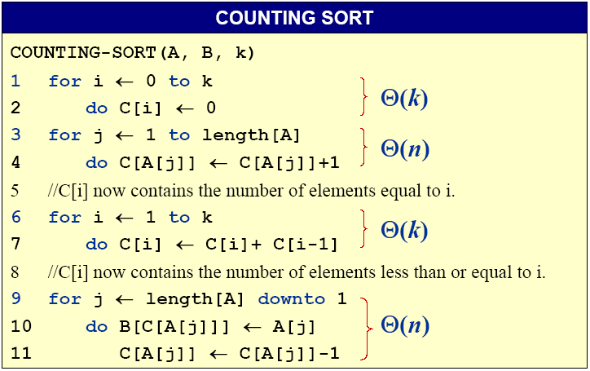
Analysis of Counting Sort
Θ(k)
Θ(n)
Θ(k)
Θ(n)
The overall time is Θ(k+n)

Slide 48
Running time
If k = O(n), then counting sort takes Θ(n) time.
--But, sorting takes Ω(n lgn) time!
--Where’s the fallacy?
Answer:
--Comparison sorting takes Ω(n lgn) time.
--Counting sort is not a comparison sort.
-- In fact, not a single comparison between elements occurs!

Slide 49
Stable sorting
Counting sort is a stable sort: it preserves the input order among equal elements.
Exercise: Where other sorts have this property?

Slide 50
8.3 Radix sort基数排序
Origin: Herman Hollerith’s card-sorting machine for the 1890 U.S. Census穿卡机上排序算法
Digit-by-digit sort逐位排序
Hollerith’s original (bad) idea: sort on most-significant digit first
Good idea: Sort on least-significant digit first with auxiliary stable sort

Slide 51
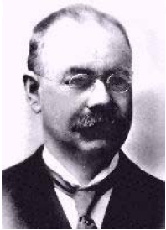
Herman Hollerith (1860-1929)赫尔曼·霍尔瑞斯
The 1880 U.S. Census took almost
10 years to process
While a lecturer at MIT, Hollerith
prototyped punched-card technology
His machines, including a “card sorter,” allowed the 1890 census total to be reported in 6 weeks
He founded the Tabulating Machine Company in 1896, which merged with other companies in 1924 to form International Business Machines

Slide 52
Operation of radix sort
3
4
6
8
4
7
3
2
5
5
3
3
2
5
9
7
7
9
6
0
5
9
7
7
9
6
0
5
7
3
4
4
6
3
8
2
5
3
5
5
2
3
0
5
6
7
7
9
9
Stable
sort

Slide 53
Operation of radix sort
3
4
6
8
4
7
3
2
5
5
3
3
2
5
9
7
7
9
6
0
5
9
7
7
9
6
0
5
7
3
4
4
6
3
8
2
5
3
5
5
2
3
2
5
3
5
5
2
3
0
5
6
7
7
9
9
7
3
4
8
3
4
6
2
2
3
3
5
5
5
0
9
6
9
5
7
7
Stable
sort
Stable
sort

Slide 54
Operation of radix sort
3
4
6
8
4
7
3
2
5
5
3
3
2
5
9
7
7
9
6
0
5
9
7
7
9
6
0
5
7
3
4
4
6
3
8
2
5
3
5
5
2
3
2
5
3
5
5
2
3
0
5
6
7
7
9
9
7
3
4
8
3
4
6
7
3
4
8
3
4
6
2
2
3
3
5
5
5
0
9
6
9
5
7
7
3
3
4
4
6
7
8
2
5
3
5
5
2
3
9
5
6
7
7
0
9
Stable
sort
Stable
sort
Stable
sort

Slide 55
Operation of radix sort-correctness
7
3
4
8
3
4
6
2
2
3
3
5
5
5
0
9
6
9
5
7
7
3
3
4
4
6
7
8
2
5
3
5
5
2
3
9
5
6
7
7
0
9
Induction on digit position
Assume that the numbers are sorted by their low-order t – 1 digits.
Stable
sort
Sort on digit t

Slide 56
Operation of radix sort-correctness
7
3
4
8
3
4
6
2
2
3
3
5
5
5
0
9
6
9
5
7
7
3
3
4
4
6
7
8
2
5
3
5
5
2
3
9
5
6
7
7
0
9
Induction on digit position
Assume that the numbers are sorted by their low-order t – 1 digits.
Stable
sort
Sort on digit t
Two numbers that differ in digit t are correctly sorted.

Slide 57
Operation of radix sort-correctness
7
3
4
8
3
4
6
2
2
3
3
5
5
5
0
9
6
9
5
7
7
3
3
4
4
6
7
8
2
5
3
5
5
2
3
9
5
6
7
7
0
9
Induction on digit position
Assume that the numbers are sorted by their low-order t – 1 digits
Stable
sort
Sort on digit t
Two numbers that differ in digit t are correctly sorted.
Two numbers equal in digit t are put in the same order as the input → correct order

Slide 58
RADIX-SORT
RADIX-SORT
RADIX-SORT( A , d ) 1 for i ← 1 to d 2 do use a stable sort to sort array A on digit i
Θ(d (n+k)), if we use counting sort and d is constant, k is the possible values which each digit can take, Θ(n)
LSD：sorting numbers on their Least Significant Digit first
How if we use MSD：sorting numbers on their Most Significant Digit first?

Slide 59
Radix sort性能分析

Slide 60
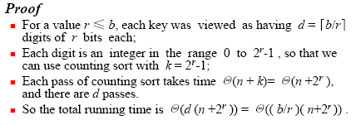
Radix sort性能分析

Slide 61

Radix sort性能分析

Slide 62
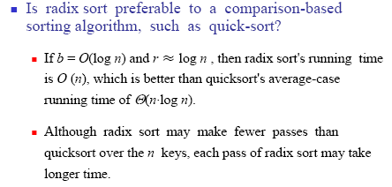
Radix sort vs comparison-based sort

Slide 63
Radix sort vs comparison-based sort

Slide 64
8.4 Bucket Sort桶排序
Like counting sort, bucket sort is fast because it assumes something about the input. Whereas counting sort assumes that the input consists of integers in a small range, bucket sort assumes that the input is generated by a random process that distributes elements uniformly输入是由一个随机过程产生，该过程将元素均匀地分布在某个区间上
Idea of Bucket Sort
-- Divide the interval [0,1) into n equal-sized subintervals, or bucket, and then distribute the n input number into the buckets

Slide 65
8.4 Bucket Sort
Assume that all the input is generated by a random process that distributes elements uniform over the interval [0,1)
Bucket sort
-- ① Allocate a bucket for each value of the key
>> That is, insert A[i] into list B[ n A[i] ]
-- ② For each bucket
>> sort list B[ i ] with insertion sort
-- ③ concatenate the list B[0], B[1],…,B[n - 1] together in order

Slide 66
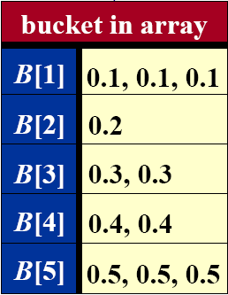
8.4 Bucket Sort Example
A=(0.5, 0.1,0.3,0.4,0.3,0.2,0.1,0.5,0.4,0.5)
Sorted list:
0.1, 0.1, 0.2, 0.3, 0.3, 0.4, 0.4, 0.5, 0.5, 0.5

Slide 67
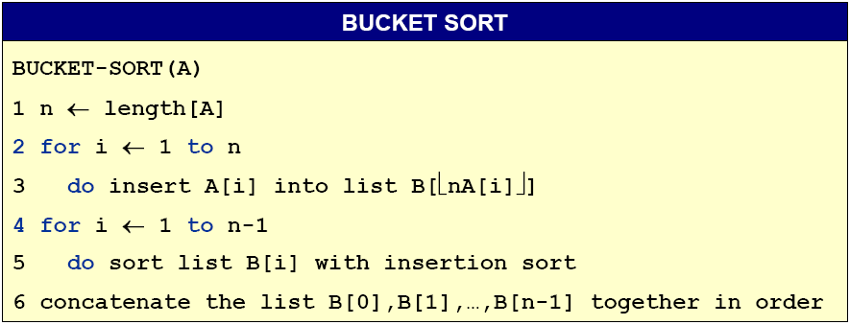
8.4 Bucket Sort Algorithm
0

Slide 68

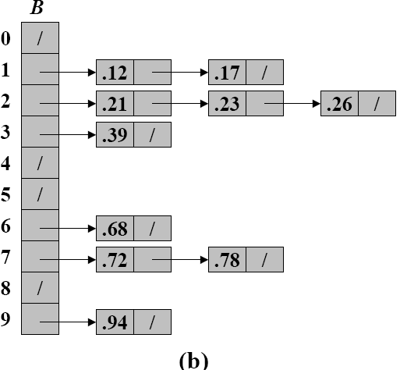
Another Example
(a) The input array A[1..10]
(b) The array B[0..9] of sorted lists (buckets) after line 5 of the algorithm. Bucket i holds values in the half-open interval [i / 10, (i + 1) /10)

Slide 69
Algorithm Analysis
Θ(n)
under uniform distribution
0
All lines except line 5 take O(n) time in the worst case. Total time to examine all buckets in line 5 is O(n), without the sorting time.
To analyze sorting time, let n_{i} be a random variable denoting the number of elements placed in bucket B[i]. The total time to sort is

Slide 70
Algorithm Analysis

Slide 71
Algorithm Analysis

Slide 72
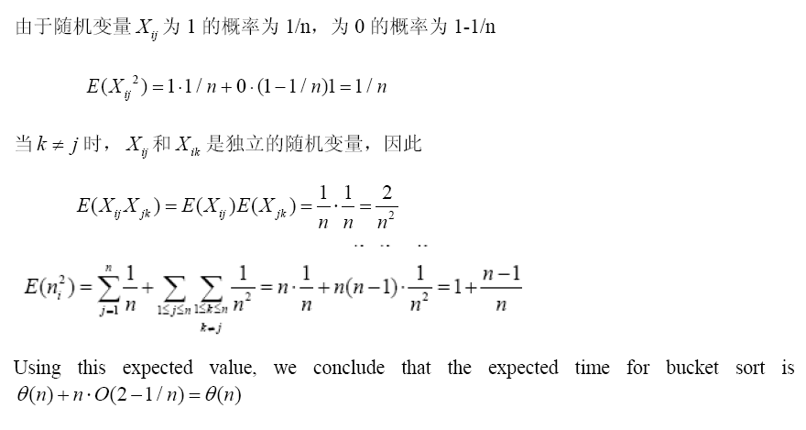
Algorithm Analysis

Slide 73
Summary of sorting algorithms
Sorting methods | Worst Case | Best Case | Average Case | Application
Insert Sort | n² | n | n² | Very fast when n<50
Bubble Sort | n² | n | n² | Very fast when n<50
Merge Sort | n lgn | n lgn | n lgn | Need extra space; good for external sort
Heap Sort | n lgn | n lgn | n lgn | Good for real-time app.
Quick Sort | n² | n lgn | n lgn | Practical and fast
Counting Sort | k+n | k+n | k+n | Small, fixed range; Need extra space
Radix Sort | d(k+n) | d(k+n) | d(k+n) | Fixed range; Need extra space
Bucket Sort | n | n | n | Uniform distribution
Which in place?
Which stable?

Slide 74
思考题
Page 173
8.2-1
8.3-1,2,3,4
8.4-1,2

