Slide 1
ArguLex
(AI-Powered Legal Argument Generator)
Team Members: Rena Patel - (MS AI)
Litesh Perumalla - (MS DS)
Uday Kiran Chimpiri - (MS CS)​
Srinivasa Manohar Kandadai - (MS AI)
Khaja Fasi Ahmed - (MS CS)

Slide 2
Introduction
ArguLex (AI-Powered Legal Argument Generator) using RAG & LLMs
Tech & Skills : Python, FastAPI, React, Firebase, NLP, LLMs, RAG (AI)
Impact Area : LegalTech, Legal Automation (Civic Tech / Government Transparency)
User Group : Lawyers, Legal Researchers, Law Students, Legal Aid Organizations
Problem Statement :
Legal research is time-consuming, costly, and inconsistent, professionals face data overload and manual drafting challenges

Slide 3
Problem Statement
Automates legal precedent retrieval based on case input
Utilizes semantic understanding for structured argument generation
Supports citation integration, legal reasoning, and multiple formats
Built with RAG (Retrieval-Augmented Generation) for enhanced search and LLM generation
Helps attorneys prepare stronger arguments and improve case outcomes

Slide 4
Implementation
Technology, Tools & Methodology​
Frontend : React, TailwindCSS​
Backend : FastAPI, Python​
Database : ChromaDB, Firebase​
Embeddings : Legal-BERT, LlamaIndex​
RAG Layer : LangChain for retrieval & OLLAMA for output​
Datasets : Scraped PDFs & legal JSON from Coun APIs​
Preprocessing : Text cleaning, entity extraction, fact isolation

Slide 5
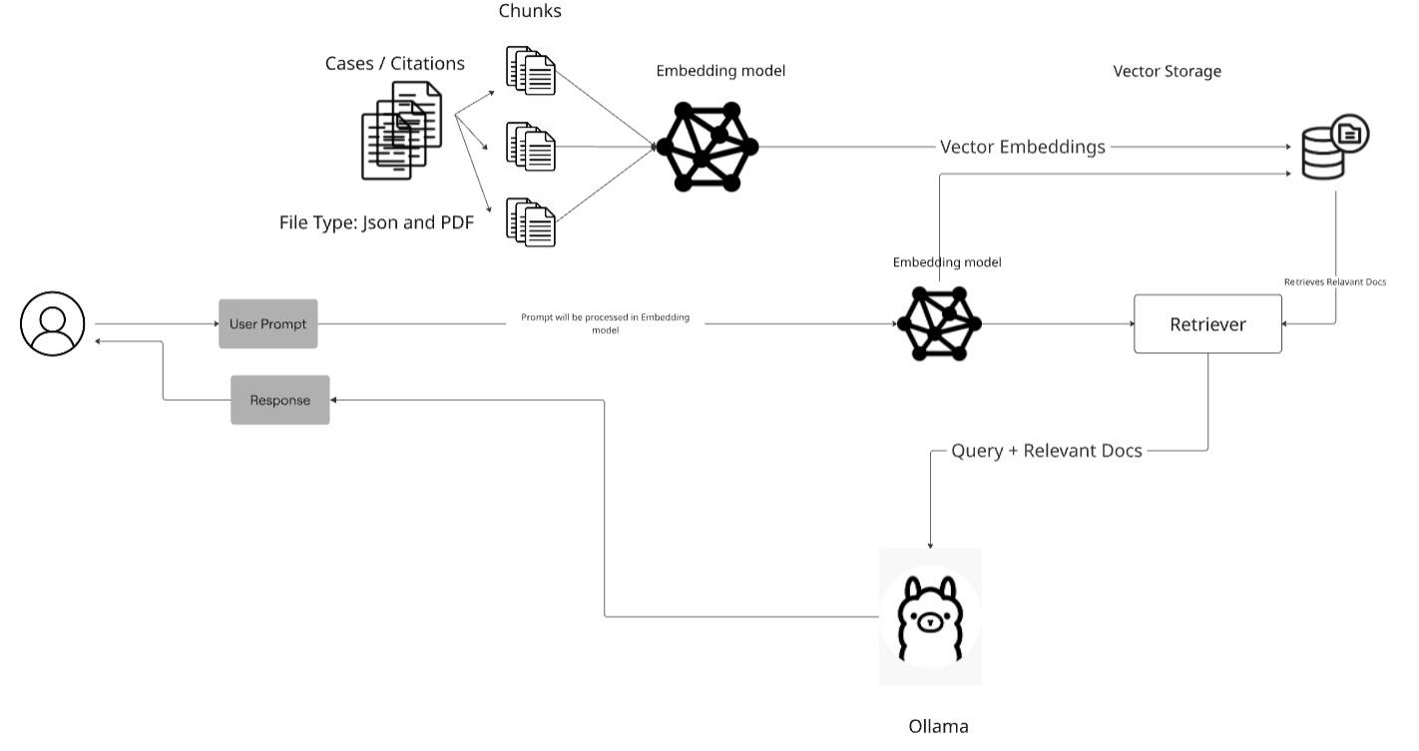
Workflow for ArguLex

Slide 6
Results & Demo
Demo :​
Ask a legal query → View AI- generated legal argument​
Performance :​
85% reduction in research time​
92% accuracy in retrieving relevant precedents​
3.5x more precedent usage compared to manual effort in case argument preparation
Evaluation :​
Evidently AI: chunk relevance, context quality, hit rate​

Slide 7
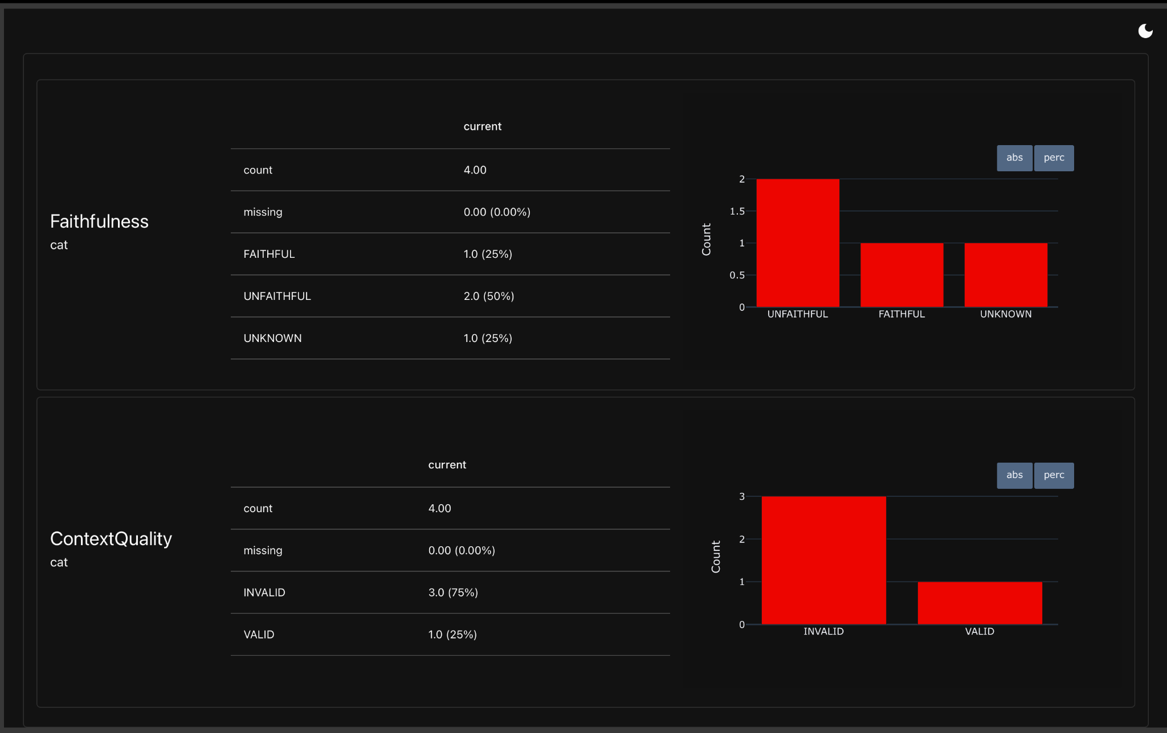
Evaluation metric

Slide 8
Impact & Scalability
Societal Impact :​
Boosts access to legal reasoning tools​
Supports public legal aid and justice systems​
Enables consistent legal documentation​
Next Steps :​
Add voice query and multilingual support​
Enable privacy-aware deployments​
Scalability :​
API-based structure allows easy integration​
Can support large datasets and various legal domains

Slide 9
Thank You

