Slide 1
K - Nearest Neighbors

Slide 2
Introduction
Knn algorithm is one of the simplest classification algorithms
It’s one of the most used machine learning algorithms
KNN is a non-parametric, Lazy learning algorithm
Its purpose is to use a database in which the data points are separated into several classes to predict the classification of a new sample point

Slide 3
Lazy Learner
KNN is a typical example of a lazy learner
It is called lazy not because of its apparent simplicity, but because it doesn't learn a discriminative function from the training data but memorizes the training dataset instead
In general an eager learner has a model fitting or training step. A lazy learner does not have a training phase.

Slide 4
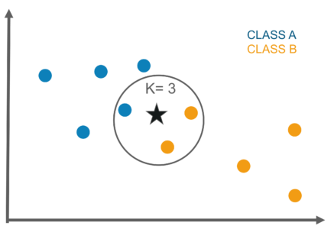
Graphical representation of 3NN

Slide 5
Explanation
In the graph the dataset is grouped into class A and class B based on the label
The input data for which the group it belongs to needs to be identified by finding out the k nearest neighbors
The majority of the neighbor’s class is considered as the final output of the input data
K value is normally taken as odd to elect the majority class

Slide 6
Applications
Credit ratings — collecting financial characteristics vs. comparing people with similar financial features to a database. Therefore, they would like to be able to use this existing database to predict a new customer’s credit rating, without having to perform all the calculations
More advance examples could include handwriting detection (like OCR), image recognition and even video recognition

Slide 7
Advantages
No assumptions about data — useful, for example, for nonlinear data
Simple algorithm — to explain and understand/interpret
High accuracy (relatively) — it is pretty high but not competitive in comparison to better supervised learning models
Versatile — useful for classification or regression

Slide 8
Disadvantages
Computationally expensive — because the algorithm stores all of the training data
High memory requirement
Stores all (or almost all) of the training data
Prediction stage might be slow (with big N)
Sensitive to irrelevant features and the scale of the data

