Slide 1

444CCS-3
Software Project Management
KING KHALID UNIVERSITY
2nd Semester – AY 1447
College of Computer Science
Inventory
RA
Renad Mohammed Alshahri
Management
Project Manager
System
WA
Wajd Yahya Asiri
Automating Inventory · Empowering Decisions
Risk & Documentation
Overview
Scope
Lifecycle
Schedule
Time
Cost
Risk ID
Response
Monitoring

Slide 2
01
Project Overview
What is IMS?
12
5
A web-based Inventory Management System that automates stock tracking, purchase & sales order processing, and reporting — replacing error-prone manual processes with a reliable, role-based application.
Week Timeline
Core Modules
Key Objectives
Automate real-time stock level tracking
Role-based access: Admin / Manager / Staff
Purchase & sales order management
Automated low-stock alerts & supplier database
Comprehensive reporting dashboard
3
8
User Roles
Risks Identified

Slide 3
02
Project Scope
✓ In Scope
✦ Success Criteria
User Auth & Role-Based Access Control
Product Catalog Management
Stock Level Tracking & Automated Alerts
Purchase & Sales Order Processing
Reporting Module & Audit Trails
Web-Based Interface (Desktop)
System deployed within 12-week timeline
All modules tested & acceptance criteria met
User manual & documentation delivered
Project within estimated budget
Project Team
✗ Out of Scope
RA
Renad Mohammed Alshahri
Project Manager · 444807477
Mobile Application Development
ERP System Integration
Barcode Scanner Hardware
WA
Wajd Yahya Asiri
Risk & Documentation · 444808566

Slide 4
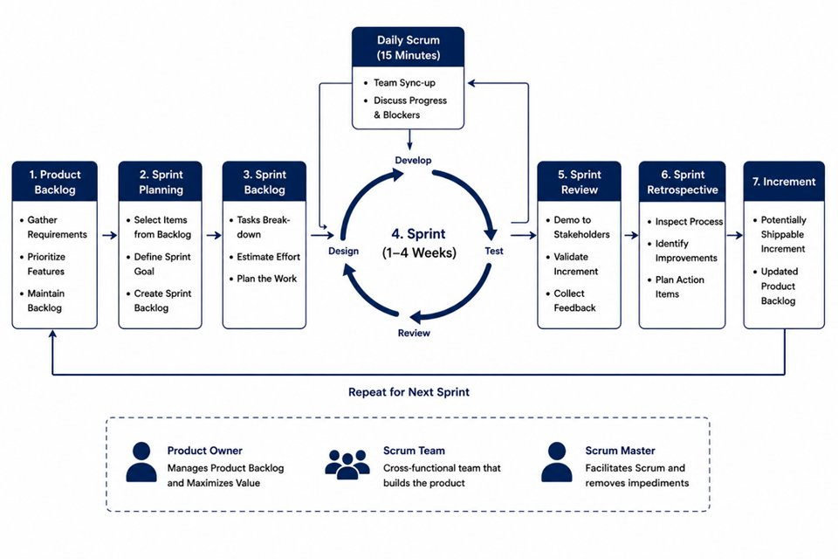
03
Software Project Lifecycle Model
AGILE (SCRUM)
Selected Lifecycle · 6 Sprints × 2 Weeks
Why Agile Scrum?
Flexible — adapts to evolving requirements
2-week sprints → early, frequent feedback
Regular stakeholder demos each sprint
Roles align with our 2-member team
Continuous risk monitoring built in
Figure 1: Agile Scrum Lifecycle Model

Slide 5
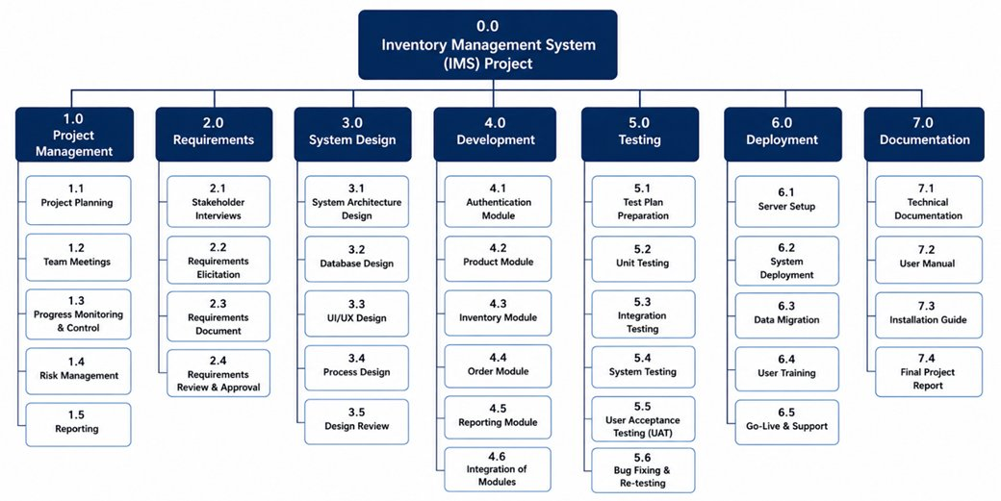
03b
Work Breakdown Structure (WBS)
Figure 2: Work Breakdown Structure — IMS Project

Slide 6
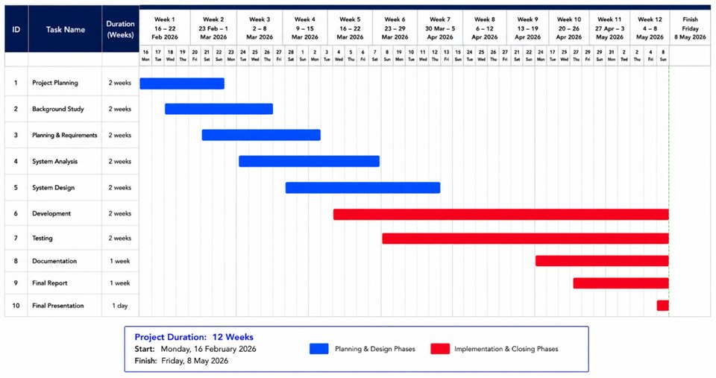
04
Project Schedule
12-Week Gantt Chart — 16 Feb 2026 → 8 May 2026
Figure 3: Gantt Chart Schedule

Slide 7
05
Time Management
Schedule Tool
Progress Tracking
Buffer Management
GanttPro Gantt chart (12 wks)
All tasks, durations & dependencies
Milestones tracked per sprint
Weekly review every Sunday
Sprint review every 2 weeks
Status in meeting minutes
1-day buffer per sprint cycle
Week 10 = dedicated testing buffer
Critical path monitored closely
Key Milestones
Wk 2
Wk 4
Wk 6
Wk 8
Wk 10
Wk 11
Wk 12
SRS Approved
Design Done
Sprint 1
Sprint 2
Testing Done
System Live
Closure

Slide 8
06
Cost Management
Phase | Est. Hours | Cost (SAR 50/hr) | Notes
Requirements Analysis | 16 hrs | SAR 800 | Stakeholder interviews & SRS
System Design | 20 hrs | SAR 1,000 | Architecture, DB, UI wireframes
Development | 70 hrs | SAR 3,500 | All 5 modules
Testing | 16 hrs | SAR 800 | Unit, integration, UAT
Documentation | 14 hrs | SAR 700 | Reports & user manual
Deployment | 6 hrs | SAR 300 | Server setup & training
Contingency Reserve | 14 hrs | SAR 700 | 10% buffer
TOTAL | 156 hrs | SAR 7,800 | Full project
156
Total Hours
SAR 7,800
Total Cost
10%
Contingency
All tools are free (open-source) or available through university licensing — minimizing external costs.

Slide 9
07
Risk Identification & Analysis
ID | Description | Probability | Impact | Level
R01 | Team member unavailability due to illness | Low | High | Medium
R02 | Requirement changes after development begins | Medium | High | High
R03 | Technical difficulties (tools/environment) | Medium | Medium | Medium
R04 | Schedule overrun / task underestimation | Medium | High | High
R05 | Data loss — lack of version control | Low | High | Medium
R06 | Authentication security vulnerabilities | Medium | High | High
R07 | Bugs undetected until final delivery | Low | High | Medium
R08 | Workload imbalance between team members | Medium | Medium | Medium
Legend: 🔴 High = Medium Prob. + High Impact · 🟡 Medium = Low-Med Prob. + Med-High Impact · 🟢 Low = Low Prob. + Low Impact

Slide 10
08
Risk Response Planning
ID | Strategy | Response Action | Owner
R01 | Mitigation | Document all work on GitHub; cross-train on all modules. | Both
R02 | Avoidance | Lock requirements post-SRS approval; formal Change Request process. | Renad
R03 | Mitigation | Set up dev environment Week 1; standardize tech stack. | Renad
R04 | Mitigation | Add schedule buffers; break tasks into smaller units. | Renad
R05 | Mitigation | GitHub mandatory commits after each session; protect main branch with PRs. | Both
R06 | Mitigation | Implement bcrypt hashing; security review before testing phase. | Wajd
R07 | Mitigation | Comprehensive test cases; dedicated UAT week (Week 10). | Wajd
R08 | Avoidance | Define clear task ownership in WBS; review workload weekly. | Both
Avoidance = prevent the risk from occurring · Mitigation = reduce probability or impact of the risk

Slide 11
09
Monitoring and Reporting
Risk Log Reviews
Progress Meetings
Risk log updated at every weekly meeting
New risks added immediately as identified
Risk status presented at every sprint review
Weekly team meeting: Sunday 7:00 PM
Sprint review every 2-week cycle
Ad-hoc meetings for critical issues
Reporting Tools
Escalation Process
GitHub: version control & shared risk log
Blackboard: formal deliverable submissions
MS Teams: daily comms & file sharing
Risks that materialize → both members alerted
Critical issues addressed immediately
Risk summary in every weekly report
Communication: Weekly → Sunday 7PM MS Teams · Sprint Review → Every 2 weeks · Submissions → Blackboard · Docs → GitHub Wiki

Slide 12
10
Future Improvements
📱 Mobile App (iOS / Android)
🔗 ERP Integration (SAP / Oracle)
📷 Barcode & QR Code Scanning
🤖 ML-Based Demand Forecasting
🏭 Multi-Warehouse Support
🛒 Customer-Facing Order Portal
SUMMARY
Covered Today:
Project Overview & Scope
Agile Scrum Lifecycle Model
12-Week Project Schedule
Time & Cost Management
8 Risks Identified & Analyzed
Risk Response Strategies
Monitoring & Reporting Plan
Thank You!
Questions & Discussion
Renad Mohammed Alshahri · Wajd Yahya Asiri
444807477 · 444808566

