Slide 1
Case Study RevoU
Games Sales
By : Renaldi Dwi Saputra

Slide 2
Problem Statement
Dataset : data
Context Gaming Industry is an interesting field to explore, it would be fun knowing who the most popular publishers and developers and which games are the most popular.
Content data: Name : Name of the game Sales : Sales of the game in Millions Series : Series of the game Release : Release date of the game Genre : Genre of the game Developer : Developer of the game Publisher : Publisher of the game

Slide 3
Question
Which game is the oldest and the newest games in that dataset?
Which publisher published most of the games ?
Which developer developed most of the games?
Which series is the most sales?
Which series have the most games?

Slide 4
CLEANING DATA

Slide 5
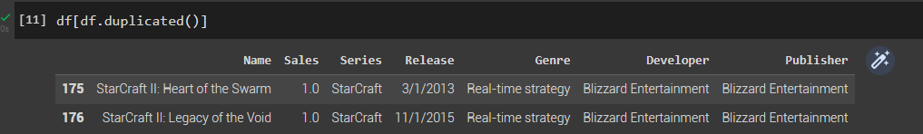
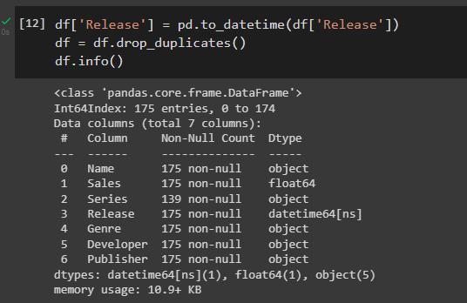
Cleaning Data
This data has some duplicated data that need to be remove and convert datatype string to datetime

Slide 6
EXPLORE DATA

Slide 7
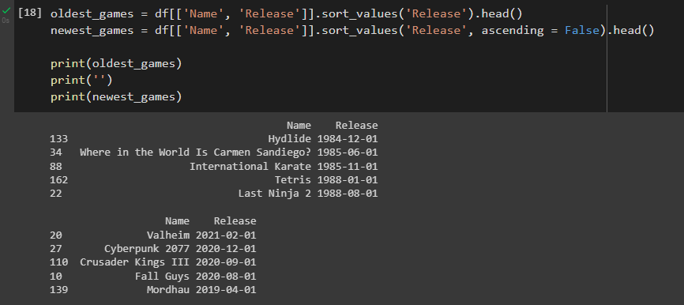
Which game is the oldest and newest games in that data set?
“Hydide” is the oldest game release on December 1, 1984 and the newest games in data is “Valheim” release on February 1, 2021

Slide 8
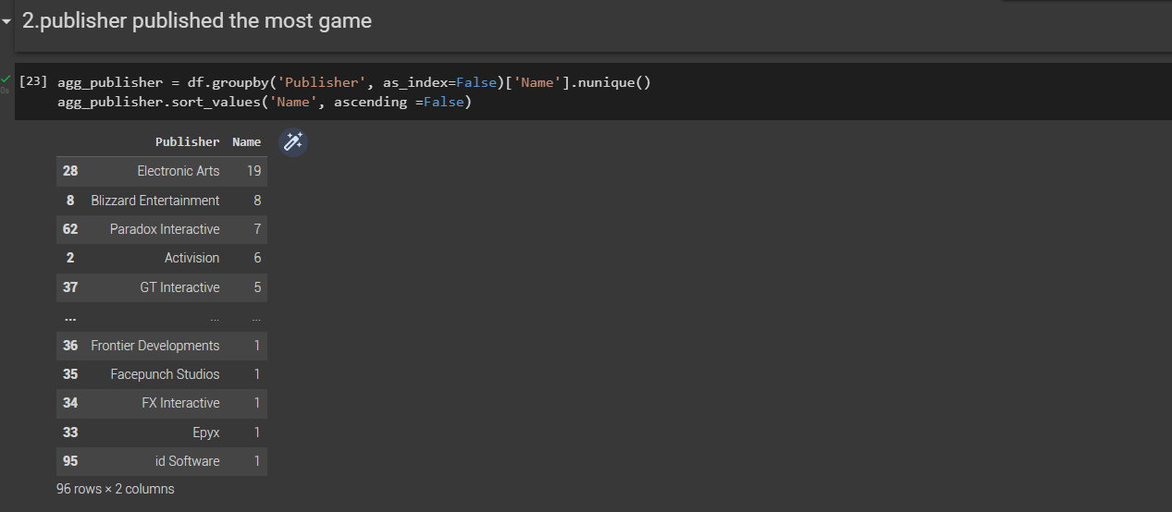
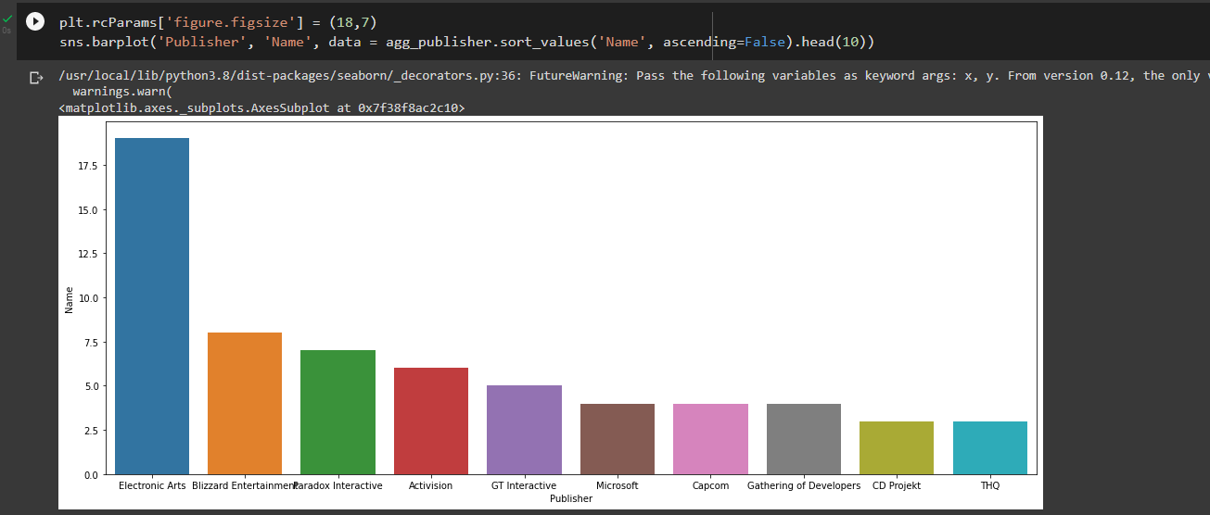
Which publisher published most of the game?
With the total of 19 games, the most games published by Electronic Art.

Slide 9
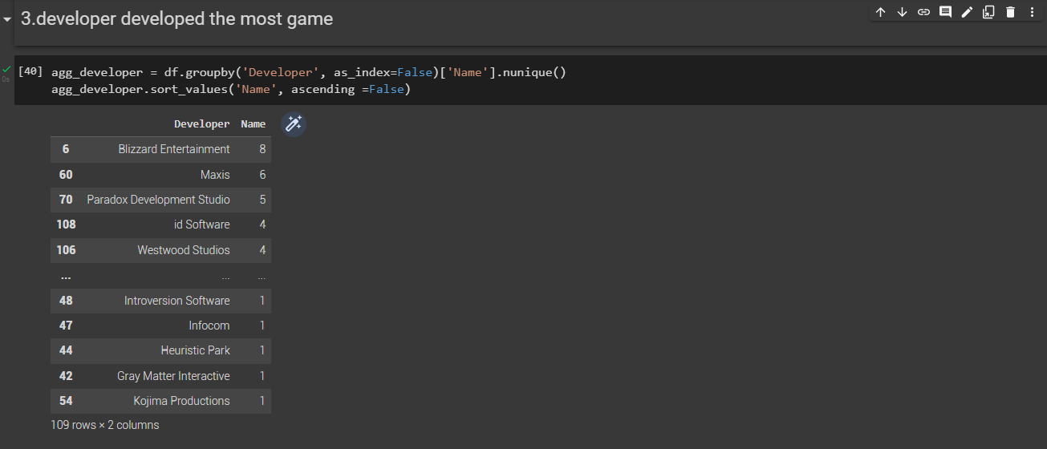
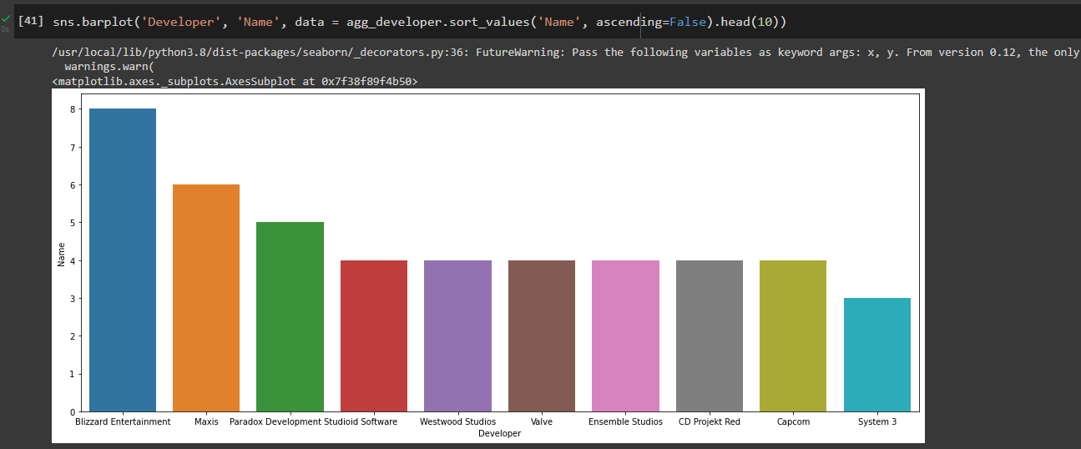
Which developer developed most of the game?
Most of the games developed, Blizzard Entertainment being the most game developer with 8 games.

Slide 10
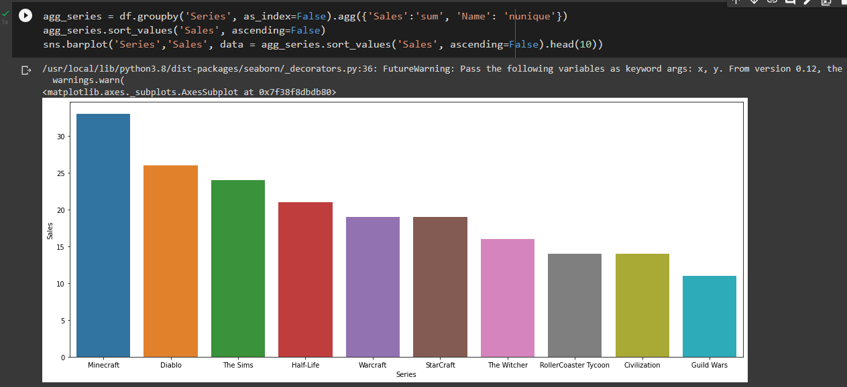
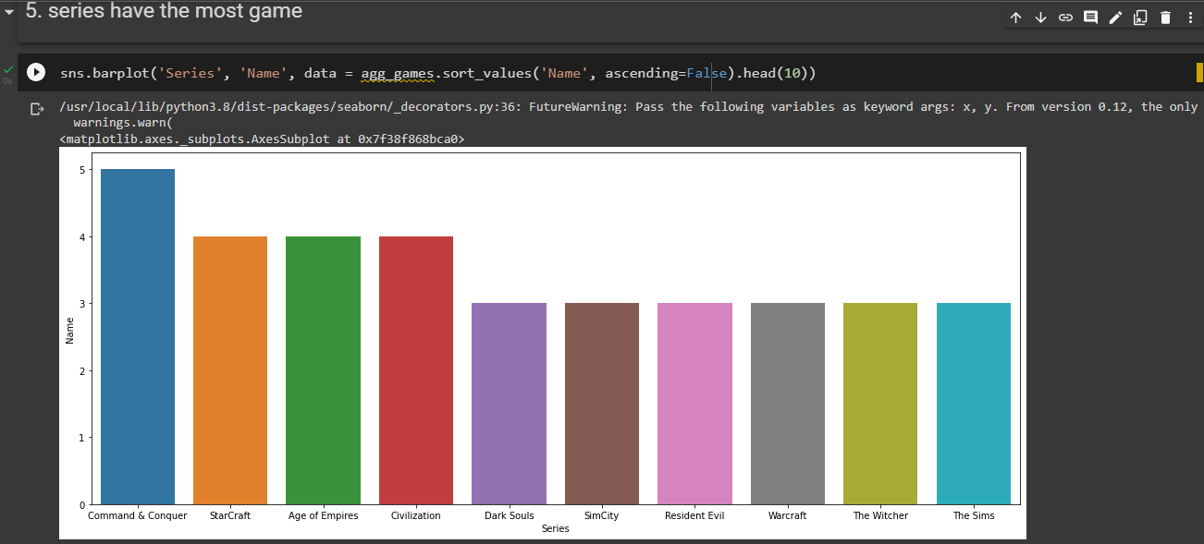
Which series is the most sales?
Which series have the most games?
With the total of 33 sales, Maincraft being the most sales series. Command and Conquer being the most game series with 5 games.

Slide 11
THANKS

