Slide 1



Final_project
View in Power BI
Last data refresh:
09/03/2023 16:15:40 UTC
Downloaded at:
09/03/2023 18:50:51 UTC

Slide 2
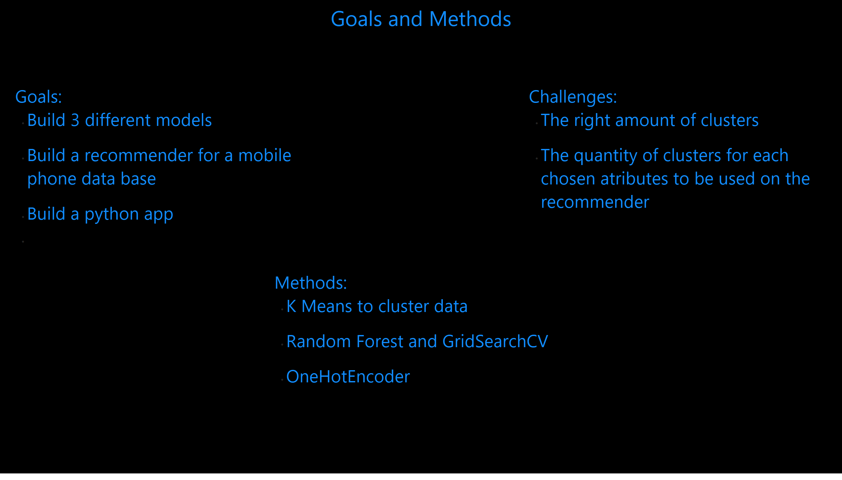
BQ
Notes:
textbox
No alt text provided
textbox
No alt text provided
textbox
No alt text provided
textbox
No alt text provided

Slide 3
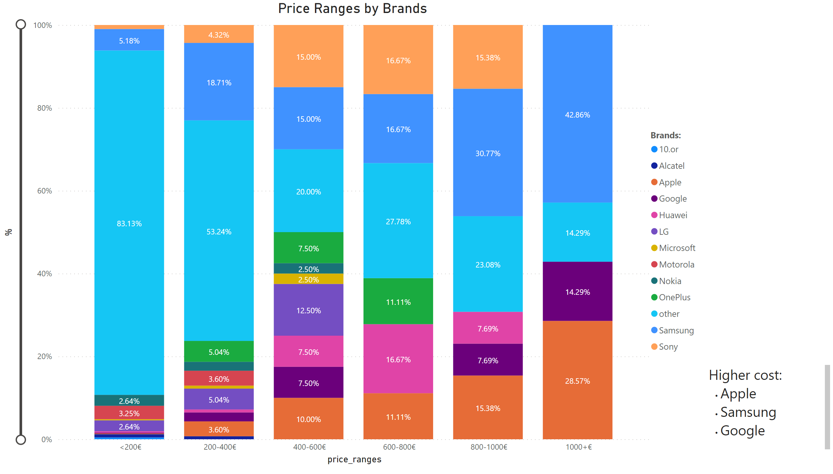
PRxB
Notes:
Price Ranges by Brands
No alt text provided
textbox
No alt text provided

Slide 4
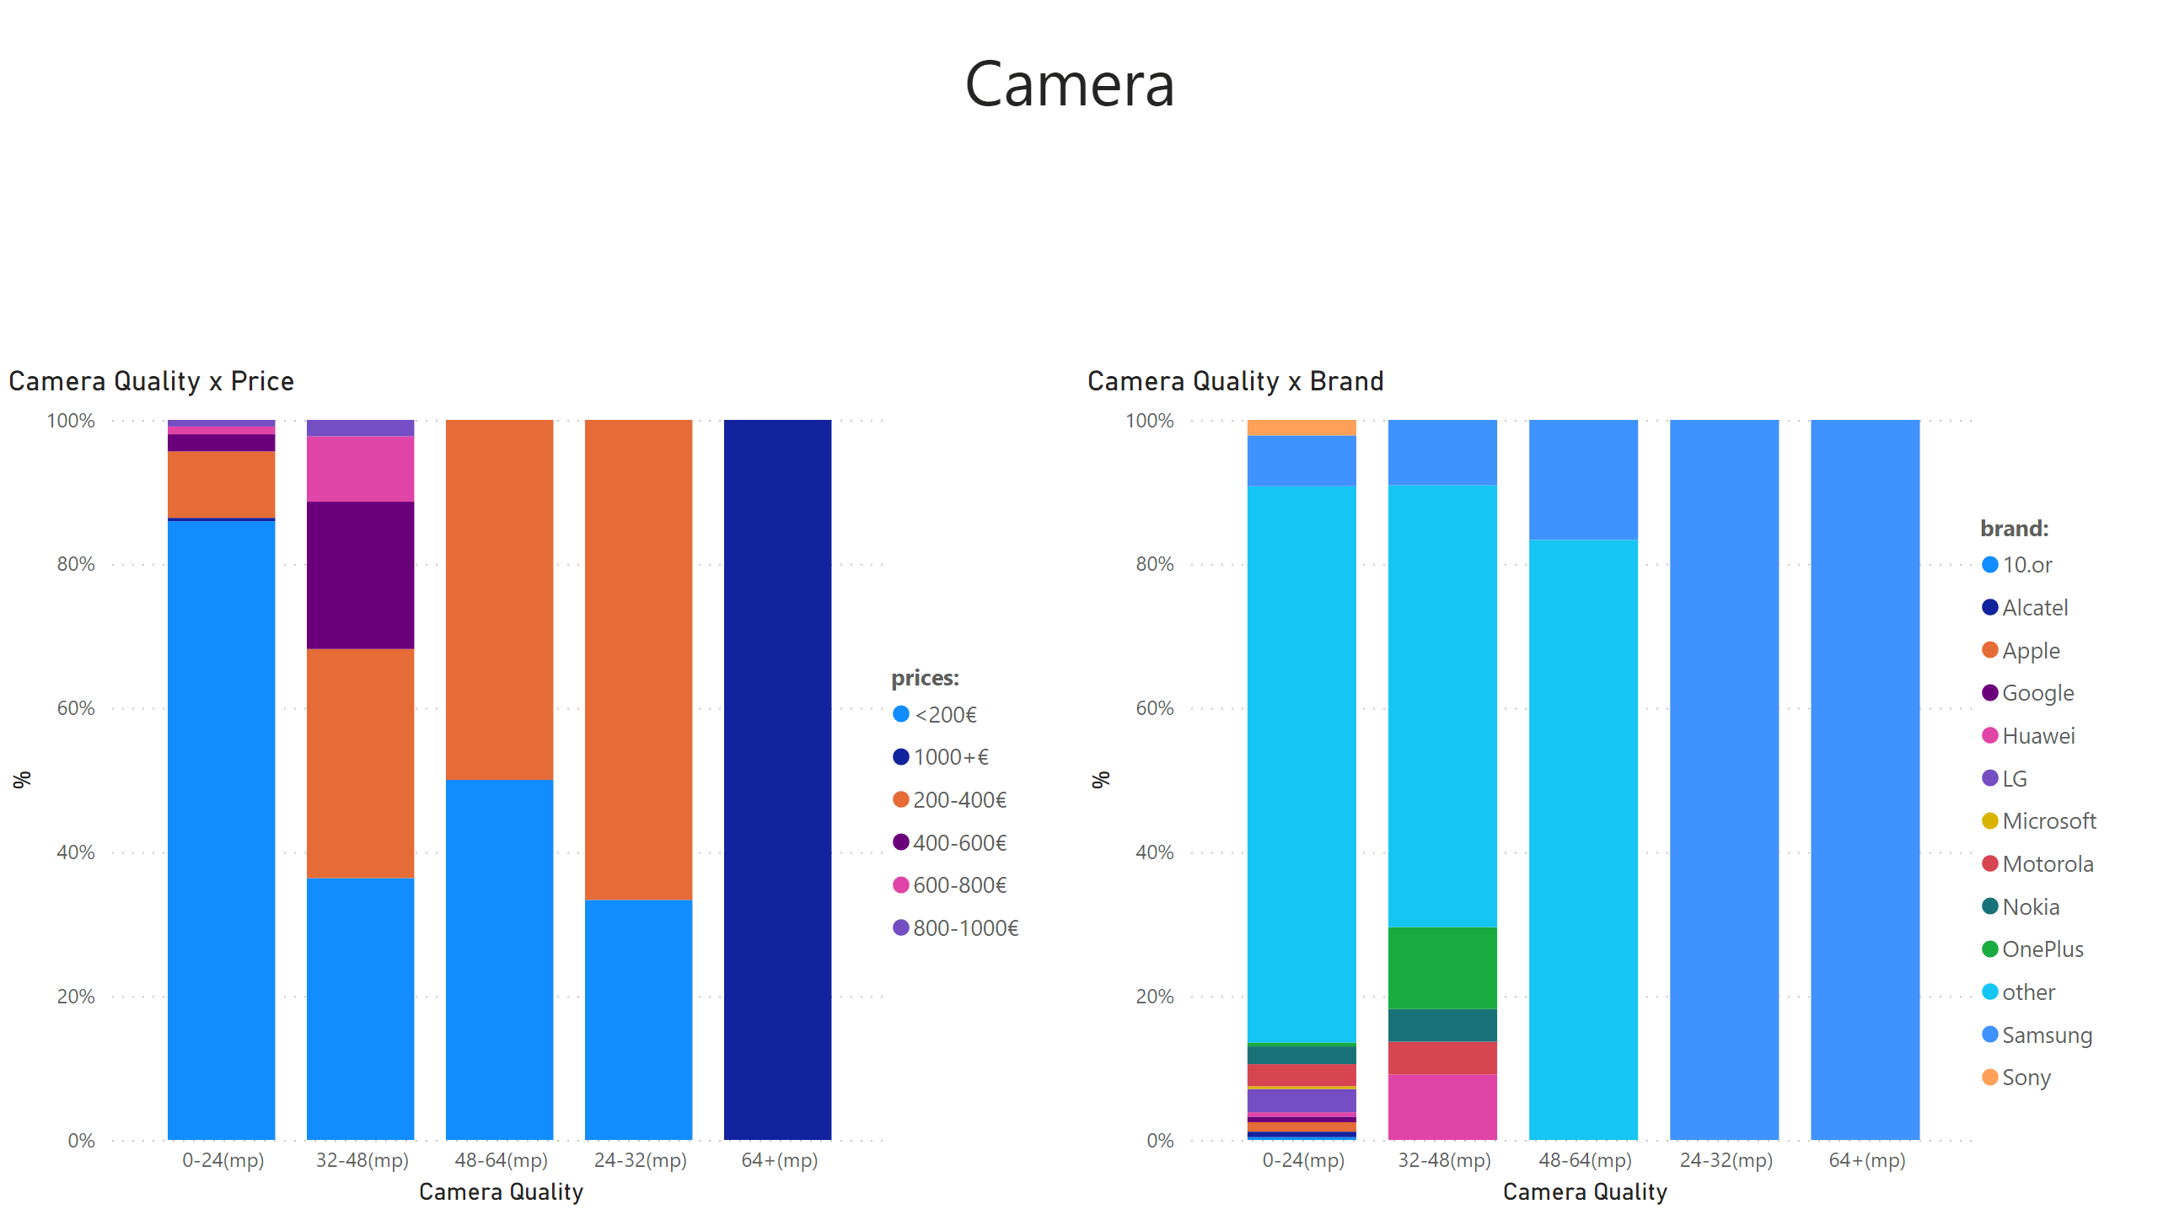
Cam
Notes:
Camera Quality x Price
No alt text provided
Camera Quality x Brand
No alt text provided
textbox
No alt text provided

Slide 5
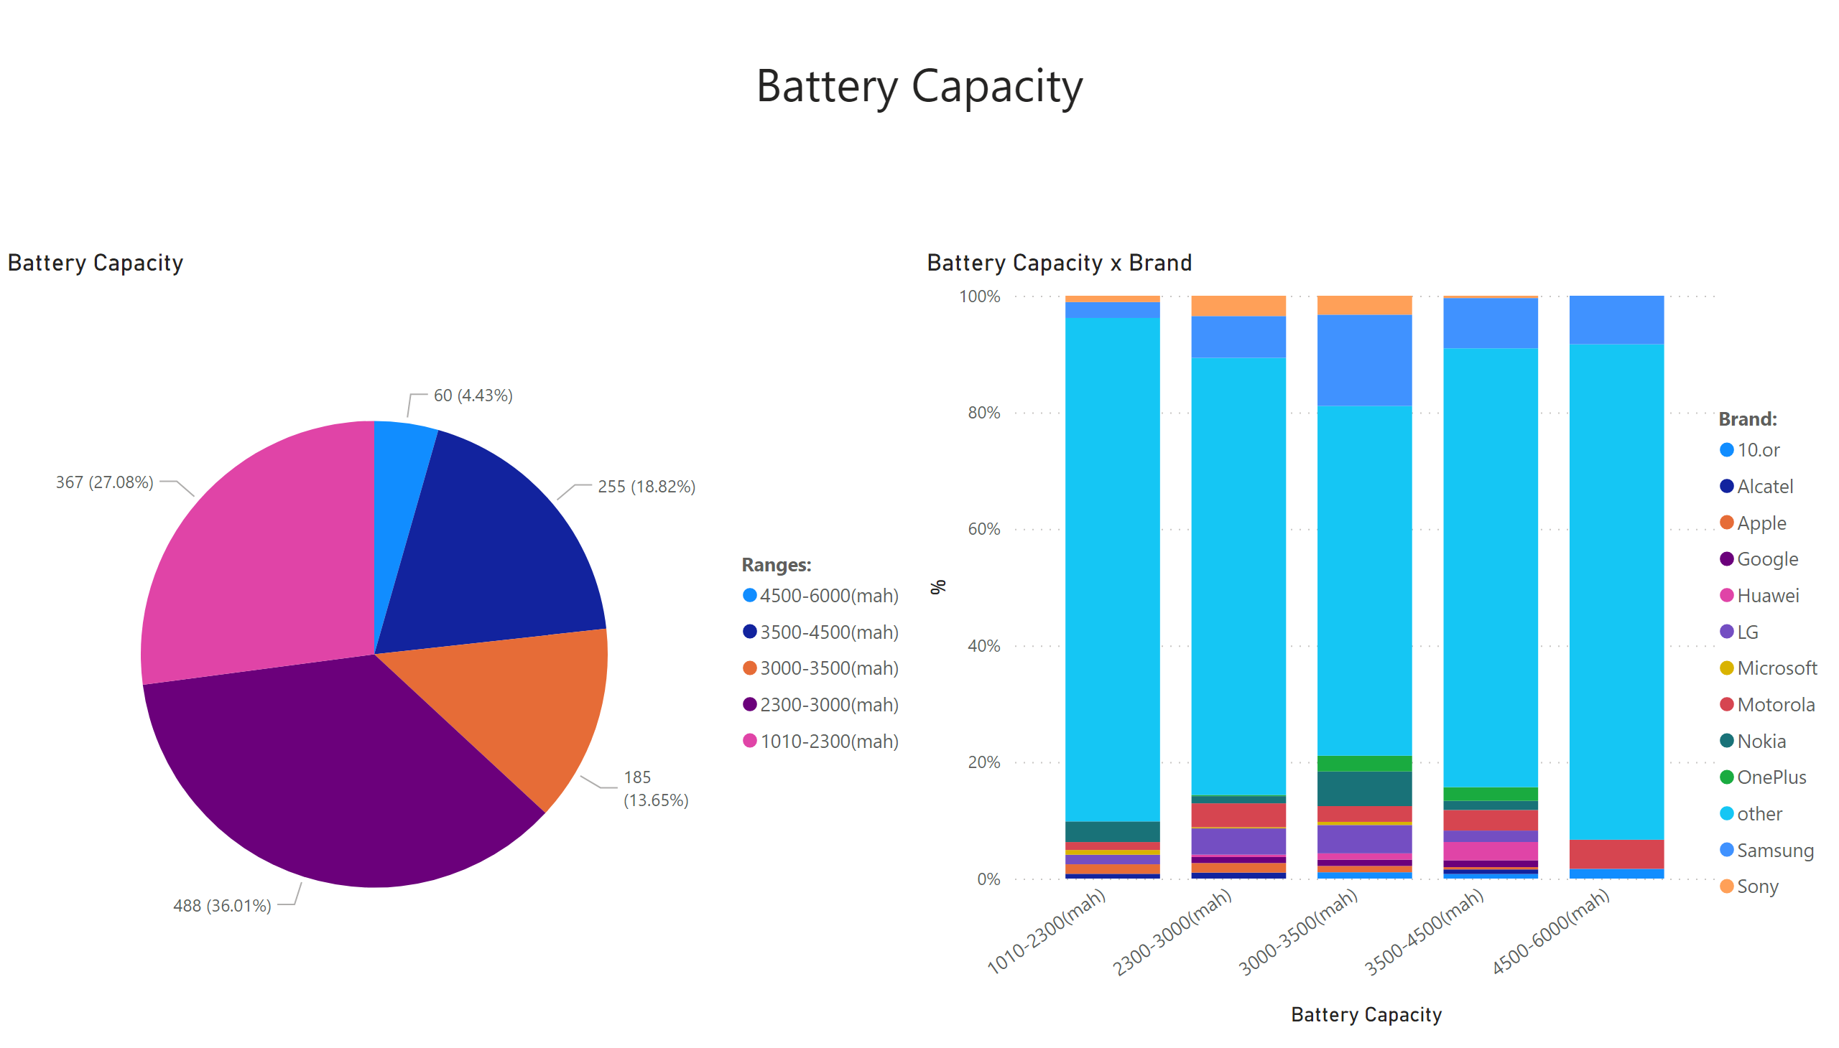
Battery
Notes:
textbox
No alt text provided
Battery Capacity x Brand
No alt text provided
Battery Capacity
No alt text provided

Slide 6
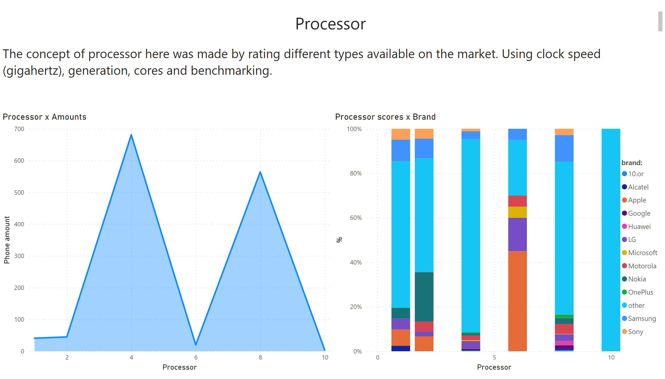
Processor
Notes:
textbox
No alt text provided
textbox
No alt text provided
Processor scores x Brand
No alt text provided
Processor x Amounts
No alt text provided

Slide 7
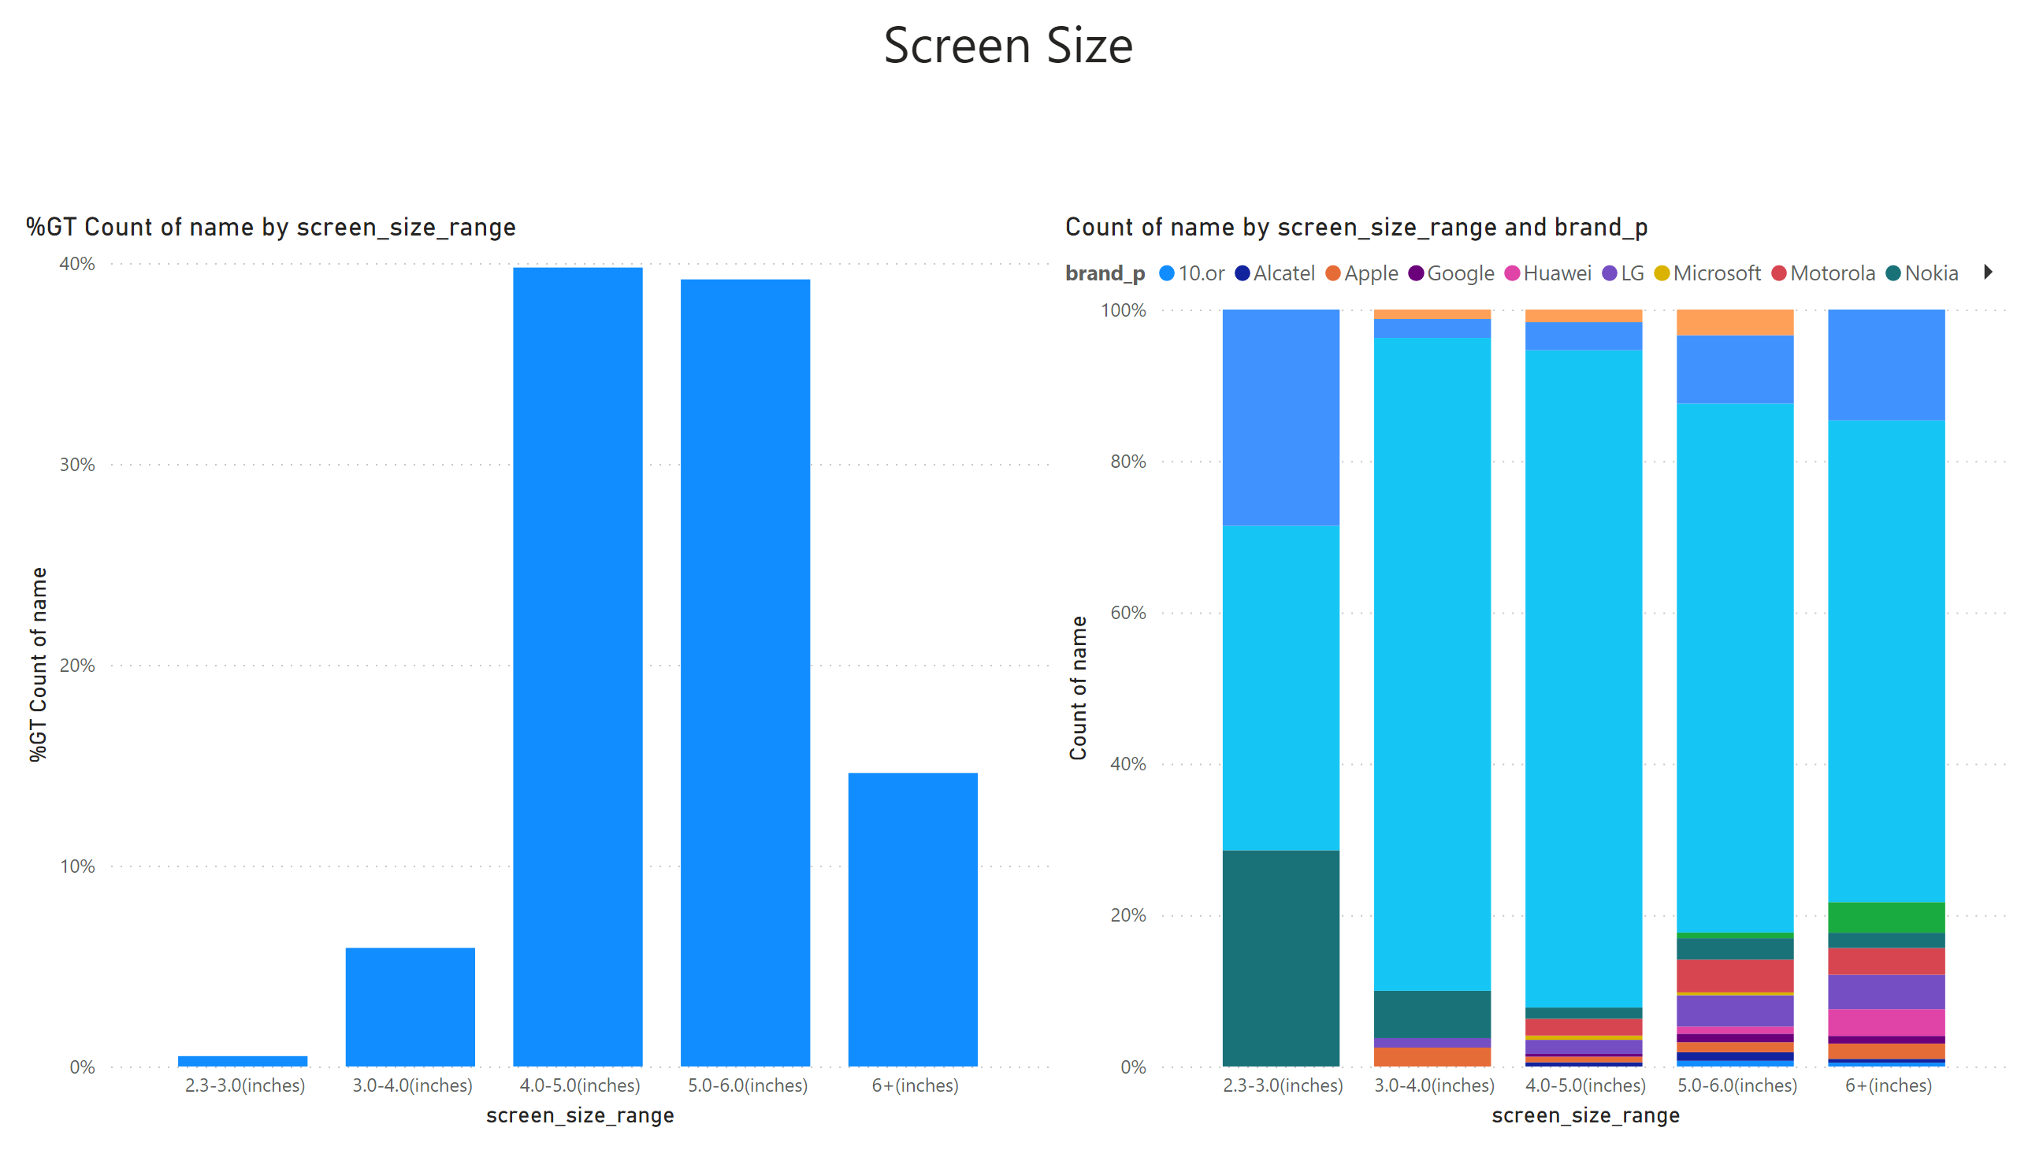
Screen
Notes:
textbox
No alt text provided
hundredPercentStackedColumnChart
No alt text provided
columnChart
No alt text provided

