Slide 1
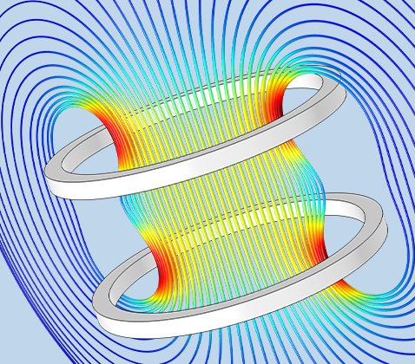

COMSOL: Testing the temperature of the skin between two coils.
Last week’s summary:
Creation of the 3d models For the coils and skin.

Slide 2
