Slide 1
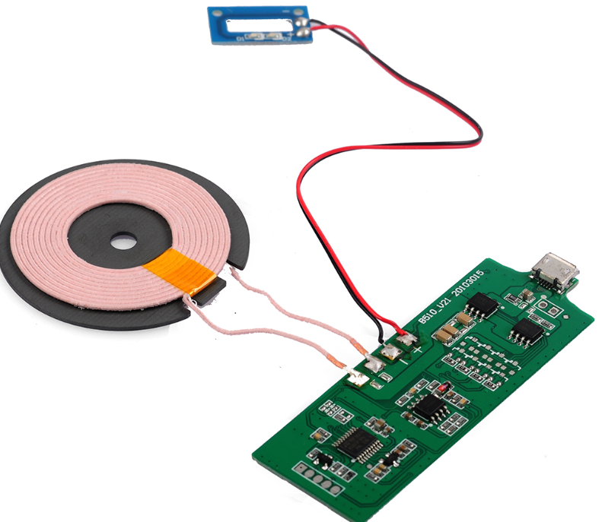
Preseason Intro

Slide 2
Groups
Motor
TET Circuit
Testing
Batteries
Control

Slide 3
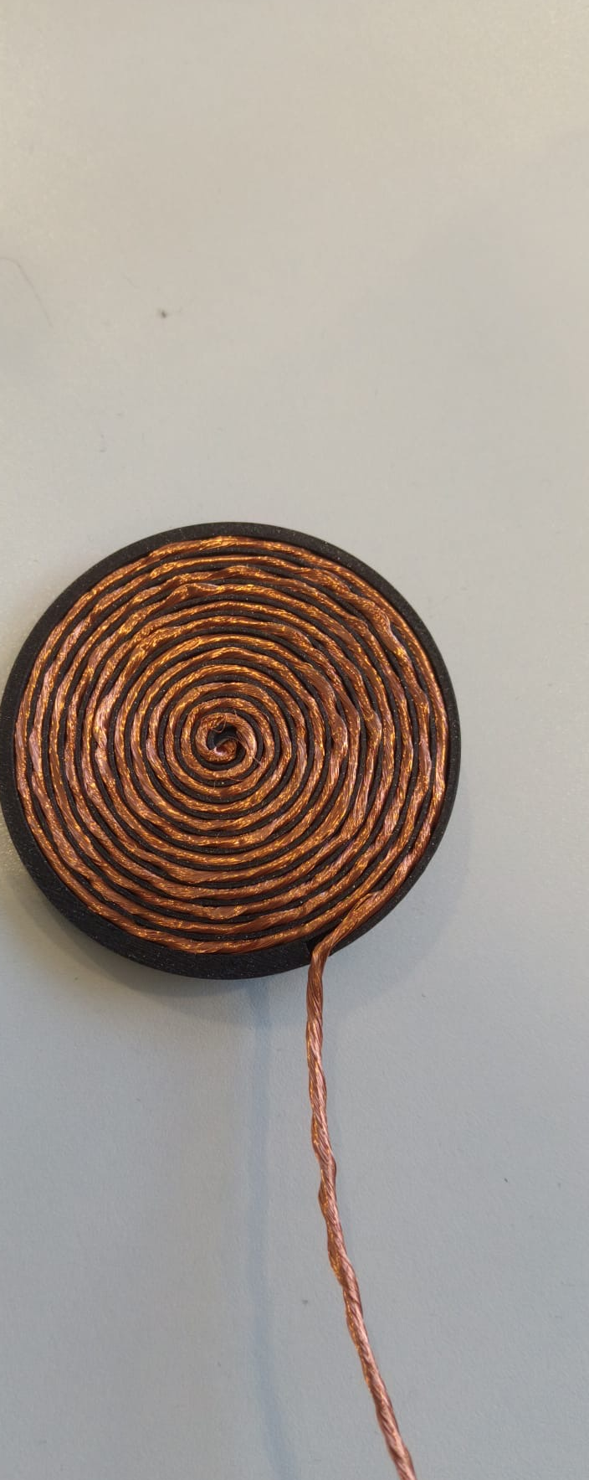
Testing
Constructed transmitter and receiver coils and arranged them in planar shapes using a 3D-printed mold
Created 10mm artificial human skin using silicone and a mold
Done testing on the coils using oscillator and LCR meter
Extracted resistance, coupling coefficient, and inductance data of the coil
Develop a more detailed and thoughtful plan for coil testing, and repeat the it three times for validation
Measure the temperature of the coils while inducting using a thermometer
Analyse and develop solutions if temperature surpass safety limit

Slide 4
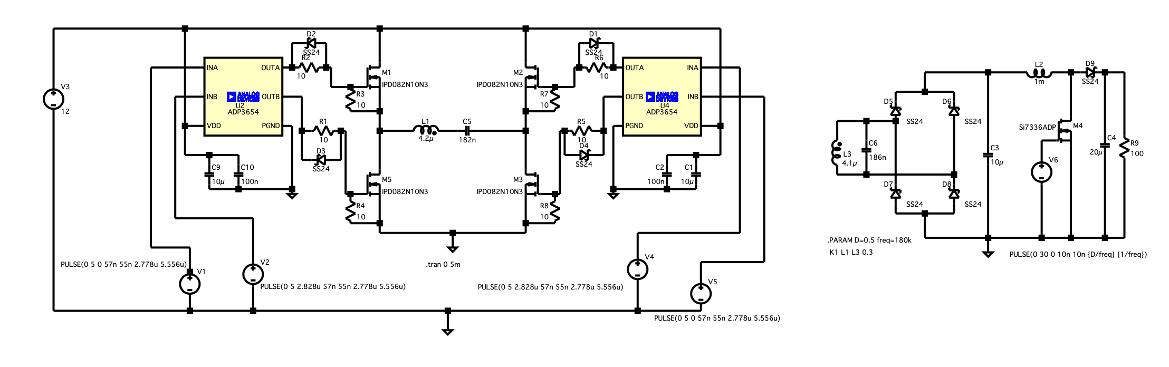
TET Circuit
Developed inverter, rectifier, and boost converter circuit on LTSpice that meets the voltage and current requirement
Converted the circuit schematics to PCB on KiCAD
Calculate the total circuit resistance and corresponding power loss; re-evaluate component choices and, where possible, substitute parts with lower series resistance while maintaining circuit performance.
Refine PCB design with a focus of footprint and power loss minimization

Slide 5
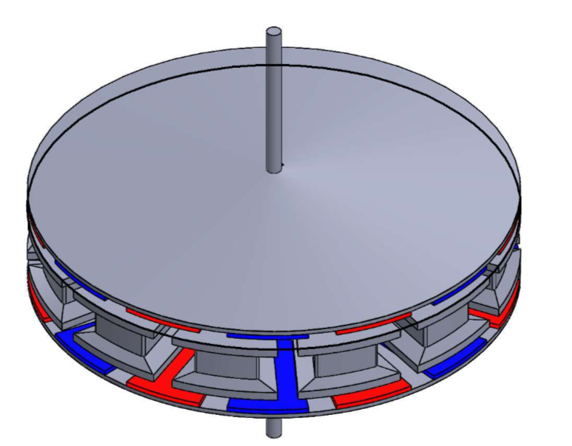
Motor
Built basic CAD for the YASA motor and initiated magnetic ANSYS analysis on it
Discuss the purpose of the ANSYS analysis, as well as the motor’s power requirement
Select motor material and refine CAD design with a focus on size and weight minimisation

Slide 6
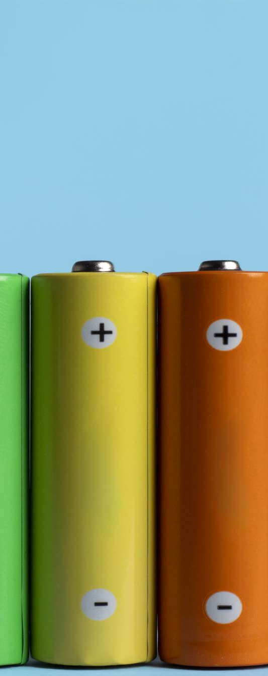
Batteries
Found lithium batteries that meet the required capacity requirement for internal battery
Continue search into small-sized rechargeable batteries that meets the capacity requirement (15Wh)
Determine types of external power source supply and the input requirement for the external circuit

Slide 7
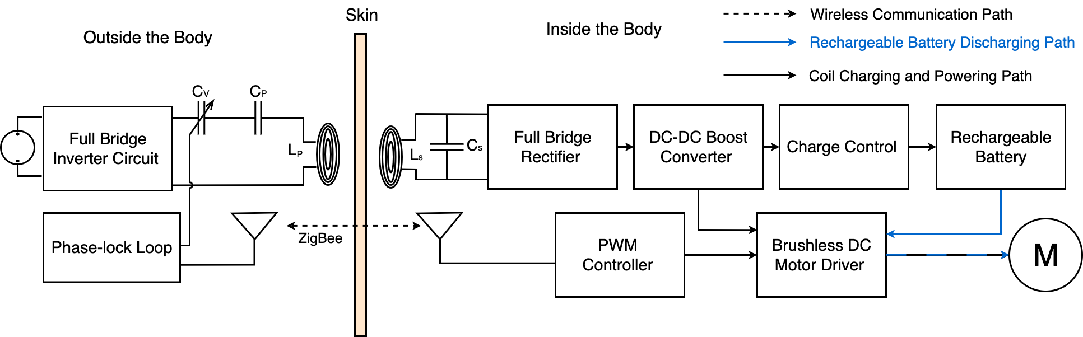
Control
Created block diagram showing the position of the frequency, battery, motor, and communication control
Research into the construction of PLL automatic frequency tuning control or better alternative
After finalising the battery choice, find the corresponding battery controller
Select suitable motor drive control for the customized motor
Research into the construction of the internal and external communication (Zigbee or better alternative)

Slide 8
Thank you for your effort!

