Slide 1
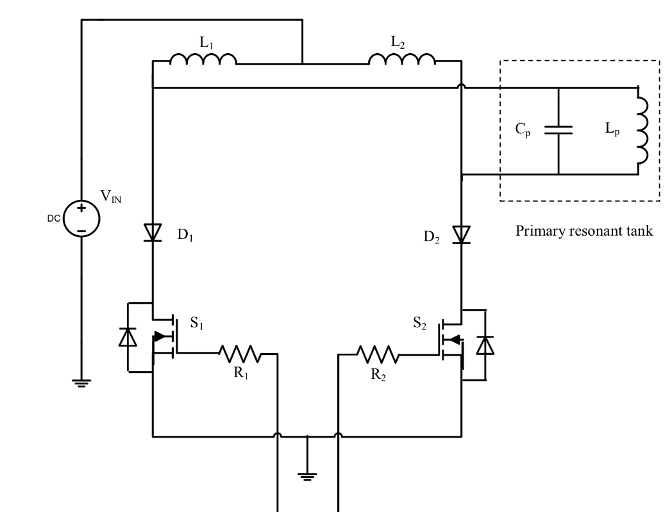
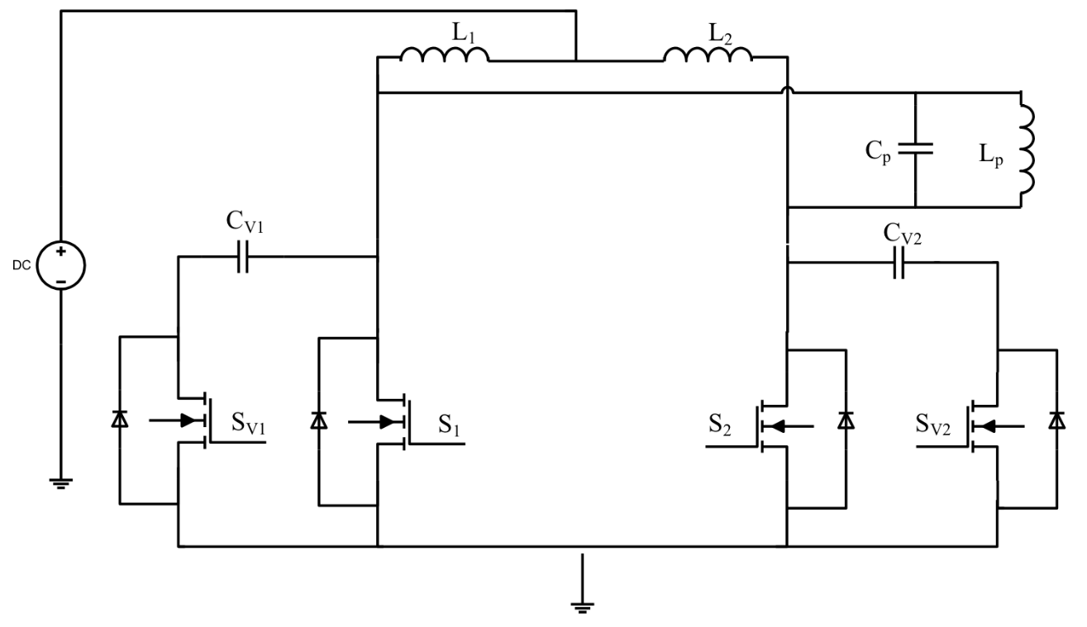
Current Fed Push Pull Converter

Slide 2
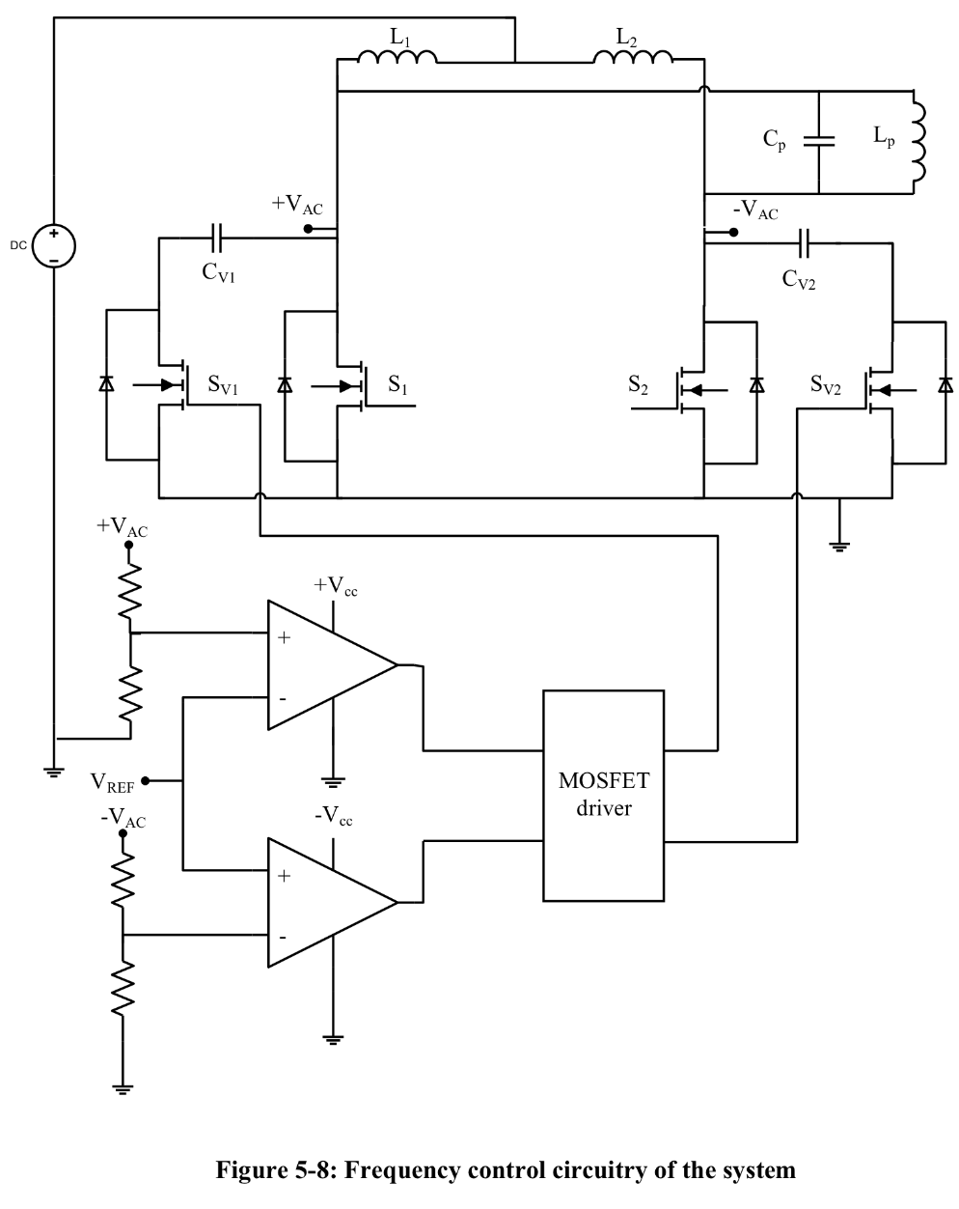
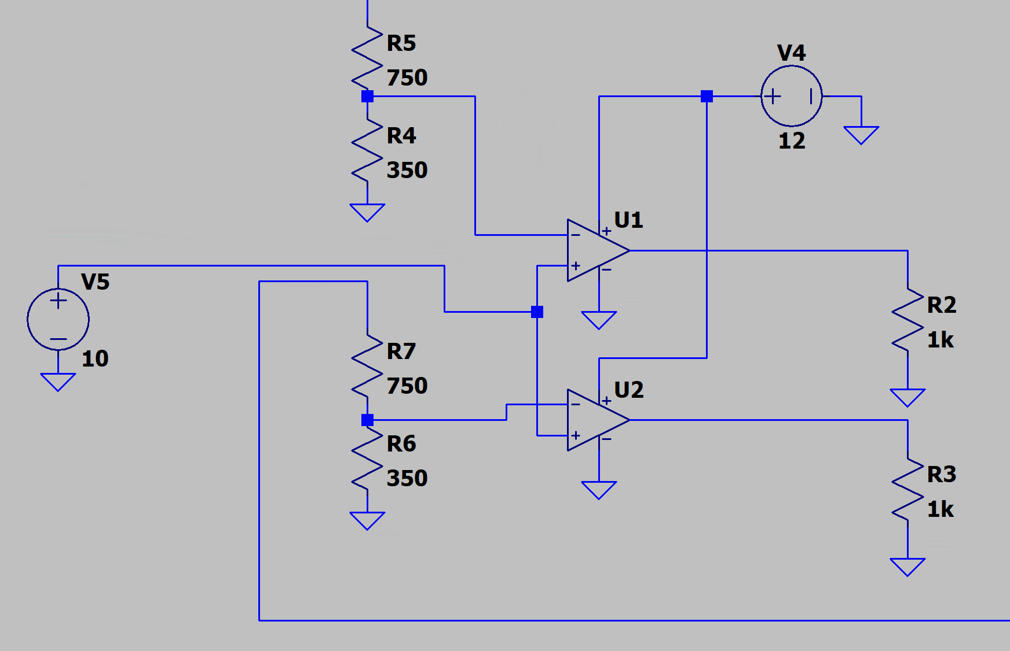
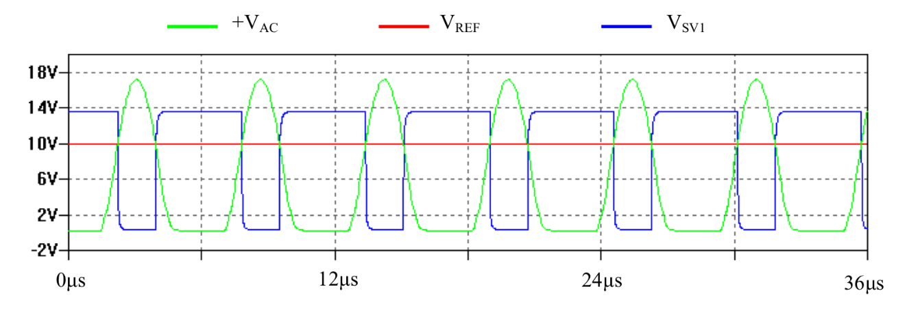

Last Week – frequency control circuitry
This week – steeper rise and fall, simulate MOSFET driver, connect Sv1
And Sv2 signals to gate

