Slide 1
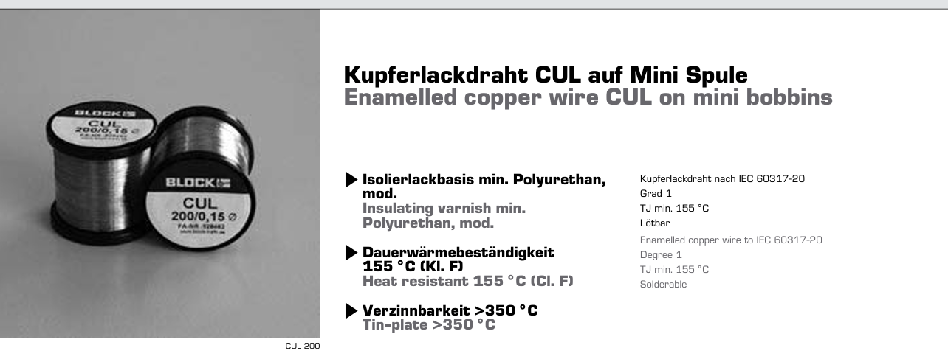
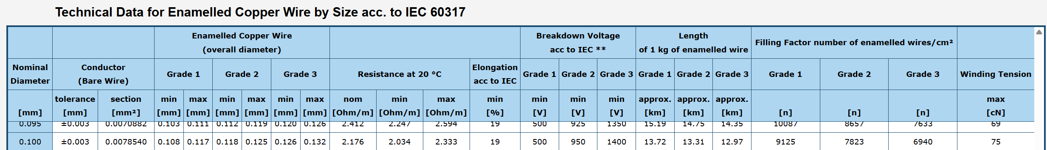
Inductance/µH | 4.0-4.2
Resistance/Ω | 0.097-0.182
Breakdown Voltage/V | 500 (worst case scenario)
Methodology
Inductance and resistance are measured via LCR meter at 100kHz frequency.
Breakdown Voltage:
Datasheet Source
IEC 60317 Source

