Slide 1
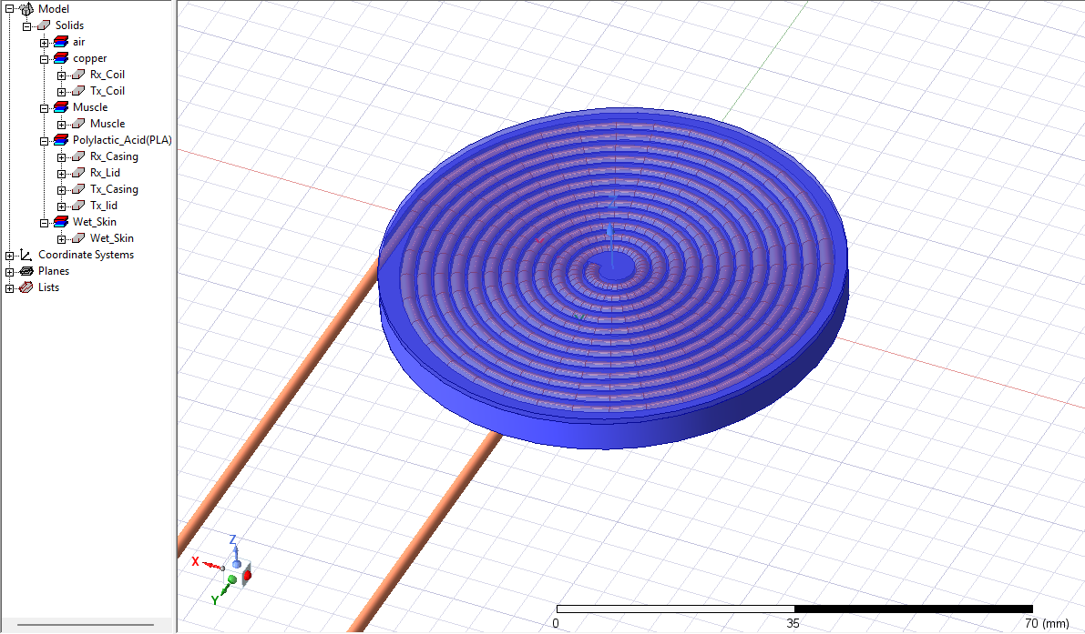
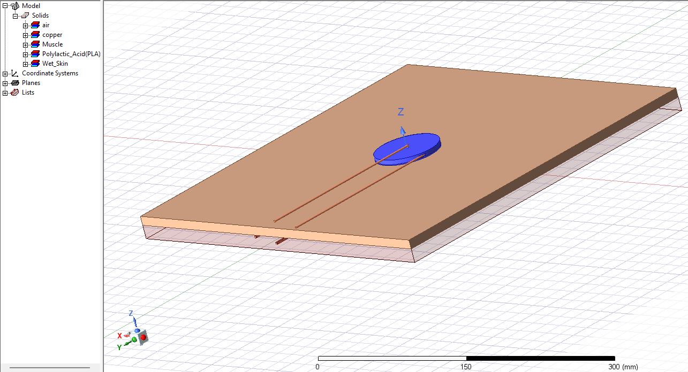
Ansys Simulation – Effect of Skin and Casing on coil performance
Future Plan:
More simulations
Investigate the coil casing material (medical-grade silicon)

