Slide 1
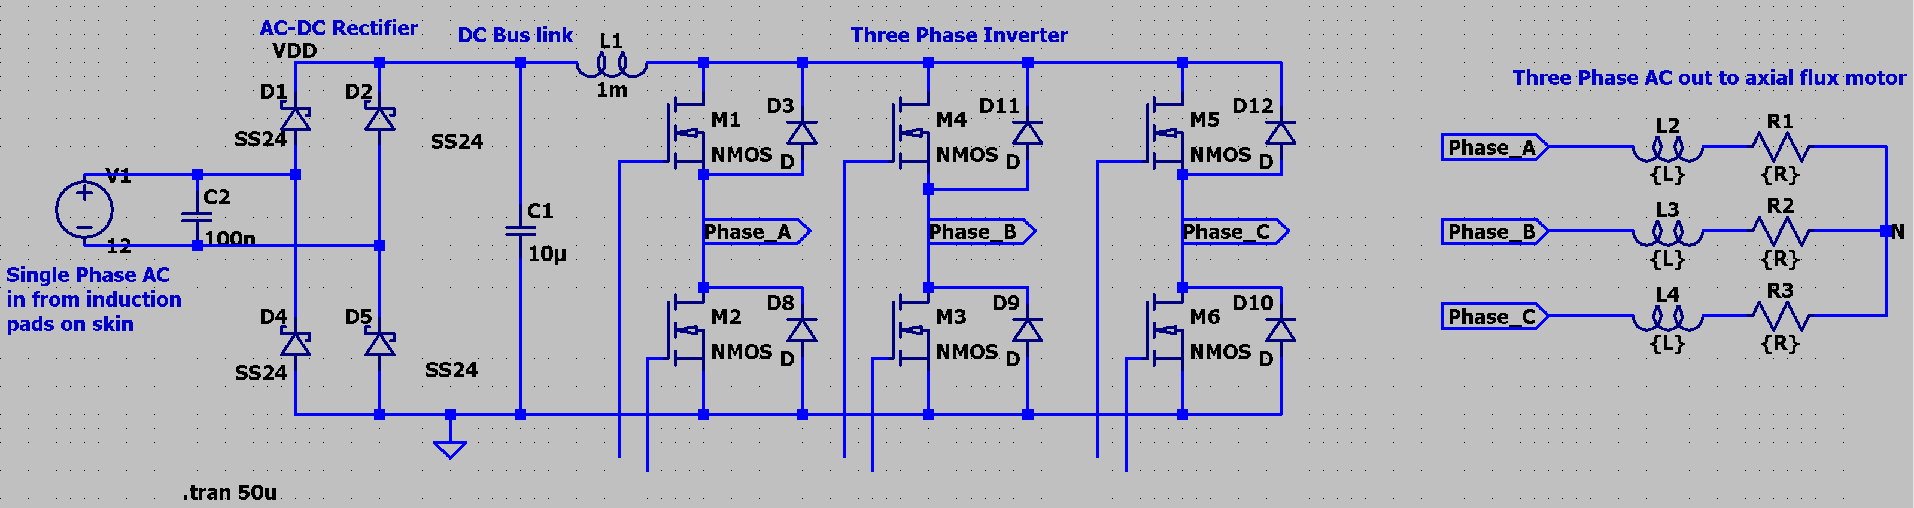
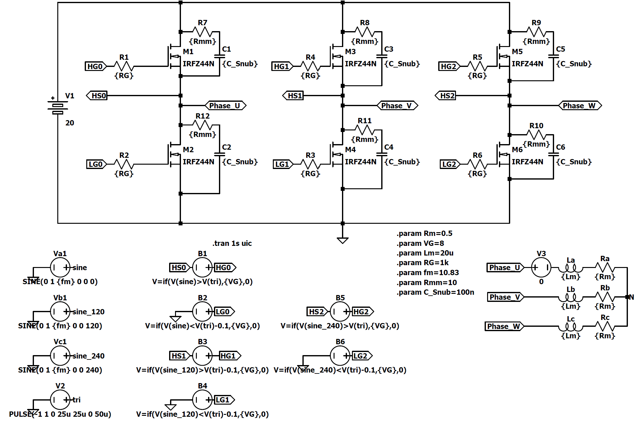
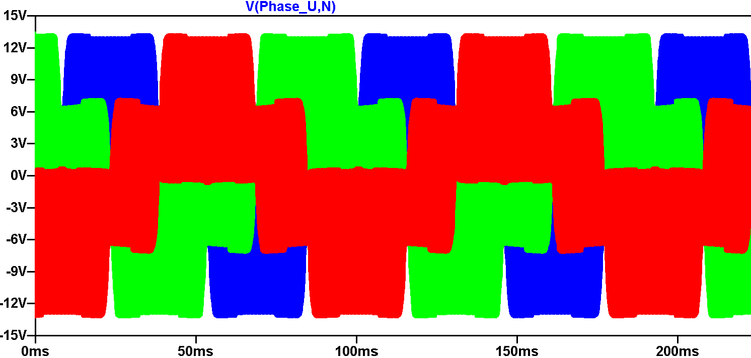
The Generalised Circuit made Last week
Gate Driver Chosen:
3 X IR2110
Progress made this Week – Main Focus Simulating the three phase Inverter
f = 10.83Hz
Steps for this week:
Implement this logic into the IR2110 Gate driver
Develop a system with a microcontroller for adaptive frequency change for resting, sleeping and exercising

