Slide 1
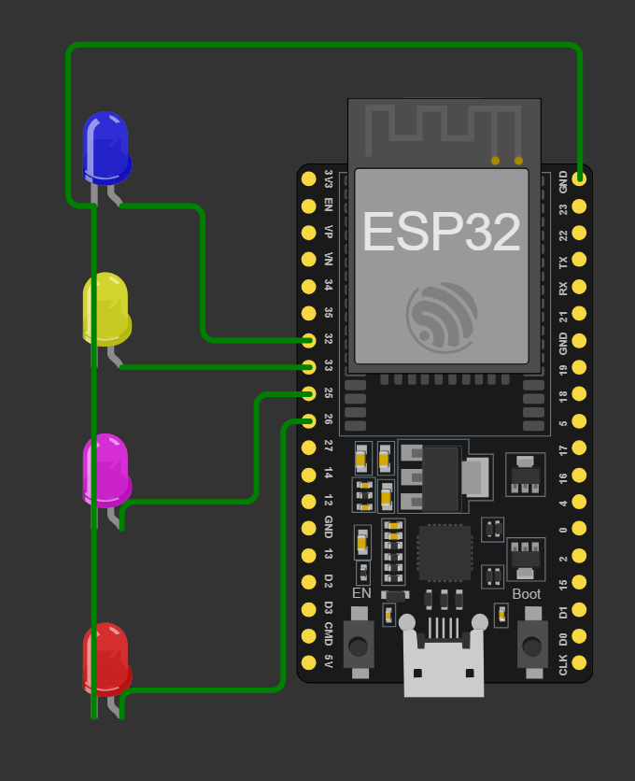
Last week ago: Finished code for PWM and finished Wokwi simulations.
Started on PCB design and layouts for original inverter design.
This week: Discussions about new inverter, implement any discussed changes.
Then adjust PCB and begin PWM for rectifier

