Slide 1
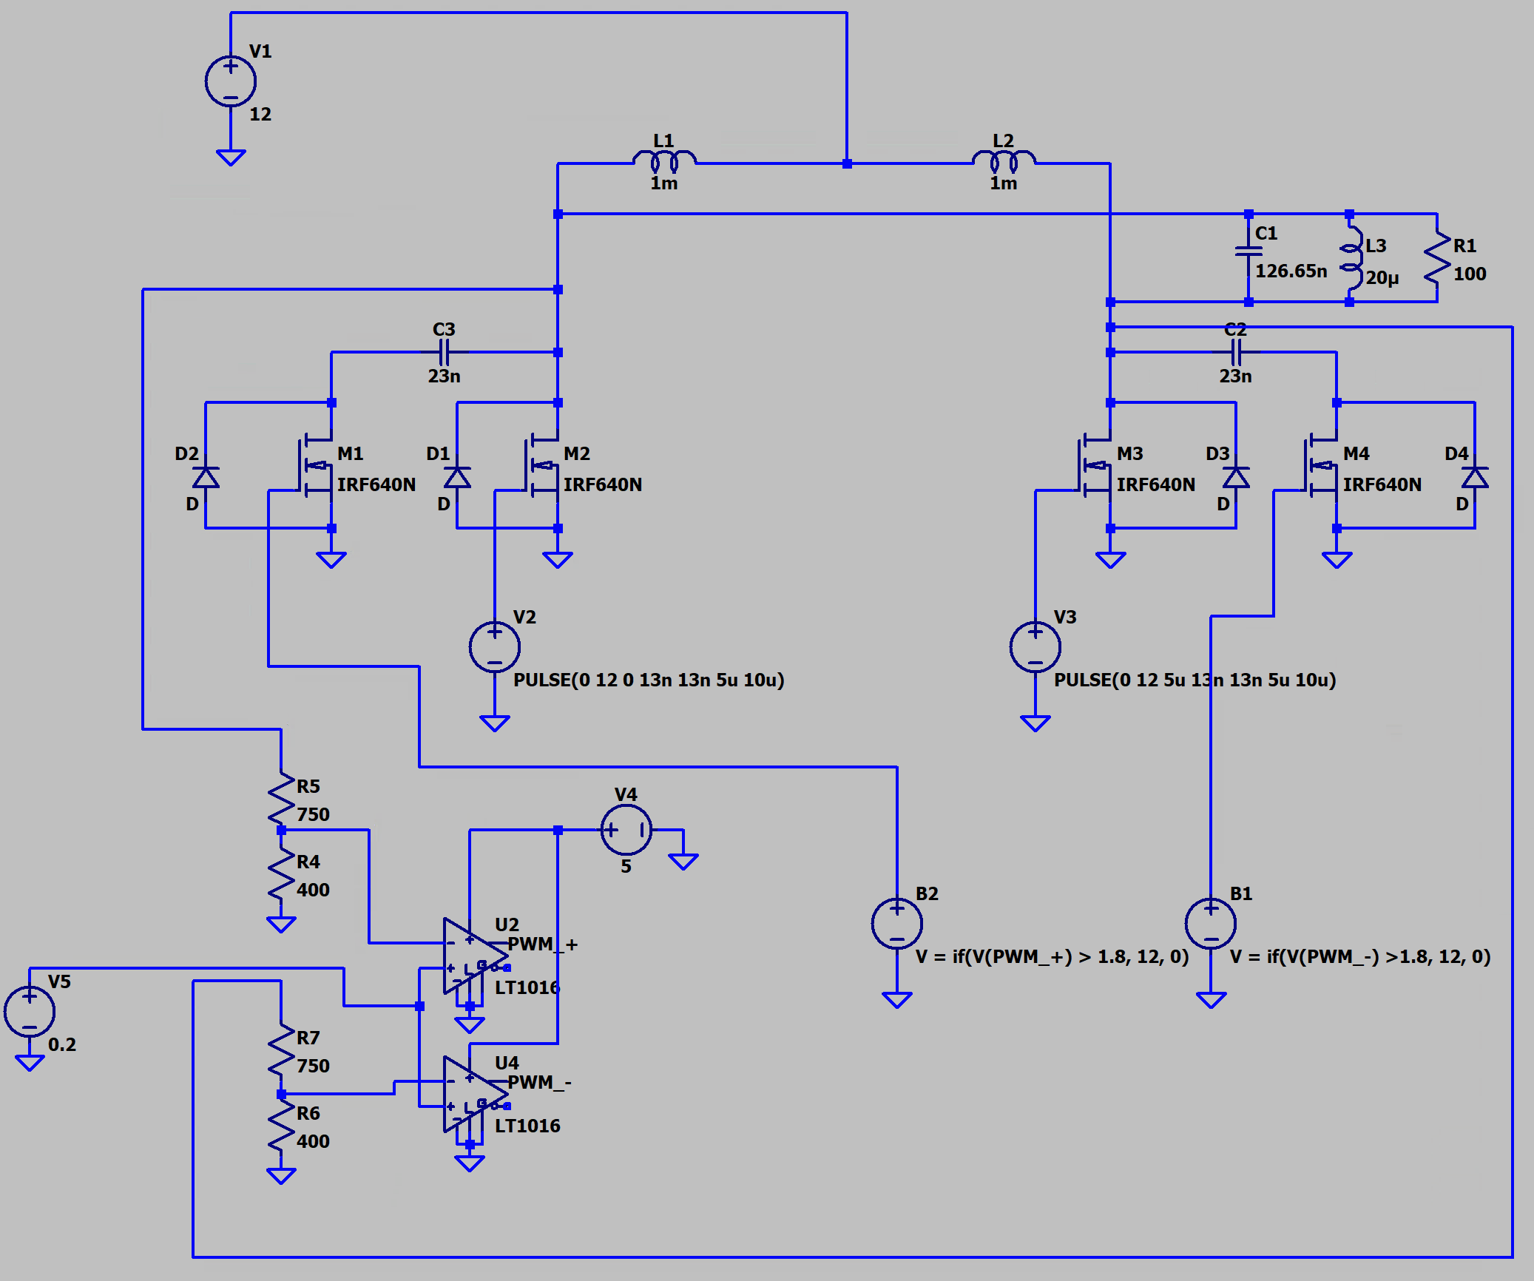
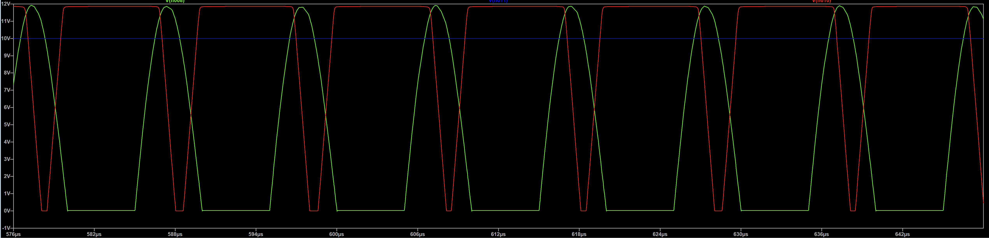
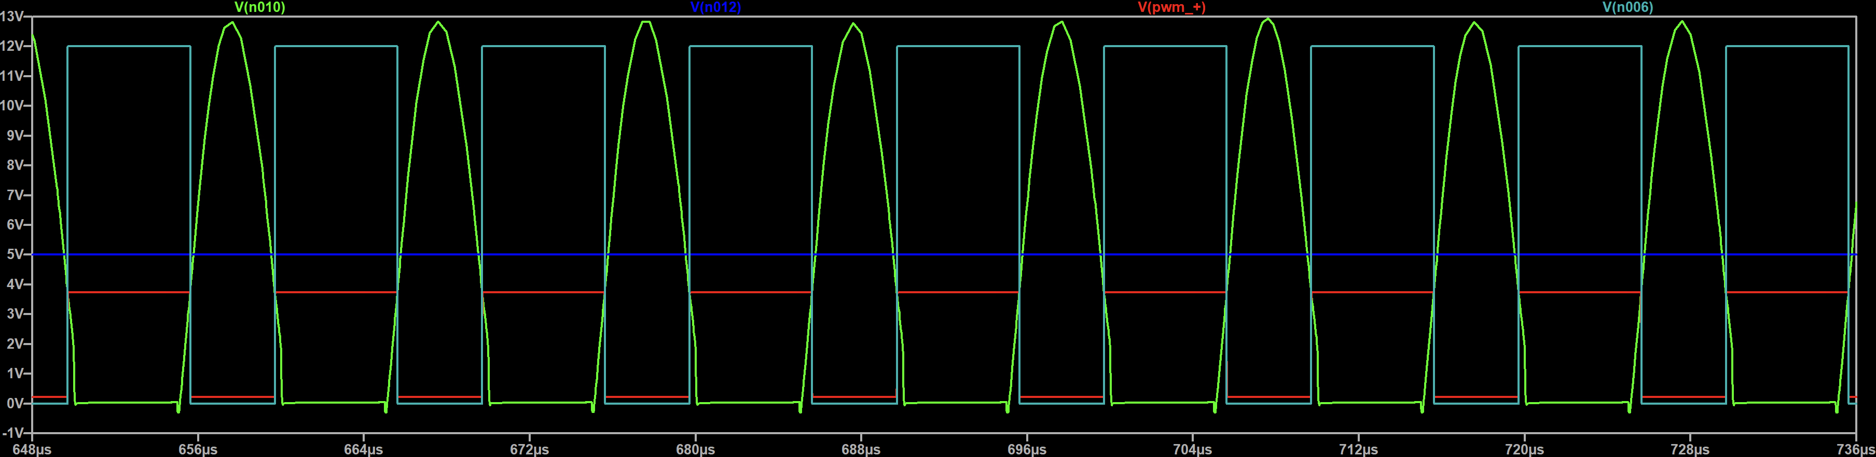
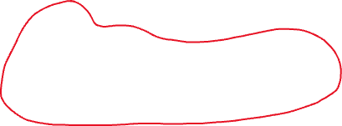
Past Week – swapped opamps to comparators, and used behavioural
voltage sources to simulate mosfet gate drivers.
This week – combine the circuits, try and find a more proper
solution/spice model for the gate driver

