Slide 1
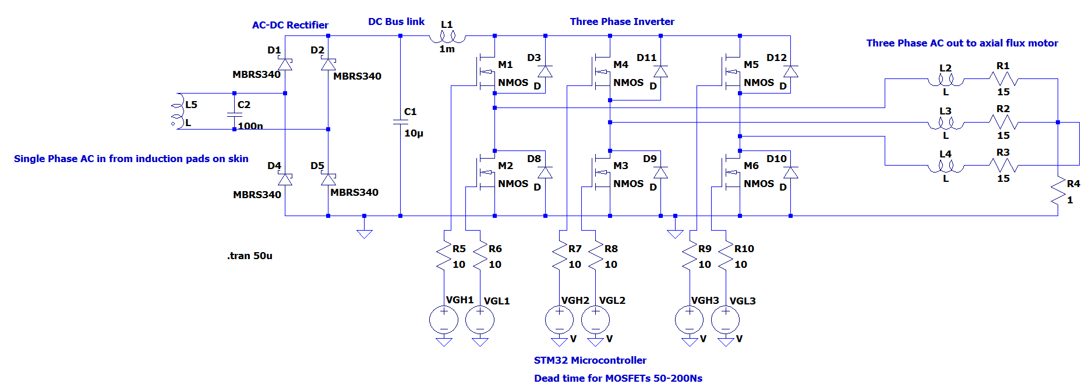
Motor Control – Safety Measures
Current Sense Amplifier
Gate Driver IC
Kian’s LTSpice Schematic:
Adds dead time so high-side and low-side MOSFETs aren’t on at the same time otherwise it creates a direct short.
Detects when current exceeds the safe rated limit of motor, MOSFETs, wiring or power supply.
Temperature Sensing
Bootstrap Capacitor
Need to limit internal temperature rise by reducing electrical load when temperature rises so system stays within thermal limits.
Used in half-bridge or full-bridge circuits and stores charge from driver supply which can be used to boost MOSFET gate above require voltage.

