Slide 1
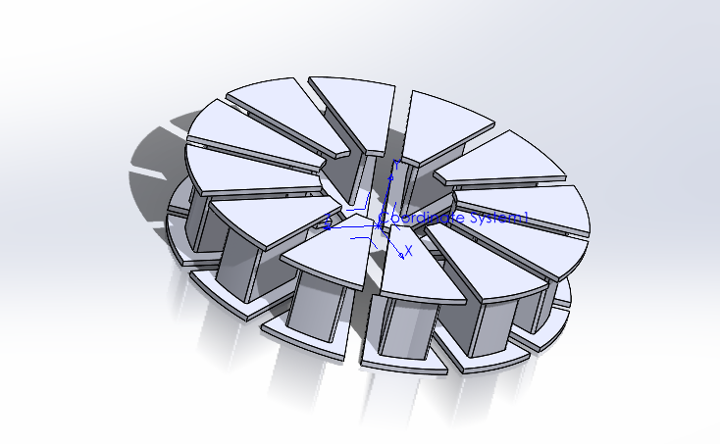
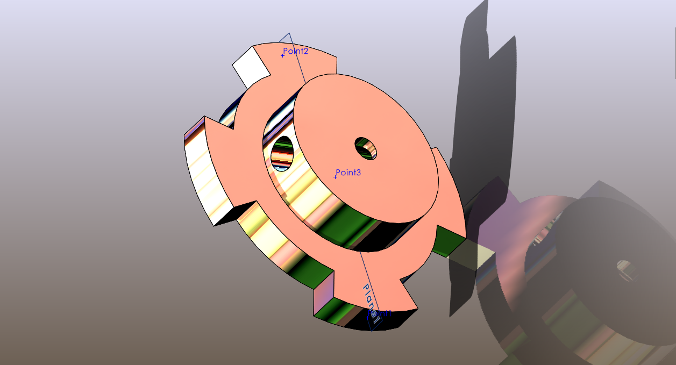
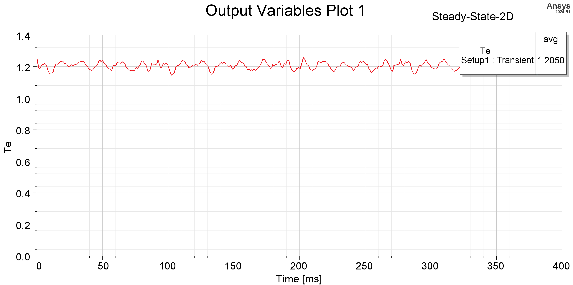
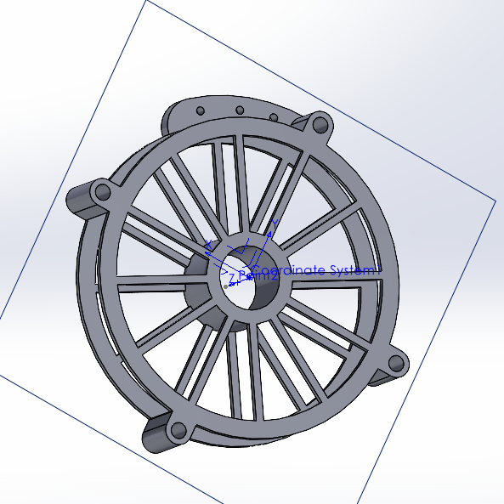
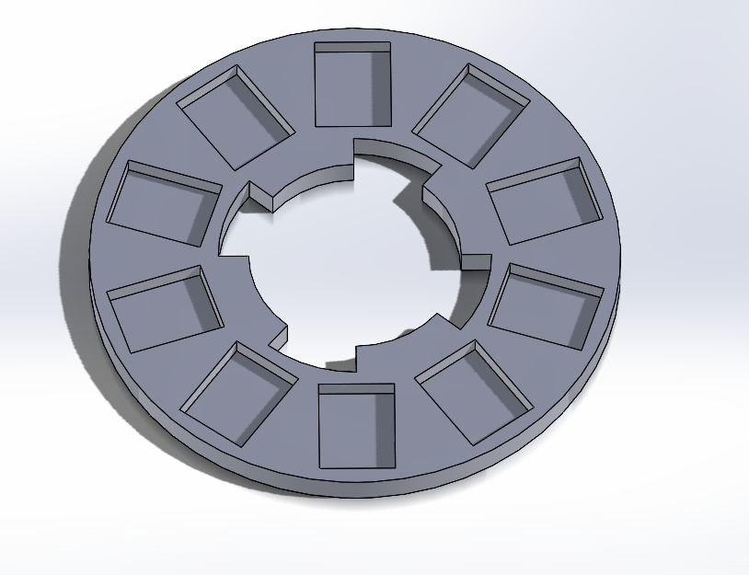
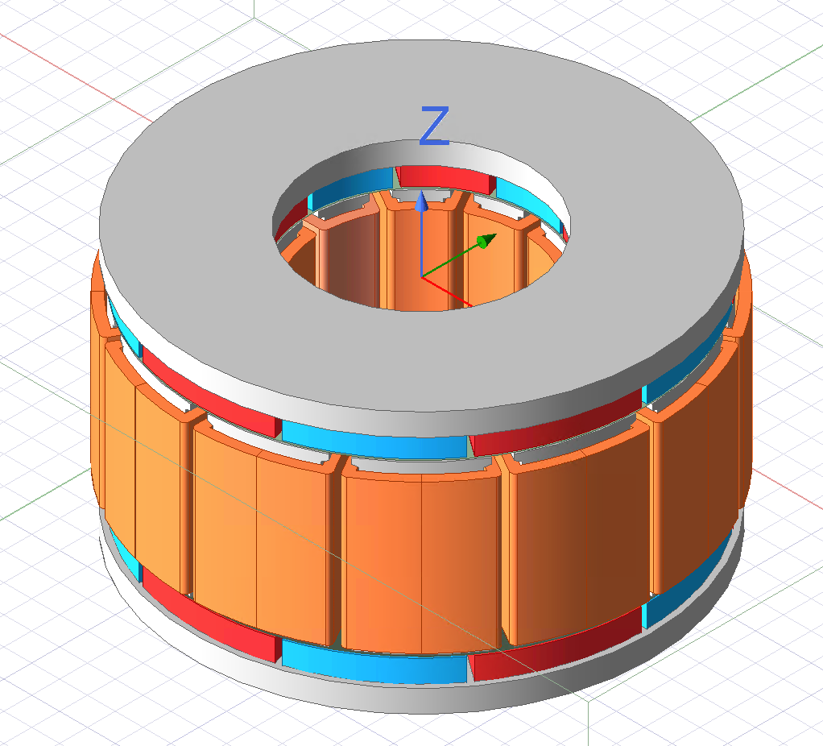
Things to buy/acquire from engineering: wire, magnets, threaded inserts
Ready to machine the prototype – design has been amended to reduce no. of turns as well as the noise.
Now need to try and produce graphs displaying the motor’s characteristics

