Slide 1
The Algorithms
Microsoft Task (Data Science)
Team members: Bakhtiyar Rakhimzhanov, Imangali Kerimbek, Renat Abdrakhmanov

Slide 2

Idea
Showing the information about the animals under extinction in Kazakhstan ( population, migration)

Slide 3

Realization
Used technologies : Python 3
Used libraries: Streamlit, Pandas,
Matplotlib, Datetime

Slide 4
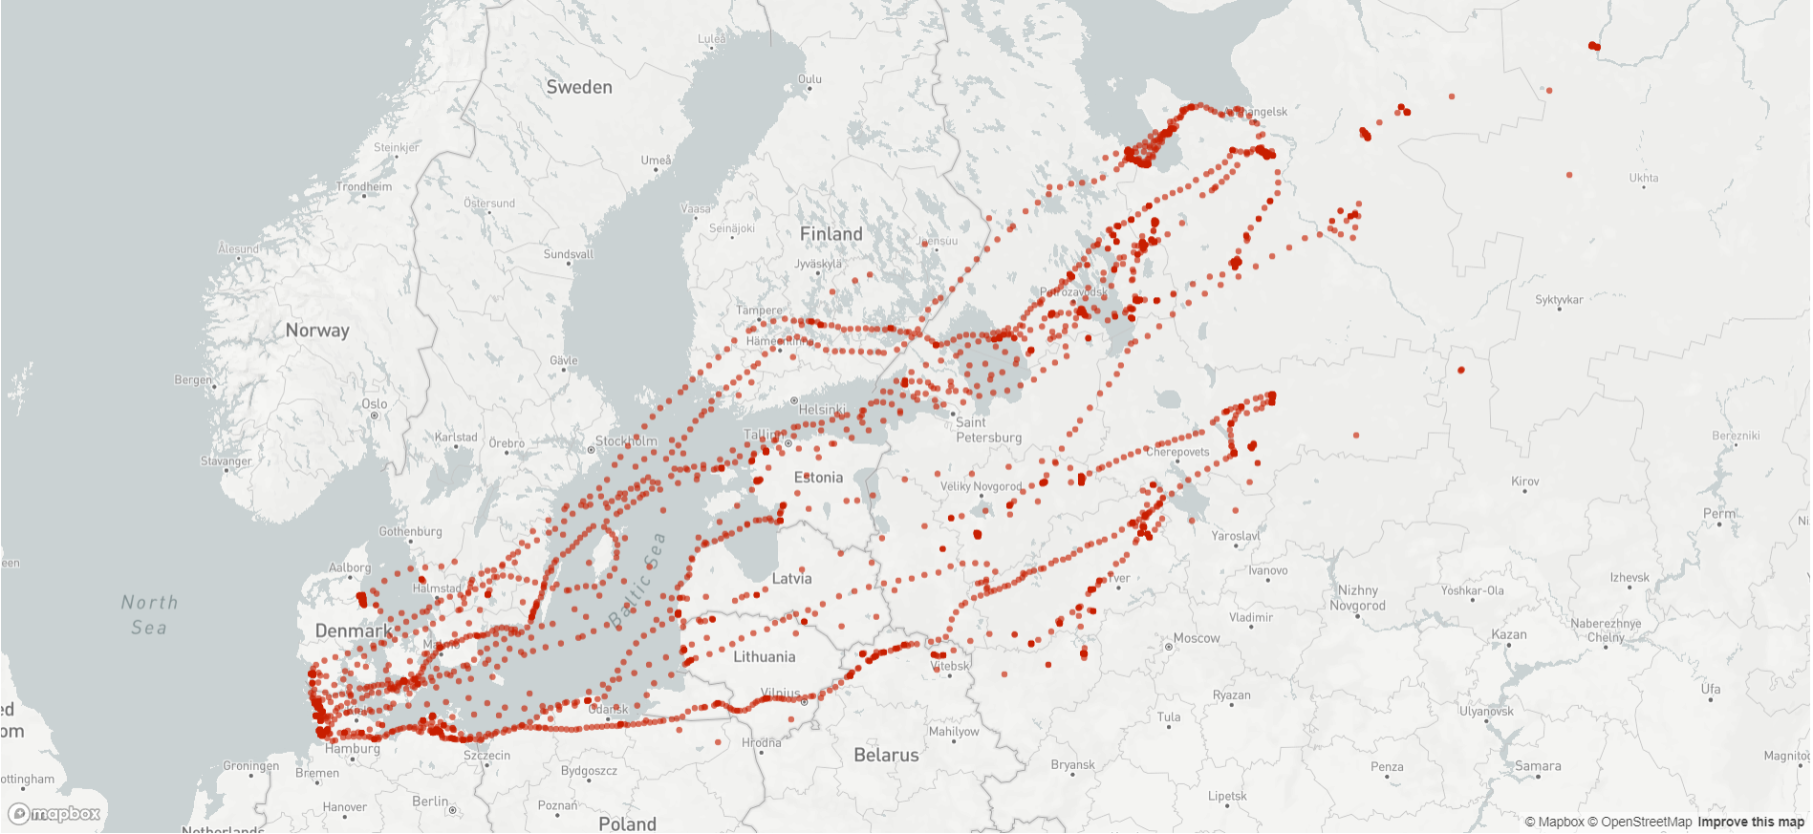
Working process 1
(Tracking animals movement)

Slide 5
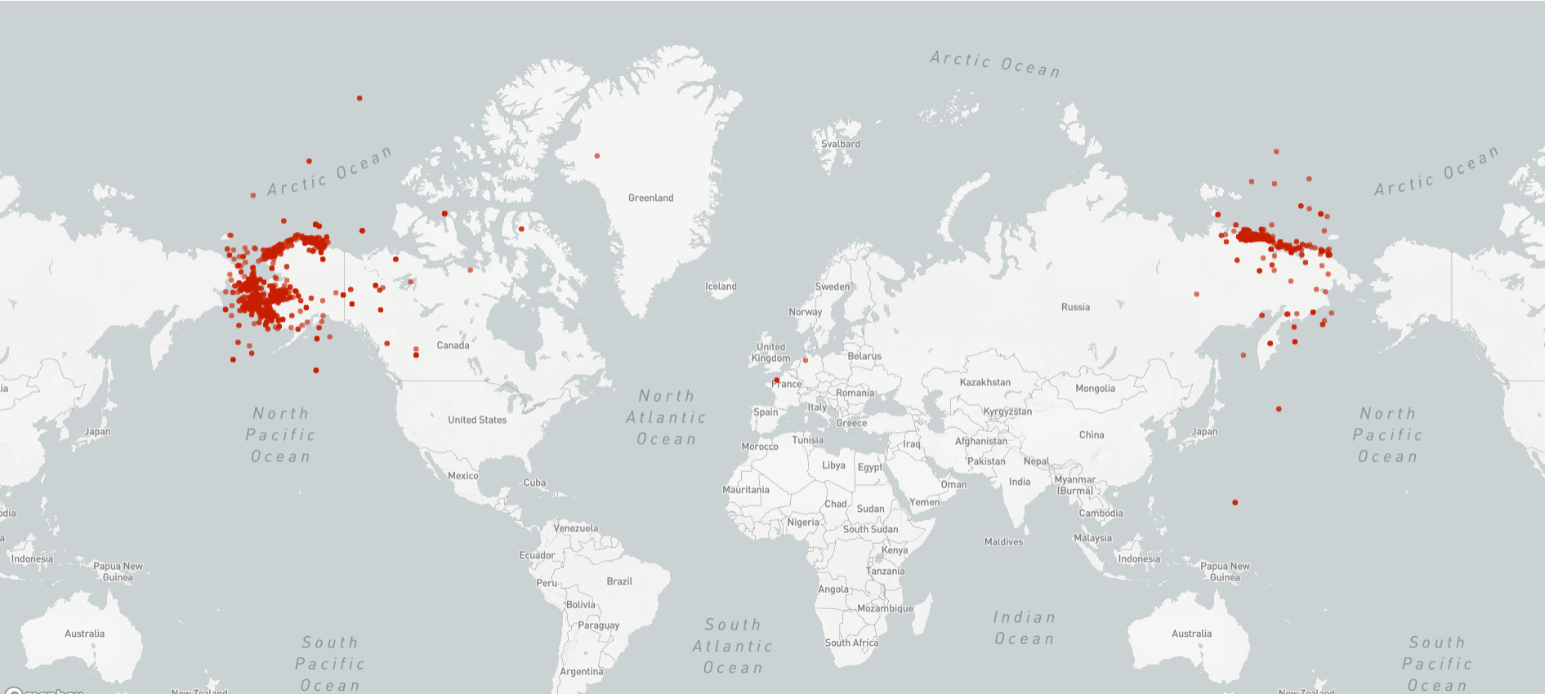
Working process 2

Slide 6
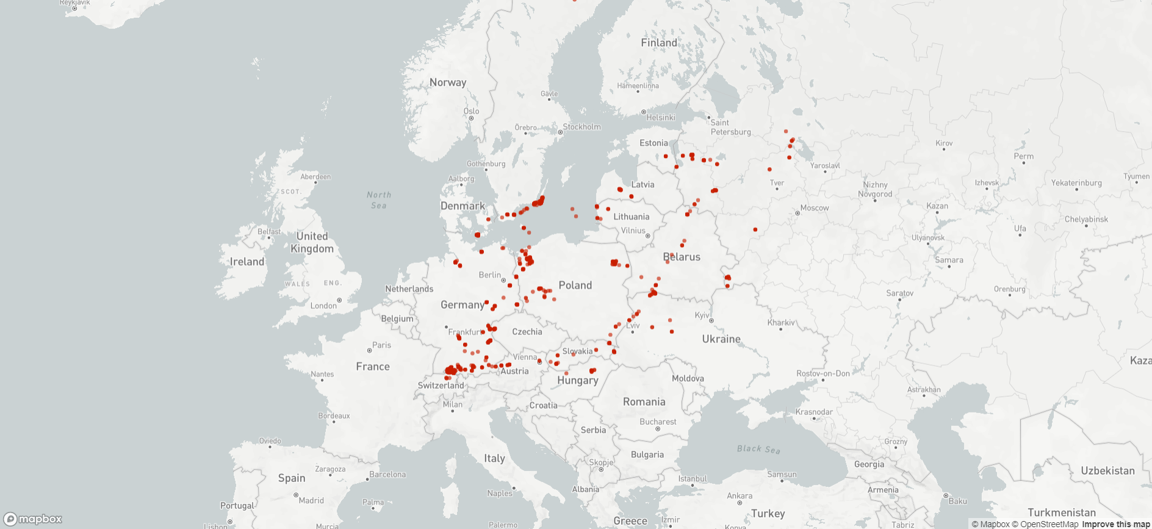
Working process 3

Slide 7
Business Potential
It can be used by scientists in order to track and research animals.
It can help the government to save the animals.
It can represent the current population of animals.

