Slide 1

Large-Scale Graph Processing
Engin Arslan
April17, 2018
April 17 2018

Slide 2



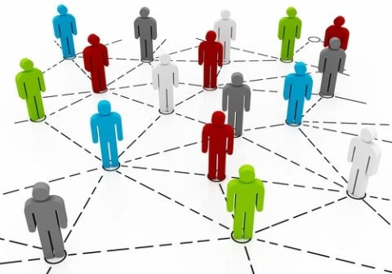
April 17 2018

Slide 3
Introduction
◮ Graphs provide a flexible abstraction for describing relationships between discrete objects.
◮ Many problems can be modeled by graphs and solved with appropriate graph algorithms.
April 17 2018

Slide 4
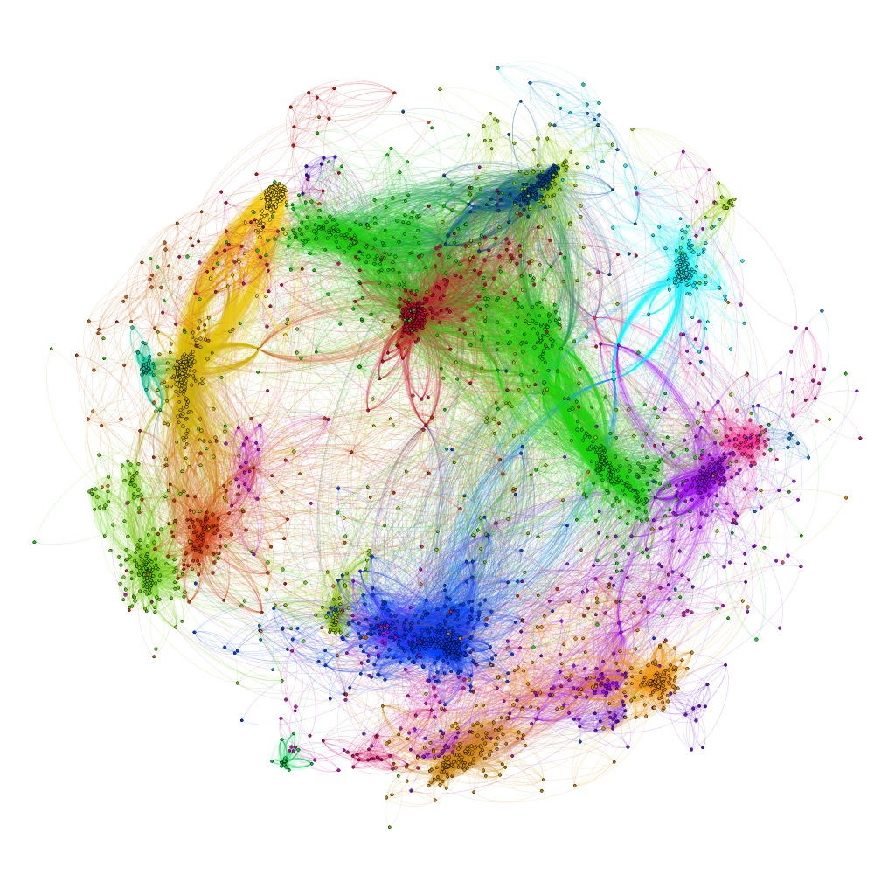
Large Graph
April 17 2018

Slide 5
Large-Scale Graph Processing
◮ Large graphs need large-scale processing.
◮ A large graph either cannot fit into memory of single computer or it fits with huge cost.
April 17 2018

Slide 6



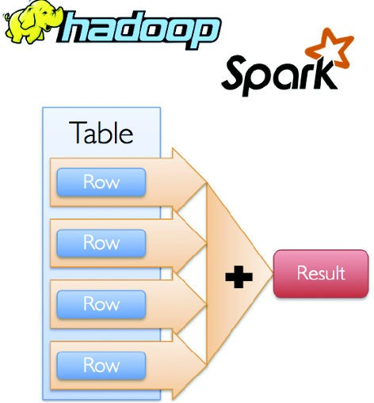
Question
Can we use platforms like MapReduce or Spark, which are based on data-parallel model, for large-scale graph proceeding?
April 17 2018

Slide 7
Data-Parallel Model for Large-Scale Graph Processing
◮ The platforms that have worked well for developing parallel applications are not necessarily effective for large-scale graph problems.
◮ Why?
April 17 2018

Slide 8
Graph Algorithms Characteristics (1/2)
◮ Unstructured problems
Difficult to extract parallelism based on partitioning of the data: the irregular structure of graphs.
Limited scalability: unbalanced computational loads resulting from poorly partitioned data.
April 17 2018

Slide 9
Graph Algorithms Characteristics (1/2)
◮ Unstructured problems
Difficult to extract parallelism based on partitioning of the data: the irregular structure of graphs.
Limited scalability: unbalanced computational loads resulting from poorly partitioned data.
◮ Iterative processing
Many graphs algorithms need multiple rounds of processing to converge to a result
April 17 2018

Slide 10
Graph Algorithms Characteristics (2/2)
◮ Inter-task communication
The nature of graph algorithms require tasks to exchange information to solve the problem
April 17 2018

Slide 11

Proposed Solution
Graph-Parallel Processing
April 17 2018

Slide 12
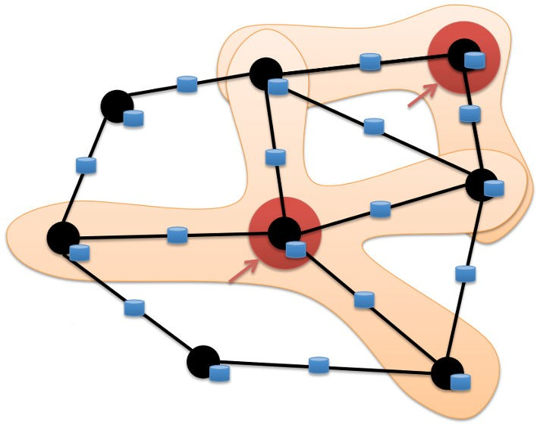
Proposed Solution
Graph-Parallel Processing
◮ Computation typically depends on the neighbors.
April 17 2018

Slide 13



Graph-Parallel Processing
◮ Restricts the types of computation.
◮ New techniques to partition and distribute graphs.
◮ Exploit graph structure.
◮ Executes graph algorithms orders-of-magnitude faster than more general data-parallel systems.
April 17 2018

Slide 14
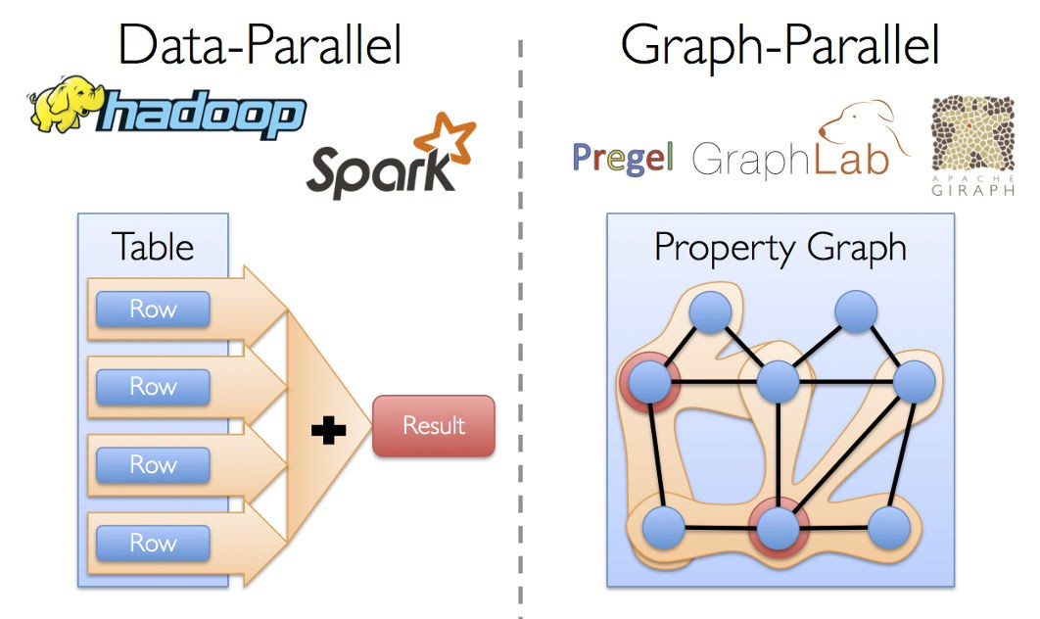
Data-Parallel vs. Graph-Parallel Computation
April 17 2018

Slide 15

Data-Parallel vs. Graph-Parallel Computation
◮ Data-parallel computation
Record-centric view of data.
Parallelism: processing independent data on separate resources.
◮ Graph-parallel computation
Vertex-centric view of graphs.
Parallelism: partitioning graph (dependent) data across processing resources, and resolving dependencies (along edges) through iterative computation and communication.
April 17 2018

Slide 16
Outline
◮ Pregel
◮ GraphLab
◮ PowerGraph
◮ GraphX
April 17 2018

Slide 17
April 17 2018

Slide 18
Pregel
◮ Large-scale graph-parallel processing platform developed at Google.
◮ Inspired by bulk synchronous parallel (BSP) model.
April 17 2018

Slide 19
Bulk Synchronous Parallel (1/2)
◮ It is a parallel programming model.
◮ The model consists of:
A set of processor-memory pairs.
A communications network that delivers messages in a point- to-point manner.
A mechanism for the efficient barrier synchronization for all or a subset of the processes.
There are no special combining, replicating, or broadcasting facilities.
April 17 2018

Slide 20
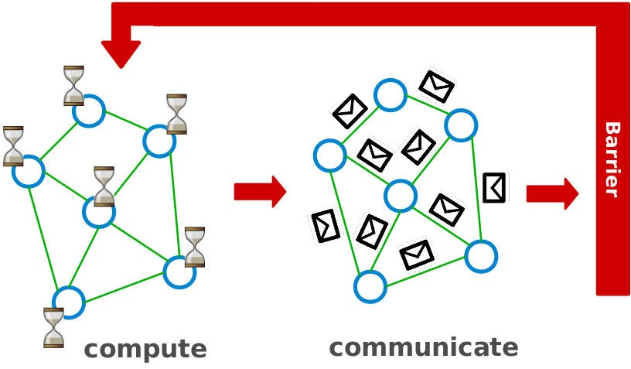

Bulk Synchronous Parallel (2/2)
All vertices update in parallel (at the same time).
April 17 2018

Slide 21
Vertex-Centric Programs
◮ Think like a vertex.
◮ Each vertex computes individually its value: in parallel
◮ Each vertex can see its local context, and updates its value accordingly.
April 17 2018

Slide 22
Data Model
◮ A directed graph that stores the program state, e.g., the current value.
April 17 2018

Slide 23
Execution Model (1/3)
◮ Applications run in sequence of iterations: supersteps
April 17 2018

Slide 24
Execution Model (1/3)
◮ Applications run in sequence of iterations: supersteps
◮ During a superstep, user-defined functions for each vertex is invoked (method Compute()): in parallel
April 17 2018

Slide 25
Execution Model (1/3)
◮ Applications run in sequence of iterations: supersteps
◮ During a superstep, user-defined functions for each vertex is invoked (method Compute()): in parallel
◮ A vertex in superstep S can:
reads messages sent to it in superstep S-1.
sends messages to other vertices: receiving at superstep S+1.
modifies its state.
April 17 2018

Slide 26
Execution Model (1/3)
◮ Applications run in sequence of iterations: supersteps
◮ During a superstep, user-defined functions for each vertex is invoked (method Compute()): in parallel
◮ A vertex in superstep S can:
reads messages sent to it in superstep S-1.
sends messages to other vertices: receiving at superstep S+1.
modifies its state.
◮ Vertices communicate directly with one another by sending messages.
April 17 2018

Slide 27
Execution Model (2/3)
◮ Superstep 0: all vertices are in the active state.
April 17 2018

Slide 28
Execution Model (2/3)
◮ Superstep 0: all vertices are in the active state.
◮ A vertex deactivates itself by voting to halt: no further work to do.

Slide 29
Execution Model (2/3)
◮ Superstep 0: all vertices are in the active state.
◮ A vertex deactivates itself by voting to halt: no further work to do.
◮ A halted vertex can be active if it receives a message.

Slide 30
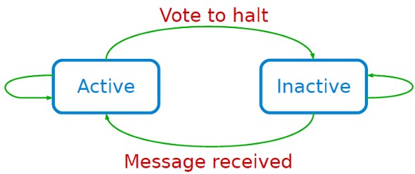
Execution Model (2/3)
◮ Superstep 0: all vertices are in the active state.
◮ A vertex deactivates itself by voting to halt: no further work to do.
◮ A halted vertex can be active if it receives a message.
◮ The whole algorithm terminates when:
All vertices are simultaneously inactive.
There are no messages in transit.
April 17 2018

Slide 31
Execution Model (3/3)
◮ Aggregation: a mechanism for global communication, monitoring, and data.
May 13-15, 2014
24 / 116

Slide 32
Execution Model (3/3)
◮ Aggregation: a mechanism for global communication, monitoring, and data.
◮ Runs after each superstep.
◮ Each vertex can provide a value to an aggregator in superstep S.
◮ The system combines those values and the resulting value is made available to all vertices in superstep S + 1.
April 17 2018

Slide 33
Execution Model (3/3)
◮ Aggregation: a mechanism for global communication, monitoring, and data.
◮ Runs after each superstep.
◮ Each vertex can provide a value to an aggregator in superstep S.
◮ The system combines those values and the resulting value is made available to all vertices in superstep S + 1.
◮ A number of predefined aggregators, e.g., min, max, sum.
◮ Aggregation operators should be commutative and associative.
April 17 2018

Slide 34
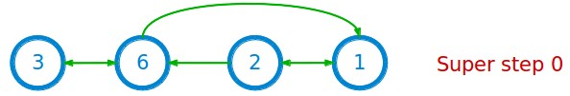
Example: Max Value (1/4)
i_val := val
for each message m
if m > val then
val := m
if i_val == val then
vote_to_halt
else
for each neighbor v
send_message(v, val)
April 17 2018

Slide 35
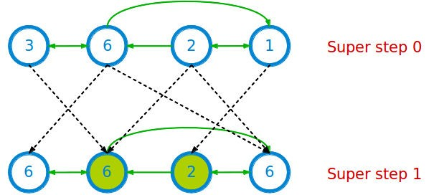
Example: Max Value (2/4)
i_val := val
for each message m
if m > val then
val := m
if i_val == val then
vote_to_halt
else
for each neighbor v
send_message(v, val)
April 17 2018

Slide 36
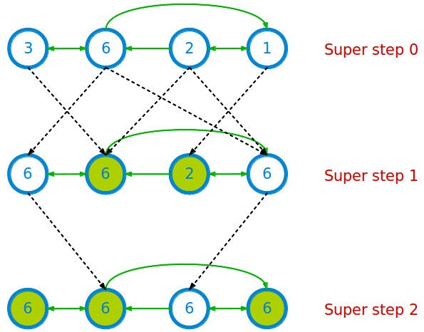
Example: Max Value (3/4)
i_val := val
for each message m
if m > val then
val := m
if i_val == val then
vote_to_halt
else
for each neighbor v
send_message(v, val)
April 17 2018

Slide 37
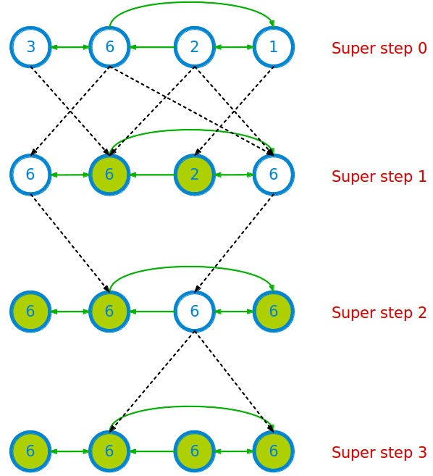
Example: Max Value (4/4)
i_val := val
for each message m
if m > val then
val := m
if i_val == val then
vote_to_halt
else
for each neighbor v
send_message(v, val)
April 17 2018

Slide 38
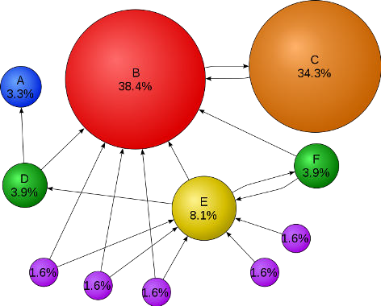
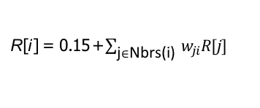
Example: PageRank
◮ Update ranks in parallel.
◮ Iterate until convergence.
R[i ] = 0.15 +$\sum_{\text{j}∈\text{Nbrs}\text{(}\text{i}\text{) }}{w_{ji}R[j]}$
April 17 2018

Slide 39
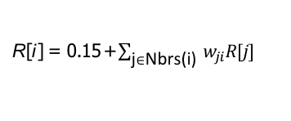
Example: PageRank
Pregel_PageRank(i, messages):
// receive all the messages
total = 0
foreach(msg in messages):
total = total + msg
// update the rank of this vertex
R[i] = 0.15 + total
// send new messages to neighbors
foreach(j in out_neighbors[i]):
sendmsg(R[i] * wij) to vertex j
R[i ] = 0.15 +$\sum_{\text{j}∈\text{Nbrs}\text{(}\text{i}\text{) }}{w_{ji}R[j]}$
April 17 2018

Slide 40
Partitioning the Graph
◮ The pregel library divides a graph into a number of partitions.
◮ Each consisting of a set of vertices and all of those vertices’ outgoing edges.
◮ Vertices are assigned to partitions based on their vertex-ID (e.g., hash(ID)).
April 17 2018

Slide 41
Implementation (1/4)
◮ Master-worker model.
◮ User programs are copied on machines.
◮ One copy becomes the master.
April 17 2018

Slide 42
Implementation (2/4)
◮ The master is responsible for
Coordinating workers activity.
Determining the number of partitions.
◮ Each worker is responsible for
Maintaining the state of its partitions.
Executing the user’s Compute() method on its vertices.
Managing messages to and from other workers.
April 17 2018

Slide 43
Implementation (3/4)
◮ The master assigns one or more partitions to each worker.
April 17 2018

Slide 44
Implementation (3/4)
◮ The master assigns one or more partitions to each worker.
◮ The master assigns a portion of user input to each worker.
Set of records containing an arbitrary number of vertices and edges.
If a worker loads a vertex that belongs to that worker’s partitions, the appropriate data structures are immediately updated.
Otherwise the worker enqueues a message to the remote peer that owns the vertex.
April 17 2018

Slide 45
Implementation (4/4)
◮ After the input has finished loading, all vertices are marked as active.
◮ The master instructs each worker to perform a superstep.
◮ After the computation halts, the master may instruct each worker to save its portion of the graph.
April 17 2018

Slide 46
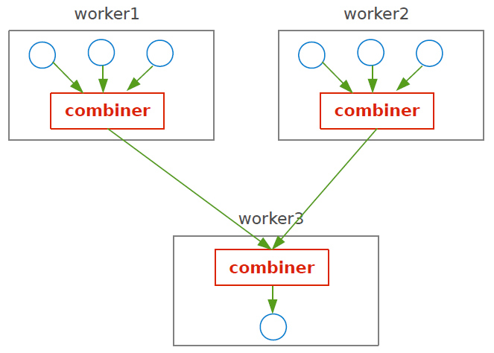
Combiner
◮ Sending a message between workers incurs some overhead: use combiner.
◮ This can be reduced in some cases: sometimes vertices only care about a summary value for the messages it is sent (e.g., min, max, sum, avg).
April 17 2018

Slide 47
Fault Tolerance (1/2)
◮ Fault tolerance is achieved through checkpointing.
◮ At start of each superstep, master tells workers to save their state:
Vertex values, edge values, incoming messages
Saved to persistent storage
◮ Master saves aggregator values (if any).
◮ This is not necessarily done at every superstep: costly
April 17 2018

Slide 48
Fault Tolerance (2/2)
◮ When master detects one or more worker failures:
All workers revert to last checkpoint.
Continue from there.
That is a lot of repeated work.
At least it is better than redoing the whole job.
April 17 2018

Slide 49
Pregel Summary
◮ Bulk Synchronous Parallel model
◮ Vertex-centric
◮ Superstep: sequence of iterations
◮ Master-worker model
◮ Communication: message passing
April 17 2018

Slide 50
Pregel Limitations
◮ Inefficient if different regions of the graph converge at different speed.
◮ Can suffer if one task is more expensive than the others.
◮ Runtime of each phase is determined by the slowest machine.
April 17 2018

Slide 51

April 17 2018

Slide 52
Data Model
◮ A directed graph that stores the program state, called data graph.
April 17 2018

Slide 53
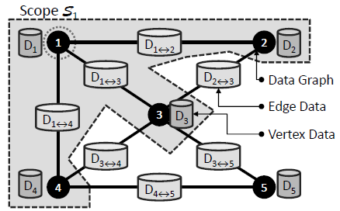
Vertex Scope
◮ The scope of vertex v is the data stored in vertex v , in all adjacent vertices and adjacent edges.
April 17 2018

Slide 54
Execution Model (1/4)
◮ Rather than adopting a message passing as in Pregel, GraphLab allows the user defined function of a vertex to read and modify any of the data in its scope.
April 17 2018

Slide 55
Execution Model (2/4)
◮ Update function: user-defined function similar to Compute in Pregel.
◮ Can read and modify the data within the scope of a vertex.
◮ Schedules the future execution of other update functions.
April 17 2018

Slide 56
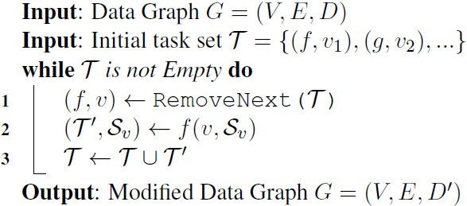
Execution Model (3/4)
◮ After executing an update function (f, g, · · ·) the modified scope data in S_{v} is written back to the data graph.
◮ Each task in the set of tasks T , is a tuple (f, v) consisting of an update function f and a vertex v.
April 17 2018

Slide 57
Execution Model (4/4)
◮ Sync function: similar to aggregate in Pregel.
◮ Maintains global aggregates.
◮ Performs periodically in the background.
April 17 2018

Slide 58
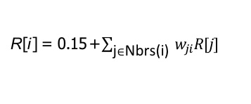
Example: PageRank
GraphLab_PageRank(i)
// compute sum over neighbors
total = 0
foreach(j in in_neighbors(i)):
total = total + R[j] * wji
// update the PageRank
R[i] = 0.15 + total
// trigger neighbors to run again
foreach(j in out_neighbors(i)):
signal vertex-program on j
R[i ] = 0.15 +$\sum_{\text{j}∈\text{Nbrs}\text{(}\text{i}\text{) }}{w_{ji}R[j]}$
April 17 2018

Slide 59
Data Consistency (1/3)
◮ Overlapped scopes: race-condition in simultaneous execution of two update functions.
April 17 2018

Slide 60
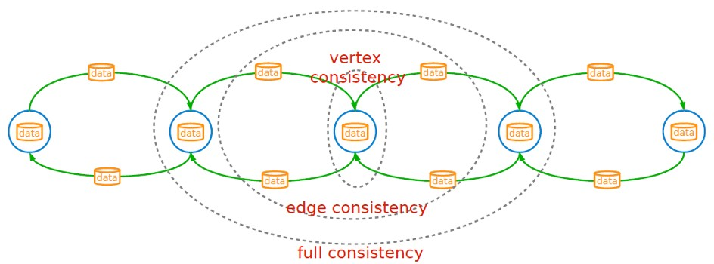
Data Consistency (1/3)
◮ Overlapped scopes: race-condition in simultaneous execution of two update functions.
◮ Full consistency: during the execution f (v), no other function reads or modifies data within the v scope.
April 17 2018

Slide 61
Data Consistency (1/3)
◮ Overlapped scopes: race-condition in simultaneous execution of two update functions.
◮ Full consistency: during the execution f (v), no other function reads or modifies data within the v scope.
◮ Edge consistency: during the execution f (v), no other function reads or modifies any of the data on v or any of the edges adjacent to v.
April 17 2018

Slide 62
Data Consistency (1/3)
◮ Overlapped scopes: race-condition in simultaneous execution of two update functions.
◮ Full consistency: during the execution f (v), no other function reads or modifies data within the v scope.
◮ Edge consistency: during the execution f (v), no other function reads or modifies any of the data on v or any of the edges adja- cent to v.
◮ Vertex consistency: during the execution f (v), no other function will be applied to v.
April 17 2018

Slide 63
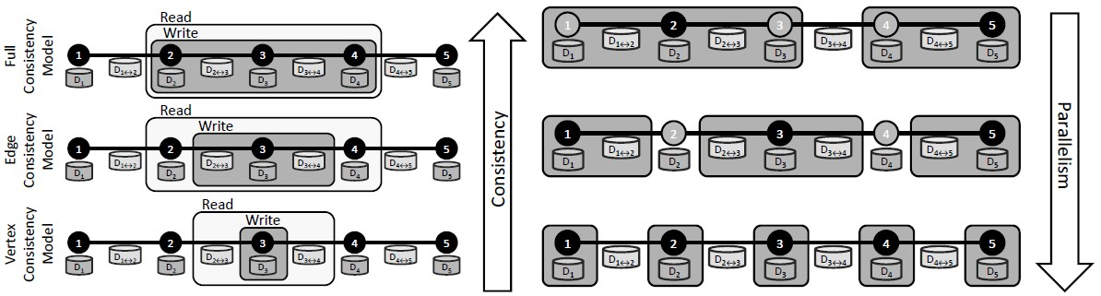
Data Consistency (2/3)
Consistency vs. Parallelism
[Low, Y., GraphLab: A Distributed Abstraction for Large Scale Machine Learning (Doctoral dissertation, University of California), 2013.]
April 17 2018

Slide 64
Data Consistency (3/3)
◮ Proving the correctness of a parallel algorithm: sequential consistency
April 17 2018

Slide 65
Data Consistency (3/3)
◮ Proving the correctness of a parallel algorithm: sequential consistency
◮ Sequential consistency: if for every parallel execution, there exists a sequential execution of update functions that produces an equivalent result.
April 17 2018

Slide 66
Data Consistency (3/3)
◮ Proving the correctness of a parallel algorithm: sequential consistency
◮ Sequential consistency: if for every parallel execution, there exists a sequential execution of update functions that produces an equivalent result.
◮ A simple method to achieve serializability is to ensure that the scopes of concurrently executing update functions do not overlap.
The full consistency model is used.
The edge consistency model is used and update functions do not modify data in adjacent vertices.
The vertex consistency model is used and update functions only access local vertex data.
April 17 2018

Slide 67
GraphLab Implementation
◮ Shared memory implementation
◮ Distributed implementation
April 17 2018

Slide 68
GraphLab Implementation
◮ Shared memory implementation
◮ Distributed implementation
April 17 2018

Slide 69
Tasks Schedulers (1/2)
◮ In what order should the tasks (vertex-update function pairs) be called?
April 17 2018

Slide 70
Tasks Schedulers (1/2)
◮ In what order should the tasks (vertex-update function pairs) be called?
A collection of base schedules, e.g., round-robin, and synchronous.
Set scheduler: enables users to compose custom update schedules.
April 17 2018

Slide 71
Tasks Schedulers (2/2)
◮ How to add new task in the queue?
April 17 2018

Slide 72
Tasks Schedulers (2/2)
◮ How to add new task in the queue?
FIFO: only permits task creation but do not permit task reordering.
Prioritized: permits task reordering at the cost of increased overhead.
April 17 2018

Slide 73
Consistency
◮ Implemented in C++ using PThreads for parallelism.
◮ Consistency: read-write lock
April 17 2018

Slide 74
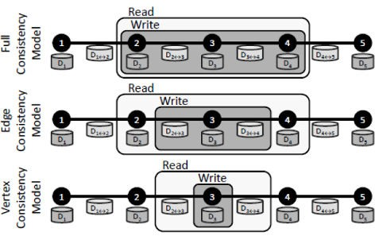
Consistency
◮ Implemented in C++ using PThreads for parallelism.
◮ Consistency: read-write lock
◮ Vertex consistency
Central vertex (write-lock)
◮ Edge consistency
Central vertex (write-lock)
Adjacent vertices (read-locks)
◮ Full consistency
Central vertex (write-locks)
Adjacent vertices (write-locks)
◮ Deadlocks are avoided by acquiring locks sequentially following a canonical order.
April 17 2018

Slide 75
GraphLab Implementation
◮ Shared memory implementation
◮ Distributed implementation
April 17 2018

Slide 76
Distributed Implementation
◮ Graph partitioning
How to efficiently load, partition and distribute the data graph across machines?
◮ Consistency
How to achieve consistency in the distributed setting?
◮ Fault tolerance
April 17 2018

Slide 77
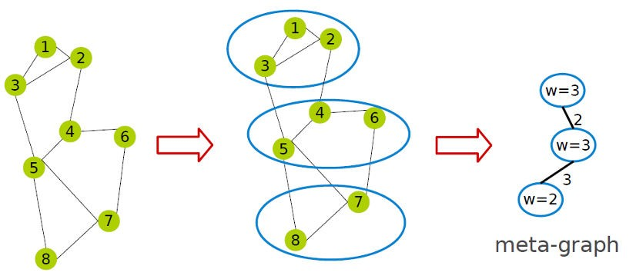
Graph Partitioning - Phase 1 (1/2)
◮ Two-phase partitioning.
◮ Partitioning the data graph into k parts, called atom: k ≫ number of machines.
◮ meta-graph: the graph of atoms (one vertex for each atom).
◮ Atom weight: the amount of data it stores.
◮ Edge weight: the number of edges crossing the atoms.
April 17 2018

Slide 78
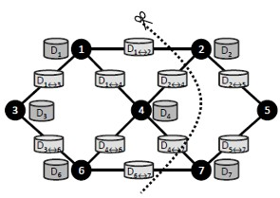
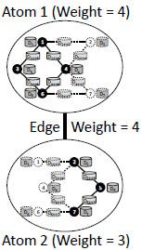
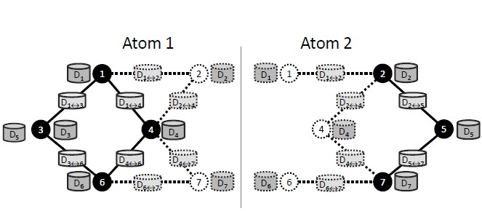
Graph Partitioning - Phase 1 (2/2)
◮ Each atom is stored as a separate file on a distributed storage system, e.g., HDFS.
◮ Each atom file is a simple binary that stores interior and the ghosts of the partition information.
◮ Ghost: set of vertices and edges adjacent to the partition boundary.
April 17 2018

Slide 79
Graph Partitioning - Phase 2
◮ Meta-graph is very small.
◮ A fast balanced partition of the meta-graph over the physical machines.
◮ Assigning graph atoms to machines.
April 17 2018

Slide 80
Consistency
◮ To achieve a serializable parallel execution of a set of dependent tasks.
◮ Chromatic Engine
◮ Distributed Locking Engine
April 17 2018

Slide 81
Consistency - Chromatic Engine
◮ Construct a vertex coloring: assigns a color to each vertex such that no adjacent vertices share the same color.
April 17 2018

Slide 82
Consistency - Chromatic Engine
◮ Construct a vertex coloring: assigns a color to each vertex such that no adjacent vertices share the same color.
◮ Edge consistency: executing, synchronously, all update tasks associated with vertices of the same color before proceeding to the next color.
April 17 2018

Slide 83
Consistency - Chromatic Engine
◮ Construct a vertex coloring: assigns a color to each vertex such that no adjacent vertices share the same color.
◮ Edge consistency: executing, synchronously, all update tasks associated with vertices of the same color before proceeding to the next color.
◮ Full consistency: no vertex shares the same color as any of its distance two neighbors.
April 17 2018

Slide 84
Consistency - Chromatic Engine
◮ Construct a vertex coloring: assigns a color to each vertex such that no adjacent vertices share the same color.
◮ Edge consistency: executing, synchronously, all update tasks associated with vertices of the same color before proceeding to the next color.
◮ Full consistency: no vertex shares the same color as any of its distance two neighbors.
◮ Vertex consistency: assigning all vertices the same color.
April 17 2018

Slide 85
Consistency - Distributed Locking Engine
◮ Associating a readers-writer lock with each vertex.
◮ Vertex consistency
Central vertex (write-lock)
◮ Edge consistency
Central vertex (write-lock), Adjacent vertices (read-locks)
◮ Full consistency
Central vertex (write-locks), Adjacent vertices (write-locks)
◮ Deadlocks are avoided by acquiring locks sequentially following a canonical order.
April 17 2018

Slide 86
Fault Tolerance - Synchronous
◮ The systems periodically signals all computation activity to halt.
◮ Then synchronizes all caches (ghosts) and saves to disk all data which has been modified since the last snapshot.
◮ Simple, but eliminates the systems advantage of asynchronous computation.
April 17 2018

Slide 87
GraphLab Summary
◮ Asynchronous model
◮ Vertex-centric
◮ Communication: distributed shared memory
◮ Three consistency levels: full, edge-level, and vertex-level
April 17 2018

Slide 88
Summary
◮ Pregel
Synchronous model: super-step
Message passing
◮ GraphLab
Asynchronous model: distributed shared-memory
Edge-cut partitioning
April 17 2018

Slide 89

Questions?
Acknowledgements
Some pictures were derived from the Spark web site (http://spark.apache.org/).
April 17 2018

