Slide 1

Apache HBase: the Hadoop Database

Slide 2
Agenda
Motivation
Data Model
The HBase Distributed System
Data Operations
Access APIs
Architecture

Slide 3
Motivation
Hadoop is a framework that supports operations on a large amount of data.
Hadoop includes the Hadoop Distributed File System (HDFS)
HDFS does a good job of storing large amounts of data, but lacks quick random read/write capability.
That’s where Apache HBase comes in.

Slide 4
Introduction
HBase is an open source, sparse, consistent distributed, sorted map modeled after Google’s BigTable.
Began as a project by Powerset to process massive amounts of data for natural language processing.
Developed as part of Apache’s Hadoop project and runs on top of Hadoop Distributed File System.

Slide 5
Big Picture
MapReduce Hive/Pig
Thrift/REST Gateway
Your Java Application
Java Client
ZooKeeper
HBase
HDFS
5

Slide 6
An Example Operation
The Job:
A MapReduce job needs to operate on a series of webpages matching *.cnn.com
The Table:
row key | column 1 | column 2
“com.cnn.world” | 13 | 4.5
“com.cnn.tech” | 46 | 7.8
“com.cnn.money” | 44 | 1.2 6

Slide 7
The HBase Data Model

Slide 8
Data Model, Groups of Tables
RDBMS Apache HBase
database
table
namespace
table

Slide 9
Data Model, Single Table
RDBMS
table | col1 | col2 | col3 | col4
row1
row2
row3

Slide 10
Data Model, Single Table
Apache HBase
columns are grouped into Column Families
table | fam1 |  | fam2
 | fam1:col1 | fam1:col2 | fam2:col1 | fam2:col2
row1
row2
row3

Slide 11
Sparse example
Row Key | fam1:contents | fam1:anchor
“com.cnn.www” | contents:html = “<html>...”
 | contents:html = “<html>...”
“com.bbc.www” |  | anchor:cnnsi.com = "BBC"
 |  | anchor:cnnsi.com = "BBC"

Slide 12
Data is physically stored by Column Family
table | fam1
 | fam1:col1 | fam1:col2
row1
row2
 | fam2
 | fam2:col1 | fam2:col2
row1
row2 |  | 12
actuality
concept
table | fam1 |  | fam2
 | fam1:col1 | fam1:col2 | fam2:col1 | fam2:col2
row1
row2

Slide 13
Column Families and Sharding
Shard A
Shard B
table | fam1
 | fam1:col1 | fam1:col2
row1
row2
 | fam2
 | fam2:col1 | fam2:col2
row1
row2
table | fam1
 | fam1:col1 | fam1:col2
row3
row4
 | fam2
 | fam2:col1 | fam2:col2
row3
row4

Slide 14
Data Model, Single Table
Apache HBase
(row, column) pairs are Versioned, sometimes referred to as Time Stamps
table |  | fam1 |  | fam2
 |  | fam1:col1 | fam1:col2 | fam2:col1 | fam2:col2
row1 | v1
 | v2
row2 | v1
 | v2

Slide 15
Data Model, Single Table
Apache HBase
A (row, column, version) tuple defines a Cell.
table |  | fam1 |  | fam2
 |  | fam1:col1 | fam1:col2 | fam2:col1 | fam2:col2
row1 | v1
 | v2
row2 | v1
 | v2

Slide 16
Data Model
The most basic unit is a column.
Rows are composed of columns, and those, in turn, are grouped into column families.
Columns are often referenced as family:qualifier.
A number of rows, in turn, form a table, and there can be many of them.
Each column may have multiple versions, with each distinct version contained in a separate cell.

Slide 17
HBase’s Distributed System

Slide 18

Scalability thru Sharding
Regions
rows 1 through 1000
a complete table
billions of rows...
rows 1001 through 2000
split into
etc.

Slide 19
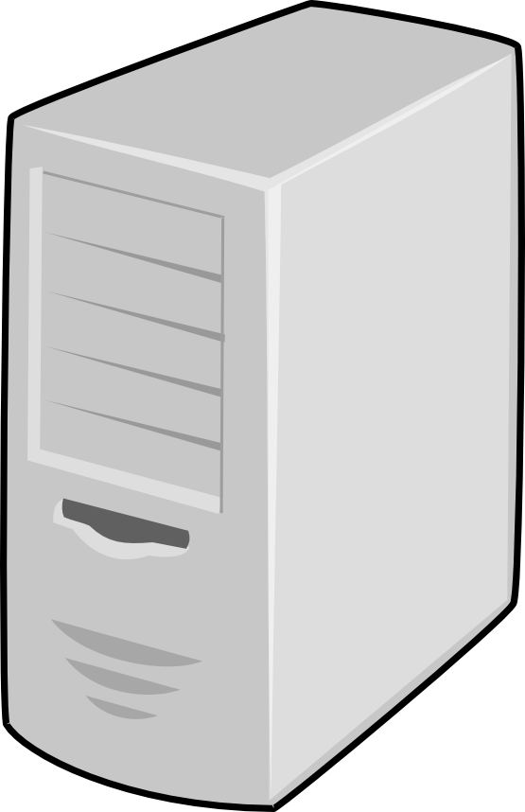



Scalability thru Sharding
Regions
RegionServers
rows 1 through 1000
Server A
rows 1001 through 2000
Server B
rows 2001 through 3000

Slide 20
Scalability thru Division of Labor
An HBase Distributed System
. . . . . . .
Master
Region
ZooKeeper
RegionServers

Slide 21
Scalability thru Division of Labor
HBase HDFS
. . . . . . .
Master
Region
ZooKeeper
RegionServers

Slide 22
Division of Labor, Master
Schema changes
Moving Regions across RegionServers (load balancing)
..
..
..
.
Region
eper RegionServers
Master
ZooKe

Slide 23

Division of Labor, ZooKeeper
Locating Regions
..
..
..
.
Region
RegionServers
ster
ZooKeeper

Slide 24

Division of Labor, RegionServer
Data operations (put, get, delete, next, etc.)
Some region splits
. . . . . . .
Region
per
RegionServers
24

Slide 25
The HBase Distributed System
Region Master
a subset of table’s rows, like a range partition
Automatically sharded
Responsible for coordinating the RegionServers
Assign regions, detects failures of RegionServers
Control some admin functions
RegionServer
Servers data for reads and writes for a group of regions.
ZooKeeper
Locate data among RegionServers

Slide 26
Availability thru Automatic Failover
DataNode failures handled by HDFS(replication)
RegionServer failures handled by Master re-assigning Regions to available RegionServers.
HMaster failover is handled automatic by having multiple HMasters.

Slide 27
. . . . . . .
Master
Region
ZooKeeper
RegionServers

Slide 28
How to Access to HBase?

Slide 29
Java Client Interfaces
Configuration holds details where to find the cluster and tunable settings.
Roughly equivalent to JDBC connection string.
HConnection represents connections to the cluster.
HBaseAdmin handles DDL operations(create,list,drop,alter,etc)
HTable is a handle on a single HBase table. Send “commands” to the table.(Put,Get,Scan,Delete).

Slide 30
Scan
//Return the result of columns called cf:qualifier from row 1 to row 1000.
HTable table = ... // instantiate HTable Scan scan = new Scan();
scan.addColumn(Bytes.toBytes("cf"),Bytes.toBytes("qualifier")); scan.setStartRow( Bytes.toBytes("row1")); // start key is inclusive scan.setStopRow( Bytes.toBytes("row1000")); // stop key is exclusive ResultScanner scanner = table.getScanner(scan)
try {
for(Result result : scanner) {
// process Result instance
}
} finally { scanner.close();
}

Slide 31
Scan
//Return the result of column family called cf from row 1 to row 1000
HTable table = ... // instantiate HTable Scan scan = new Scan(); scan.addFamily(Bytes.toBytes("cf"));
scan.setStartRow( Bytes.toBytes("row1")); // start key is inclusive scan.setStopRow( Bytes.toBytes("row1000")); // stop key is exclusive ResultScanner scanner = table.getScanner(scan)
try {
for(Result result : scanner) {
// process Result instance
}
} finally { scanner.close();
}

Slide 32
Get
Return an entire row
HTable htable = ... // instantiate HTable
Get get = new Get(Bytes.toBytes("row1")); Result r = htable.get(get);
Return column family called cf HTable htable = ... // instantiate HTable Get get = new Get(Bytes.toBytes("row1"));
get.addFamily(Bytes.toBytes("cf")); Result r = htable.get(get);
Return the column called cf:qualifier
HTable htable = ... // instantiate HTable Get get = new Get(Bytes.toBytes("row1")); get.addColumn(Bytes.toBytes("cf"),Bytes. toBytes("qualifier"));
Result r = htable.get(get);
Return column family in version2.
HTable htable = ... // instantiate HTable Get get = new Get(Bytes.toBytes("row1")); get.addFamily(Bytes.toBytes("cf")); get.setTimestamp(v2);
Result r = htable.get(get);

Slide 33
Delete
Delete an entire row
HTable htable = ... // instantiate HTable
Delete delete = new Delete(Bytes.toBytes("row1")); htable.delete(delete);
Delete the latest version of a specified column
HTable htable = ... // instantiate HTable
Delete delete = new Delete(Bytes.toBytes("row1")); delete.deleteColumn(Bytes.toBytes("cf"),Bytes. toBytes("qualifier"));
htable.delete(delete);
Delete a specified version of a specified column
HTable htable = ... // instantiate HTable Delete delete = new Delete(Bytes.toBytes ("row1")); delete.deleteColumn(Bytes.toBytes("cf"), Bytes.toBytes("qualifier"),version); htable.delete(delete);

Slide 34
Put
Put a new version of a cell using current timestamp by default
HTable htable = ... // instantiate HTable Put put = new Put(Bytes.toBytes("row1")); put.add(Bytes.toBytes("cf"),Bytes.toBytes ("qualifier"),Bytes.toBytes("data")); htable.put(put);
Overwriting an existing value
HTable htable = ... // instantiate HTable Put put = new Put(Bytes.toBytes("row1")); put.add(Bytes.toBytes("cf"),Bytes.toBytes ("qualifier"),timestamp,Bytes.toBytes ("data"));
htable.put(put);

Slide 35
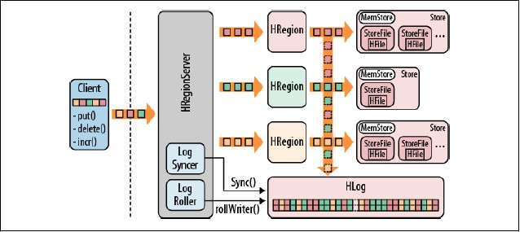

Slide 36
Implementation Details of Put
The client initiates an action that modifies data.
Modification is wrapped into a KeyValue object instance and sent over to the HRegionServer that serves the matching regions.
Once the KeyValue instance arrives, they are routed to the HRegion instances that are responsible for the given rows.
The data is written to the Write-Ahead Log, and then put into MemStore of the actual Store that holds the record.
When the memstores get to a certain size, the data is persisted in the background to the filesystem.

Slide 37
Join?
HBase does not support join.
NoSql is mostly designed for fast appends and key-based retrievals.
Joins are expensive and infrequent.
What if you still need it?
Write a MapReduce join to make it.
At Map function, read two tables. The output key should be the value on the joined attribute for table1 and table2.
At Reduce function, “join” the tuple that contains the same key.
Other implementations using Hive/Pig/...

Slide 38
Other Clients
Use some sort of proxy that translate your request into an API call.
These proxies wrap the native Java API into other protocol APIs.
Representational State Transfer(REST)
Protocol Buffers, Thrift, Avro

Slide 39
REST
is a protocol between the gateways and the clients.
uses HTTP verbs to perform an action, giving developers a wide choice of languages and programs to use.
suffers from the verbosity level of the protocol. Human- readable text, be in plain or XML-based, is used to communicate between the client and server.

Slide 40
REST
Translate the request into Java API call.
Request following the semantics defined by REST.
Region Server
Gateway Server
Rest Client Server
Sent through HTTP.
Rest Client

Slide 41
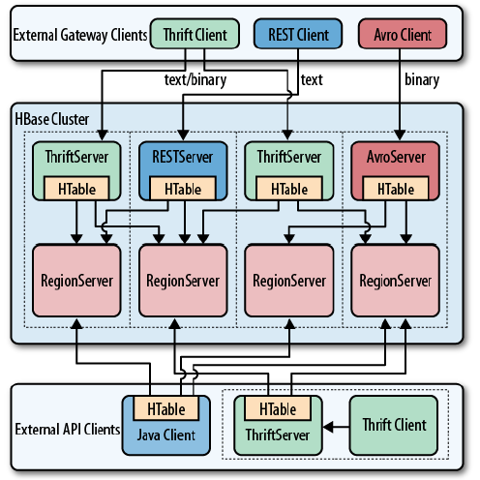
Improvements
Companies with large server farms, extensive bandwidth usage, and many disjoint services felt the need to reduce the overhead and implemented their own Remote Procedure Call(RPC) layers.
Google Protocol Buffers
Facebook Thrift
Apache Avro

Slide 42
Architecture
storage structures:
B+ Trees (typical RDBMS storage)
Log-Structured Merge-Trees(HBase)

Slide 43
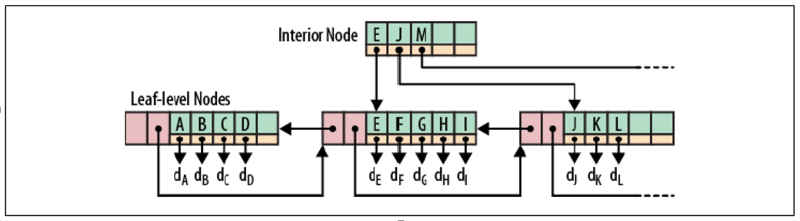
B+ Trees

Slide 44
Log-Structured Merge-Tree
Log-structured merge-trees, also known as LSM-trees, follow a different approach. Incoming data is stored in a logfile first, completely sequentially. Once the log has the modification saved, it then updates an in-memory store that holds the most recent updates for fast lookup.
When the system has accrued enough updates and starts to fill up the in- memory store, it flushes the sorted list of key → record pairs to disk, creating a new store file. Then the updates to the log can be thrown away, as all modifications have been persisted.

Slide 45
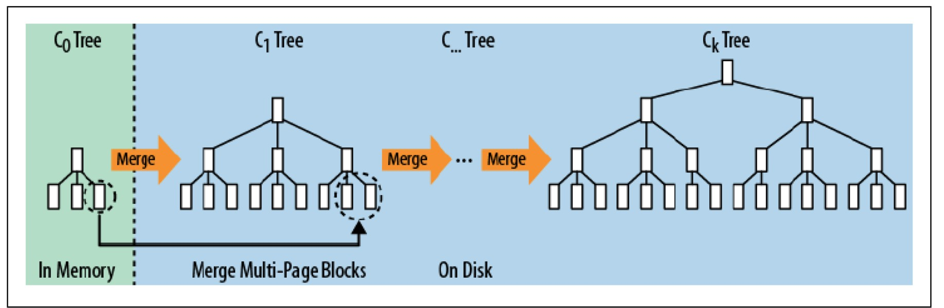
Log-Structured Merge-Tree
How a multipage block is merged from the in-memory tree into the next on-disk tree:

Slide 46
Compare: Seek VS Transfer
B+ trees work well until there are too many modifications, because they force you to perform costly optimizations to retain that advantage for a limited amount of time. The more and faster you add data at random locations, the faster the pages become fragmented again. Eventually, you may take in data at a higher rate than the optimization process takes to rewrite the existing files. The updates and deletes are done at disk seek rates, rather than disk transfer rates.
LSM-trees work at disk transfer rates and scale much better to handle large amounts of data. They also guarantee a very consistent insert rate, as they transform random writes into sequential writes using the logfile plus in-memory store.

Slide 47
Compare: Seek VS Transfer
As discussed, there are two different database paradigms: one is seek and the other is transfer.
Seek is typically found in RDBMS and is caused by the B-tree or B+ tree structures used to store the data. It operates at the disk seek rate, resulting in log(N) seeks per access.
Transfer, on the other hand, as used by LSM-trees, sorts and merges files while operating at transfer rates, and takes log(updates) operations.

Slide 48
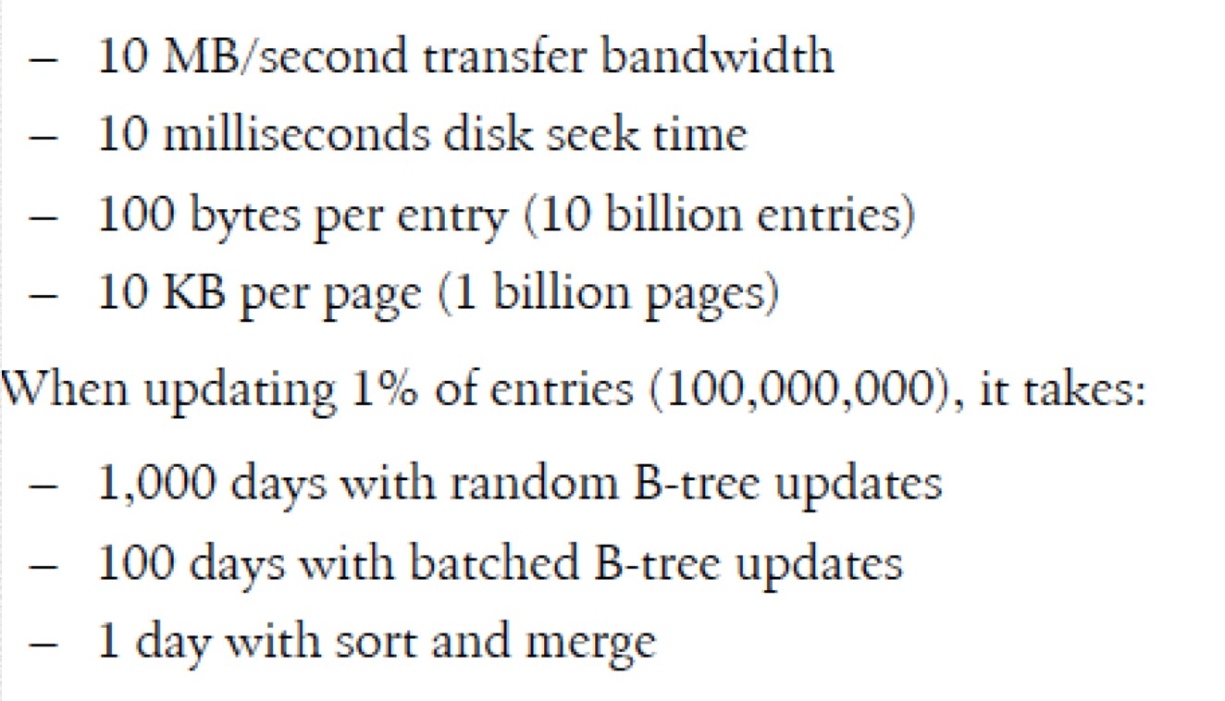
Compare: Seek VS Transfer
At scale seek, seek is inefficient compared to transfer:

Slide 49
Cluster Architecture
client finds
Region Server’s location provided
HMaster
Client
by ZooKeeper
Zoo Keeper
HMaster
Clients reads and writes rows by directly accessing Region Servers
Master assign regions and achieves load
balacing
RegionServer
RegionServer
RegionServer
HDFS

Slide 50
-ROOT- and .META.
Zookeeper records the location of -ROOT- table
-ROOT- records Region information of .META. tables
.META. records Region information of user tables
The mapping of Regions to Region Server is kept in a system table called . META. When trying to read or write data from HBase, the clients read the required Region information from the .META table and directly communicate with the appropriate Region Server. Each Region is identified by the start key (inclusive) and the end key (exclusive)

Slide 51
Communication Flow
a new client contacts the ZooKeeper ensemble(a separate cluster of ZooKeeper nodes).It does so by retrieving the server name (i.e., hostname) that hosts the -ROOT- region from ZooKeeper.
query that region server to get the server name that hosts the .META. table region containing the row key.
query the reported .META. server and retrieve the server name that has the region containing the row key the client is looking for.

Slide 52
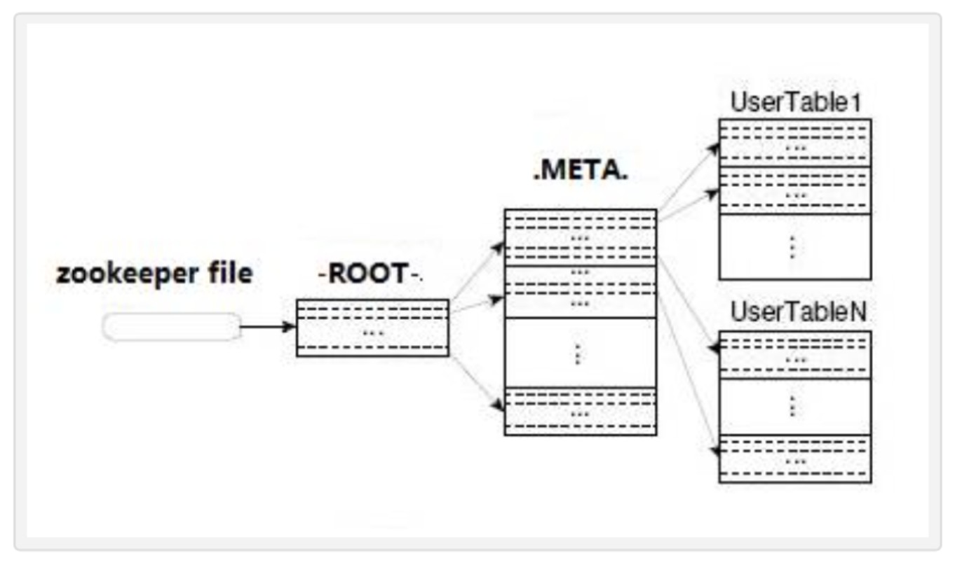
Communication Flow

Slide 53
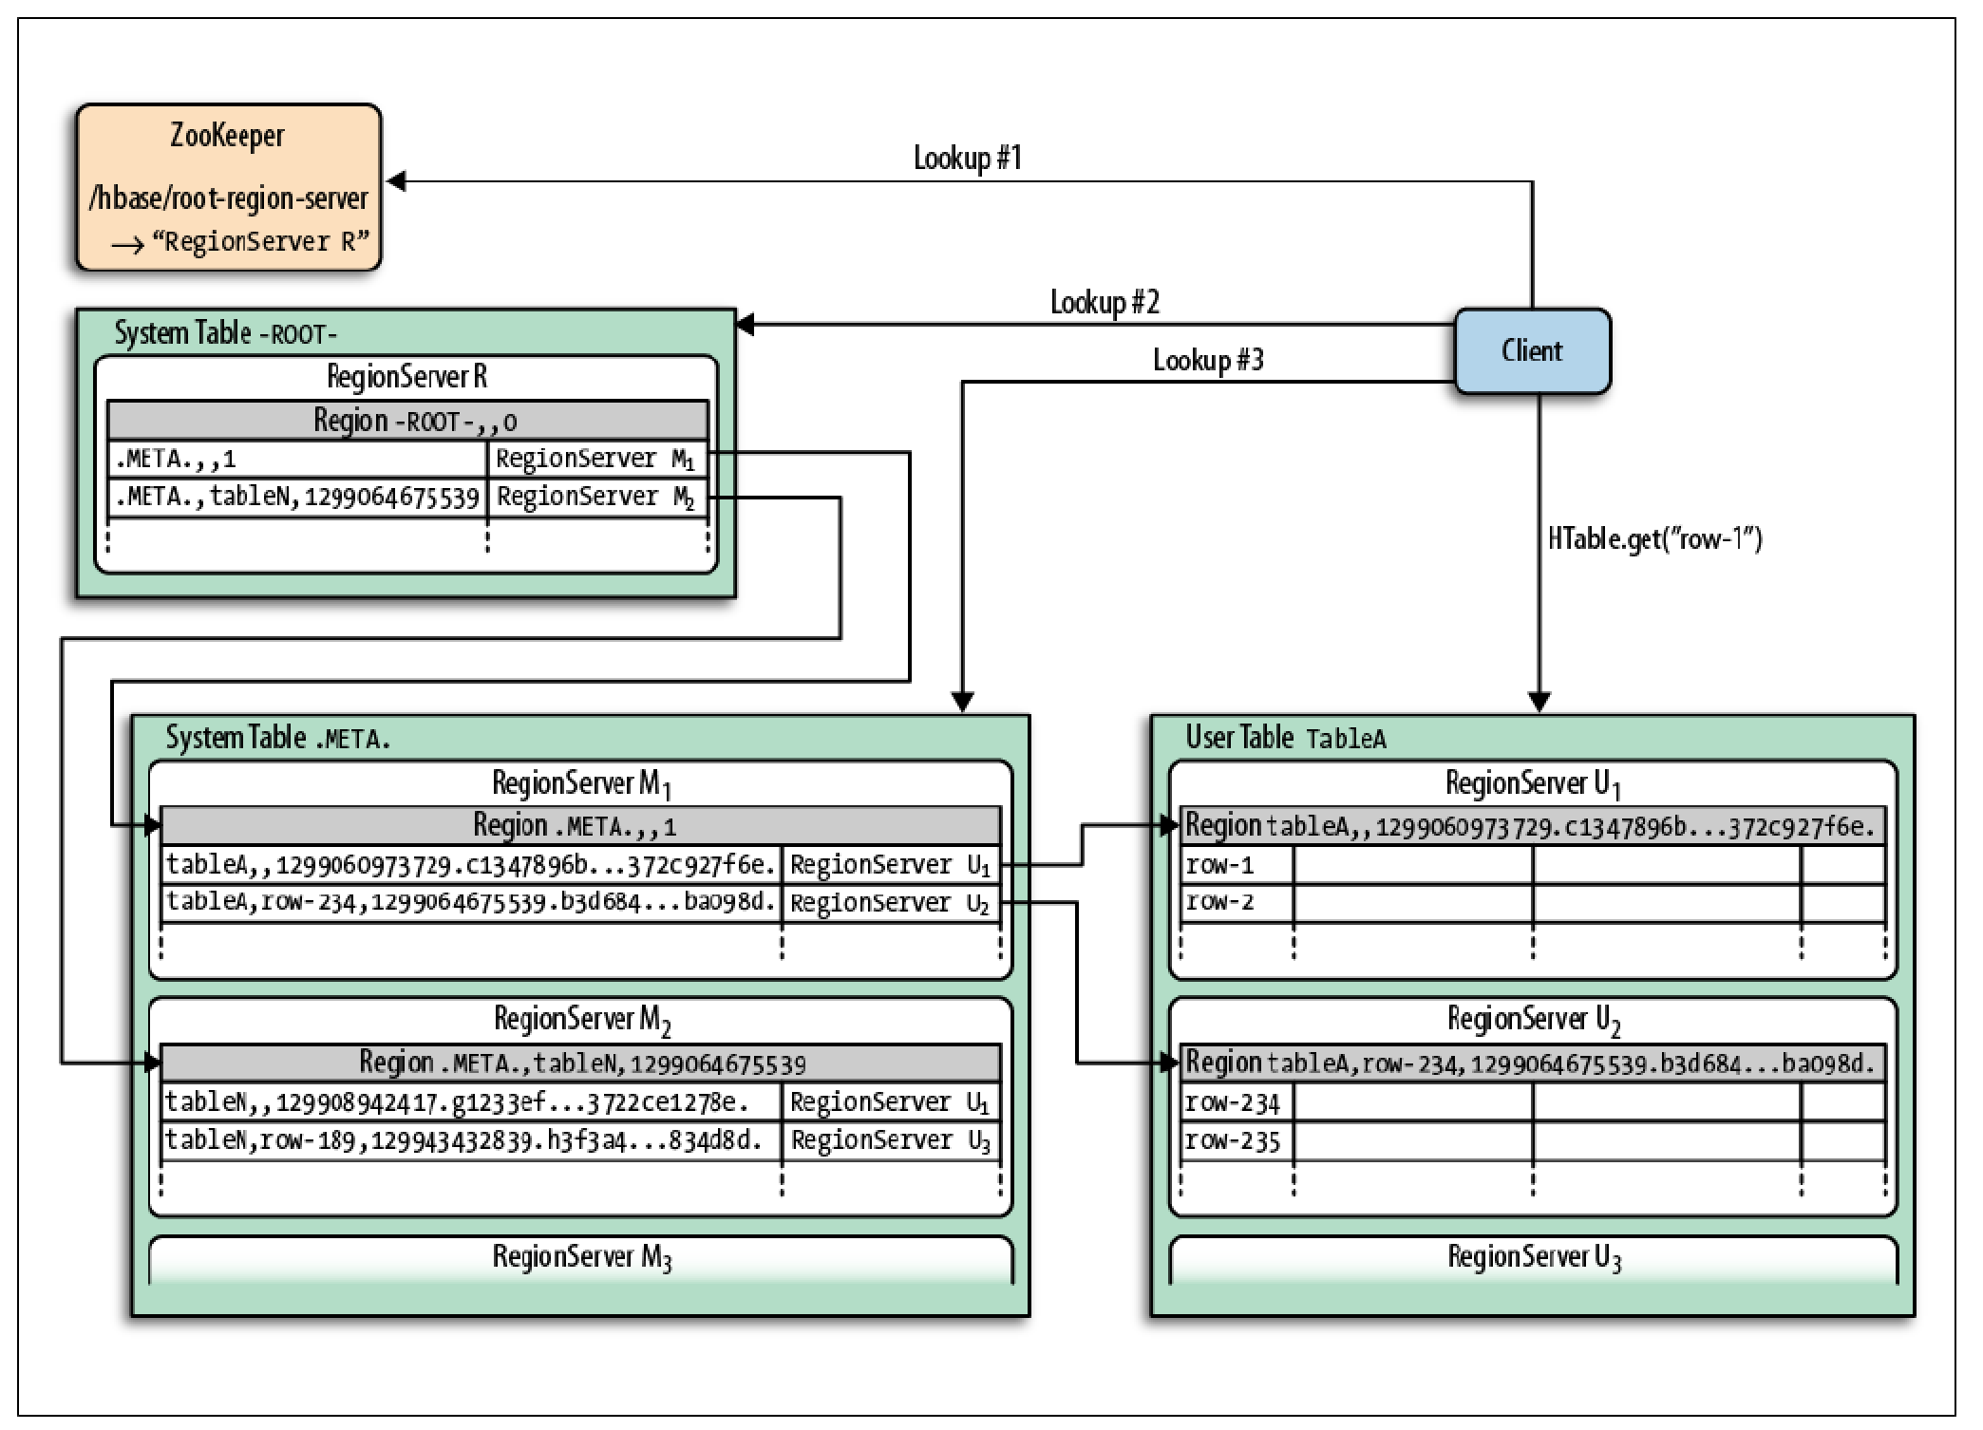

Slide 54
Summary
Motivation -> Random read/write access
Data Model -> Column family and qualifier, Versions
Distributed Nature -> Master, Region, RegionServer
Data Operations -> Get,Scan,Put,Delete
Access APIs -> Java, REST, Thrift
Architecture -> LSM Tree, Communication Workflow

Slide 55
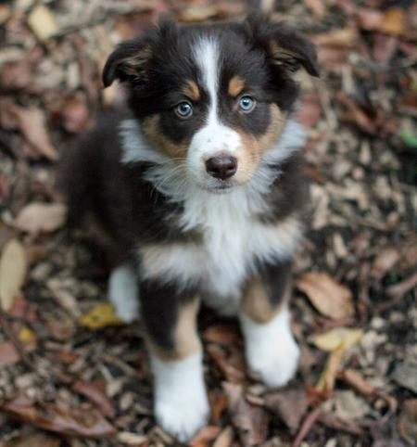
Questions?

Slide 56
ZooKeeper
ZooKeeper is a high-performance coordination service for distributed applications(like HBase). It exposes common services like naming, configuration management, synchronization, and group services, in a simple interface so you don't have to write them from scratch. You can use it off- the-shelf to implement consensus, group management, leader election, and presence protocols. And you can build on it for your own, specific needs.
HBase relies completely on Zookeeper. HBase provides you the option to use its built-in Zookeeper which will get started whenever you start HBase.
HBase depends on a running ZooKeeper cluster. All participating nodes and clients need to be able to access the running ZooKeeper ensemble. Apache HBase by default manages a ZooKeeper "cluster" for you. It will start and stop the ZooKeeper ensemble as part of the HBase start/stop process.

