Slide 1

Hive and SharkSQL
for Rich Analytics at Scale
Engin Arslan
Engin Arslan
Hive and Shark
<number> / 45

Slide 2
Motivation
◮ MapReduce is hard to program.
◮ No schema, lack of query languages, e.g., SQL.
Engin Arslan
Hive and Shark
<number> / 45

Slide 3
Solution
◮ Adding tables, columns, partitions, and a subset of SQL to unstructured data.
Engin Arslan
Hive and Shark
<number> / 45

Slide 4

Hive
◮ A system for managing and querying structured data built on top of Hadoop.
Engin Arslan
Hive and Shark
<number> / 45

Slide 5
Hive
◮ A system for managing and querying structured data built on top of Hadoop.
◮ Converts a query to a series of MapReduce phases.
Engin Arslan
Hive and Shark
4 / 45

Slide 6

Hive
◮ A system for managing and querying structured data built on top of Hadoop.
◮ Converts a query to a series of MapReduce phases.
◮ Initially developed by Facebook.
Engin Arslan
Hive and Shark
4 /45

Slide 7
Hive
◮ A system for managing and querying structured data built on top of Hadoop.
◮ Converts a query to a series of MapReduce phases.
◮ Initially developed by Facebook.
◮ Focuses on scalability and extensibility.
Engin Arslan
Hive and Shark
4 / 45

Slide 8

Scalability
◮ Massive scale out and fault tolerance capabilities on commodity hardware.
◮ Can handle petabytes of data.
Engin Arslan
Hive and Shark
5 / 45

Slide 9

Extensibility
◮ Data types: primitive types and complex types.
◮ User Defined Functions (UDF).
◮ Serializer/Deserializer: text, binary, JSON ...
◮ Storage: HDFS, Hbase, S3 ...
Engin Arslan
Hive and Shark
6 / 45

Slide 10

RDBMS vs. Hive
 | RDBMS | Hive
Language | SQL | HiveQL
Update Capabilities | INSERT, UPDATE, and DELETE | INSERT OVERWRITE; no UPDATE or DELETE
OLAP | Yes | Yes
OLTP | Yes | No
Latency | Sub-second | Minutes or more
Indexes | Any number of indexes | No indexes, data is always scanned (in parallel)
Data size | TBs | PBs
Engin Arslan
Hive and Shark
7 / 45

Slide 11
RDBMS vs. Hive
 | RDBMS | Hive
Language | SQL | HiveQL
Update Capabilities | INSERT, UPDATE, and DELETE | INSERT OVERWRITE; no UPDATE or DELETE
OLAP | Yes | Yes
OLTP | Yes | No
Latency | Sub-second | Minutes or more
Indexes | Any number of indexes | No indexes, data is always scanned (in parallel)
Data size | TBs | PBs
◮ Online Analytical Processing (OLAP): allows users to analyze database information from multiple database systems at one time.
◮ Online Transaction Processing (OLTP): facilitates and manages transaction-oriented applications.
Engin Arslan
Hive and Shark
7 / 45

Slide 12
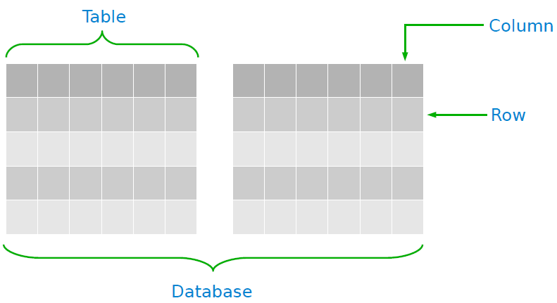
Hive Data Model
◮ Re-used from RDBMS:
Database: Set of Tables.
Table: Set of Rows that have the same schema (same columns).
Row: A single record; a set of columns.
Column: provides value and type for a single value.
Engin Arslan
Hive and Shark
8 / 45

Slide 13
Hive Data Model - Table
◮ Analogous to tables in relational databases.
◮ Each table has a corresponding HDFS directory.
◮ For example data for table customer is in the directory
/db/customer.
Engin Arslan
Hive and Shark
9 / 45

Slide 14
Hive Data Model - Partition
◮ A coarse-grained partitioning of a table based on the value of a column, such as a date.
◮ Faster queries on slices of the data.
◮ If customer is partitioned on column country, then data with a particular country value SE, will be stored in files within the directory
/db/customer/country=SE.
Engin Arslan
Hive and Shark
10 / 45

Slide 15
Hive Data Model - Bucket
◮ Data in each partition may in turn be divided into buckets based on the hash of a column in the table.
◮ For more efficient queries.
◮ If customer country partition is subdivided further into buckets, based on username (hashed on username), the data for each bucket will be stored within the directories:
/db/customer/country=SE/000000 0
...
/db/customer/country=SE/000000 5
Engin Arslan
Hive and Shark
11 / 45

Slide 16
Column Data Types
◮ Primitive types
integers, float, strings, dates and booleans
◮ Nestable collections
array and map
◮ User-defined types
Users can also define their own types programmatically
Engin Arslan
Hive and Shark
12 / 45

Slide 17
Hive Operations
◮ HiveQL: SQL-like query languages
Engin Arslan
Hive and Shark
13 / 45

Slide 18
Hive Operations
◮ HiveQL: SQL-like query languages
◮ DDL operations (Data Definition Language)
Create, Alter, Drop
Engin Arslan
Hive and Shark
13 / 45

Slide 19
Hive Operations
◮ HiveQL: SQL-like query languages
◮ DDL operations (Data Definition Language)
Create, Alter, Drop
◮ DML operations (Data Manipulation Language)
Load and Insert (overwrite)
Does not support updating and deleting (later versions support update and delete)
Engin Arslan
Hive and Shark
13 / 45

Slide 20
Hive Operations
◮ HiveQL: SQL-like query languages
◮ DDL operations (Data Definition Language)
Create, Alter, Drop
◮ DML operations (Data Manipulation Language)
Load and Insert (overwrite)
◮ SQL operations
Select, Filter, Join, Groupby
Engin Arslan
Hive and Shark
13 / 45

Slide 21
DDL Operations (1/3)
◮ Create tables
-- Creates a table with three columns
CREATE TABLE customer (id INT, name STRING, address STRING) ROW FORMAT DELIMITED FIELDS TERMINATED BY ’\t’;
Engin Arslan
Hive and Shark
14 / 45

Slide 22
DDL Operations (1/3)
◮ Create tables
-- Creates a table with three columns
CREATE TABLE customer (id INT, name STRING, address STRING) ROW FORMAT DELIMITED FIELDS TERMINATED BY ’\t’;
◮ Create tables with partitions
-- Creates a table with three columns and a partition column
-- /db/customer2/country=SE;
-- /db/customer2/country=IR;
CREATE TABLE customer2 (id INT, name STRING, address STRING) PARTITION BY (country STRING)
Engin Arslan
Hive and Shark
14 / 45

Slide 23
DDL Operations (2/3)
◮ Create tables with buckets
-- Specify the columns to bucket on and the number of buckets
-- /db/customer3/000000_0
-- /db/customer3/000000_1
-- /db/customer3/000000_2
set hive.enforce.bucketing = true;
CREATE TABLE customer3 (id INT, name STRING, address STRING) CLUSTERED BY (id) INTO 3 BUCKETS;
Engin Arslan
Hive and Shark
15 / 45

Slide 24
DDL Operations (2/3)
◮ Create tables with buckets
-- Specify the columns to bucket on and the number of buckets
-- /db/customer3/000000_0
-- /db/customer3/000000_1
-- /db/customer3/000000_2
set hive.enforce.bucketing = true;
CREATE TABLE customer3 (id INT, name STRING, address STRING) CLUSTERED BY (id) INTO 3 BUCKETS;
◮ Browsing through tables
-- lists all the tables
SHOW TABLES;
-- shows the list of columns
DESCRIBE customer;
Engin Arslan
Hive and Shark
15 / 45

Slide 25
DDL Operations (3/3)
◮ Altering tables
-- rename the customer table to alaki
ALTER TABLE customer RENAME TO alaki;
-- add two new columns to the customer table
ALTER TABLE customer ADD COLUMNS (job STRING);
ALTER TABLE customer ADD COLUMNS (grade INT COMMENT ’some comment’);
Engin Arslan
Hive and Shark
16 / 45

Slide 26
DDL Operations (3/3)
◮ Altering tables
-- rename the customer table to alaki
ALTER TABLE customer RENAME TO alaki;
-- add two new columns to the customer table
ALTER TABLE customer ADD COLUMNS (job STRING);
ALTER TABLE customer ADD COLUMNS (grade INT COMMENT ’some comment’);
◮ Dropping tables
DROP TABLE customer;
Engin Arslan
Hive and Shark
16 / 45

Slide 27
DML Operations
◮ Loading data from flat files.
-- if ’LOCAL’ is omitted then it looks for the file in HDFS.
-- the ’OVERWRITE’ signifies that existing data in the table is deleted.
-- if the ’OVERWRITE’ is omitted, data are appended to existing data sets.
LOAD DATA LOCAL INPATH ’data.txt’ OVERWRITE INTO TABLE customer;
-- loads data into different partitions
LOAD DATA LOCAL INPATH ’data1.txt’ OVERWRITE INTO TABLE customer2 PARTITION (country=’SE’);
LOAD DATA LOCAL INPATH ’data2.txt’ OVERWRITE INTO TABLE customer2 PARTITION (country=’IR’);
Engin Arslan
Hive and Shark
Mar 1, 2018
17 / 45

Slide 28
DML Operations
◮ Loading data from flat files.
-- if ’LOCAL’ is omitted then it looks for the file in HDFS.
-- the ’OVERWRITE’ signifies that existing data in the table is deleted.
-- if the ’OVERWRITE’ is omitted, data are appended to existing data sets.
LOAD DATA LOCAL INPATH ’data.txt’ OVERWRITE INTO TABLE customer;
-- loads data into different partitions
LOAD DATA LOCAL INPATH ’data1.txt’ OVERWRITE INTO TABLE customer2 PARTITION (country=’SE’);
LOAD DATA LOCAL INPATH ’data2.txt’ OVERWRITE INTO TABLE customer2 PARTITION (country=’IR’);
◮ Store the query results in tables
INSERT OVERWRITE TABLE customer SELECT * From old_customers;
Engin Arslan
Hive and Shark
Mar 1, 2018
17 / 45

Slide 29
SQL Operations (1/3)
◮ Selects and filters
SELECT id FROM customer2 WHERE country=’SE’;
-- selects all rows from customer table into a local directory
INSERT OVERWRITE LOCAL DIRECTORY ’/tmp/hive-sample-out’ SELECT * FROM customer;
-- selects all rows from customer2 table into a directory in hdfs
INSERT OVERWRITE DIRECTORY ’/tmp/hdfs_ir’ SELECT * FROM customer2 WHERE country=’IR’;
Engin Arslan
Hive and Shark
Mar 1, 2018
18 / 45

Slide 30
SQL Operations (2/3)
◮ Aggregations and groups
SELECT MAX(id) FROM customer;
SELECT country, COUNT(*), SUM(id) FROM customer2 GROUP BY country;
INSERT TABLE high_id_customer SELECT c.name, COUNT(*) FROM customer c WHERE c.id > 10 GROUP BY c.name;
Engin Arslan
Hive and Shark
Mar 1, 2018
19 / 45

Slide 31
SQL Operations (3/3)
◮ Join
CREATE TABLE customer (id INT, name STRING, address STRING) ROW FORMAT DELIMITED FIELDS TERMINATED BY ’\t’;
CREATE TABLE order (id INT, cus_id INT, prod_id INT, price INT) ROW FORMAT DELIMITED FIELDS TERMINATED BY ’\t’;
SELECT * FROM customer c JOIN order o ON (c.id = o.cus_id);
Engin Arslan
Hive and Shark
Mar 1, 2018
20 / 45

Slide 32
User-Defined Function (UDF)
package com.example.hive.udf;
import org.apache.hadoop.hive.ql.exec.UDF;
import org.apache.hadoop.io.Text;
public final class Lower extends UDF {
public Text evaluate(final Text s) {
if (s == null) {
return null;
}
return new Text(s.toString().toLowerCase());
}
}
-- Register the class
CREATE FUNCTION my_lower AS ’com.example.hive.udf.Lower’;
-- Using the function
SELECT my_lower(title), sum(freq) FROM titles GROUP BY my_lower(title);
Engin Arslan
Hive and Shark
Mar 1, 2018
21 / 45

Slide 33
Executing SQL Questions
◮ Processes HiveQL statements and generates the execution plan through three-phase processes.
1
Query parsing: transforms a query string to a parse tree representation.
2
Logical plan generation: converts the internal query representation to a logical plan, and optimizes it.
3
Physical plan generation: split the optimized logical plan into multiple map/reduce and HDFS tasks.
Engin Arslan
Hive and Shark
Mar 1, 2018
22 / 45

Slide 34
Optimization (1/2)
◮ Column pruning
Projecting out the needed columns.
◮ Predicate pushdown
Filtering rows early in the processing, by pushing down predicates to the scan (if possible).
◮ Partition pruning
Pruning out files of partitions that do not satisfy the predicate.
Engin Arslan
Hive and Shark
Mar 1, 2018
23 / 45

Slide 35
Optimization (2/2)
◮ Map-side joins
The small tables are replicated in all the mappers and joined with other tables.
No reducer needed.
◮ Join reordering
Only materialized and kept small tables in memory.
This ensures that the join operation does not exceed memory limits on the reducer side.
Engin Arslan
Hive and Shark
Mar 1, 2018
24 / 45

Slide 36
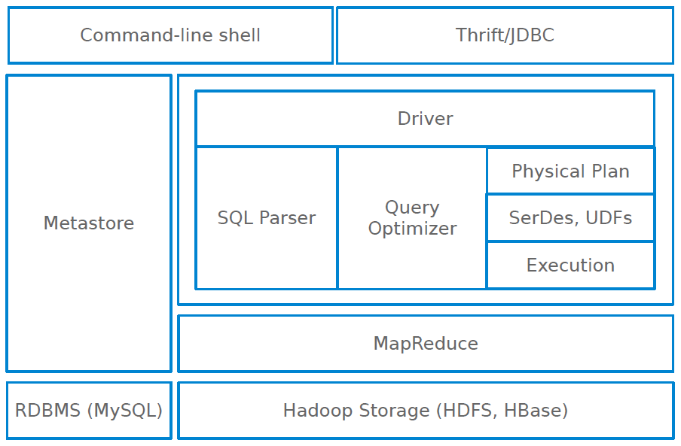
Hive Components (1/8)
Engin Arslan
Hive and Shark
Mar 1, 2018
25 / 45

Slide 37

Hive Components (2/8)
◮ External interfaces
User interfaces, e.g., CLI and web UI
Application programming interfaces, e.g., JDBC and ODBC
Thrift, a framework for cross-language services.
Engin Arslan
Hive and Shark
Mar 1, 2018
26 / 45

Slide 38
Hive Components (3/8)
◮ Driver
Manages the life cycle of a HiveQL statement during compilation, optimization and execution.
Engin Arslan
Hive and Shark
Mar 1, 2018
27 / 45

Slide 39
Hive Components (4/8)
◮ Compiler (Parser/Query Optimizer)
Translates the HiveQL statement into a a logical plan, and optimizes it.
Engin Arslan
Hive and Shark
Mar 1, 2018
28 / 45

Slide 40
Hive Components (5/8)
◮ Physical plan
Transforms the logical plan into a DAG of Map/Reduce jobs.
Engin Arslan
Hive and Shark
Mar 1, 2018
29 / 45

Slide 41
Hive Components (6/8)
◮ Execution engine
The driver submits the individual mapreduce jobs from the DAG to the execution engine in a topological order.
Engin Arslan
Hive and Shark
Mar 1, 2018
30 / 45

Slide 42
Hive Components (7/8)
◮ SerDe
Serializer/Deserializer allows Hive to read and write table rows in any custom format.
Engin Arslan
Hive and Shark
Mar 1, 2018
31 / 45

Slide 43
Hive Components (8/8)
◮ Metastore
The system catalog.
Contains metadata about the tables.
Metadata is specified during table creation and reused every time the table is referenced in HiveQL.
Metadatas are stored on either a traditional relational database, e.g., MySQL, or file system and not HDFS.
Engin Arslan
Hive and Shark
Mar 1, 2018
32 / 45

Slide 44

Hive on Spark
Engin Arslan
Hive and Shark
Mar 1, 2018
33 / 45

Slide 45
Spark RDD - Reminder
◮ RDDs are immutable, partitioned collections that can be created through various transformations, e.g., map, groupByKey, join.
Engin Arslan
Hive and Shark
Mar 1, 2018
34 / 45

Slide 46

Executing SQL over Spark RDDs
◮ Shark runs SQL queries over Spark using three-step process:
1
Query parsing: Shark uses Hive query compiler to parse the query and generate a parse tree.
2
Logical plan generation: the tree is turned into a logical plan and basic logical optimization is applied.
3
Physical plan generation: Shark applies additional optimization and creates a physical plan consisting of transformations on RDDs.
Engin Arslan
Hive and Shark
Mar 1, 2018
35 / 45

Slide 47
Hive Components
Engin Arslan
Hive and Shark
Mar 1, 2018
36 / 45

Slide 48
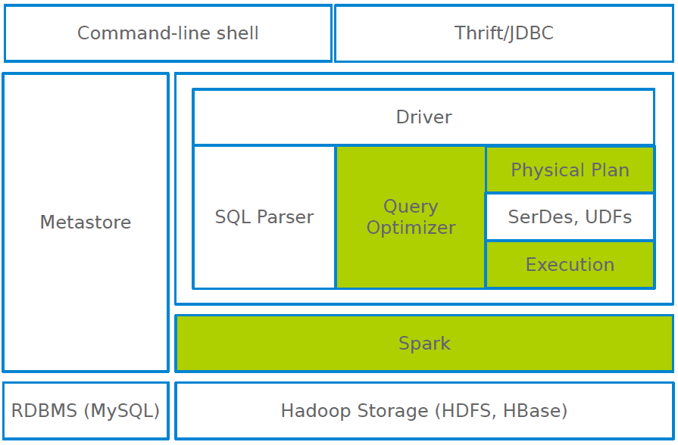
Shark Components
Engin Arslan
Hive and Shark
Mar 1, 2018
37 / 45

Slide 49
Shark and Spark
◮ Shark extended RDD execution model:
Partial DAG Execution (PDE): to re-optimize a running query after running the first few stages of its task DAG.
In-memory columnar storage and compression: to process relational data efficiently.
Control over data partitioning.
Engin Arslan
Hive and Shark
Mar 1, 2018
38 / 45

Slide 50
Partial DAG Execution (1/2)
◮ How to optimize the following query?
SELECT * FROM table1 a JOIN table2 b ON (a.key = b.key) WHERE my_crazy_udf(b.field1, b.field2) = true;
Engin Arslan
Hive and Shark
Mar 1, 2018
39 / 45

Slide 51
Partial DAG Execution (1/2)
◮ It can not use cost-based optimization techniques that rely on accurate a priori data statistics.
◮ They require dynamic approaches to query optimization.
◮ Partial DAG Execution (PDE): dynamic alteration of query plans based on data statistics collected at run-time.
◮ How to optimize the following query?
SELECT * FROM table1 a JOIN table2 b ON (a.key = b.key) WHERE my_crazy_udf(b.field1, b.field2) = true;
Engin Arslan
Hive and Shark
Mar 1, 2018
39 / 45

Slide 52
Partial DAG Execution (2/2)
◮ The workers gather customizable statistics at global and per-
partition granularities at run-time.
◮ Each worker sends the collected statistics to the master.
◮ The master aggregates the statistics and alters the query plan based on such statistics.
Engin Arslan
Hive and Shark
Mar 1, 2018
40 / 45

Slide 53
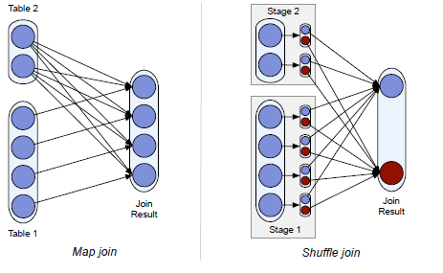
Join Optimization
Partial DAG execution can be used to perform several run-time optimizations for join queries

Slide 54
Join Optimization
In shuffle join, both join tables are hash-partitioned by the join key. Each reducer joins corresponding partitions using a local join algorithm, which is chosen by each reducer based on runtime statistics

Slide 55
Join Optimization
In map join (also known as broadcast join) a small input table is broadcast to all nodes, where it is joined with each partition of a large table. This approach can result in significant cost savings by avoiding an expensive repartitioning and shuffling phase

Slide 56
Join Optimization
Map join is only worthwhile if some join inputs are small, so Shark uses partial DAG execution to select the join strategy at runtime based on its inputs’ exact sizes

Slide 57
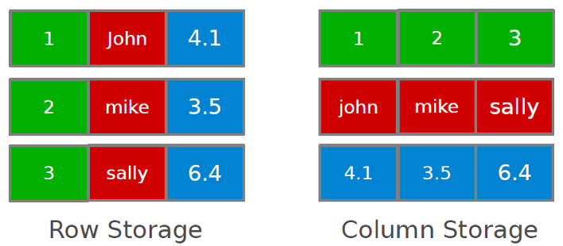
Columnar Memory Store
◮ Simply caching Hive records as JVM objects is inefficient.
◮ 12 to 16 bytes of overhead per object in JVM implementation:
e.g., storing a 270MB table as JVM objects uses approximately 971 MB of memory.
◮ Shark employs column-oriented storage using arrays of primitive objects.
Engin Arslan
Hive and Shark
Mar 1, 2018
41 / 45

Slide 58
Data Partitioning
◮ Shark allows co-partitioning two tables, which are frequently joined together, on a common key for faster joins in subsequent queries.
Engin Arslan
Hive and Shark
Mar 1, 2018
42 / 45

Slide 59
Shark/Spark Integration
◮ Shark provides a simple API for programmers to convert results from SQL queries into a special type of RDDs: sql2rdd.
val youngUsers = sql2rdd("SELECT * FROM users WHERE age < 20") println(youngUsers.count)
val featureMatrix = youngUsers.map(extractFeatures(_)) kmeans(featureMatrix)
Engin Arslan
Hive and Shark
Mar 1, 2018
43 / 45

Slide 60
Summary
◮ Operators: DDL, DML, SQL
◮ Hive architecture vs. Shark architecture
◮ Add advance features to Spark, e.g., PDE, columnar memory store
Engin Arslan
Hive and Shark
Mar 1, 2018
44 / 45

Slide 61
Questions?
Engin Arslan
Hive and Shark
Mar 1, 2018
45 / 45

