Slide 1

Resource Management
Engin Arslan
April 28, 2020
Resource Management

Slide 2

Motivation
◮ Rapid innovation in cloud computing.
◮ No single framework optimal for all applications.
Resource Management

Slide 3
Motivation
◮ Rapid innovation in cloud computing.
◮ No single framework optimal for all applications.
◮ Running each framework on its dedicated cluster:
Expensive
Hard to share data
Resource Management

Slide 4

Proposed Solution
Running multiple frameworks on a single cluster
Resource Management

Slide 5

Proposed Solution
Running multiple frameworks on a single cluster
Maximize utilization Share data between frameworks
Resource Management

Slide 6
Two Resource Management Systems ...
◮ Mesos
◮ YARN
Resource Management

Slide 7
Two Resource Management Systems ...
◮ Mesos
◮ YARN
Resource Management

Slide 8
Mesos
Mesos
A common resource sharing layer, over which diverse frameworks can run
Resource Management

Slide 9


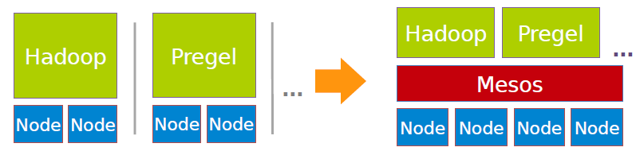
Mesos
Mesos
A common resource sharing layer, over which diverse frameworks can run
Resource Management

Slide 10
Mesos Goals
◮ High utilization of resources
◮ Supports diverse frameworks (current and future)
◮ Scalability to 10,000’s of nodes
◮ Reliability in face of failures
Resource Management

Slide 11
Computation Model
◮ A framework (e.g., Hadoop, Spark) manages and runs one or more jobs.
Resource Management
April 24, 2018

Slide 12
Computation Model
◮ A framework (e.g., Hadoop, Spark) manages and runs one or more jobs.
◮ A job consists of one or more tasks.
Resource Management
April 24, 2018

Slide 13
Computation Model
◮ A framework (e.g., Hadoop, Spark) manages and runs one or more jobs.
◮ A job consists of one or more tasks.
◮ A task (e.g., map, reduce) consists of one or more processes running on same machine.
Resource Management
April 24, 2018

Slide 14
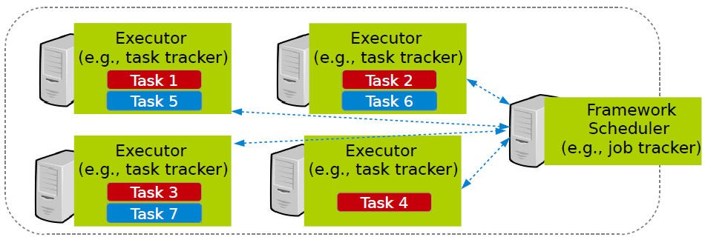
Computation Model
◮ A framework (e.g., Hadoop, Spark) manages and runs one or more jobs.
◮ A job consists of one or more tasks.
◮ A task (e.g., map, reduce) consists of one or more processes running on same machine.
Resource Management

Slide 15
Mesos Design Elements
◮ Fine-grained sharing
◮ Resource offers
Resource Management

Slide 16
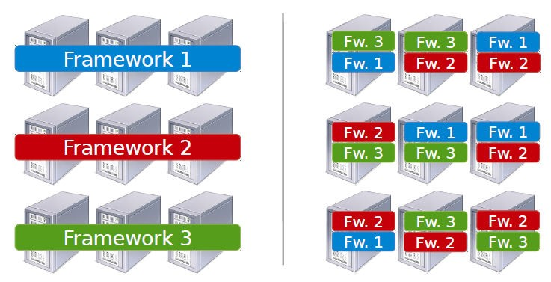
Fine-Grained Sharing
◮ Allocation at the level of tasks within a job.
◮ Improves utilization, latency, and data locality.
Coarse-grained sharing
Fine-grained sharing
Resource Management

Slide 17
Resource Offer
◮ Offer available resources to frameworks, let them pick which resources to use and which tasks to launch.
◮ Keeps Mesos simple, lets it support future frameworks.
Resource Management

Slide 18
Question?
How to schedule resource offering among frameworks?
Resource Management

Slide 19
Schedule Frameworks
◮ Global scheduler
◮ Distributed scheduler
Resource Management

Slide 20
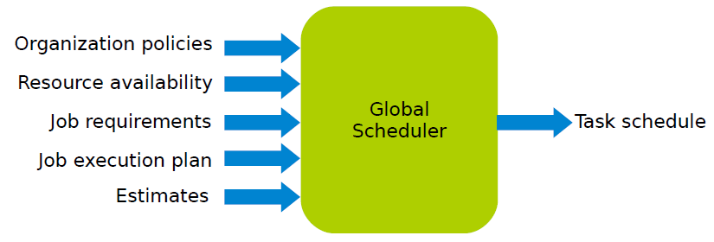
Global Scheduler (1/2)
◮ Job requirements
Response time
Throughput
Availability
◮ Job execution plan
Task DAG
Inputs/outputs
◮ Estimates
Task duration
Input sizes
Transfer sizes
Resource Management

Slide 21
Global Scheduler (2/2)
◮ Advantages
Can achieve optimal schedule.
◮ Disadvantages
Complexity: hard to scale and ensure resilience.
Hard to anticipate future frameworks requirements.
Need to refactor existing frameworks.
Resource Management
April 24, 2018

Slide 22
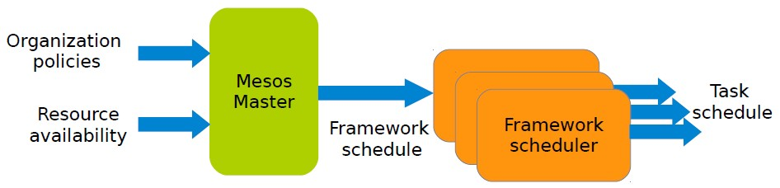
Distributed Scheduler (1/3)
Resource Management
April 24, 2018

Slide 23
Distributed Scheduler (2/3)
◮ Unit of allocation: resource offer
Vector of available resources on a node
For example, node1: < 1CPU, 1GB >, node2: < 4CPU, 16GB >
◮ Master sends resource offers to frameworks.
◮ Frameworks select which offers to accept and which tasks to run.
Resource Management
April 24, 2018

Slide 24
Distributed Scheduler (3/3)
◮ Advantages
Simple: easier to scale and make resilient.
Easy to port existing frameworks, support new ones.
◮ Disadvantages
Distributed scheduling decision: not optimal.
Resource Management
April 24, 2018

Slide 25
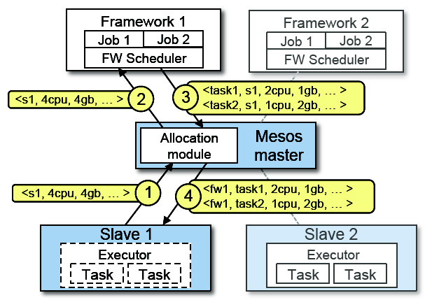
Mesos Architecture (1/4)
◮ Slaves continuously send status updates about resources to the Master.
Resource Management
April 24, 2018

Slide 26
Mesos Architecture (2/4)
◮ Pluggable scheduler picks framework to send an offer to.
Resource Management
April 24, 2018

Slide 27
Mesos Architecture (3/4)
◮ Framework scheduler selects resources and provides tasks.
Resource Management
April 24, 2018

Slide 28
Mesos Architecture (4/4)
◮ Framework executors launch tasks.
Resource Management
April 24, 2018

Slide 29
Question?
How to allocate resources of different types?
Resource Management
April 24, 2018

Slide 30
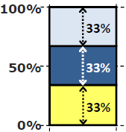
Single Resource: Fair Sharing
CPU
◮ n users want to share a resource, e.g., CPU.
Solution: allocate each ¹ of the shared resource.
n
Resource Management
April 24, 2018
April 24, 2018

Slide 31
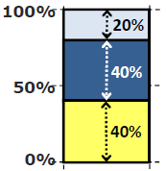
Single Resource: Fair Sharing
CPU
◮ n users want to share a resource, e.g., CPU.
Solution: allocate each ¹ of the shared resource.
n
◮ Generalized by max-min fairness.
Handles if a user wants less than its fair share.
E.g., user 1 wants no more than 20%.
Resource Management
April 24, 2018
April 24, 2018

Slide 32
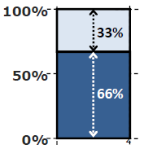
Single Resource: Fair Sharing
CPU
◮ n users want to share a resource, e.g., CPU.
Solution: allocate each ¹ of the shared resource.
n
◮ Generalized by max-min fairness.
Handles if a user wants less than its fair share.
E.g., user 1 wants no more than 20%.
◮ Generalized by weighted max-min fairness.
Give weights to users according to importance.
E.g., user 1 gets weight 1, user 2 weight 2.
Resource Management
April 24, 2018

Slide 33
Max-Min Fairness
◮ 1 resource: CPU
◮ Total resources: 20 CPU
◮ User 1 has x tasks and wants < 1CPU > per task
◮ User 2 has y tasks and wants < 2CPU > per task
Resource Management
April 24, 2018

Slide 34
Max-Min Fairness
◮ 1 resource: CPU
◮ Total resources: 20 CPU
◮ User 1 has x tasks and wants < 1CPU > per task
◮ User 2 has y tasks and wants < 2CPU > per task
max(x, y) (maximize allocation)
Resource Management
April 24, 2018

Slide 35
Max-Min Fairness
◮ 1 resource: CPU
◮ Total resources: 20 CPU
◮ User 1 has x tasks and wants < 1CPU > per task
◮ User 2 has y tasks and wants < 2CPU > per task
max(x, y) (maximize allocation) subject to
x + 2y ≤ 20 (CPU constraint)
x = 2y
Resource Management
April 24, 2018

Slide 36
Max-Min Fairness
◮ 1 resource: CPU
◮ Total resources: 20 CPU
◮ User 1 has x tasks and wants < 1CPU > per task
◮ User 2 has y tasks and wants < 2CPU > per task
max(x, y) (maximize allocation) subject to
x + 2y ≤ 20 (CPU constraint)
x = 2y
so
x = 10
y = 5
Resource Management
April 24, 2018

Slide 37
Why is Fair Sharing Useful?
◮ Proportional allocation: user 1 gets weight 2, user 2 weight 1.
◮ Priorities: give user 1 weight 1000, user 2 weight 1.
◮ Reservations: ensure user 1 gets 10% of a resource, so give user 1 weight 10, sum weights ≤ 100.
◮ Isolation policy: users cannot affect others beyond their fair share.
Resource Management
April 24, 2018

Slide 38
Properties of Max-Min Fairness
◮ Share guarantee
Each user can get at least ¹ of the resource.
n
But will get less if her demand is less.
◮ Strategy proof
Users are not better off by asking for more than they need.
Users have no reason to lie.
Resource Management
April 24, 2018

Slide 39
Properties of Max-Min Fairness
◮ Share guarantee
Each user can get at least ¹ of the resource.
n
But will get less if her demand is less.
◮ Strategy proof
Users are not better off by asking for more than they need.
Users have no reason to lie.
◮ Max-Min fairness is the only reasonable mechanism with these two properties.
◮ Widely used: OS, networking, datacenters, ...
Resource Management
April 24, 2018

Slide 40
Question?
When is Max-Min Fairness NOT Enough?
Resource Management
April 24, 2018

Slide 41
Question?
When is Max-Min Fairness NOT Enough?
Need to schedule multiple, heterogeneous resources, e.g., CPU, memory, etc.
Resource Management
April 24, 2018

Slide 42
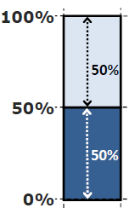
Problem
◮ Single resource example
1 resource: CPU
User 1 wants < 1CPU > per task
User 2 wants < 2CPU > per task
Resource Management
April 24, 2018
April 24, 2018

Slide 43
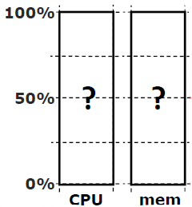
Problem
◮ Single resource example
1 resource: CPU
User 1 wants < 1CPU > per task
User 2 wants < 2CPU > per task
◮ Multi-resource example
2 resources: CPUs and mem
User 1 wants < 1CPU, 4GB > per task
User 2 wants < 2CPU, 1GB > per task
Resource Management
April 24, 2018

Slide 44
Problem
◮ Single resource example
1 resource: CPU
User 1 wants < 1CPU > per task
User 2 wants < 2CPU > per task
◮ Multi-resource example
2 resources: CPUs and mem
User 1 wants < 1CPU, 4GB > per task
User 2 wants < 2CPU, 1GB > per task
What is a fair allocation?
Resource Management
April 24, 2018

Slide 45
A Natural Policy (1/2)
◮ Asset fairness: give weights to resources (e.g., 1 CPU = 1 GB) and equalize total value given to each user.
Resource Management
April 24, 2018
April 24, 2018

Slide 46
A Natural Policy (1/2)
◮ Asset fairness: give weights to resources (e.g., 1 CPU = 1 GB) and equalize total value given to each user.
◮ Total resources: 28 CPU and 56GB RAM (e.g., 1 CPU = 2 GB)
User 1 has x tasks and wants < 1CPU, 2GB > per task
User 2 has y tasks and wants < 1CPU, 4GB > per task
Resource Management
April 24, 2018

Slide 47
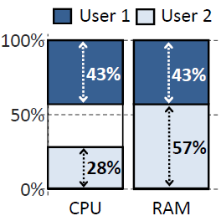
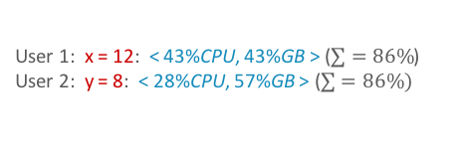
A Natural Policy (1/2)
◮ Asset fairness: give weights to resources (e.g., 1 CPU = 1 GB) and equalize total value given to each user.
◮ Total resources: 28 CPU and 56GB RAM (e.g., 1 CPU = 2 GB)
User 1 has x tasks and wants < 1CPU, 2GB > per task
User 2 has y tasks and wants < 1CPU, 4GB > per task
◮ Asset fairness yields:
max(x, y)
x + y ≤ 28
2x + 4y ≤ 56
4x = 6y
User 1: x = 12: < 43%CPU, 43%GB > ($\sum{=86\%}$)
User 2: y = 8: < 28%CPU, 57%GB > ($\sum{=86\%})$
Resource Management
April 24, 2018

Slide 48
A Natural Policy (2/2)
◮ Problem: violates share gurantee.
◮ User 1 gets less than 50% of both CPU and RAM.
◮ Better off in a separate cluster with half the resources.
Resource Management
April 24, 2018

Slide 49
Challenge
◮ Can we find a fair sharing policy that provides:
Share guarantee
Strategy-proofness
◮ Can we generalize max-min fairness to multiple resources?
Resource Management
April 24, 2018

Slide 50
Proposed Solution
Dominant Resource Fairness (DRF)
Resource Management
April 24, 2018

Slide 51
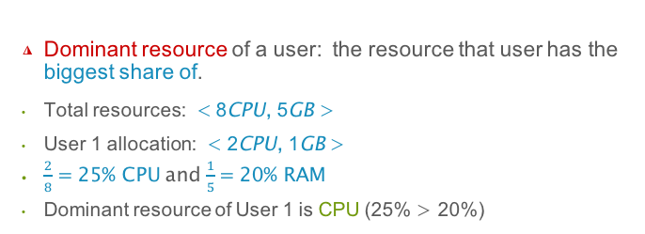
Dominant Resource Fairness (DRF) (1/2)
◮ Dominant resource of a user: the resource that user has the biggest share of.
Total resources: < 8CPU, 5GB >
User 1 allocation: < 2CPU, 1GB >
$\frac{2}{8}=$ 25% CPU and $\frac{1}{5}=$20% RAM
Dominant resource of User 1 is CPU (25% > 20%)
Resource Management
April 24, 2018

Slide 52
Dominant Resource Fairness (DRF) (1/2)
◮ Dominant resource of a user: the resource that user has the biggest share of.
Total resources: < 8CPU, 5GB >
User 1 allocation: < 2CPU, 1GB >
$\frac{2}{8}=$ 25% CPU and $\frac{1}{5}=$20% RAM
Dominant resource of User 1 is CPU (25% > 20%)
◮ Dominant share of a user: the fraction of the dominant resource she is allocated.
User 1 dominant share is 25%.
Resource Management
April 24, 2018

Slide 53
Dominant Resource Fairness (DRF) (2/2)
◮ Apply max-min fairness to dominant shares: give every user an equal share of her dominant resource.
Resource Management
April 24, 2018

Slide 54
Dominant Resource Fairness (DRF) (2/2)
◮ Apply max-min fairness to dominant shares: give every user an equal share of her dominant resource.
◮ Equalize the dominant share of the users.
Total resources: < 9CPU, 18GB >
User 1 wants < 1CPU, 4GB >; Dominant resource: RAM ¹ < ⁴
9 18
User 2 wants < 3CPU, 1GB >; Dominant resource: CPU ³ > ¹
9 18
Resource Management
April 24, 2018

Slide 55
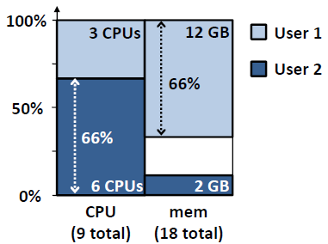
Dominant Resource Fairness (DRF) (2/2)
◮ Apply max-min fairness to dominant shares: give every user an equal share of her dominant resource.
◮ Equalize the dominant share of the users.
Total resources: < 9CPU, 18GB >
User 1 wants < 1CPU, 4GB >; Dominant resource: RAM ¹ < ⁴
9 18
User 2 wants < 3CPU, 1GB >; Dominant resource: CPU ³ > ¹
9 18
◮ max(x, y)
x + 3y ≤ 9
4x + y ≤ 18
4x 3y
18 ⁼ 9
User 1: x = 3: < 33% CPU, 66% GB >
User 2: y = 2: < 66% CPU, 16% GB >
Resource Management
April 24, 2018

Slide 56
Online DRF Scheduler
◮ Whenever there are available resources and tasks to run: Schedule a task to the user with the smallest dominant share.
Resource Management
April 24, 2018

Slide 57
Two Resource Management Systems ...
◮ Mesos
◮ YARN
Resource Management
April 24, 2018

Slide 58
YARN
YARN
Yet Another Resource Negotiator
Resource Management
April 24, 2018

Slide 59
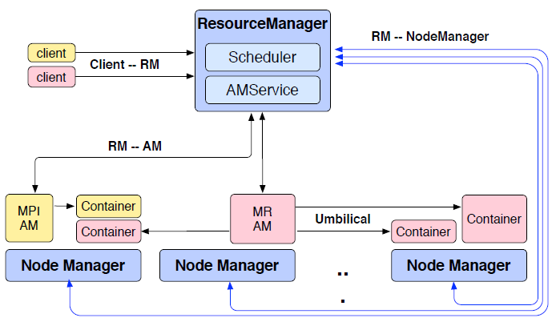
YARN Architecture
◮ Resource Manager (RM)
◮ Application Master (AM)
◮ Node Manager (NM)
Resource Management
April 24, 2018

Slide 60
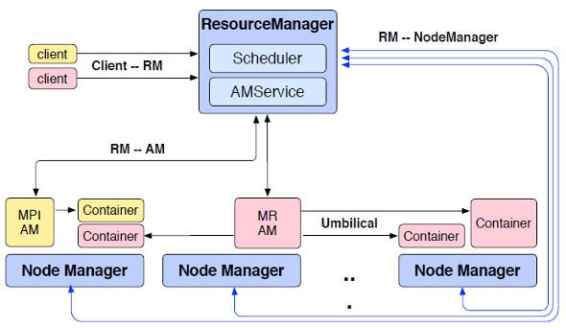
YARN Architecture - Resource Manager (1/2)
◮ One per cluster
Central: global view
Enable global properties
Fairness, capacity, locality
◮ Job requests are submitted to RM.
To start a job (application), RM finds a container to spawn AM.
◮ Container
Logical bundle of resources (CPU/memory).
◮ No static resource partitioning.
Resource Management
April 24, 2018

Slide 61
YARN Architecture - Resource Manager (2/2)
◮ Only handles an overall resource profile for each application.
Local optimization is up to the application.
◮ Preemption
Request resources back from an application.
Checkpoint snapshot instead of explicitly killing jobs / migrate computation to other containers.
Resource Management
April 24, 2018

Slide 62
YARN Architecture - Application Manager (1/2)
◮ The head of a job.
◮ Runs as a container.
◮ Request resources from RM.
# of containers/resource per container/locality ...
◮ Dynamically changing resource consumption, based on the containers it receives from the RM.
Resource Management
April 24, 2018

Slide 63
YARN Architecture - Application Manager (2/2)
◮ Requests are late-binding.
The conditions that caused the AM to issue the request may not remain true when it receives its resources.
◮ Can run any user code, e.g., MapReduce, Spark, etc.
◮ AM determines the semantics of the success or failure of the container.
Resource Management
April 24, 2018

Slide 64
YARN Architecture - Node Manager (1/2)
◮ The worker daemon.
◮ Registers with RM.
◮ One per node.
◮ Report resources to RM: memory, CPU, ...
◮ Containers are described by a Container Launch Context (CLC).
The command necessary to create the process
Environment variables
Security tokens
• ...
Resource Management
April 24, 2018

Slide 65
YARN Architecture - Node Manager (2/2)
◮ Configure the environment for task execution.
◮ Garbage collection.
◮ Auxiliary services.
A process may produce data that persist beyond the life of the container.
Output intermediate data between map and reduce tasks.
Resource Management
April 24, 2018

Slide 66
YARN Framework (1/2)
◮ Submitting the application: passing a CLC for the AM to the RM.
◮ When RM starts the AM, it should register with the RM.
Periodically advertise its liveness and requirements over the heartbeat protocol.
Resource Management
April 24, 2018

Slide 67
YARN Framework (2/2)
◮ Once the RM allocates a container, AM can construct a CLC to launch the container on the corresponding NM.
It monitors the status of the running container and stop it when the resource should be reclaimed.
◮ Once the AM is done with its work, it should unregister from the RM and exit cleanly.
Resource Management
April 24, 2018

Slide 68
Mesos vs. YARN
◮ Similarities:
Both have schedulers at two levels.
◮ Differences:
Mesos is an offer-based resource manager, whereas YARN has a request-based approach.
Mesos uses framework schedulers for inter-job scheduling, whereas YARN uses per-job optimization through AM (however, per-job AM has higher overhead compare to Mesos).
Resource Management
April 24, 2018

Slide 69
Summary
◮ Resource management: Mesos and YARN
◮ Mesos
Offered-based
Max-Min fairness: DRF
◮ YARN
Request-based
RM, AM, NM
Resource Management
April 24, 2018

Slide 70
Questions?
Acknowledgements
Some slides were derived from Ion Stoica and Ali Ghodsi slides (Berkeley University), and Wei-Chiu Chuang slides (Purdue University).
Resource Management
April 24, 2018

