Slide 1

Spark and Resilient Distributed Datasets
Engin Arslan
February 11, 2019
Engin Arslan
Spark
<number> / 49

Slide 2
Motivation
◮ MapReduce greatly simplified big data analysis on large, unreliable clusters.
◮ But as soon as it got popular, users wanted more:
  Iterative jobs, e.g., machine learning algorithms
  Interactive analytics
Engin Arslan
Spark
<number> / 49

Slide 3
Motivation
◮ Both iterative and interactive queries need one thing that MapReduce lacks:
Engin Arslan
Spark
3 / 49

Slide 4
Motivation
◮ Both iterative and interactive queries need one thing that MapReduce lacks:
Efficient primitives for data sharing.
Engin Arslan
Spark
3 / 49

Slide 5

Motivation
◮ Both iterative and interactive queries need one thing that MapReduce lacks:
Efficient primitives for data sharing.
◮ In MapReduce, the only way to share data across jobs is stable storage, which is slow.
◮ Replication also makes the system slow, but it is necessary for fault tolerance.
Engin Arslan
Spark
3 / 49

Slide 6

Proposed Solution
In-Memory Data Processing and Sharing.
Engin Arslan
Spark
4 / 49

Slide 7
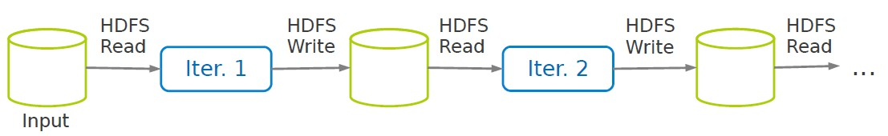
Example
Engin Arslan
Spark
<number> / 49
5 / 49

Slide 8
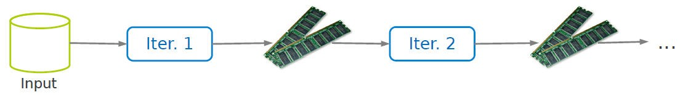
Example
Engin Arslan
Spark
5 / 49

Slide 9
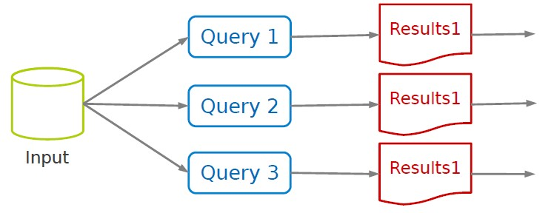
Example
Engin Arslan
Spark
<number> / 49
6 / 49

Slide 10
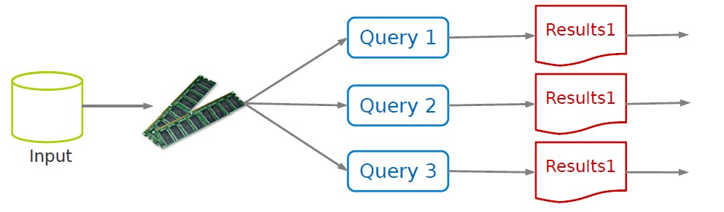
Example
Engin Arslan
Spark
6 / 49

Slide 11
Challenge
How to design a distributed memory abstraction that is both fault tolerant and efficient?
Engin Arslan
Spark
7 / 49

Slide 12


Challenge
How to design a distributed memory abstraction that is both fault tolerant and efficient?
Solution
Resilient Distributed Datasets (RDD)
Engin Arslan
Spark
7 / 49

Slide 13
Resilient Distributed Datasets (RDD) (1/2)
◮ A distributed memory abstraction.
Engin Arslan
Spark
8 / 49

Slide 14
Resilient Distributed Datasets (RDD) (1/2)
◮ A distributed memory abstraction.
◮ Immutable collections of objects spread across a cluster.
Engin Arslan
Spark
8 / 49

Slide 15
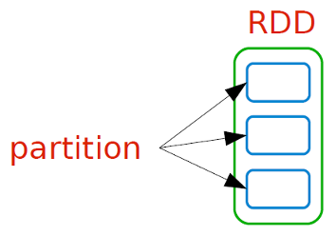
Resilient Distributed Datasets (RDD) (2/2)
◮ An RDD is divided into a number of partitions, which are atomic pieces of information.
◮ Partitions of an RDD can be stored on different nodes of a cluster.
Engin Arslan
Spark
9 / 49

Slide 16
Programming Model
Engin Arslan
Spark
10 / 49

Slide 17
Spark Programming Model (1/2)
◮ Spark programming model is based on parallelizable operators.
◮ Parallelizable operators are higher-order functions that execute user defined functions in parallel.
Engin Arslan
Spark
11 / 49

Slide 18
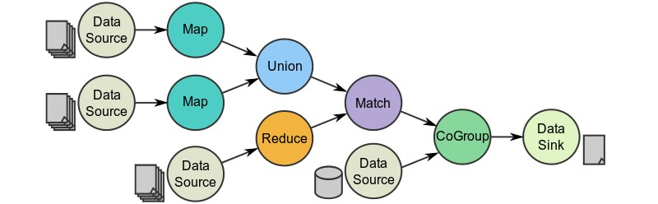
Spark Programming Model (2/2)
◮ A data flow is composed of any number of data sources, operators, and data sinks by connecting their inputs and outputs.
◮ Job description based on directed acyclic graphs (DAG).
Engin Arslan
Spark
12 / 49

Slide 19
Higher-Order Functions (1/3)
◮ Higher-order functions: RDDs operators.
◮ There are two types of RDD operators: transformations and actions.
Engin Arslan
Spark
13 / 49

Slide 20
Higher-Order Functions (2/3)
◮ Transformations: lazy operators that create new RDDs.
◮ Actions: lunch a computation and return a value to the program or write data to the external storage.
Engin Arslan
Spark
14 / 49

Slide 21
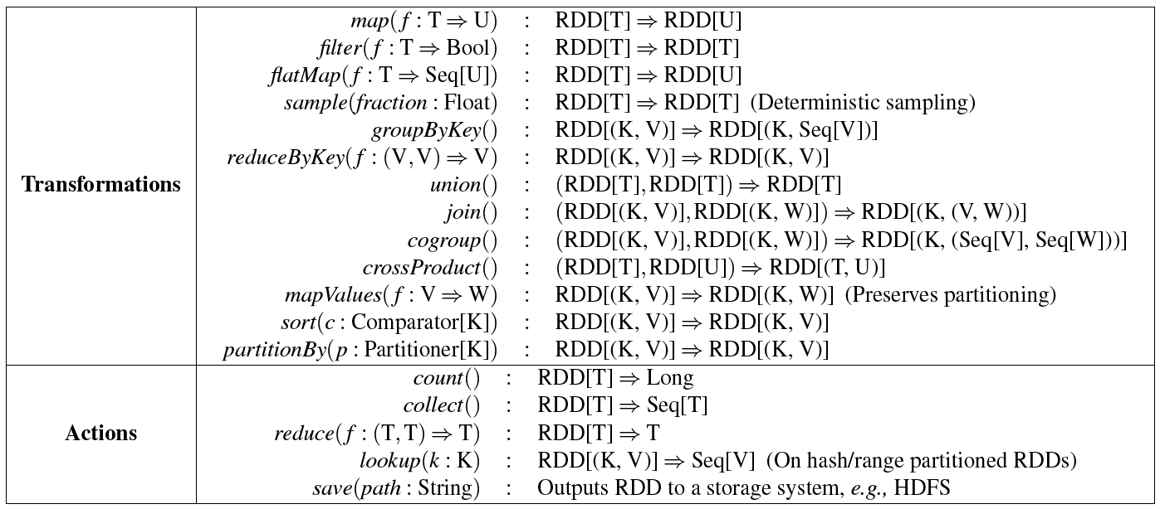
Higher-Order Functions (3/3)
Engin Arslan
Spark
15 / 49

Slide 22
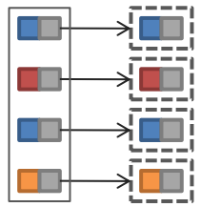
RDD Transformations - Map
◮ All pairs are independently processed.
Engin Arslan
Spark
16 / 49

Slide 23
RDD Transformations - Map
◮ All pairs are independently processed.
// passing each element through a function.
val nums = sc.parallelize(Array(1, 2, 3))
val squares = nums.map(x => x * x) // {1, 4, 9}
// selecting those elements that func returns true.
val even = squares.filter(x => x % 2 == 0) // {4}
// mapping each element to zero or more others.
nums.flatMap(x => Range(0, x, 1)) // {0, 0, 1, 0, 1, 2}
Engin Arslan
Spark
16 / 49

Slide 24
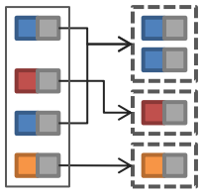
RDD Transformations - Reduce
◮ Pairs with identical key are grouped.
◮ Groups are independently processed.
Engin Arslan
Spark
17 / 49

Slide 25
RDD Transformations - Reduce
◮ Pairs with identical key are grouped.
◮ Groups are independently processed.
val pets = sc.parallelize(Seq(("cat", 1), ("dog", 1), ("cat", 2)))
pets.reduceByKey((x, y) => x + y)
// {(cat, 3), (dog, 1)}
pets.groupByKey()
// {(cat, (1, 2)), (dog, (1))}
Engin Arslan
Spark
17 / 49

Slide 26
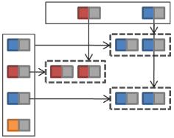
RDD Transformations - Join
◮ Performs an equi-join on the key.
◮ Join candidates are independently processed.
Engin Arslan
Spark
18 / 49

Slide 27
RDD Transformations - Join
◮ Performs an equi-join on the key.
◮ Join candidates are independently processed.
val visits = sc.parallelize(Seq(("index.html", "1.2.3.4"),
("about.html", "3.4.5.6"),
("index.html", "1.3.3.1")))
val pageNames = sc.parallelize(Seq(("index.html", "Home"),
("about.html", "About")))
visits.join(pageNames)
// ("index.html", ("1.2.3.4", "Home"))
// ("index.html", ("1.3.3.1", "Home"))
// ("about.html", ("3.4.5.6", "About"))
Engin Arslan
Spark
18 / 49

Slide 28
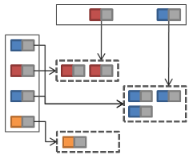
RDD Transformations - CoGroup
◮ Groups each input on key.
◮ Groups with identical keys are processed together.
Engin Arslan
Spark
19 / 49

Slide 29
RDD Transformations - CoGroup
◮ Groups each input on key.
◮ Groups with identical keys are processed together.
val visits = sc.parallelize(Seq(("index.html", "1.2.3.4"),
("about.html", "3.4.5.6"),
("index.html", "1.3.3.1")))
val pageNames = sc.parallelize(Seq(("index.html", "Home"),
("about.html", "About")))
visits.cogroup(pageNames)
// ("index.html", (("1.2.3.4", "1.3.3.1"), ("Home")))
// ("about.html", (("3.4.5.6"), ("About")))
Engin Arslan
Spark
19 / 49

Slide 30
RDD Transformations - Union and Sample
◮ Union: merges two RDDs and returns a single RDD using bag semantics, i.e., duplicates are not removed.
◮ Sample: similar to mapping, except that the RDD stores a random number generator seed for each partition to deterministically sample parent records.
Engin Arslan
Spark
20 / 49

Slide 31
Basic RDD Actions (1/2)
◮ Return all the elements of the RDD as an array.
val nums = sc.parallelize(Array(1, 2, 3))
nums.collect() // Array(1, 2, 3)
Engin Arslan
Spark
21 / 49

Slide 32
Basic RDD Actions (1/2)
◮ Return all the elements of the RDD as an array.
val nums = sc.parallelize(Array(1, 2, 3))
nums.collect() // Array(1, 2, 3)
◮ Return an array with the first n elements of the RDD.
nums.take(2) // Array(1, 2)
Engin Arslan
Spark
21 / 49

Slide 33
Basic RDD Actions (1/2)
◮ Return all the elements of the RDD as an array.
val nums = sc.parallelize(Array(1, 2, 3))
nums.collect() // Array(1, 2, 3)
◮ Return an array with the first n elements of the RDD.
nums.take(2) // Array(1, 2)
◮ Return the number of elements in the RDD.
nums.count() // 3
Engin Arslan
Spark
21 / 49

Slide 34
Basic RDD Actions (2/2)
◮ Aggregate the elements of the RDD using the given function.
nums.reduce((x, y) => x + y) or
nums.reduce(_ + _) // 6
Engin Arslan
Spark
22 / 49

Slide 35
Basic RDD Actions (2/2)
◮ Aggregate the elements of the RDD using the given function.
nums.reduce((x, y) => x + y) or
nums.reduce(_ + _) // 6
◮ Write the elements of the RDD as a text file.
nums.saveAsTextFile("hdfs:/file.txt")
Engin Arslan
Spark
22/ 49

Slide 36
SparkContext
◮ Main entry point to Spark functionality.
◮ Available in shell as variable sc.
◮ In standalone programs, you should make your own.
import org.apache.spark.SparkContext import org.apache.spark.SparkContext._
val sc = new SparkContext(master, appName, [sparkHome], [jars])
Engin Arslan
Spark
23 / 49

Slide 37
SparkContext
◮ Main entry point to Spark functionality.
◮ Available in shell as variable sc.
◮ In standalone programs, you should make your own.
import org.apache.spark.SparkContext import org.apache.spark.SparkContext._
val sc = new SparkContext(master, appName, [sparkHome], [jars])
local local[k]
spark://host:port mesos://host:port
Engin Arslan
Spark
23 / 49

Slide 38
Creating RDDs
◮ Turn a collection into an RDD.
val a = sc.parallelize(Array(1, 2, 3))
Engin Arslan
Spark
24 / 49

Slide 39
Creating RDDs
◮ Turn a collection into an RDD.
val a = sc.parallelize(Array(1, 2, 3))
◮ Load text file from local FS, HDFS, or S3.
val a = sc.textFile("file.txt")
val b = sc.textFile("directory/*.txt")
val c = sc.textFile("hdfs://namenode:9000/path/file")
Engin Arslan
Spark
24 / 49

Slide 40
Example (1/2)
◮ Count the lines containing UNR.
val file = sc.textFile("hdfs://...")
val unr= file.filter(_.contains(”UNR"))
val cachedUNR = unr.cache()
val ones = cachedUNR.map(_ => 1)
val count = ones.reduce(_+_)
Engin Arslan
Spark
25 / 49

Slide 41
Example (1/2)
◮ Count the lines containing UNR.
Transformation
val file = sc.textFile("hdfs://...")
val unr= file.filter(_.contains(”UNR"))
val cachedUNR = unr.cache()
val ones = cachedUNR.map(_ => 1)
val count = ones.reduce(_+_)
Transformation
Action
Engin Arslan
Spark
25 / 49

Slide 42
Example (2/2)
◮ Count the lines containing UNR.
val file = sc.textFile("hdfs://...")
val count = file.filter(_.contains("UNR")).count()
Engin Arslan
Spark
26 / 49

Slide 43
Example (2/2)
◮ Count the lines containing UNR.
val file = sc.textFile("hdfs://...")
val count = file.filter(_.contains("UNR")).count()
Action
Transformation
Engin Arslan
Spark
26 / 49

Slide 44
Example - Standalone Application (1/2)
import org.apache.spark.SparkContext import org.apache.spark.SparkContext._
object WordCount {
def main(args: Array[String]) {
val sc = new SparkContext("local", ”UNR", "127.0.0.1", List("/usr/local/spark/examples/jars/spark-examples*.jar"))
val file = sc.textFile("...").cache()
val count = file.filter(_.contains(”UNR")).count()
}
}
Engin Arslan
Spark
27 / 49

Slide 45
Example - Standalone Application (2/2)
◮ unr.sbt:
name := ”UNR Count" version := "1.0"
scalaVersion := "2.10.3"
libraryDependencies += "org.apache.spark" %% "spark-core" % "0.9.0-incubating" resolvers += "Akka Repository" at "http://repo.akka.io/releases/"
How to create an sbt package: https://spark.apache.org/docs/latest/quick-start.html
Engin Arslan
Spark
28 / 49

Slide 46
Shared Variables (1/2)
◮ When Spark runs a function in parallel as a set of tasks on different nodes, it ships a copy of each variable used in the function to each task.
◮ Sometimes, a variable needs to be shared across tasks, or between tasks and the driver program.
Engin Arslan
Spark
29 / 49

Slide 47
Shared Variables (2/2)
◮ No updates to the variables are propagated back to the driver program.
◮ General read-write shared variables across tasks is inefficient.
For example, to give every node a copy of a large input dataset.
◮ Two types of shared variables: broadcast variables and accumulators.
Engin Arslan
Spark
30 / 49

Slide 48
Shared Variables: Broadcast Variables
◮ A read-only variable cached on each machine rather than shipping a copy of it with tasks.
◮ The broadcast values are not shipped to the nodes more than once.
scala> val broadcastVar = sc.broadcast(Array(1, 2, 3))
broadcastVar: spark.Broadcast[Array[Int]] = spark.Broadcast(b5c40191-...)
scala> broadcastVar.value
res0: Array[Int] = Array(1, 2, 3)
Engin Arslan
Spark
31 / 49

Slide 49
Shared Variables: Accumulators
◮ They are only added.
◮ They can be used to implement counters or sums.
◮ Tasks running on the cluster can then add to it using the += operator.
scala> val accum = sc.accumulator(0)
accum: spark.Accumulator[Int] = 0
scala> sc.parallelize(Array(1, 2, 3, 4)).foreach(x => accum += x)
...
scala> accum.value
res2: Int = 10
Engin Arslan
Spark
32 / 49

Slide 50
Execution Engine (SPARK)
Engin Arslan
Spark
33 / 49

Slide 51

Spark
◮ Spark provides a programming interface in Scala.
◮ Each RDD is represented as an object in Spark.
Engin Arslan
Spark
34 / 49

Slide 52
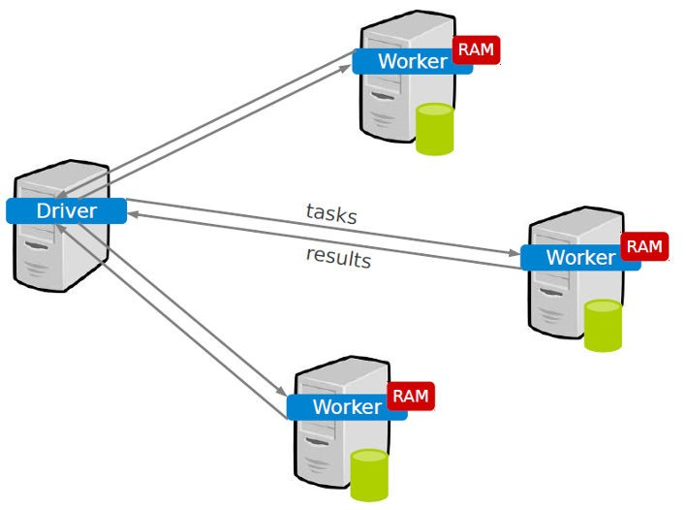
Spark Programming Interface
◮ A Spark application consists of a driver program that runs the user’s main function and executes various parallel operations on a cluster.
Engin Arslan
Spark
35 / 49

Slide 53
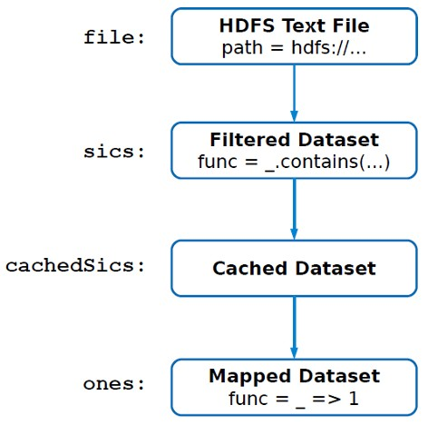
Lineage
◮ Lineage: transformations used to build an RDD.
◮ RDDs are stored as a chain of objects capturing the lineage of each RDD.
unr
cachedUNR
val file = sc.textFile("hdfs://...")
val unr= file.filter(_.contains(”UNR"))
val cachedUNR = sics.cache()
val ones = cachedUNR.map(_ => 1)
val count = ones.reduce(_+_)
Engin Arslan
Spark
36 / 49

Slide 54
RDD Dependencies (1/3)
◮ Two types of dependencies between RDDs: Narrow and Wide.
Engin Arslan
Spark
37 / 49

Slide 55
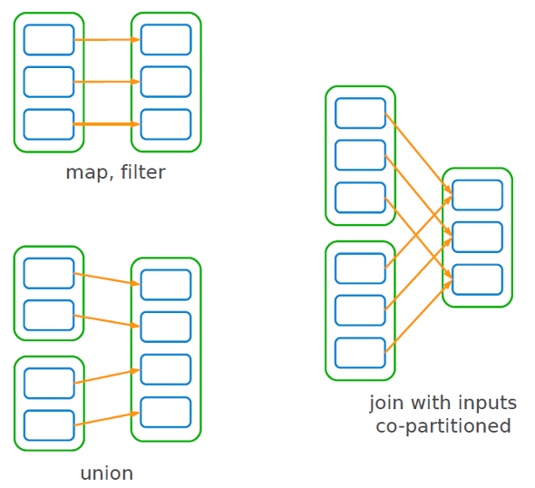
RDD Dependencies: Narrow (2/3)
◮ Narrow: each partition of a parent RDD is used by at most one partition of the child RDD.
◮ Narrow dependencies allow pipelined execution on one cluster node: a map followed by a filter.
Engin Arslan
Spark
38 / 49

Slide 56
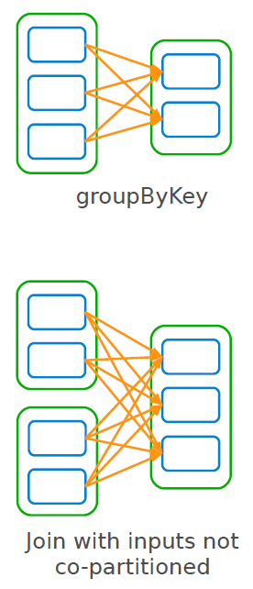
RDD Dependencies: Wide (3/3)
◮ Wide: each partition of a parent RDD is used by multiple partitions of the child RDDs.
Engin Arslan
Spark
39 / 49

Slide 57
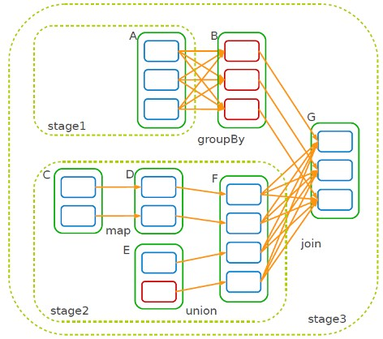
Job Scheduling (1/2)
◮ When a user runs an action on an RDD: the scheduler builds a DAG of stages from the RDD lineage graph.
◮ A stage contains as many pipelined transformation with narrow dependencies
◮ The boundary of a stage:
  Shuffles for wide dependencies.
  Already computed partitions.
Engin Arslan
Spark
40 / 49

Slide 58
Job Scheduling (2/2)
◮ The scheduler launches tasks to compute missing partitions from each stage until it computes the target RDD.
◮ Tasks are assigned to machines based on data locality.
If a task needs a partition, which is available in the memory of a node, the task is sent to that node.
Engin Arslan
Spark
41 / 49

Slide 59
RDD Fault Tolerance (1/3)
◮ RDDs maintain lineage information that can be used to reconstruct lost partitions.
◮ Logging lineage rather than the actual data.
◮ No replication.
◮ Recompute only the lost partitions of an RDD.
Engin Arslan
Spark
42 / 49

Slide 60
Job Scheduling (2/3)
◮ The intermediate records of wide dependencies are materialized on the nodes holding the parent partitions: to simplify fault recovery.
◮ If a task fails, it will be re-ran on another node, as long as its stages parents are available.
◮ If some stages become unavailable, the tasks are submitted to compute the missing partitions in parallel.
Engin Arslan
Spark
43 / 49

Slide 61
RDD Fault Tolerance (3/3)
◮ Recovery may be time-consuming for RDDs with long lineage chains and wide dependencies.
◮ It can be helpful to checkpoint some RDDs to stable storage.
◮ Decision about which data to checkpoint is left to users.
Engin Arslan
Spark
44 / 49

Slide 62
Memory Management (1/2)
◮ If there is not enough space in memory for a new computed RDD partition: a partition from the least recently used RDD is evicted.
◮ Spark provides three options for storage of persistent RDDs:
In memory storage as deserialized Java objects.
In memory storage as serialized Java objects.
On disk storage.
Engin Arslan
Spark
45 / 49

Slide 63
Memory Management (2/2)
◮ When an RDD is persisted, each node stores any partitions of the RDD that it computes in memory.
◮ This allows future actions to be much faster.
◮ Persisting an RDD using persist() or cache() methods.
◮ Different storage levels:
MEMORY ONLY
MEMORY AND DISK
MEMORY ONLY SER
MEMORY AND DISK SER
MEMORY ONLY 2, MEMORY AND DISK 2, etc.
Engin Arslan
Spark
46 / 49

Slide 64
RDD Applications
◮ Applications suitable for RDDs
Batch applications that apply the same operation to all elements of a dataset.
◮ Applications not suitable for RDDs
Applications that make asynchronous fine-grained updates to shared state, e.g., storage system for a web application.
Engin Arslan
Spark
47 / 49

Slide 65
Summary
◮ RDD: a distributed memory abstraction that is both fault tolerant and efficient
◮ Two types of operations: Transformations and Actions.
◮ RDD fault tolerance: Lineage
Engin Arslan
Spark
48 / 49

Slide 66
Questions?
Engin Arslan
Spark
49 / 49

