Slide 1
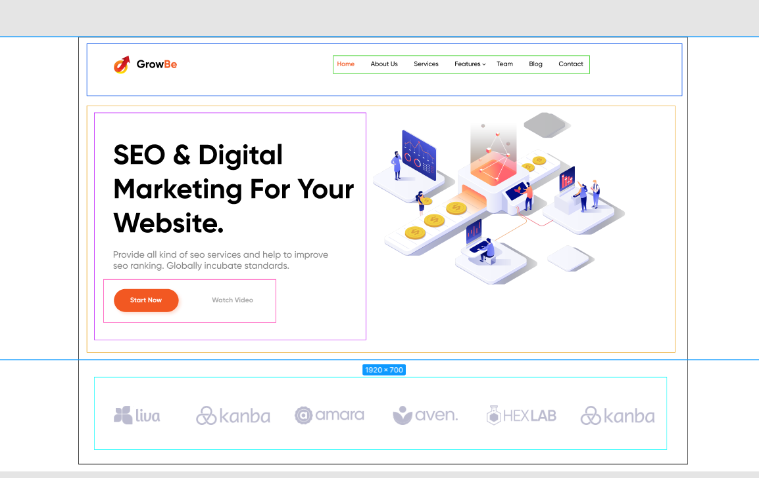
header
top_header
top_content
top
top_button
top_info
top_logo

