Slide 1
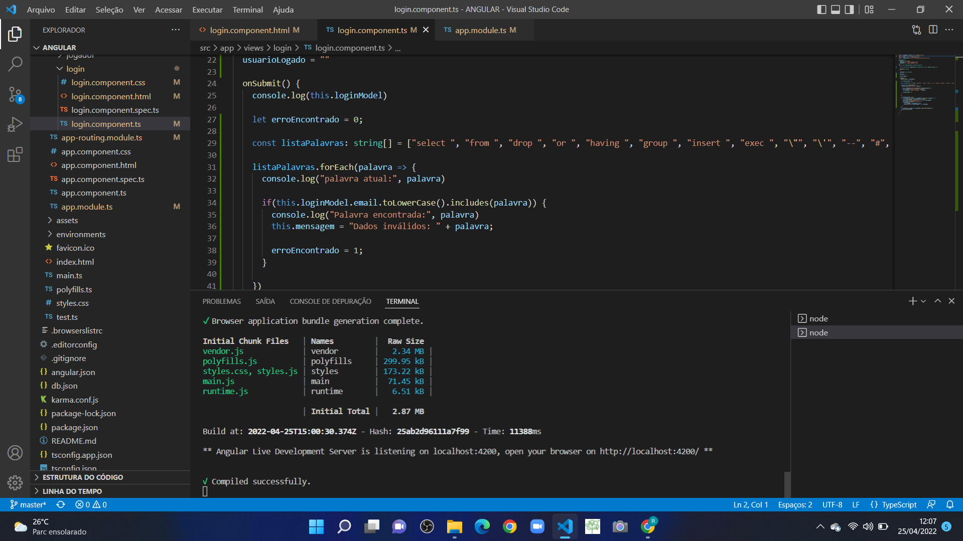
SQL INJECTION NO CÓDIGO

Slide 2
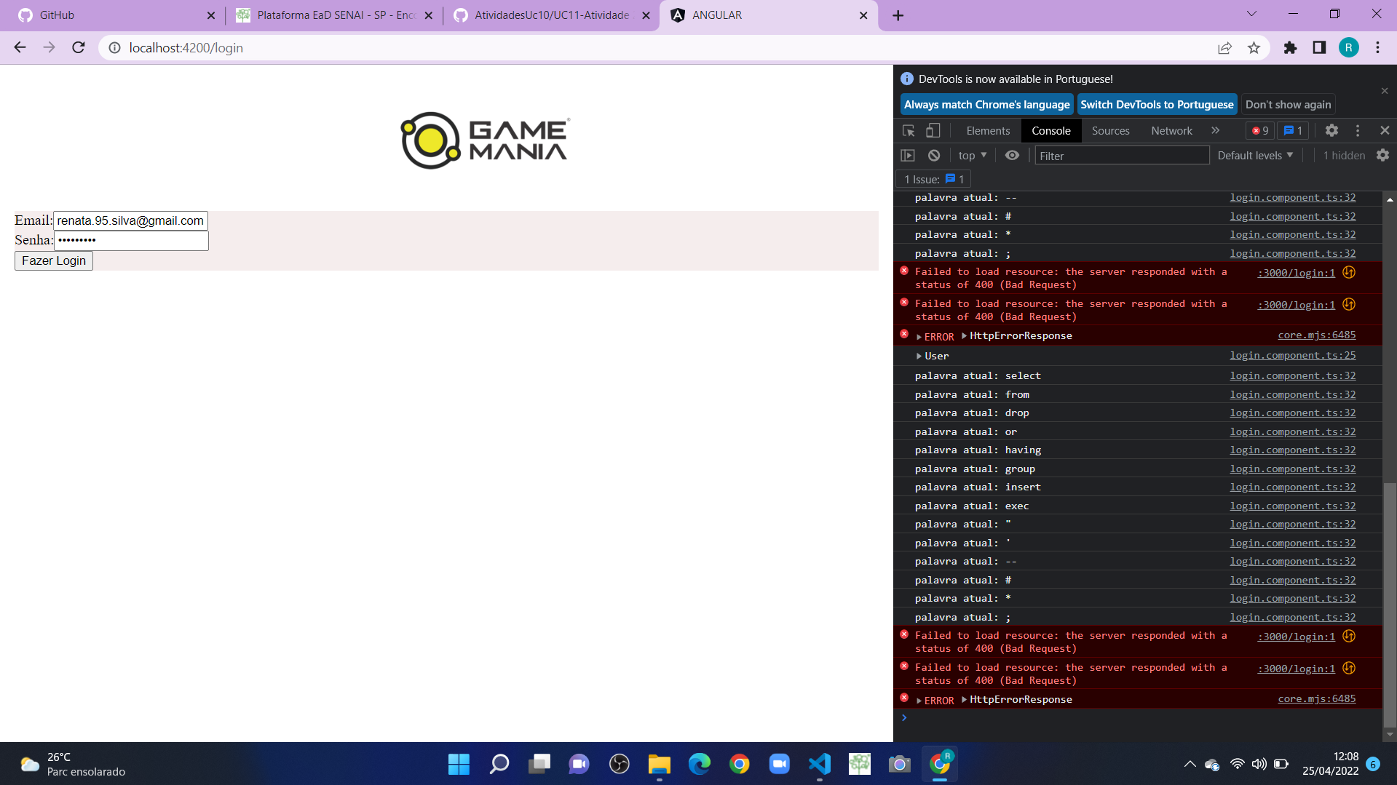
SQL INJECTION NO SITE

Slide 3
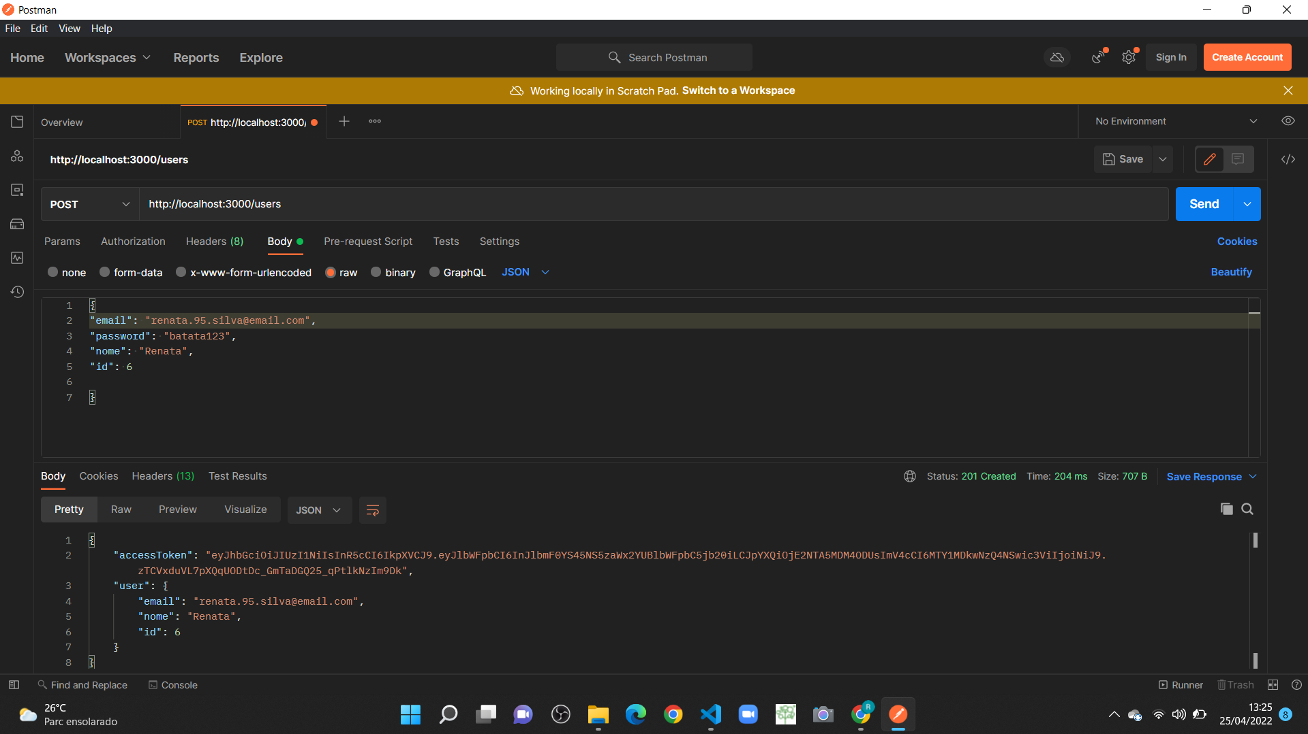
POST NO POSTMAN

Slide 4
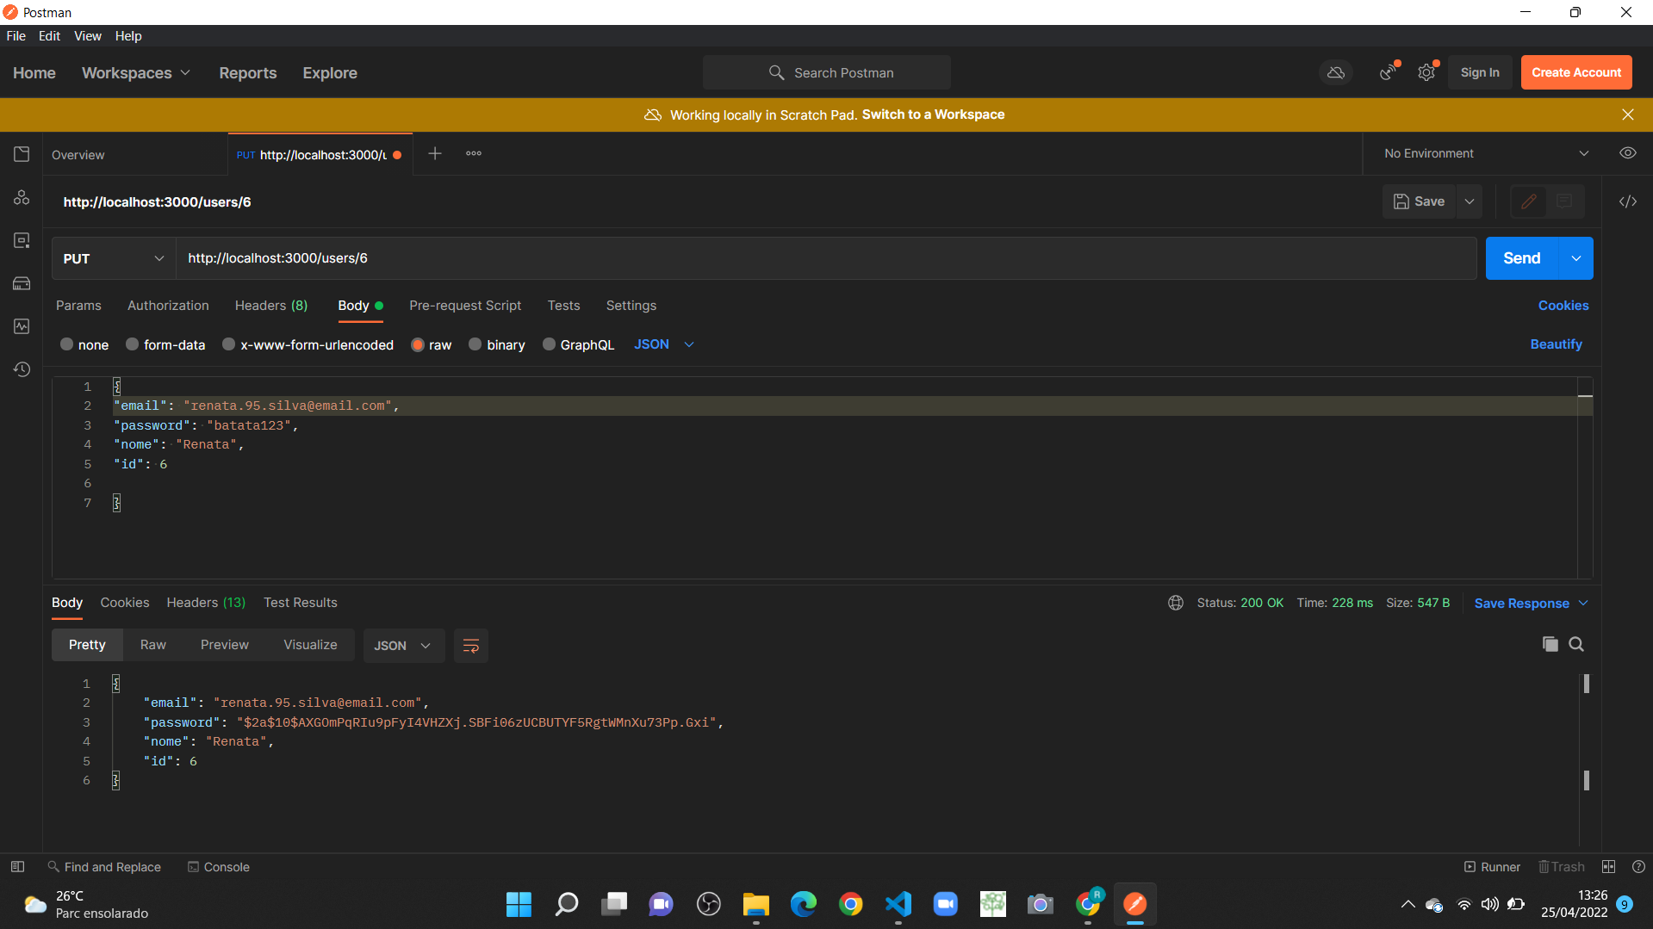
PUT NO POSTMAN

Slide 5
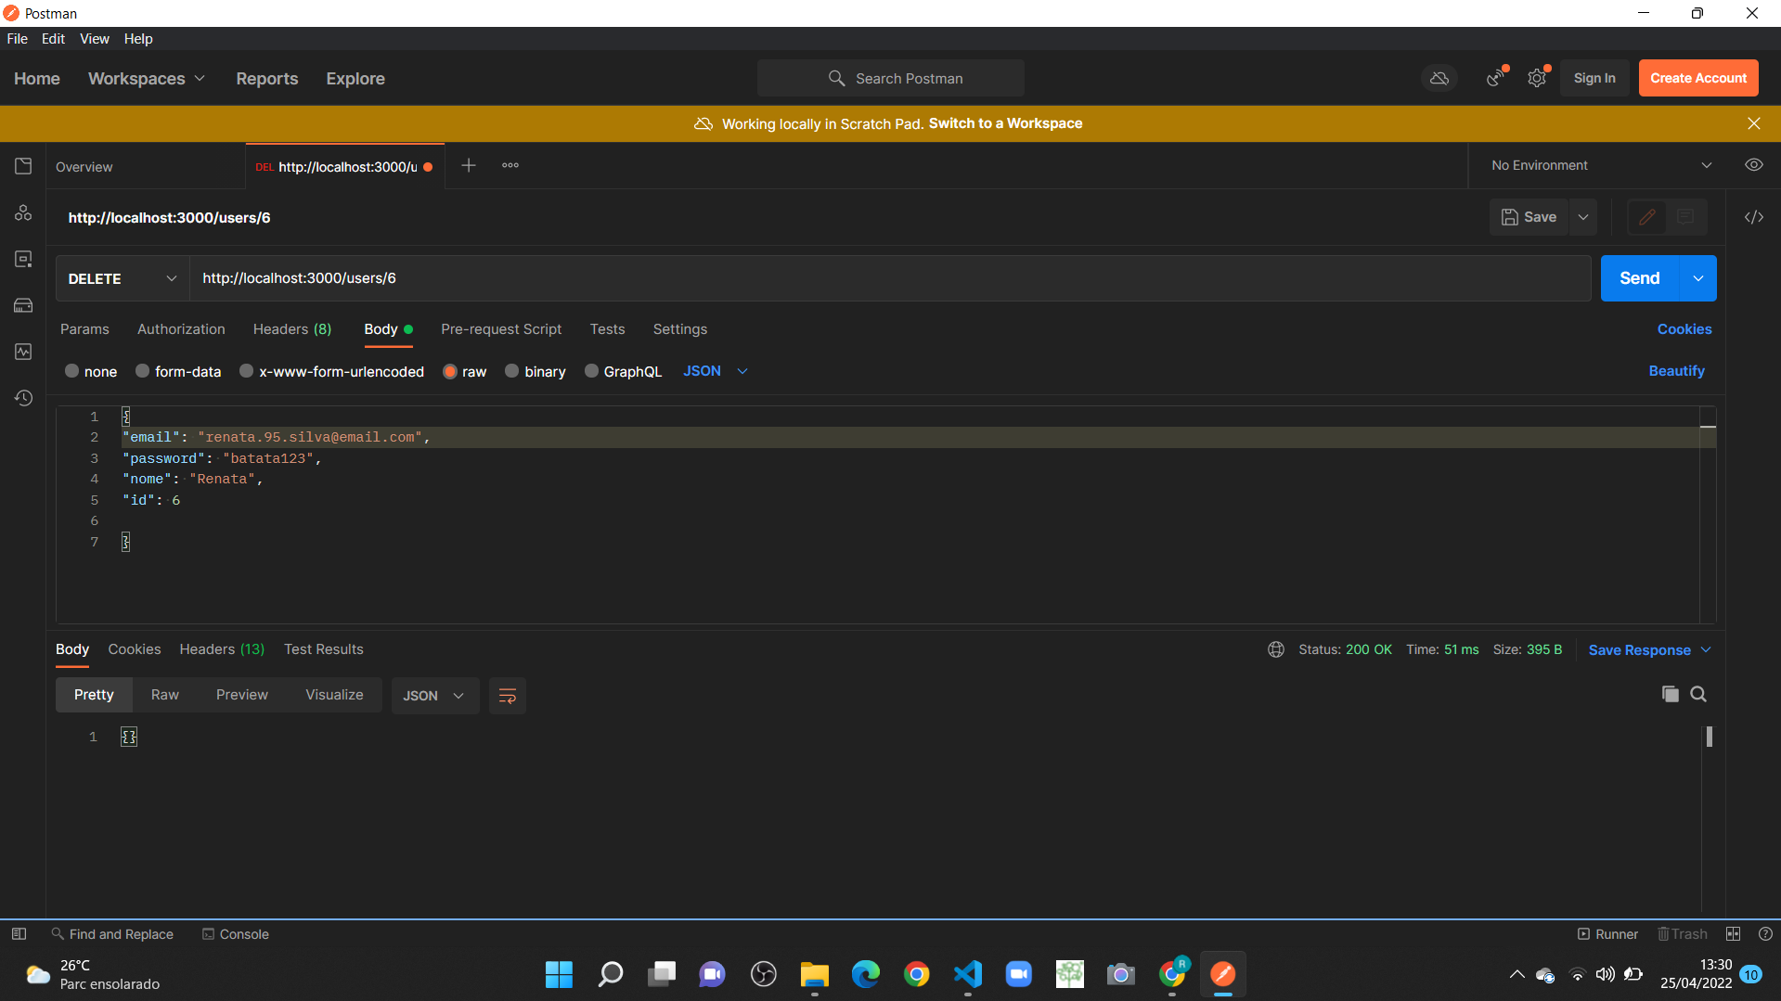
DELETE NO POSTMAN

Slide 6
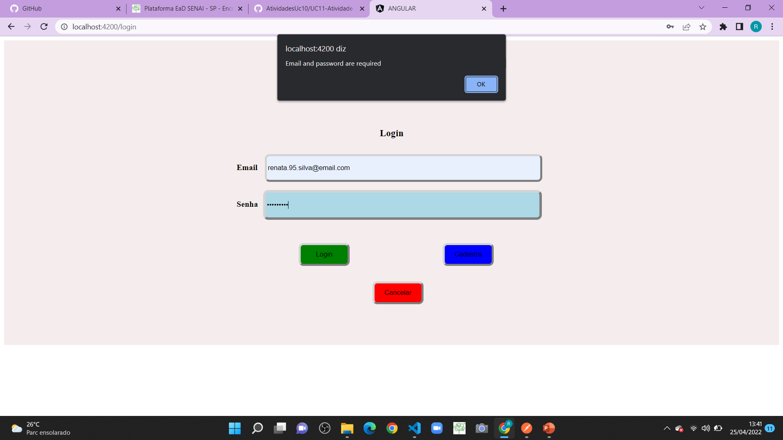
LOGIN NO SITE

