Slide 1

Foodie
A web app to book your favorite restaurants

Slide 2
What is Foodie?
A web app to simplify and manage reservations for your favorite restaurants
Show all available restaurants in your city
Choose your favorite cooking style
Your favorite table in your favorite restaurant just a few clicks away
Rate and show your restaurant’s ratings

Slide 3
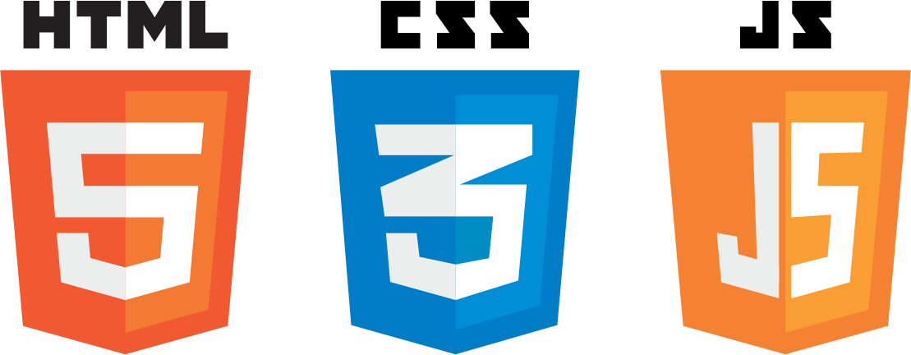



Languages used
Front-end: HTML5,CSS3,Javascript
Back-end : Python (using Flask microframework)
DB: MySql (with SqlAlchemy , as ORM (Object Relational Mapping) for Python ,a library that allows you to interact with relational databases using Python objects and methods

Slide 4
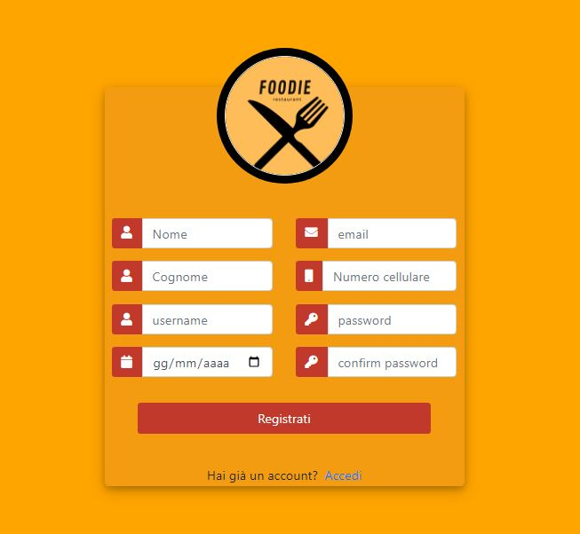
Registration
Before using Foodie, a user must be registered.

Slide 5
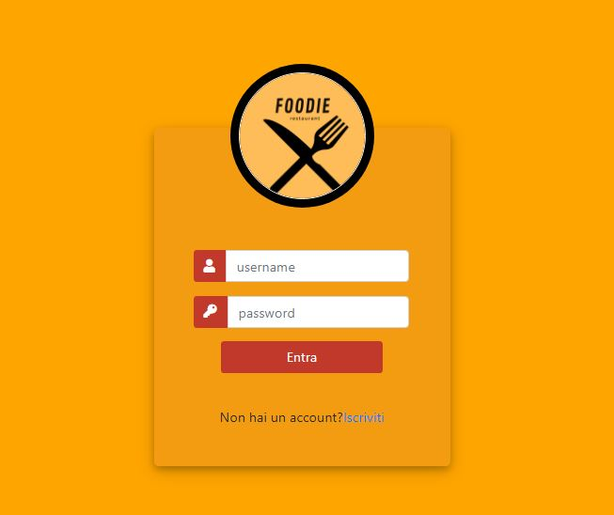
Login
Now you can login in our app writing your credentials.

Slide 6
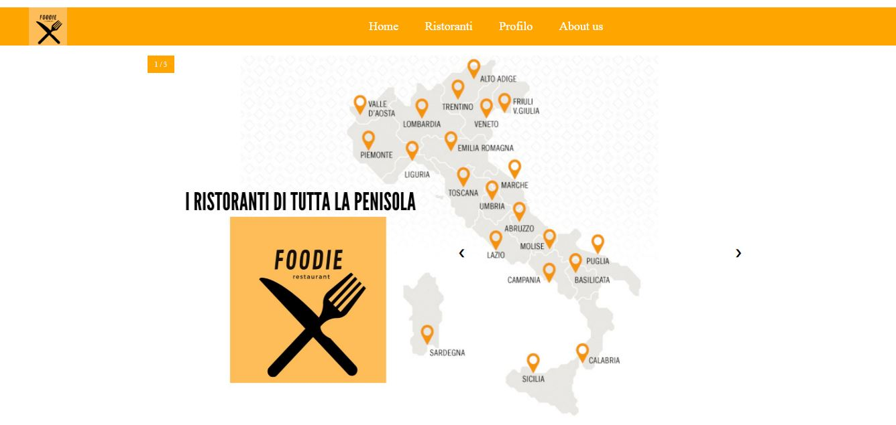
Homepage
Easy-to-use homepage:
Simple navigation bar to access all of the app functionality

Slide 7
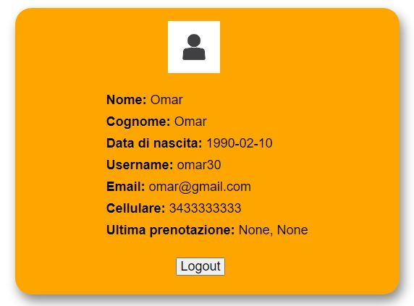
Profile
Accessing the «Profilo» section, you can see details about your profile

Slide 8
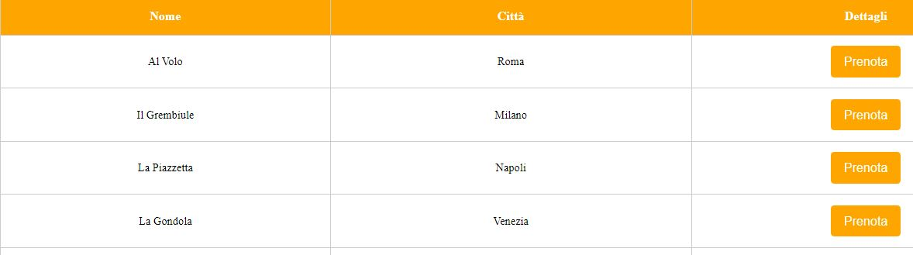
Restaurants
Show all the restaurants that have decided to join the platform

Slide 9

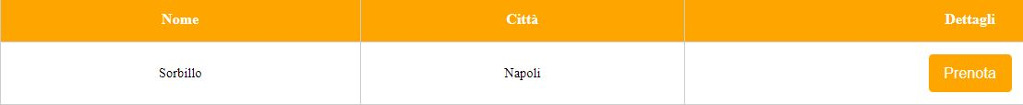
Restaurants
Choose restaurants filtering by name, city or category
It is not mandatory to compile all the filters, also just one is enough,
for example:

Slide 10
Restaurants
Using «fuzzywuzzy», a powerful python library, even not typing the correct name your restaurant will be shown up
A very useful function is token_set_ratio(); it calculates how similar two strings are.

Slide 11
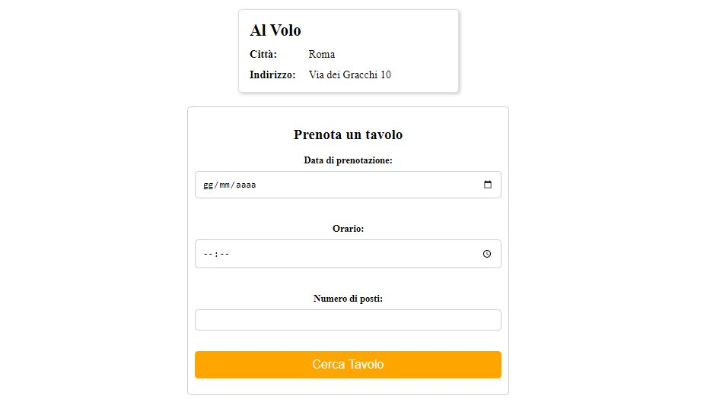
Prenotation
Just click the «Prenota» button…
…and you can access to your restaurant details to book it or review it

Slide 12
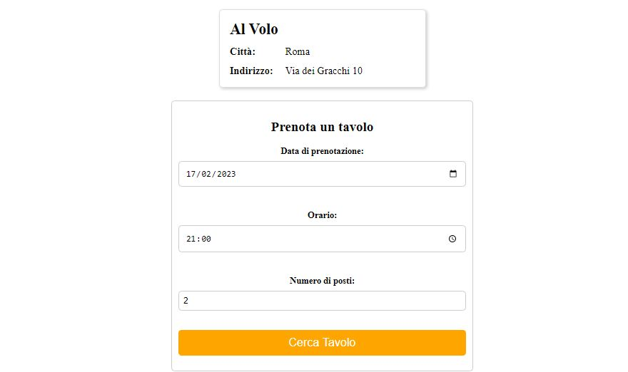
Prenotation
Just compile the form fields…

Slide 13
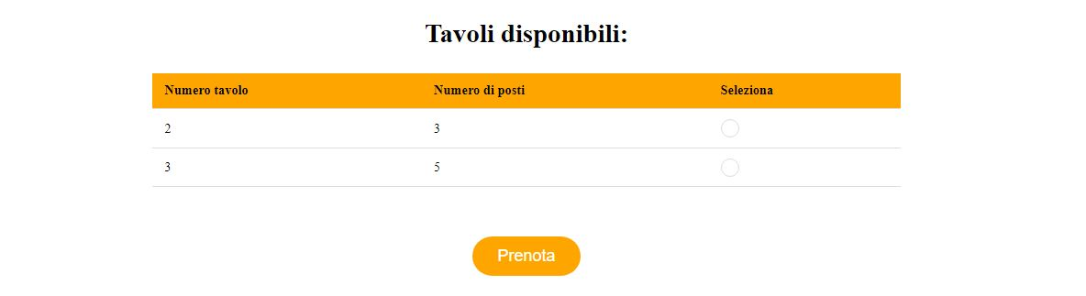
Prenotation
…and see which tables are available

Slide 14
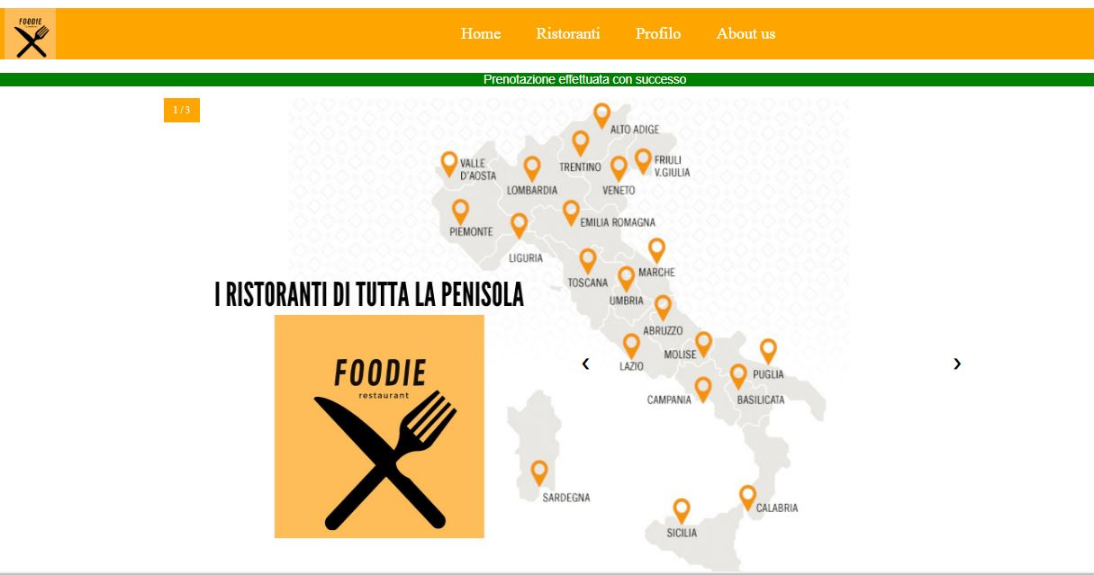
Prenotation
Selecting your table and clicking «prenota», you will be redirected into the homepage where a notification message will alert you that your prenotation was successful.

Slide 15
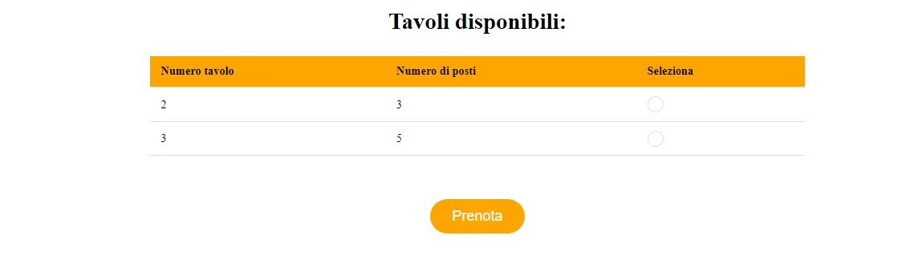
Prenotation
Each booking has a total duration of 2 hours. In that period of time, the table will not be available
in this case, table 1 is not available in the selected time period

Slide 16
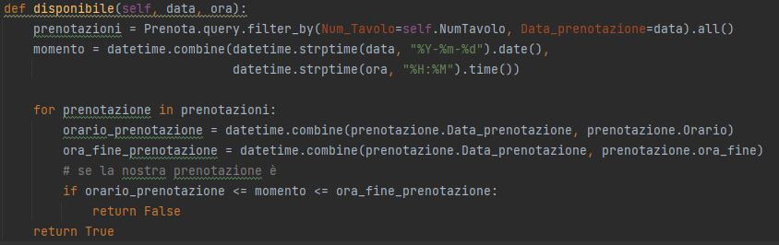
Prenotation
Through the ‘Disponibile‘ function we check which tables are available in that period of time

Slide 17

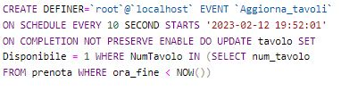
Prenotation
When the reservation has expired, the tuple must be deleted from the database and the table becomes available again. We use 2 events :

Slide 18
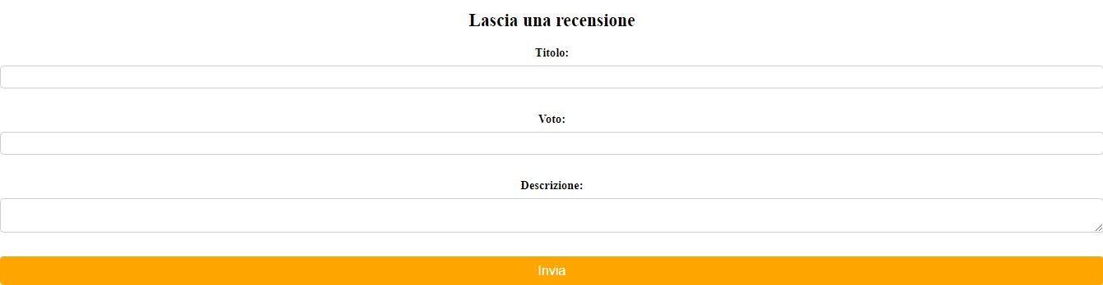
Reviews
A user can leave a review to the restaurant, giving a rating from 1 to 10 and also leaving a textual description of the review

Slide 19
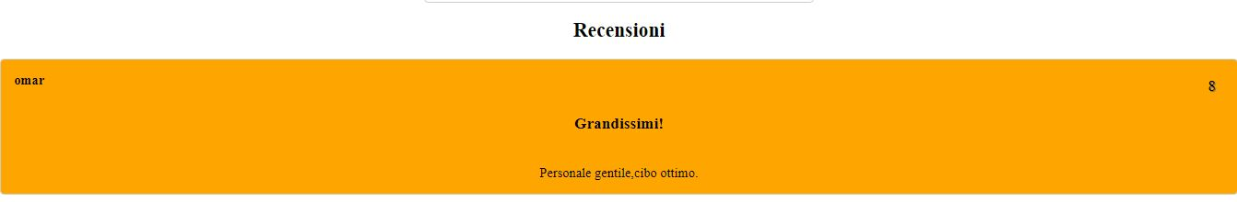
Reviews
Once submitted, reviews will be visible to all users

Slide 20
A PROJECT BY:
Alessandro di Nuzzo - 0124002080
Matteo Nobler - 0124001853
Renato Di Donna- 0124002337

