Slide 1

University of Naples "Parthenope" Department of Science and Technology Master's Degree Course in Computer Science (Machine Learning and Big Data)
Propositional Logic Minesweeper
Project specifications
Candidate Renato Esposito Matr. 0120000278
Academic Year 2023/2024

Slide 2
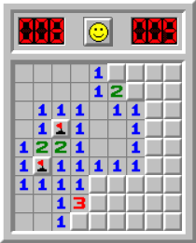
Minesweeper
Minesweeper is a single player logic-puzzle video game generally played on personal computers.
The game consists of a grid of clickable tiles, with hidden "mines" scattered across the board.
The goal is to clear the board without detonating any mines, with the help of clues about the number of nearby mines in each field.
Many versions of this game have been developed, but the implementation of this project refers to the "standard" version.

Slide 3
Basic Rules
Playing Field: the game takes place on a 6x6 rectangular grid of cells.
Cells: each cell can hide a mine, be empty or contain a number.
Cell Discovery: by clicking on an cell, if it doesn't have a mine, a number appears indicating how many mines there are in adjacent cells.
Reporting Mines: players can mark with a flag cells that they suspect contain mines.
Final Objective: uncover all cells without clicking on a mine. The game ends in victory if all cells without mines have been discovered or in defeat if a mine is clicked.

Slide 4
Gameplay
The game is played by the intelligent agent (IA), which makes the moves and discovers the cells.
The user can click a button to allow the IA ​​to make its next move.
The user can also mark cells that he suspects contain mines.
Initial Discovery: the first click is always safe and does not contain a mine.
The discovered cells display a number (1 to 8) indicating how many mines are in the surrounding eight cells.
When the IA uncovers a cell that has no adjacent mines (indicated by a number zero), the game automatically uncovers all surrounding cells, potentially revealing more empty cells, and so on, until there are no more empty cells with no adjacent mines to automatically discover.

