Slide 1
TP1: Raytracer
Renato utsch, DCC UFMG

Slide 2
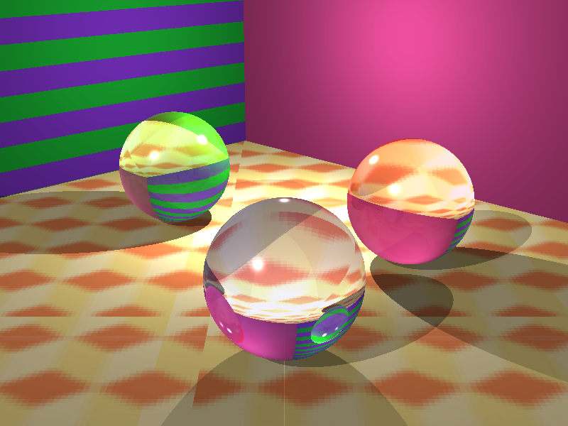
Sequential Raytracer

Slide 3

Sequential Raytracer

Slide 4


Slide 5
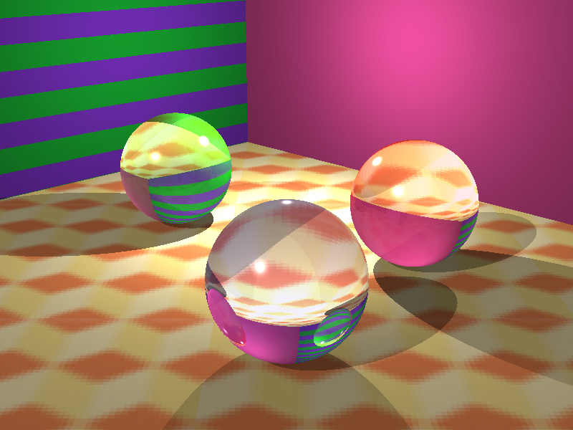
OpenCL Raytracer

Slide 6
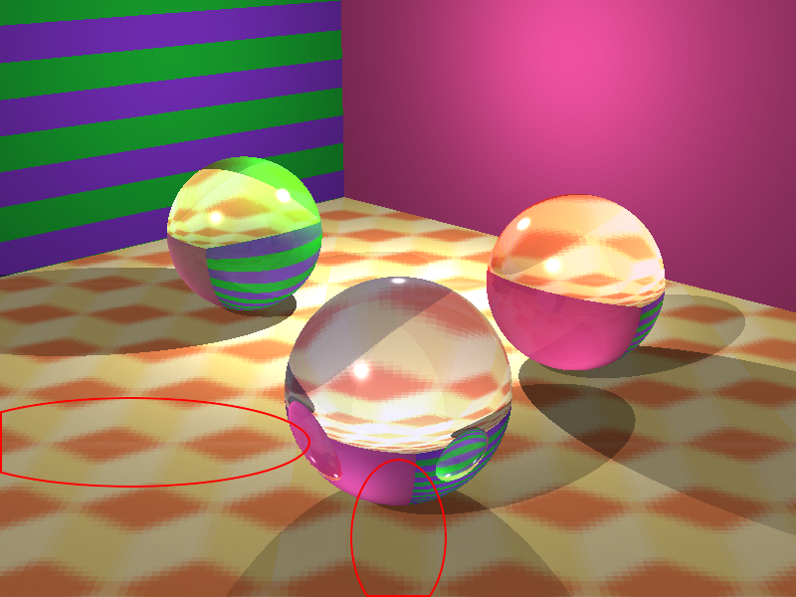
OpenCL Raytracer

Slide 7
PROBLEMS

Slide 8
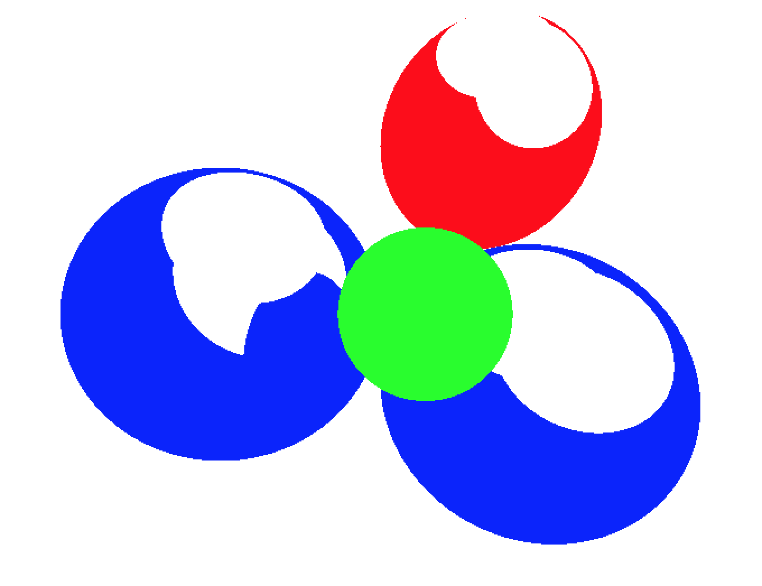
PROBLEMS

Slide 9
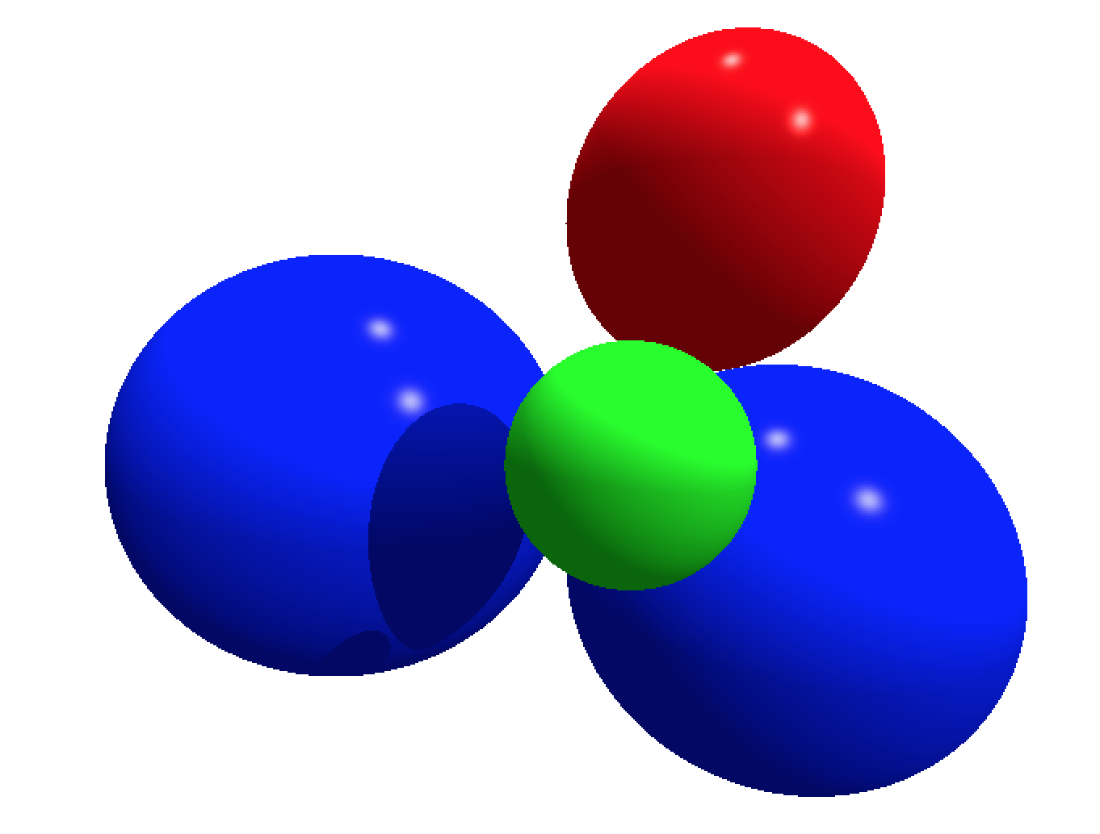
Correct

Slide 10
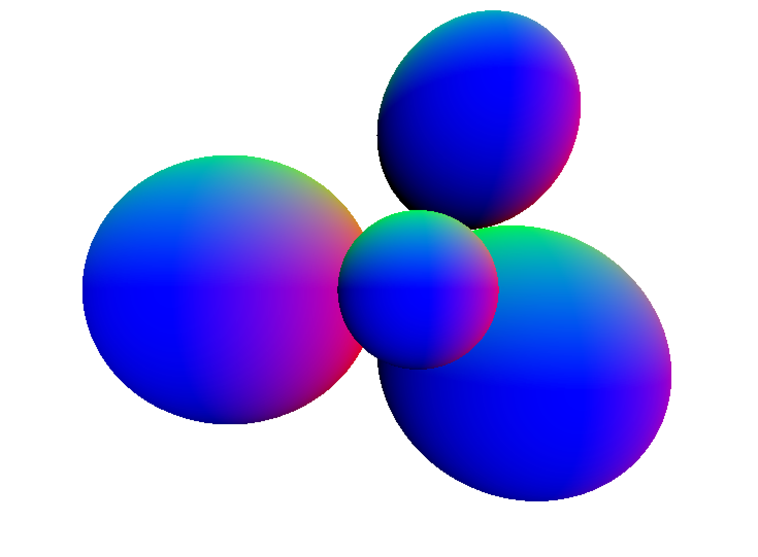
Correct

Slide 11
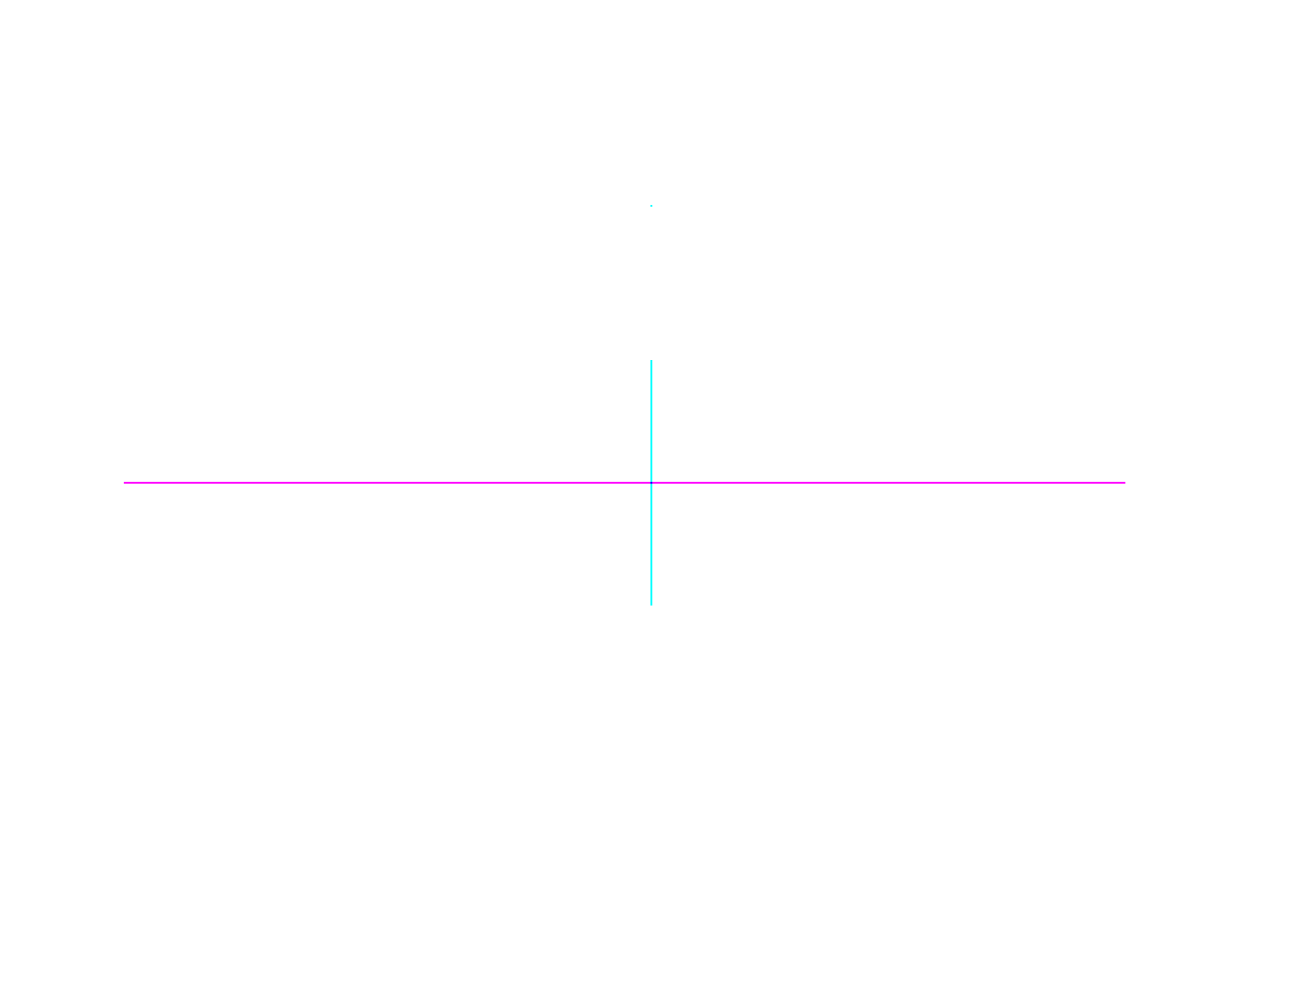
WAT

Slide 12

SHIT

Slide 13
Correct

Slide 14
THANK GOD

Slide 15
FINALLY

Slide 16
CORRECT

Slide 17
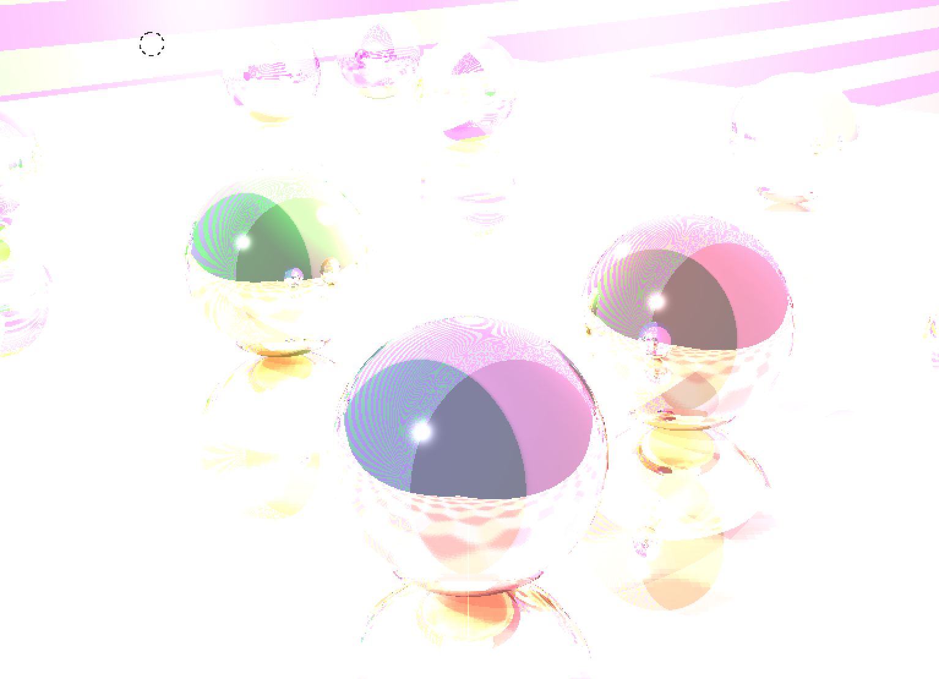
NOT… RIGHT

Slide 18
OpenCL Raytracer Options
Anti Aliasing (Supersampling)
Soft Shadows

Slide 19
test4

Slide 20
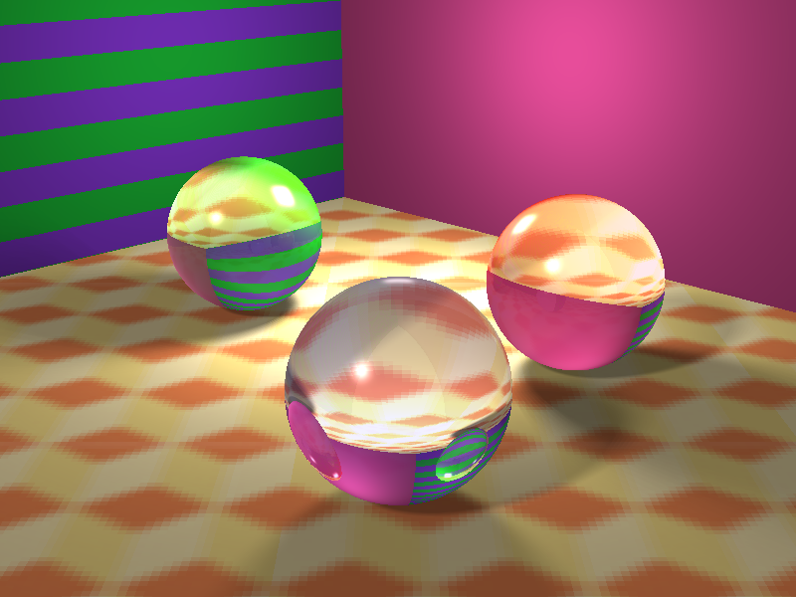
Test4 --ss 8

Slide 21

Test4 --ss 8 --AA 4

Slide 22
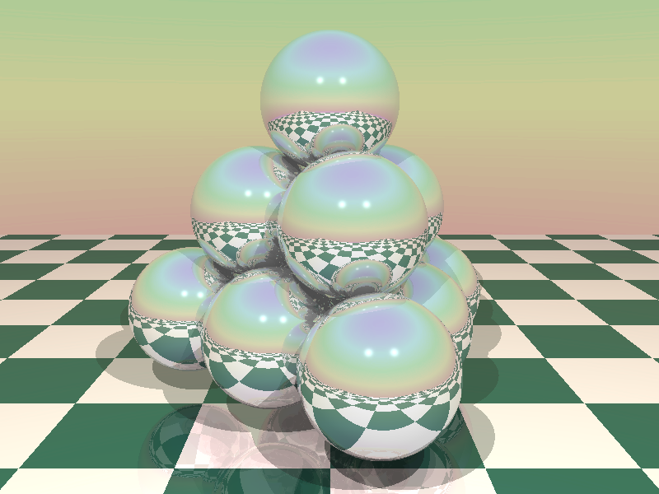
Test5

Slide 23

Test5 --SS8

Slide 24
Test5 --SS8 --AA4

Slide 25
PERFORMANCE
Sequential
Test1: ~1100ms
Test4: ~3700ms
Test5: ~3800ms
OpenCL
Test1: ~1100ms
Test4: ~3700ms
Test5: ~3800ms
OpenCL --SS8
Test1: ~1100ms
Test4: ~3700ms
Test5: ~3800ms
OpenCL --SS8 --AA4
Test1: ~1100ms
Test4: ~3700ms
Test5: ~3800ms

