Slide 1

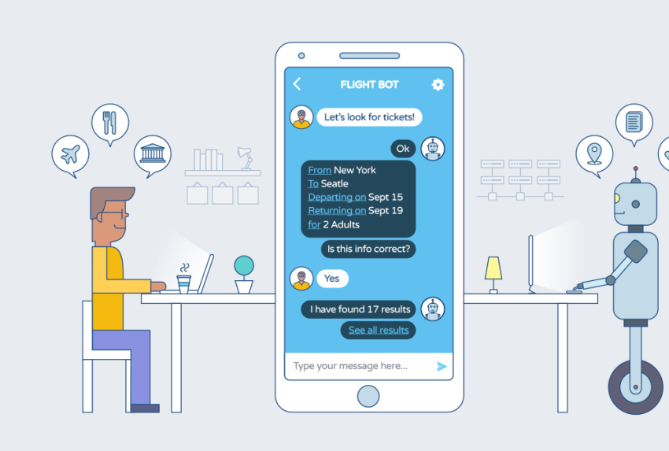
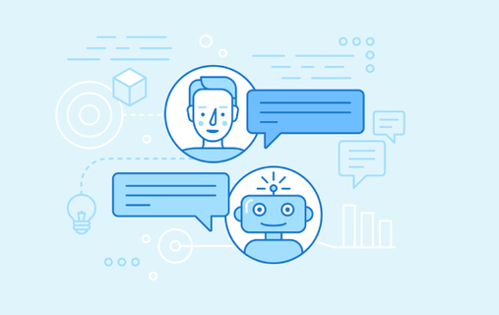
A.I Doc (A Healthcare Chatbot)
A Project Summary
By Prabhat Kumar Dubey

Slide 2
About the Project
Healthcare chatbot is intended to provide personalized health and therapy information to patients, provide relevant products and services to patients, as well as suggest diagnoses and recommend treatments based on patient symptoms.
This healthcare chatbot system will help hospitals to provide healthcare support online 24 x 7, it answers deep as well as general questions. By asking the questions in series it helps patients by guiding what exactly he/she is gotten into. This in term helps Doctor to get information about the patients before physical interaction if needed.

Slide 3
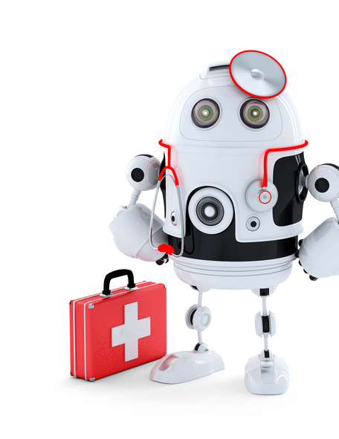
What’s a Chatbot?
Chatbot or bot – is a computer program that simulates a natural human conversation.
Instead of having a conversation with another person, the user talks with a bot that's either powered by basic rules or machine learning. Every chatbot serves a specific purpose — health bots are designed to help with health-related issues

Slide 4
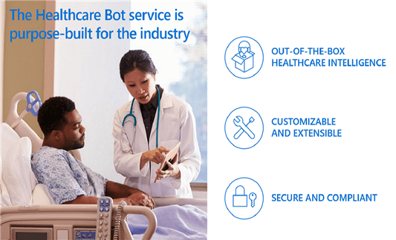
Primary reason for this Project
Ease the burden on doctors in primary care and help patients learn to take care of their health responsibly.

Slide 5
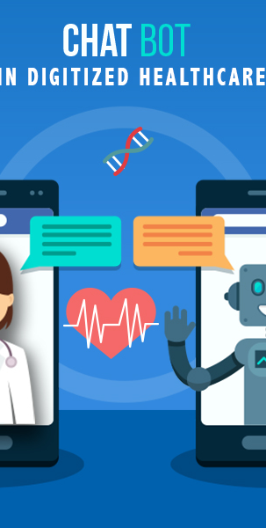
Tools and concept used:
The project is based on Decision tree algorithm which help it to predict the diseases caused by the symptom given by the user. It can also provide details about the disease as well as a diagnosis. By using the Wikipedia lib. The data and datasets are processed by the pandas lib, NumPy lib, sklearn lib, random lib, sys lib and squlite3 lib. Dataset is collected from Kaggle.com and user data is stored in SQL Database using squlite3 lib.

Slide 6
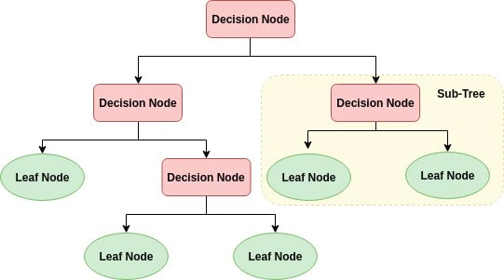
Decision tree algorithm
Decision Tree algorithm belongs to the family of supervised learning algorithms.
They can be used to solve both regression and classification problems.
Decision tree uses the tree representation to solve the problem in which each leaf node corresponds to a class label and attributes are represented on the internal node of the tree.
Information Gain When we use a node in a decision tree to partition the training instances into smaller subsets the entropy changes. Information gain is a measure of this change in entropy.
Entropy Entropy is the measure of uncertainty of a random variable, it characterizes the impurity of an arbitrary collection of examples. The higher the entropy more the information content.

Slide 7

Python Libraries used:
Wikipedia: is a Python library that makes it easy to access and parse data from Wikipedia.
NumPy: Is the core library for scientific computing in Python. It provides a high-performance multidimensional array object, and tools for working with these arrays.
Pandas: is an open source, BSD-licensed library providing high-performance, easy-to-use data structures and data analysis tools for the Python programming language.
Random: generates a random float uniformly in the semi-open range [0.0, 1.0)
Sys: System-specific parameters and functions.
Squlite3: provides a standardized Python DBI API 2.0 compliant interface to the SQLite database.
Sklearn:is a free machine learning library for Python. It features various algorithms like support vector machine, random forests, and k-neighbours.

Slide 8
Advantages:
Instantly 24/7 arability.
A friendly humanly way interaction.
Access anywhere, no matter where you are located.
It can ease the work of Doctor’s by reducing the number of patients by providing general information about the patient from its database.
It can help the patients to learn to take care of their health responsibly. People will be able to treat themselves from their homes

Slide 9
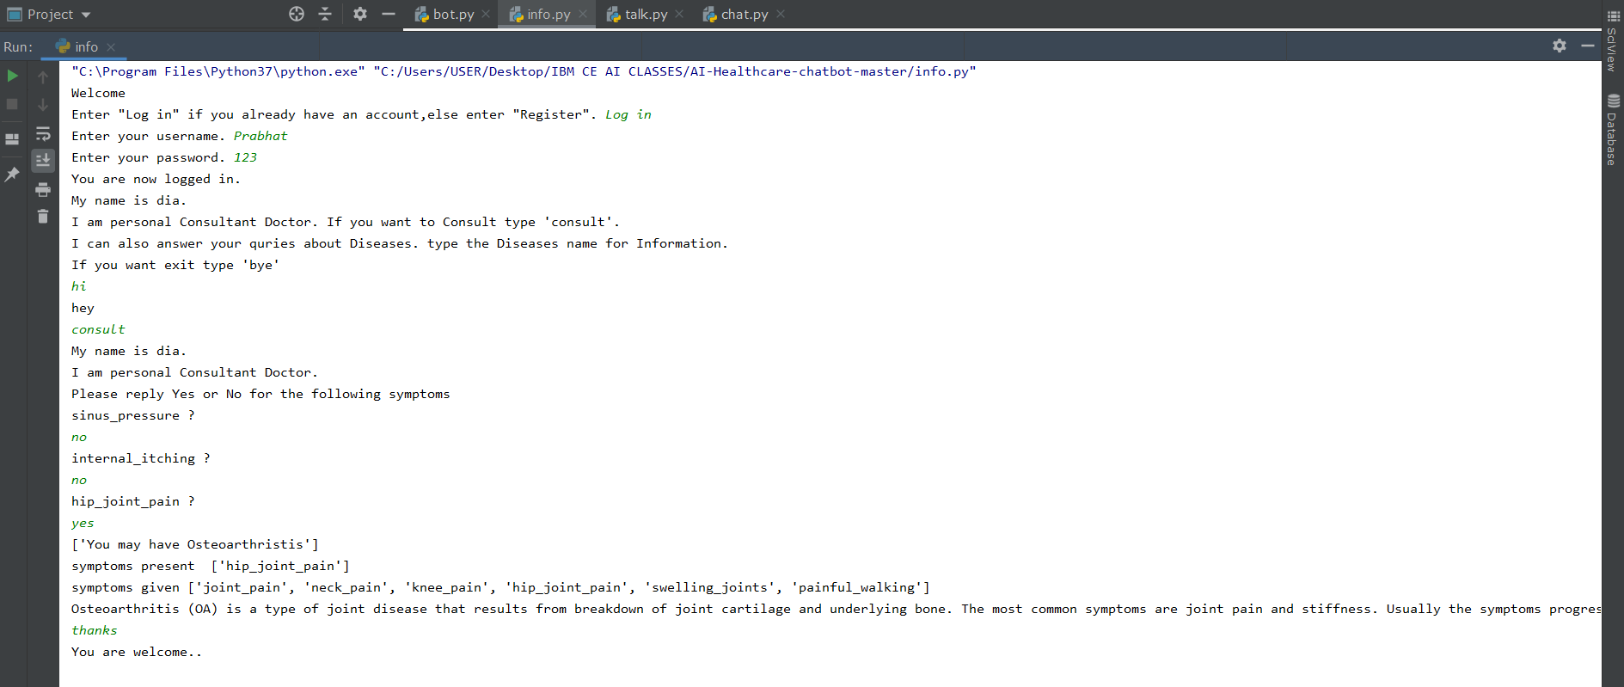
VIDEO LINK:
https://drive.google.com/file/d/1D2anq-DP18ngYwKZULQFJCUWC-SjOhEw/view?usp=drivesdk

Slide 10
The References:
• https://www.wikipedia.org
• https://www.kaggle.com
• https://www.w3schools.com/
• https://github.com
• https://www.google.com

