Slide 1
Hoang
MATH179 Midterm Project
2024

Slide 2
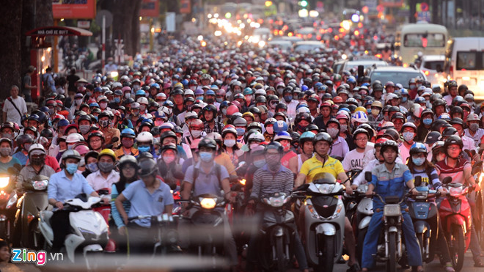

Slide 3
Predicting Used 🚙 Value
What’s the maximum listing price my used car could be sold?
3,000,000 observations from (kaggle.com/us-used-cars-dataset) – 10GB.
66 features, half of them have no descriptions in metadata.
Crawled on cargurus.com in September 2020 -> submissions are independent.
Diverse data types: text, number, Nan
Metric: custom Mean Absolute Error, where:
under-prediction will * 1.2
over-prediction will * 0.8
=> Motivation Questions:
1. What features should be used for prediction?
2. How well will my prediction be without knowing any feature descriptions?

Slide 4
Explore Data: getting started
What’s my response column name? “price”.
=> X: DataFrame without column ‘price’.
y: Column ‘price’ and nothing else.
Do I want an intercept β₀?
<= Are there rows where all features’ values being zero(s) ?
=> YES
=> X: DataFrame without column ‘price’ and has a column full of 1’s.
Do I want duplicating rows / columns ?
<= Will duplicating rows / columns affect regression coefficients? No.
<= Will duplicating rows / columns invalidate regression assumptions? Yes (multi-collinearity).
=> NO, remove them.
How do I split the data?
=> Just split as usual (80% X_train, y_train; 20% X_test, y_test)
(because I forgot to split train-valid-test)

Slide 5
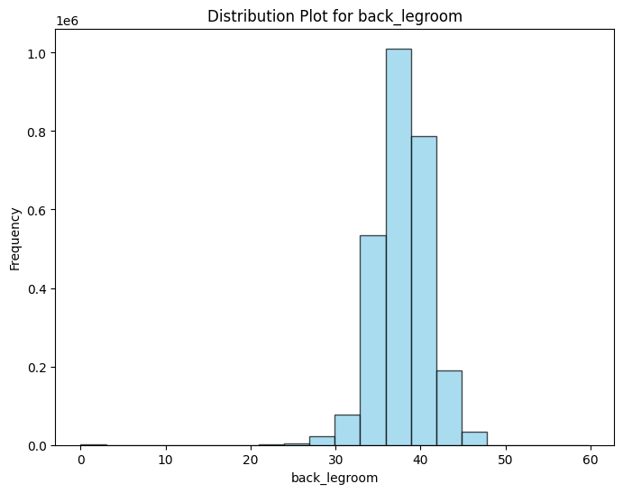
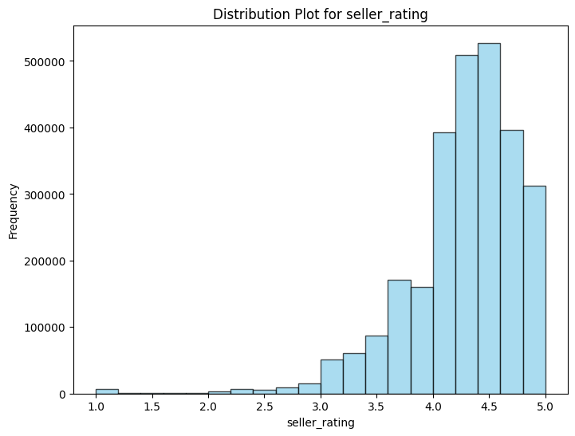
Explore Data: welcoming “ the null”
Remove ”massive null” columns having 20%+ (600,000+) missing observations.
Impute “small null” columns: based on the distribution of a column
If this: => Impute mean
If that: => Impute median
Else: => Impute mode

Slide 6
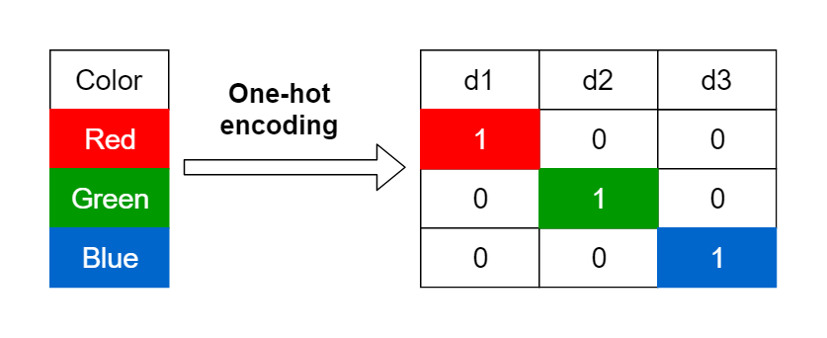
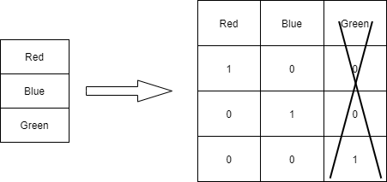
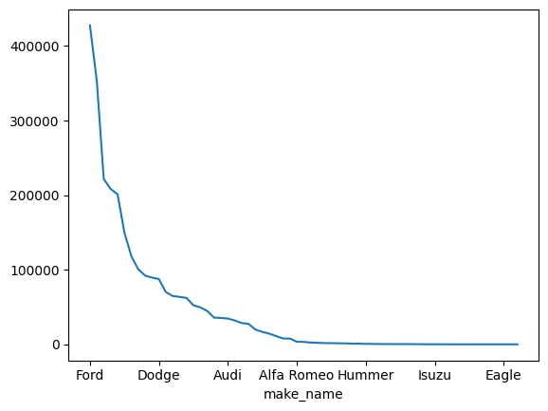
Explore Data: translating “the text”
👉
What if we’re overcrowded ⁉️
What do I want from encoding? 1 to 2 same meaning as 2 to 3 <= IQR Frequency Encoding.

Slide 7
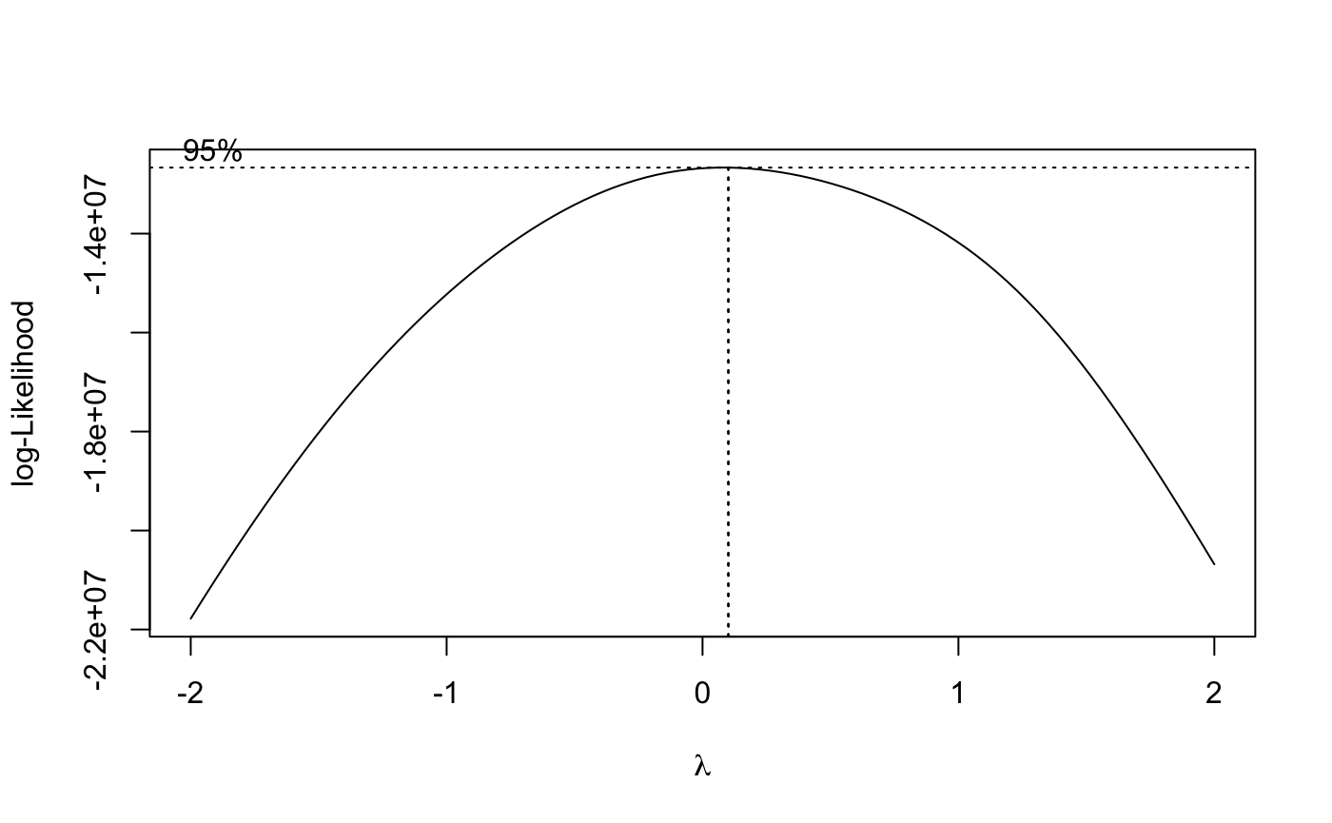
The Full Linear Model: preparing the ingredient
Do I want to transform y?
=> YES
Do I want to transform X? <= When do I need to transform X?
Non-Linearity Linearity
Something needs it (PCA, PLS, Ridge, …)
magic

Slide 8
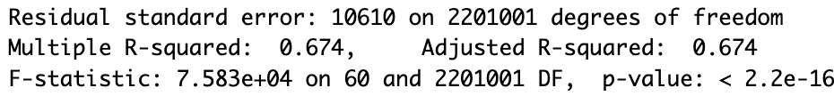

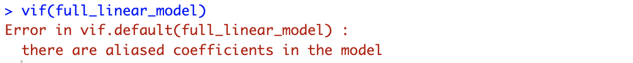
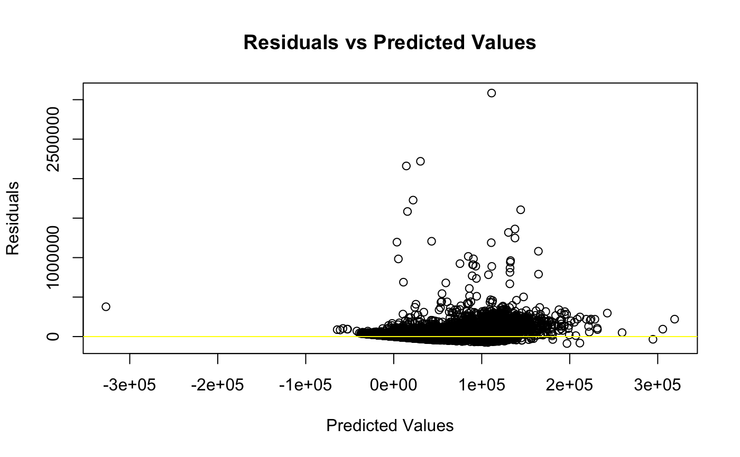
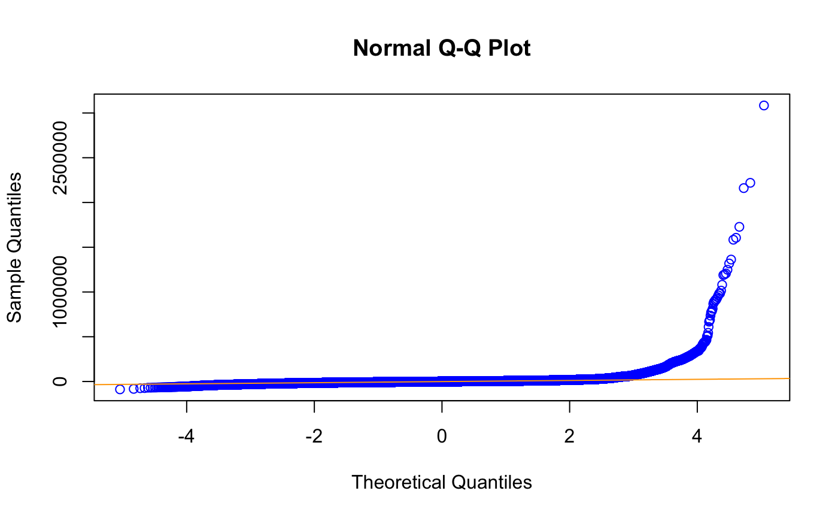
The Full Linear Model
What’s the R-Squared(s)?
How long did it take?
Testing Result: train: 6234 ; test: 10,689
Does multi-collinearity exist?

Slide 9
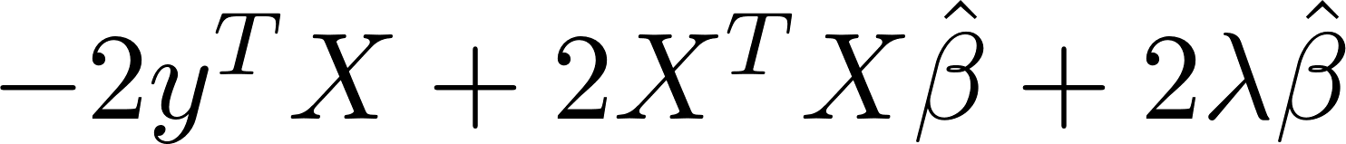
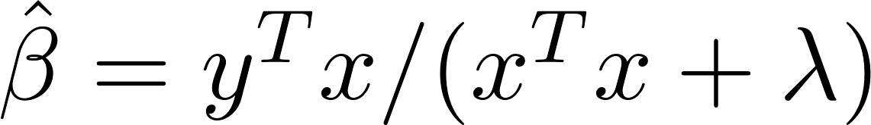
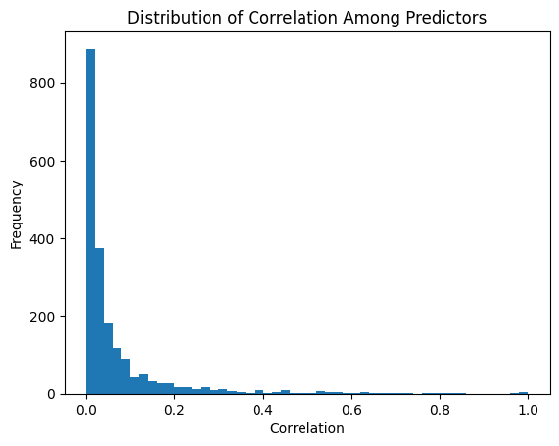
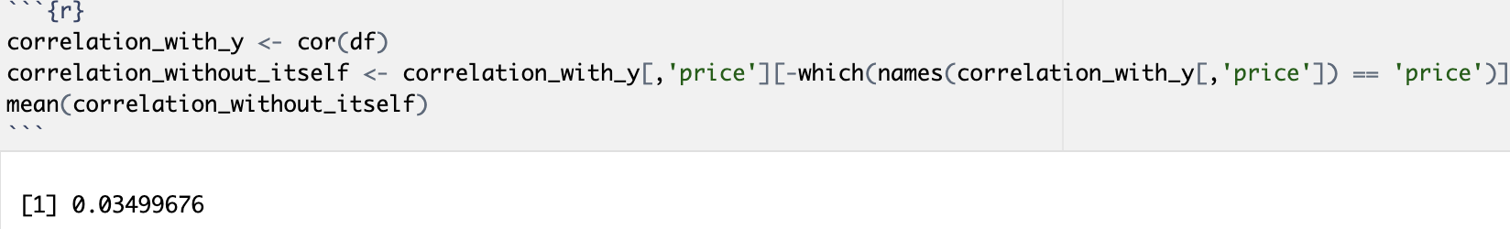
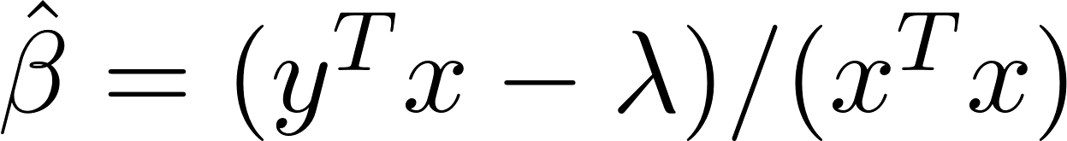
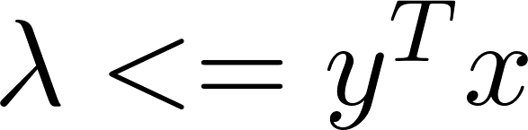
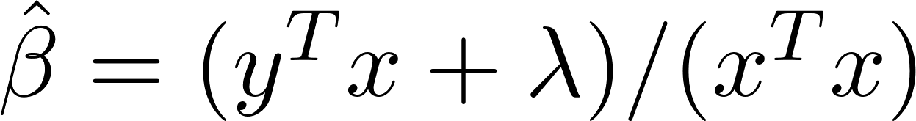
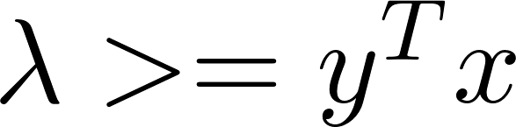

Multicollinearity: Regularize vs Transform Dataset I want: VIF(a linear model) < 5, ideally ~ 1 to 2
Principle Component Analysis
Partial Least Squares
Ridge Regression
1.d(ridge function)=
2. Solution when d(ridge function) = 0:
always > 0 whatever the penalty rate
If majority of correlations among predictors are small,
PCA is not effective
If majority of correlations with response are small,
PLS is not effective
The LASSO
Solution when d(lasso function) = 0:
1. when
2. when
The LASSO
then OLS
Whatever_Error(LASSO)
<
Whatever_Error(OLS)

Slide 10
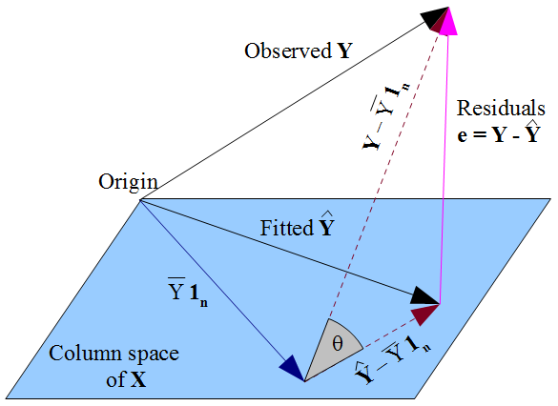
Multi-collinearity: Optimization I want: VIF(a linear model) < 5, ideally ~ 1 to 2 , find how much should I penalize for the LASSO
Idea:
VIF = 1 / (1 – R^2)
R^2 is how much variance of actual_y (represented by SST) are from predicted_y (SSReg)
Geometrically:
=> SSReg = cov_mat(y, X)^T @ cov_mat(X) @ cov_mat(y, X)
=> SST = cov_mat(y)
=> R^2 = SSReg / SST = SSReg @ SST^-1
= cov_mat(y, X)^T @ cov_mat(X)^-1 @ cov_mat(y, X)
=> VIF = 1 / (1 – R^2) => cov_mat(X)^-1 = F(cov_mat(X))
=> VIF_regularization = F(cov_mat(X) + lambda * I)

Slide 11
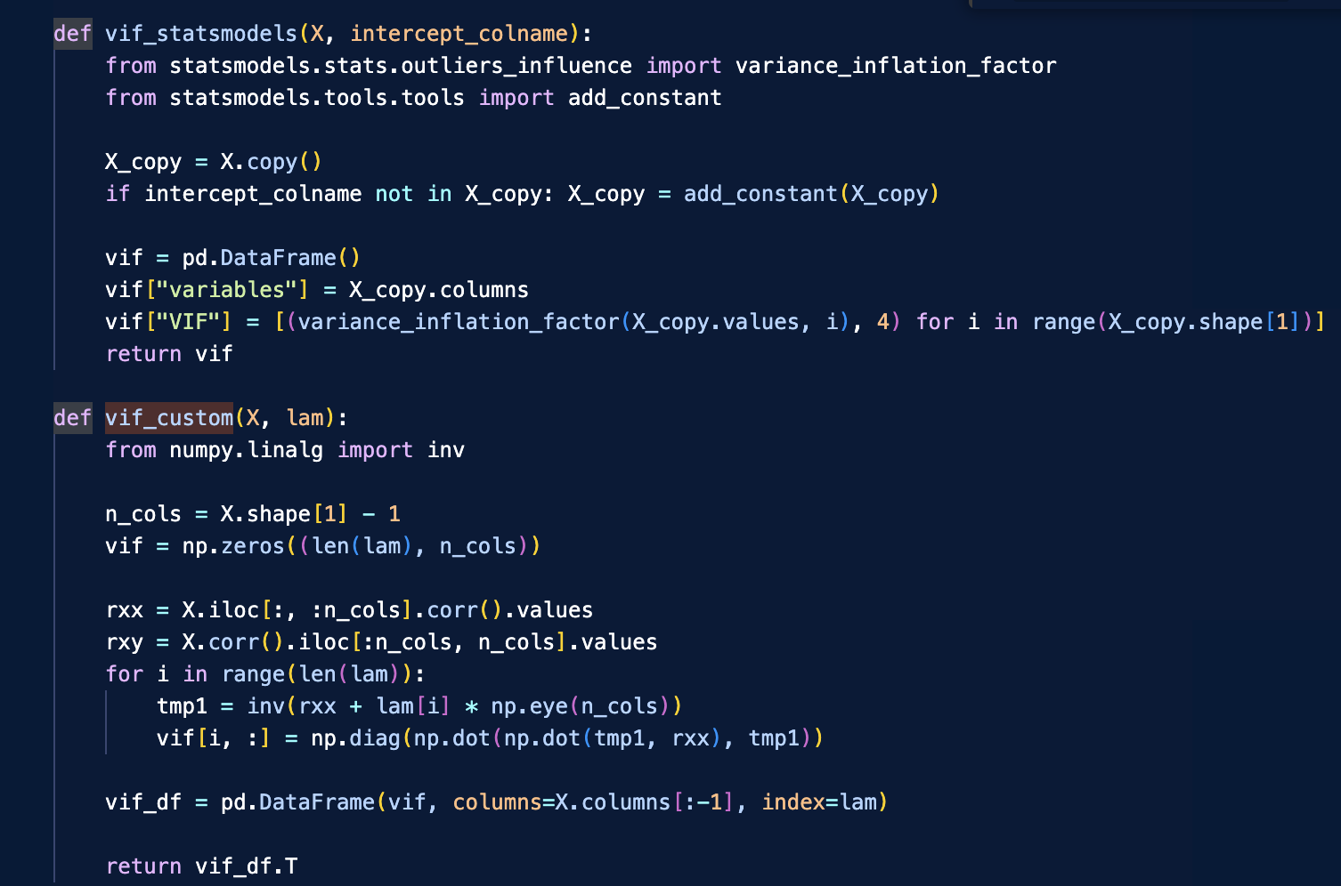
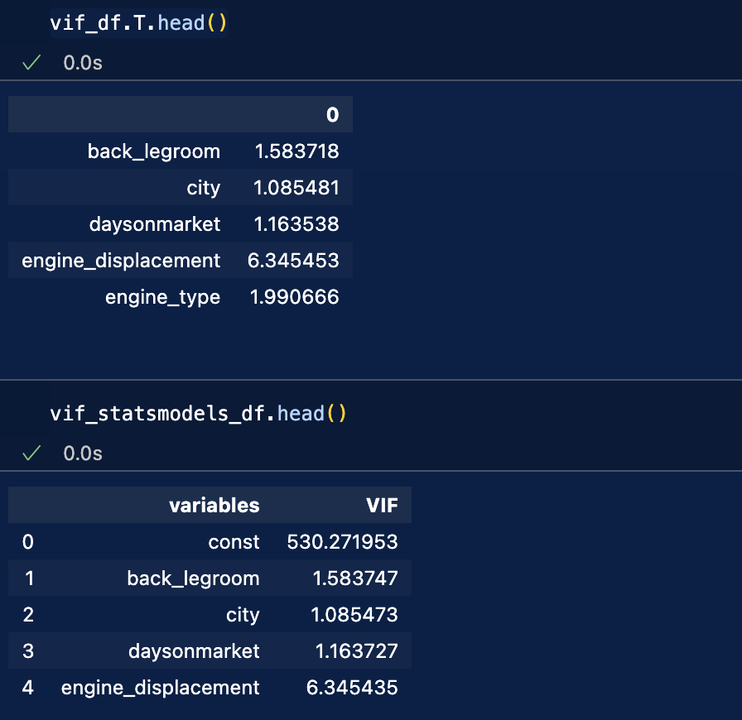
Multi-collinearity: Code I want: VIF(a linear model) < 5, ideally ~ 1 to 2 , find how much should I penalize for the LASSO
Idea: Proof

Slide 12
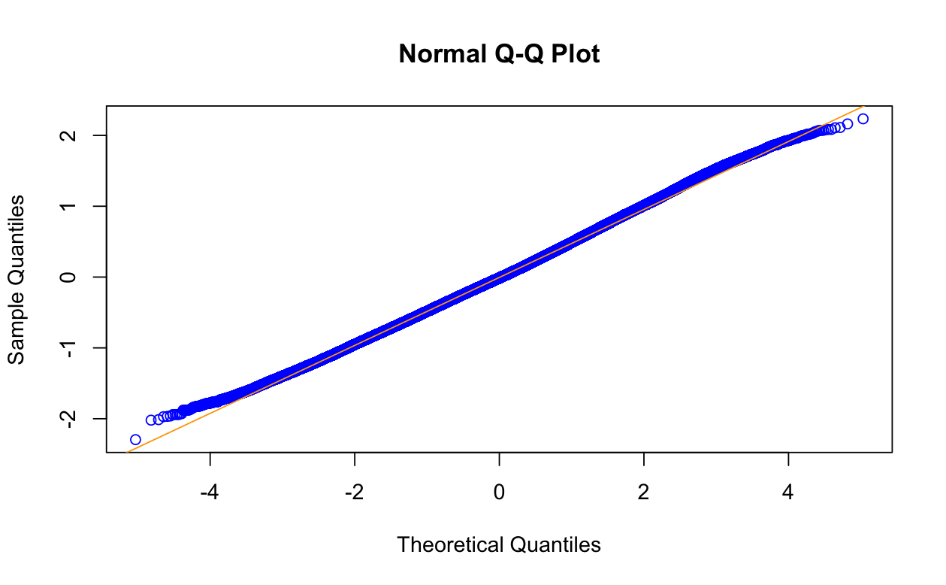
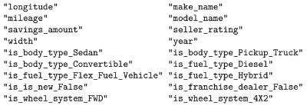
Multi-collinearity: finding lambda I want: VIF(a linear model) < 5, ideally ~ 1 to 2 , find how much should I penalize for the LASSO
Idea:
Generate a list of penalties (lambdas)
Find the smallest lambda that VIF table has > 0 rows, collect all the rows
Fit each row with a linear model, then pick the model having the lowest AIC.
=> Reduced 2/3 of features
Mean Training error = 4125.352
Mean Testing error = 4988.026

