Slide 1
Discovery of Potent Myeloid Cell Leukemia 1 (Mcl-1) Inhibitors Using Fragment-Based Methods and Structure-Based Design
Arles Lesmana, Zhang Zhicheng, Kaj van Schie
ACMDD | 4 Nov 2022

Slide 2
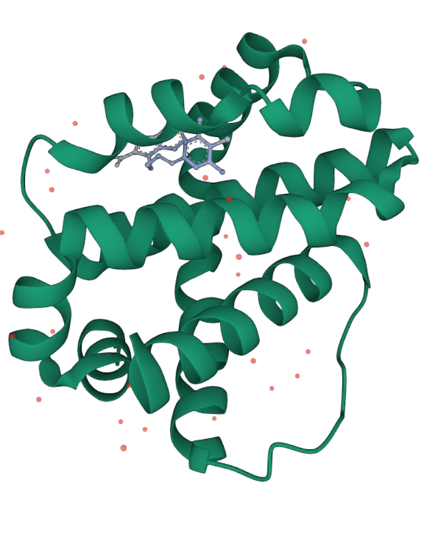
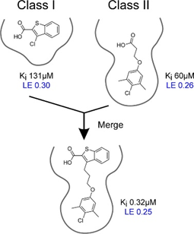
Background
Anti-apoptotic member of BCL-2
Various cancers show overexpression of MCL-1
Inhibition (or downregulation) of MCL-1 has been suggested for cancer treatment
Standard ligand (19G) was discovered by NMR-based fragment screening
Various MCL-1 inhibitors are on various stages of clinical trials

Slide 3
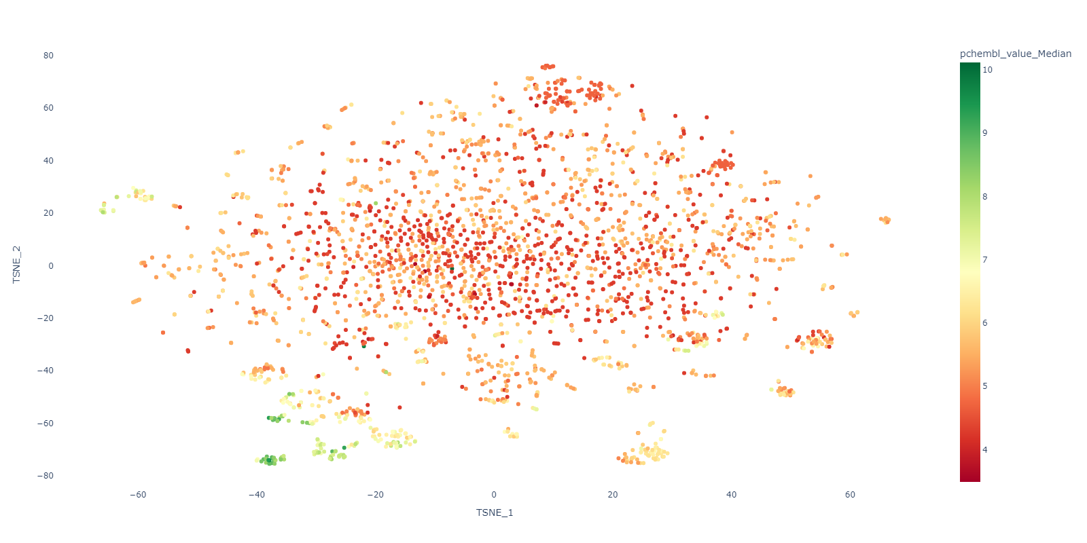
Background
Visualization of all existing chemical space for MCL-1 ligand
There has to be better ligand out there, right?

Slide 4
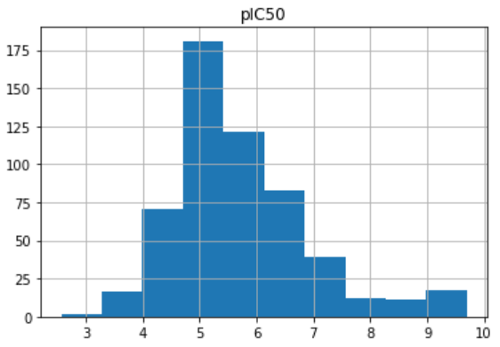
1. Data Acquisition
Mcl-1 uniprot_id: "Q07820”
Filter entries with binding ‘B’ sites (-1106)
Filter entries with IC50 in molar units (-116)
Convert bioactivity to unit nM and pIC50
ChEMBL data set for Mcl-1
1825 compounds
Data set filtered & formatted by bioactivity & SMILES
553 compounds
compound data:
the pIC50 value distribution
Notes:
Active compound: If pIC50 value is above 6.5 (as pointed out by literature)

Slide 5
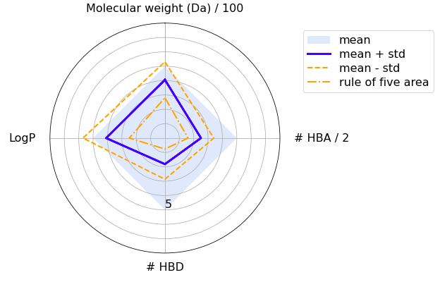
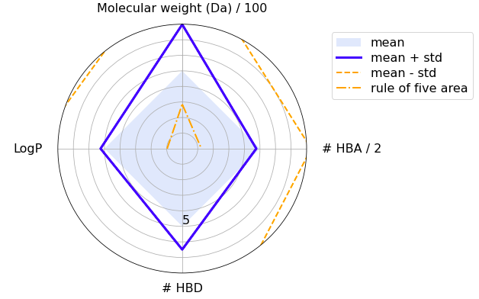
2. Molecular Filtration: ADME criteria
Filter data set by Lipinski’s rule of five (-137)
the radarplot for the dataset of
compounds that fulfill the Ro5
the radarplot for the dataset of
compounds that violate the Ro5

Slide 6
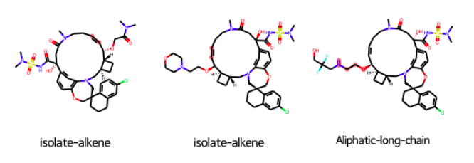
2. Molecular Filtration: Unwanted Structures
Filter out PAINS (-119)
Filter out unwanted structures (-146)
Highlight substructures
Data set filtered & formatted by unwanted structures
297 compounds

Slide 7
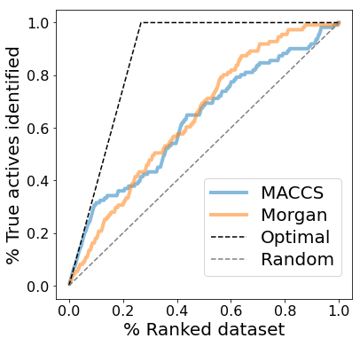

3. Ligand-based Screening: Compound Similarity
Calculate MACCS/Morgan fingerprints and
Tanimoto/Dice similarity for data set
Split data set into active & inactive
compounds (${PIC}_{50}$ cutoff = 5.92)
VS of query AZD5991 against data set
based on a similarity search
Evaluate screening with enrichment plots
Data set ranked by similarity to query compound
Query: AZD5991
Notes:
This compound is one of the inhibitors of MCL-1 currently on clinical trial (phase 2 If I'm not mistaken).

Slide 8
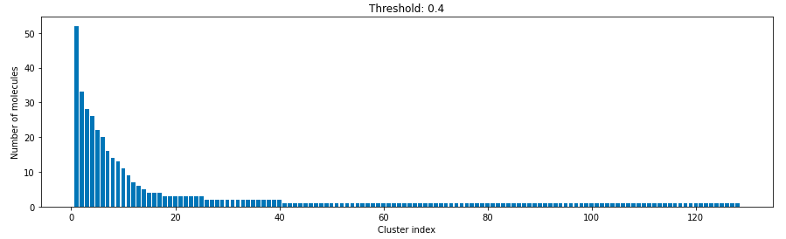
4. Compound Clustering
Cluster data set with the Butina algorithm
Pick diverse subset based on clusters
Notes:
We set up the threshold at 0.4 because it shows better clustering

Slide 9
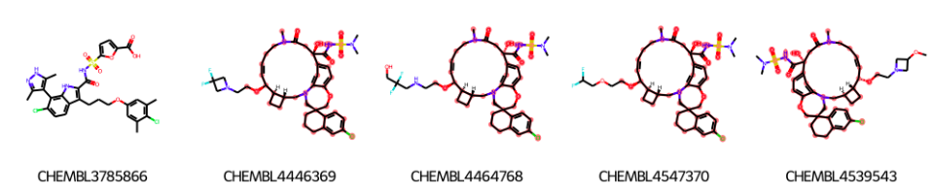
5. Maximum Common Substructures
Show MCS for largest cluster using FMCS algorithm

Slide 10
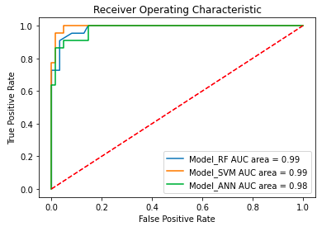
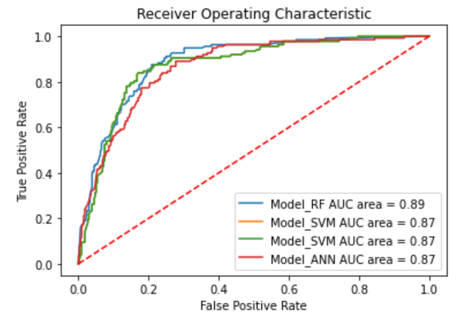

6. Ligand-based screening: Machine learning
Split data set into active & inactive compounds (${PIC}_{50}$ cutoff= 5.92)
Train ML classifiers using random forests,support vector machines & artificial neural networks
Apply k-fold cross validation (CV)
Evaluate models with ROC curves
Talktorial 7
CBR Teaching 2
Notes:
CBR teaching classifiers include NaN & >= whereas talktorial 7 was only = --> increases specificity

Slide 11
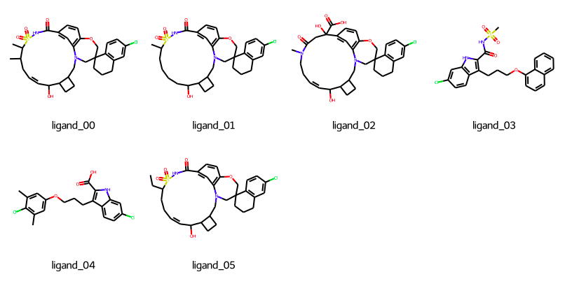
7. Data Acquisition from PDB
Get PDB IDs from UniProt ID of query target
Filter PDB structures: X-ray, resolution S 3Å
& presence of ligand (ranking by resolution)
Align top 6 protein-ligand structures
PDB data set
112 PDB structures

Slide 12
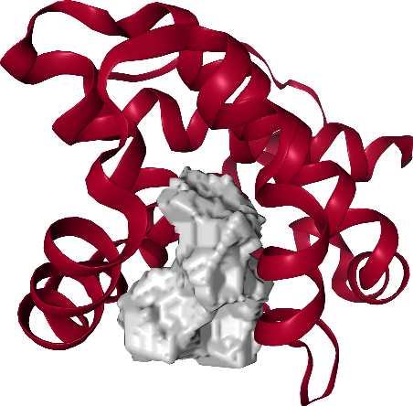
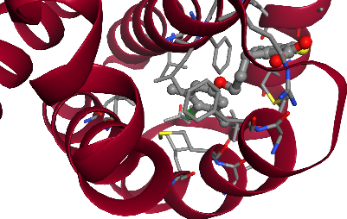
8. Ligand-based Ensemble Pharmacophores
Extract pharmacophore features: H-bond donors/acceptors & hydrophobic .
Cluster each feature type (k-means)
Generate ensemble pharmacophore

Slide 13
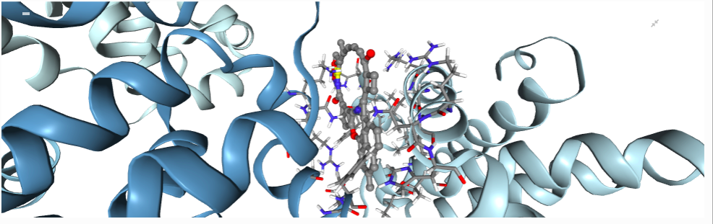
9. Docking
Docking of ligand 1 (with strongest affinity)

Slide 14
9. Docking
Ligand no | Chemical ID | Affinity (kcal/mol) | pChEMBL
0 | Q51 | -11.974 | 8.78
1 | N0M | -10.692 | 7.84
2 | Q4V | -10.683 | 7.84
3 | 5WL | -8.751 | 6.42
4 | 19H | -8.591 | 6.30
5 | N0J | -10.518 | 7.72

Slide 15
Conclusion
Machine learning approach allow us to identify potential inhibitors of MCL-1
Cyclic peptides generally show better binding affinity
De novo generation would also allow us to "think out of the box" to create better ligand with better affinity value

Slide 16
Thank you

Slide 17
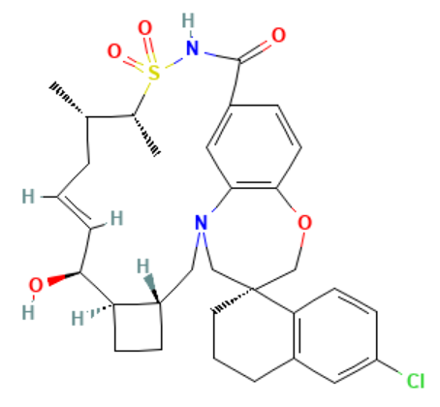
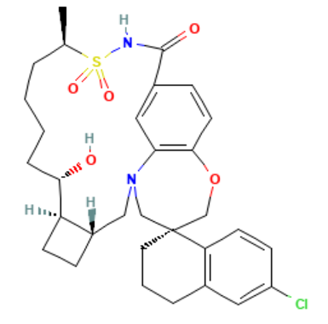
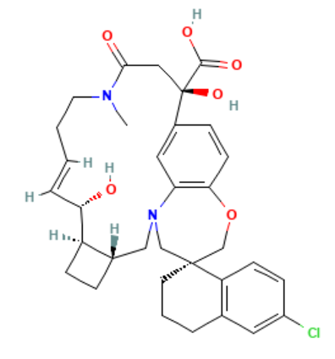
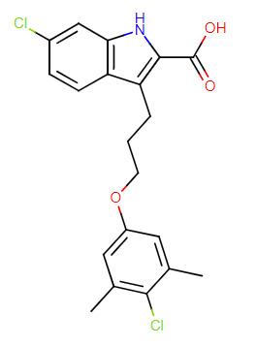
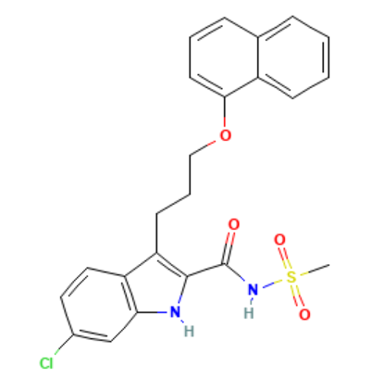
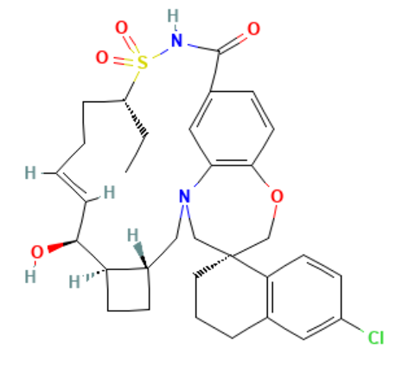
Top 6 Compound identified

