Slide 1
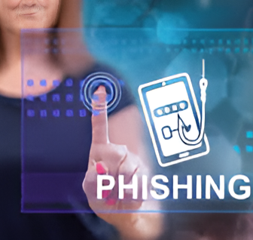
Phishing Awareness Training Internship Project – CodeAlpha
By: RENEE deGraft-ETSISON

Slide 2
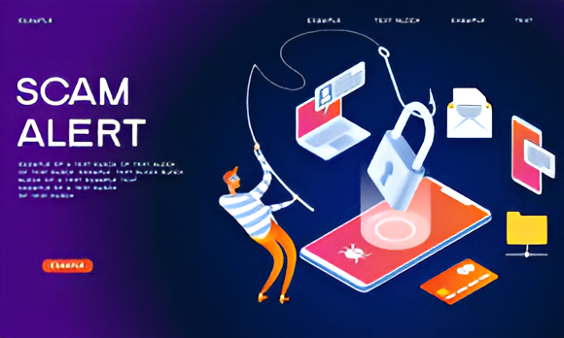
What is Phishing?
Phishing is a type of cyberattack in which attackers trick individuals into revealing sensitive information like passwords, credit card numbers, or login credentials by pretending to be a legitimate entity.
🎯 Objective:
To help users identify, avoid, and report phishing threats effectively.

Slide 3
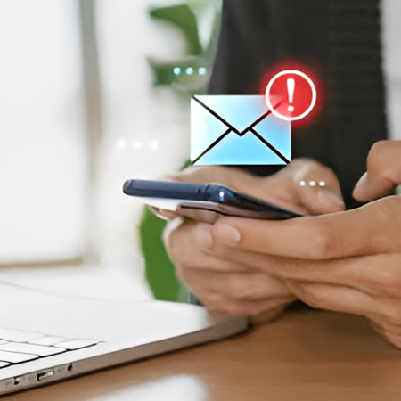
TYPES OF PHISHING ATTACKS
📧 Email Phishing
The most common type. Attackers send fake emails that look real.
🎯 Spear Phishing
Highly targeted attacks using personal information.
📱 Smishing
Phishing attempts sent via SMS/text messages.
📞 Vishing
Voice phishing, where scammers call pretending to be officials or support agents.

Slide 4

How to Recognize a Phishing Email
🚨 Red Flags to Watch For:
• Unfamiliar or spoofed sender address
• Urgent or threatening language
• Spelling or grammar mistakes
• Suspicious links (hover to preview before clicking)
• Requests for sensitive data like passwords or PINs
Tip: Always verify before responding.

Slide 5

Spot the Difference Fake URL: http://login-yourbank.co Real URL: https://www.yourbank.com ⋇ Look for HTTPS and a padlock symbol ⋇ Check the domain name carefully ⋇ Avoid clicking on links in unsolicited emails Attackers often mimic real sites — always double-check the URL!
Real vs. Fake Website

Slide 6
Social Engineering Tactics
Tricks Used by Attackers:
• Urgency: “Reset your password now!”
• Authority: “Message from your bank or CEO”
• Fear: “Your account is compromised”
• Curiosity: “Check your surprise reward!”
💡 Phishing succeeds by playing on emotions — pause before you react.

Slide 7
Best Practices to Avoid Phishing
How to Stay Safe
• Don't click links from unknown sources
• Use multi-factor authentication (MFA)
• Report suspicious emails to your IT/security team
• Keep antivirus software and browsers updated
• Regularly check email headers and domain names
🔐 Prevention is your best defense

Slide 8

Mini Quiz
Question:
Which of these is a sign of a phishing email?
A. Comes from a known domain
B. Asks for urgent action
C. Contains only images
D. Comes with a privacy policy
Click Here for more of the mini-quiz questions

Slide 9

Conclusion
Final Thoughts
Phishing is one of the most common and dangerous cyber threats, but with awareness, you can avoid it.
Stay alert
Stay informed
Stay secure
🔗 GitHub Link
Thank you!

