Slide 1
Outline Rendering
---Tianshi Xie

Slide 2
Introduction
What’s the outline rendering?
How does it work?
How to implement outline rendering?
Future work.
Run the Demo.

Slide 3
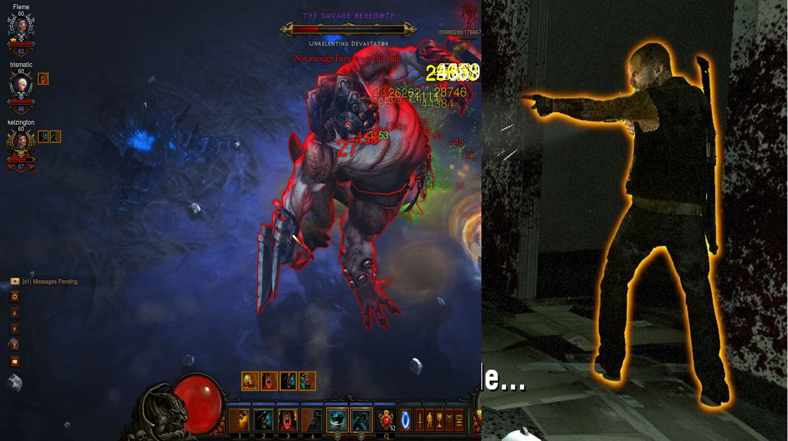
What is the outline rendering

Slide 4
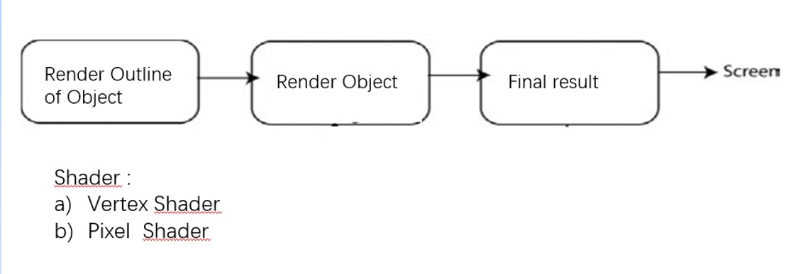
How does it work?

Slide 5
How to implement the Outline Rendering
Sobel filter method
Normal method.

Slide 6
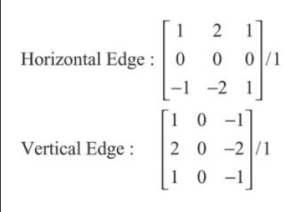
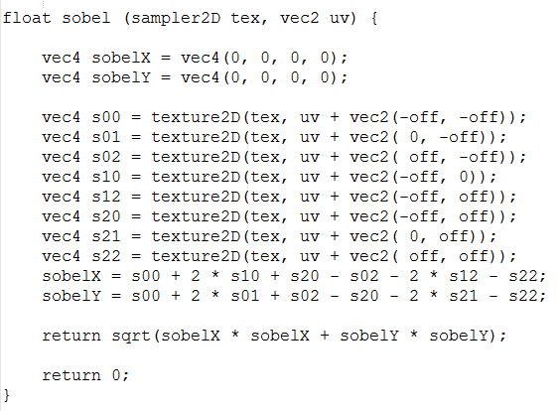
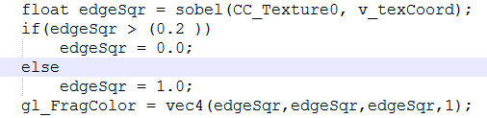
Sobel filter method

Slide 7
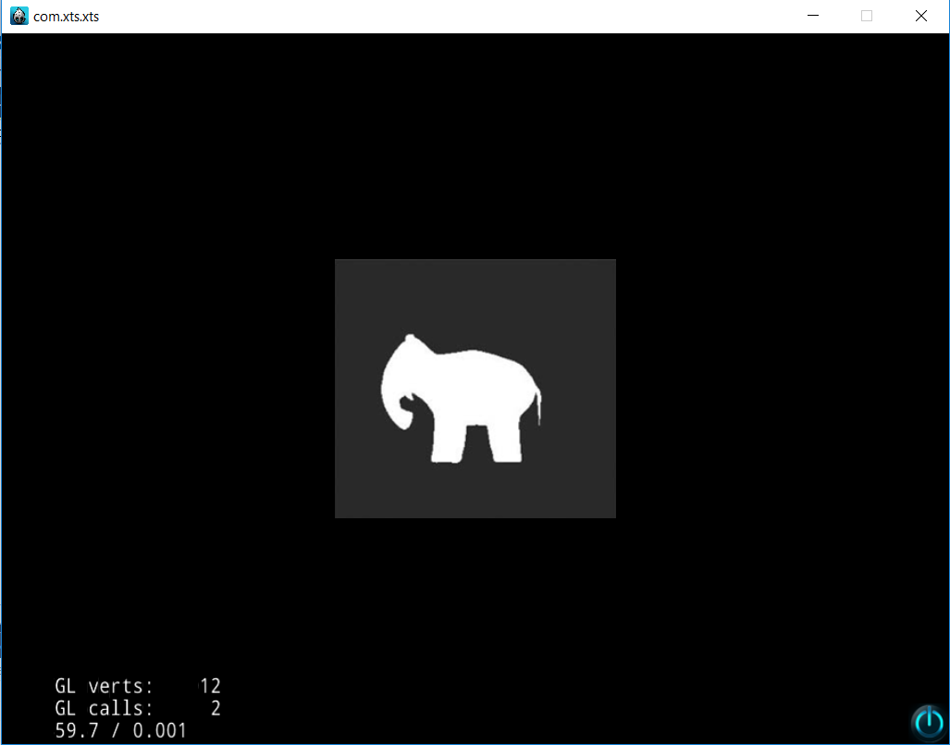
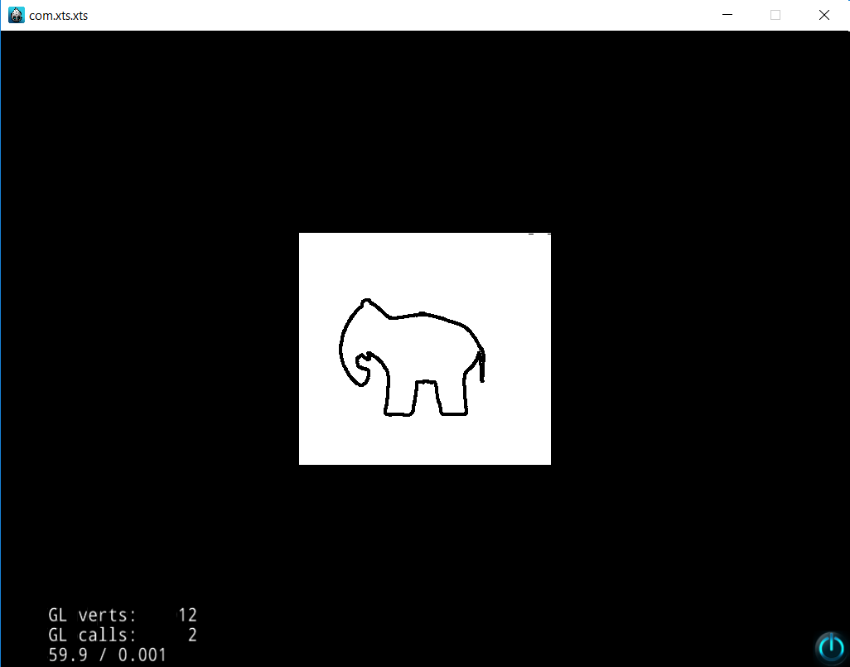
Run the demo

Slide 8
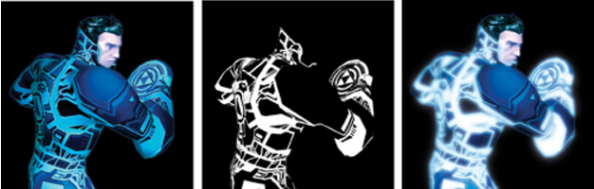
Advanced Effects

Slide 9
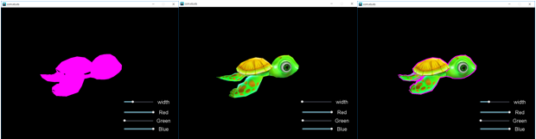
Outline rendering in 3D

Slide 10
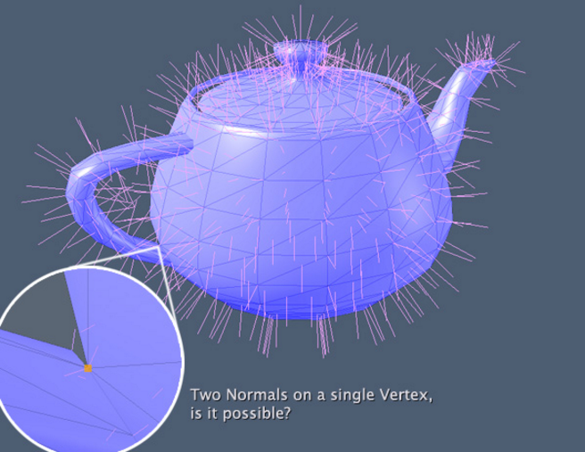
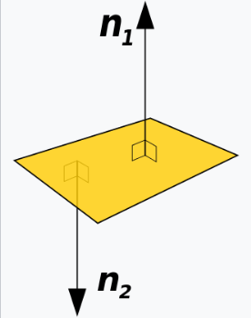
Normal method

Slide 11
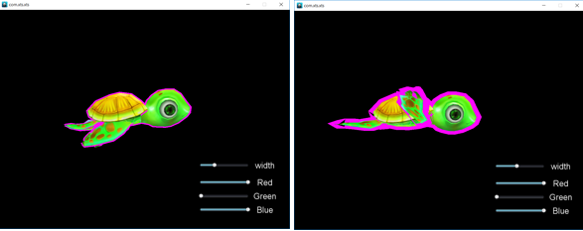
Thickening outline of object

Slide 12

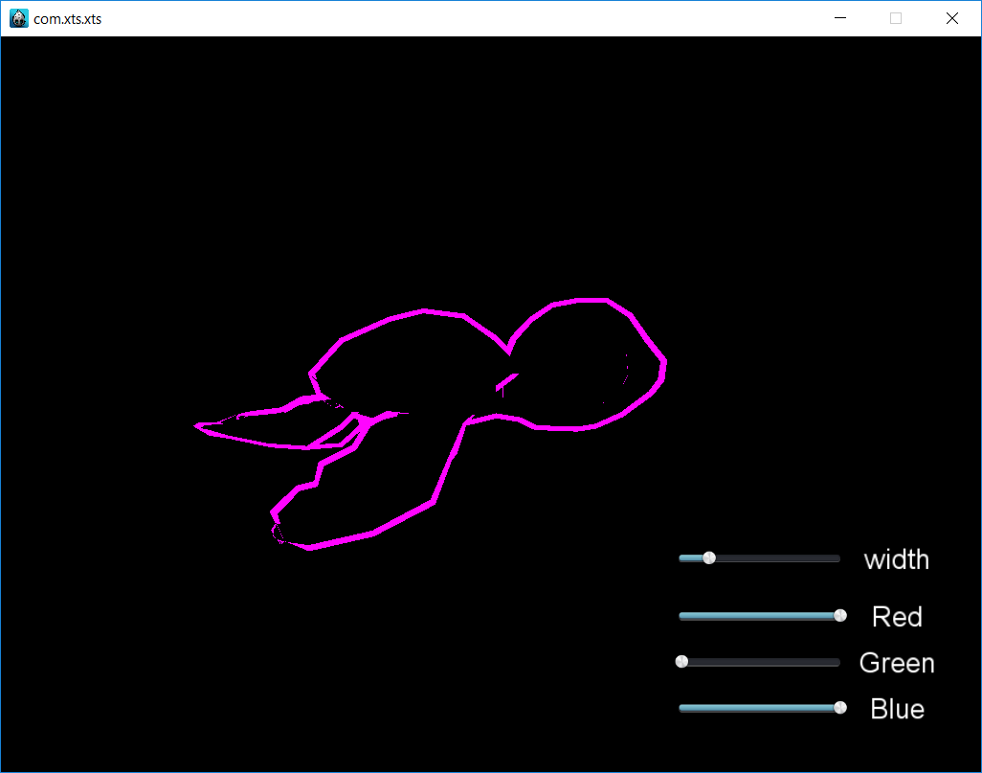
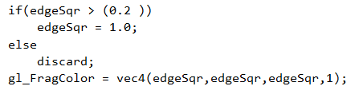
Focus on performance
1 mobile device vs pc
2 Real outline

Slide 13
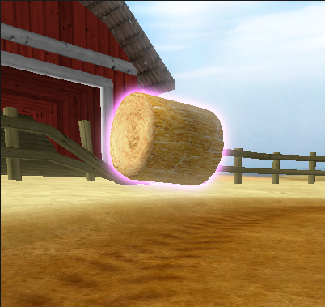
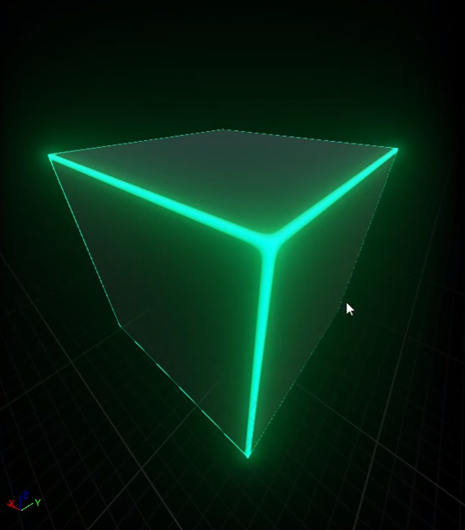
Future work
Multi-outline
Smoothing outline
Glowing outline

Slide 14




