Slide 1
OpenAPI: You're Doing It Wrong
@markrendle
Build Stuff, November 2023

Slide 2
www.rendlelabs.com
WORKSHOPS
High Performance .NET
Modern APIs in ASP.NET Core
gRPC in ASP.NET Core
Effective .NET Migration

Slide 3
OpenAPI: You're Doing It Wrong
@markrendle
Build Stuff, November 2023

Slide 4
So what is it?

Slide 5
OpenAPI Versions
2.0: Swagger
3.0: Current
3.1: New & Improved!

Slide 6
OpenAPI Versions
2.0: Swagger
3.0: Current
3.1: New & Improved!
Use this one

Slide 7
Implementation

Slide 8
OpenAPI in .NET
Swashbuckle
NSwag

Slide 9
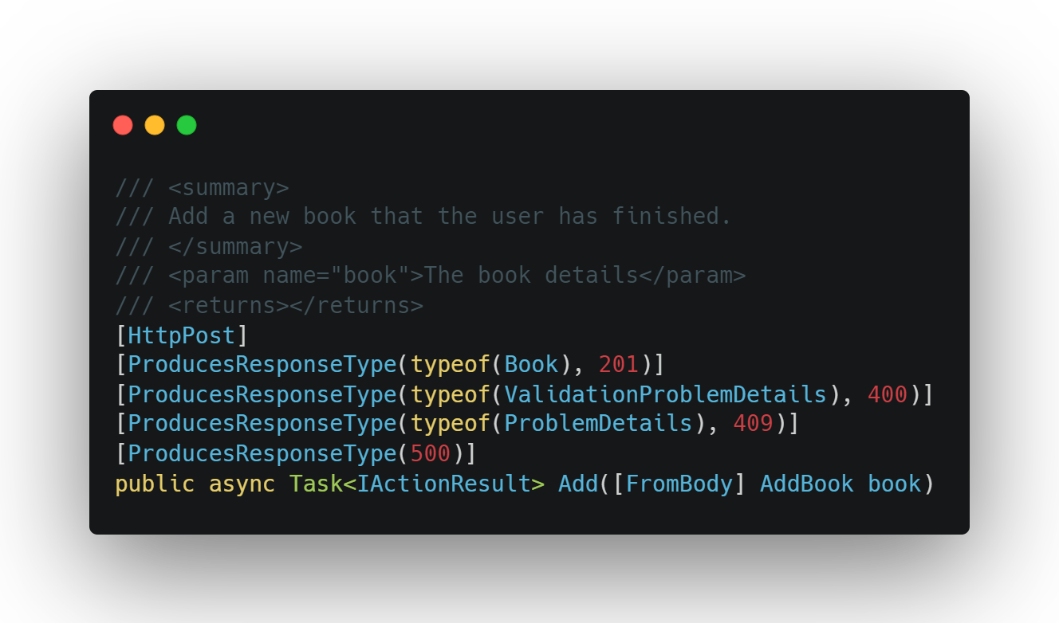
OpenAPI in .NET

Slide 10
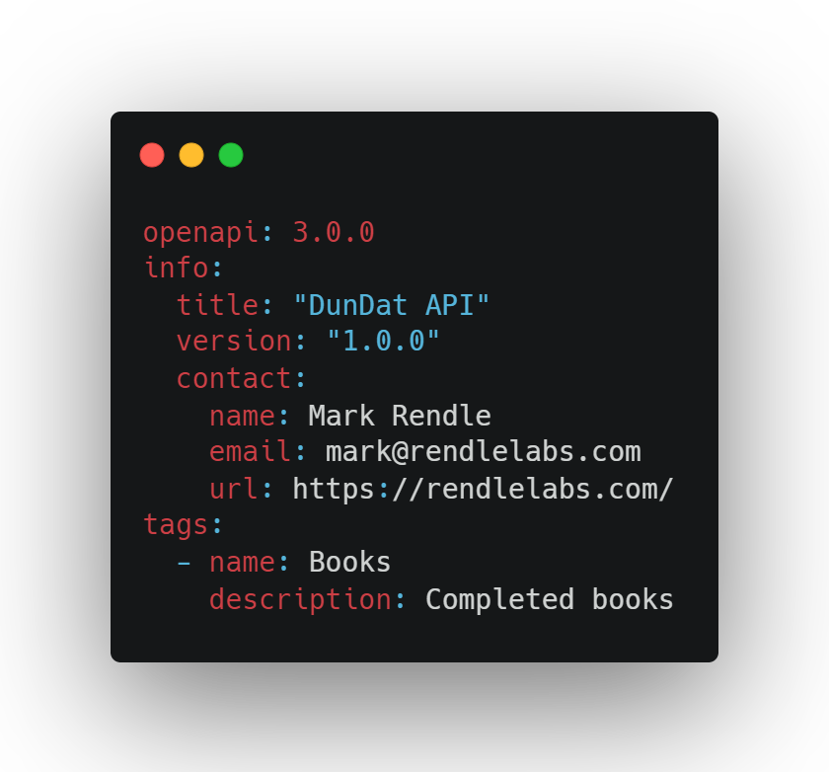
OpenAPI everywhere else

Slide 11
Hand-crafted Artisanal YAML files

Slide 12
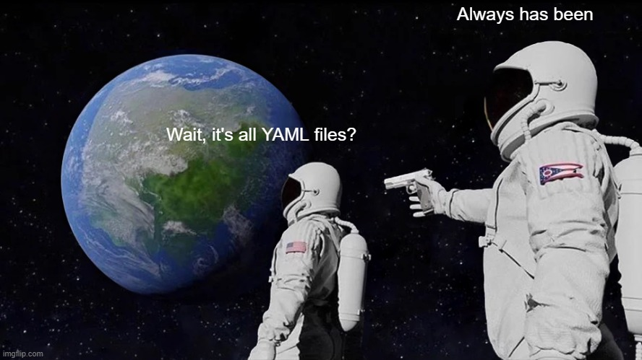

Slide 13
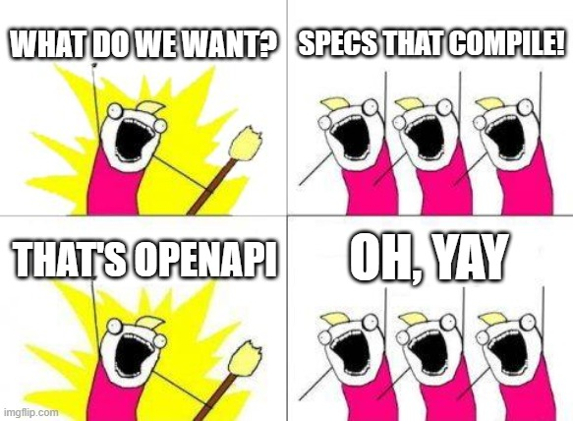

Slide 14
Why, Mark? Why?
Source of truth for your team
Separate Design and Implementation
Better description of your API
Automated documentation

Slide 15
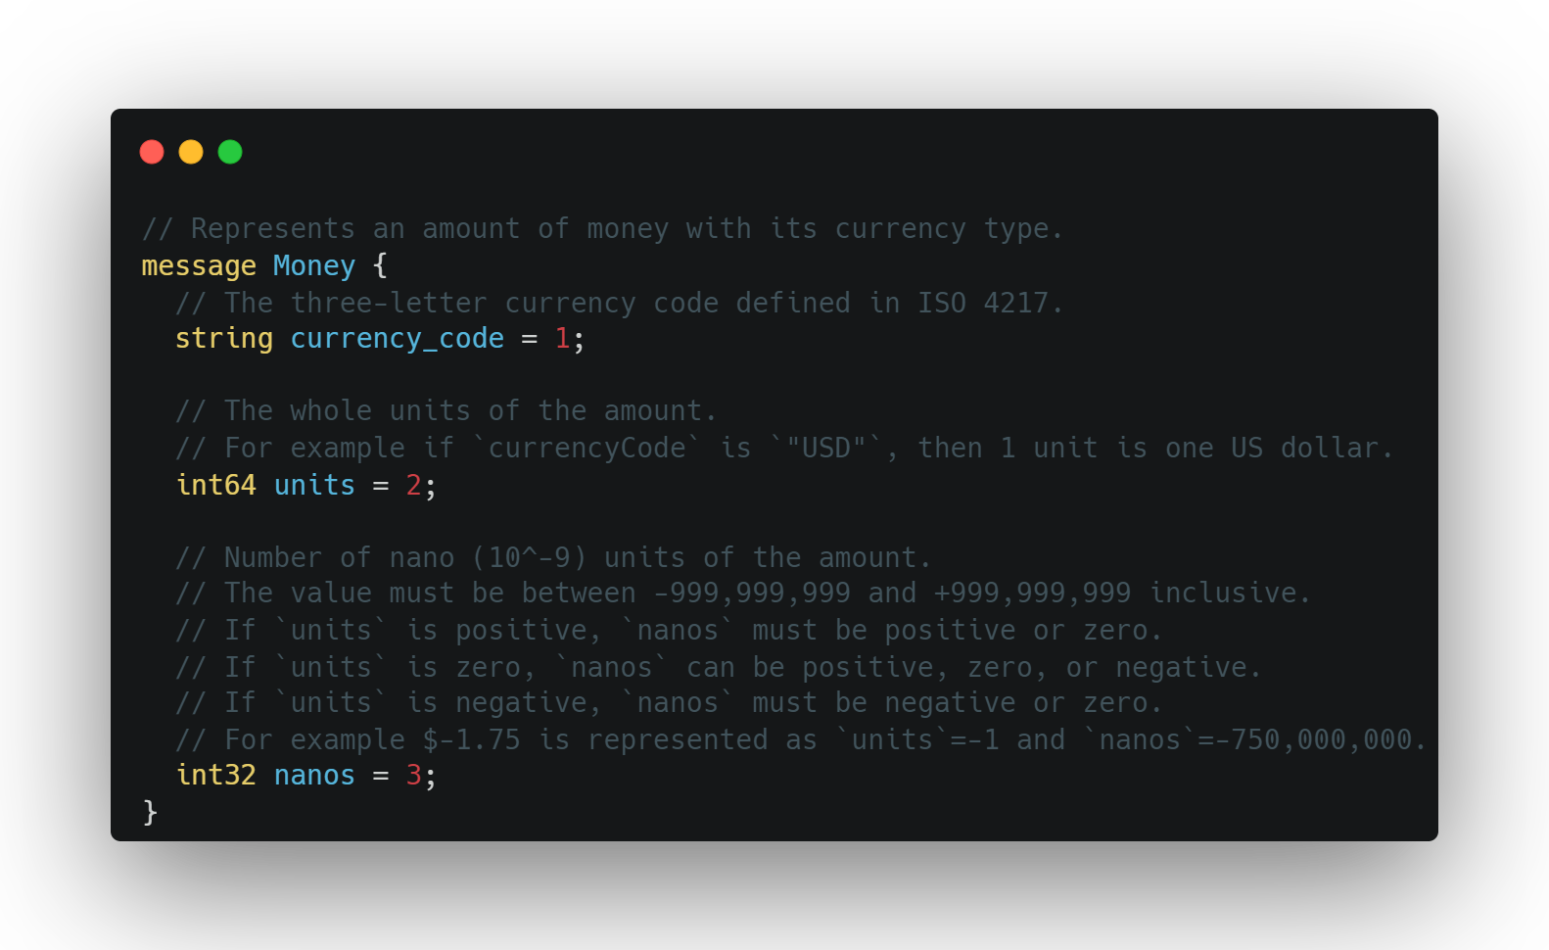
Protobuf

Slide 16
OpenAPI

Slide 17
Paths

Slide 18
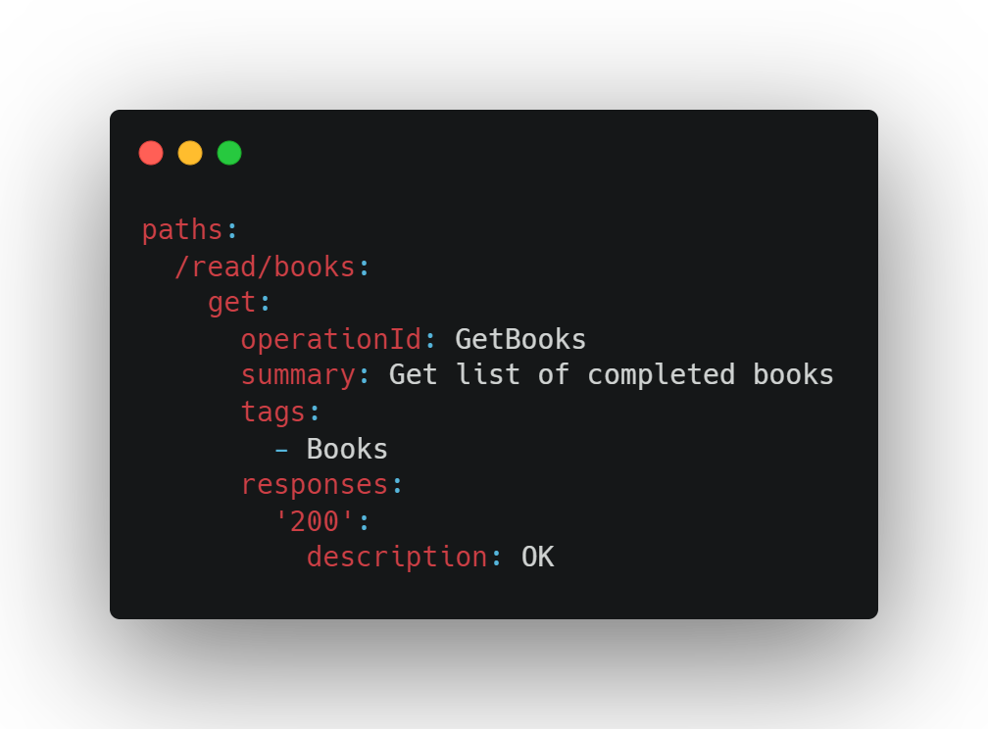

Slide 19
Responses

Slide 20
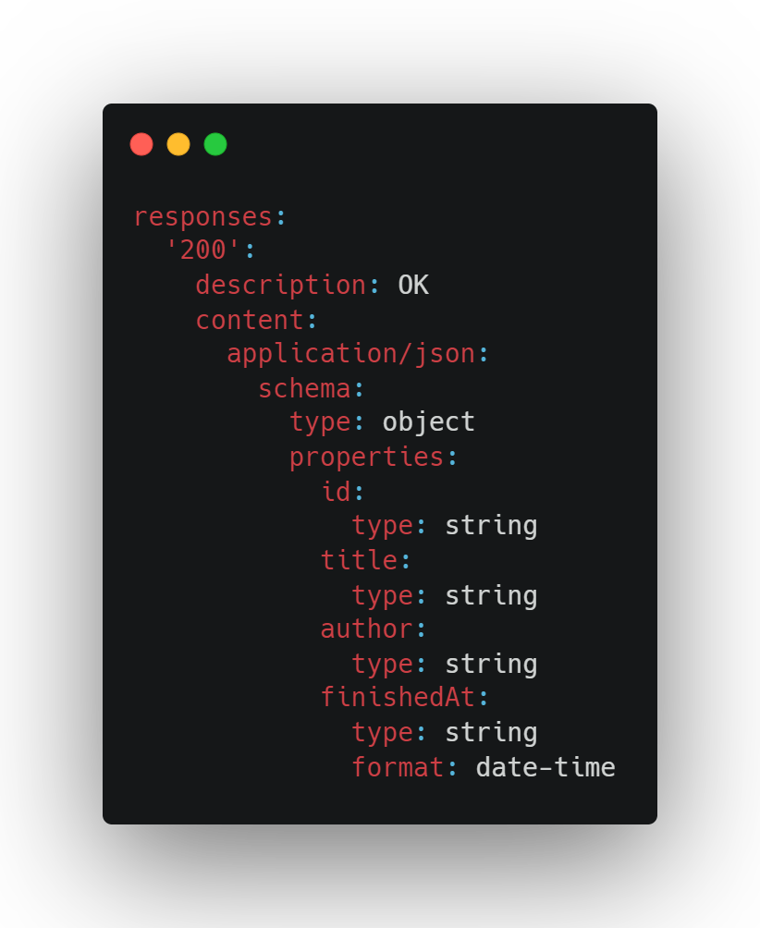

Slide 21
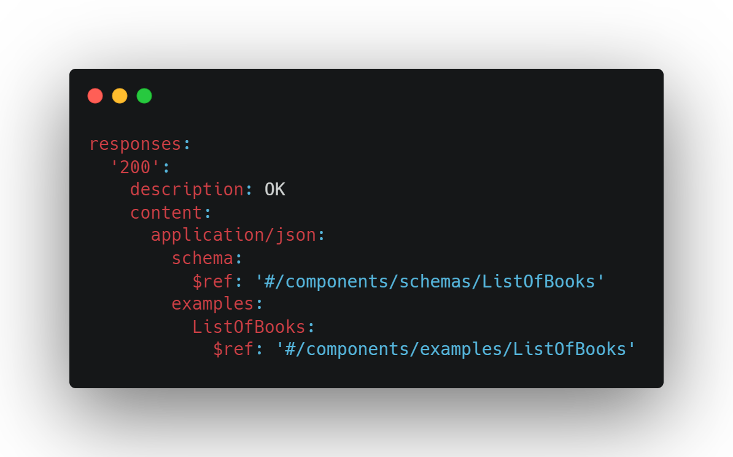

Slide 22
Parameters

Slide 23
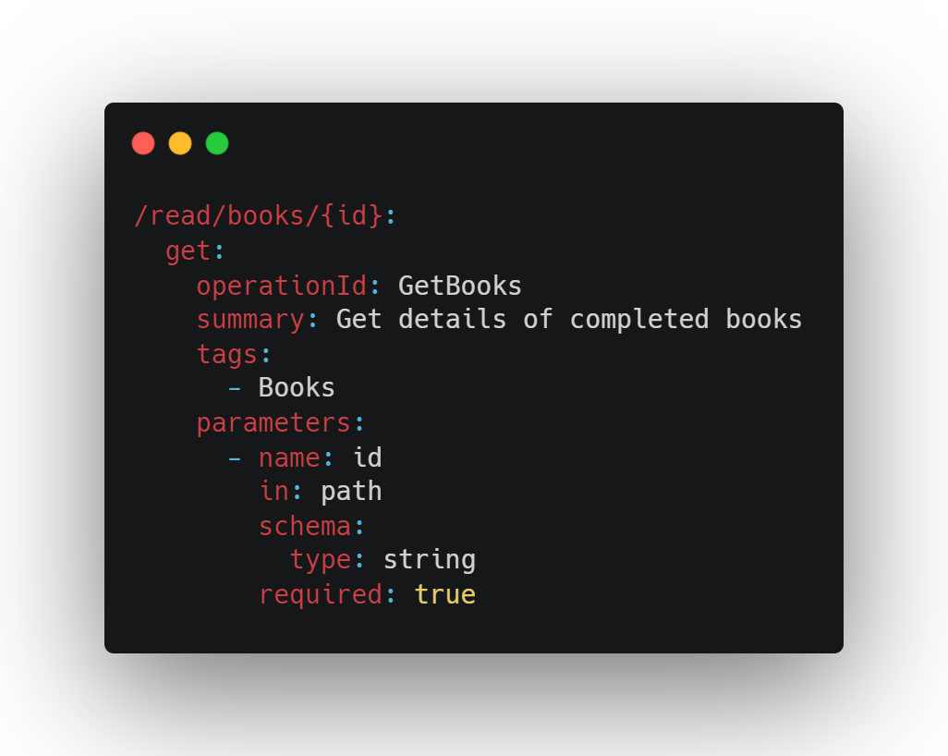

Slide 24
Requests

Slide 25
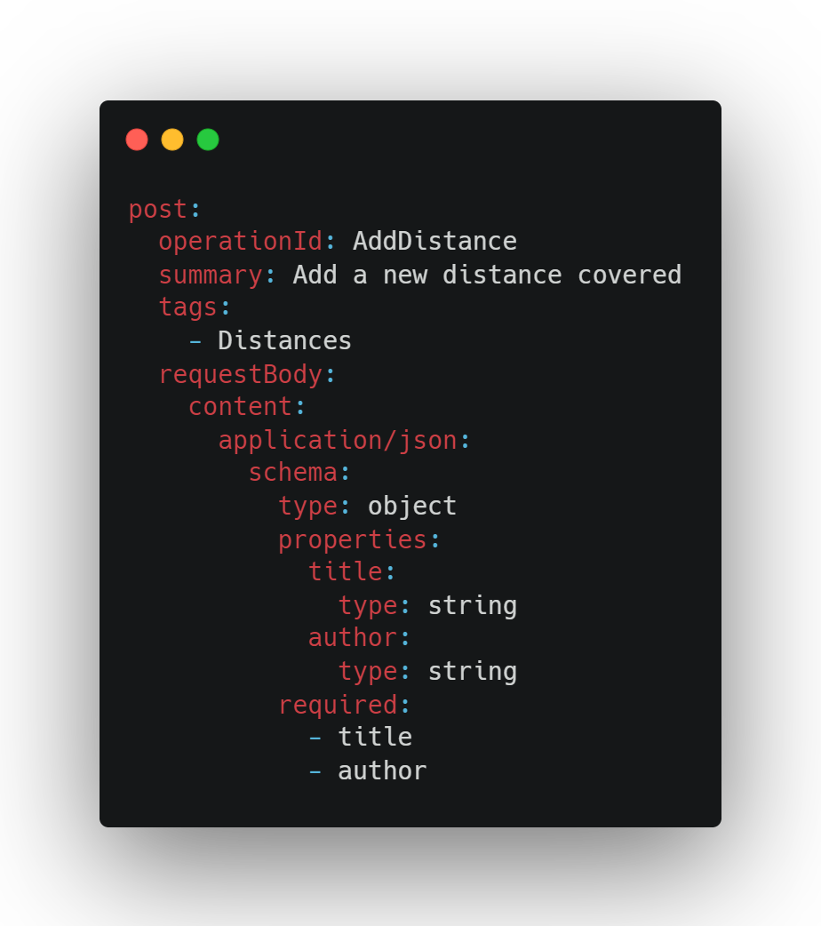

Slide 26
Components

Slide 27
Components
schemas
responses
requestBodies
parameters
headers
securitySchemes
examples
links
callbacks

Slide 28
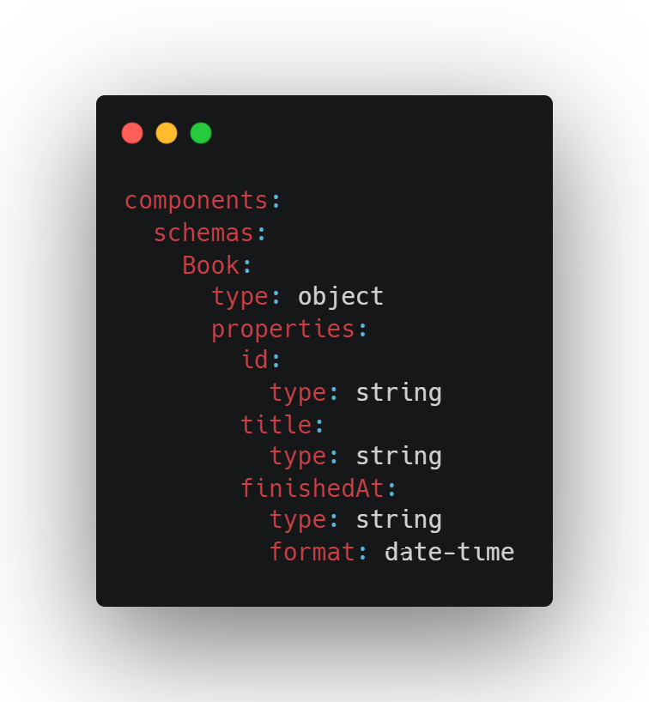

Slide 29
References

Slide 30
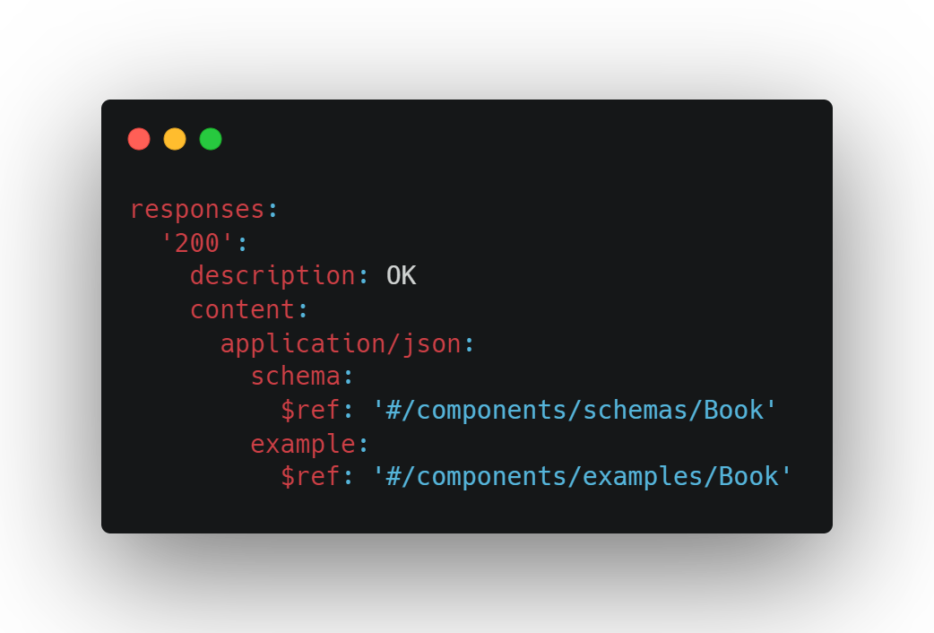

Slide 31
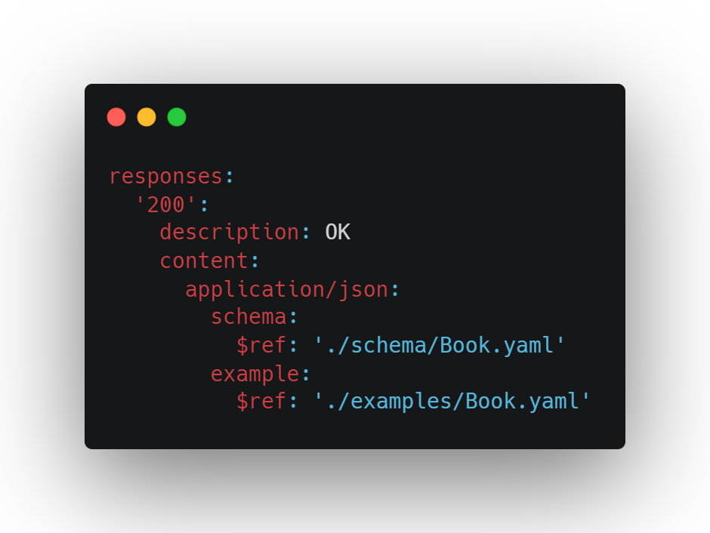

Slide 32
Security

Slide 33
Problems
application/problem+json

Slide 34
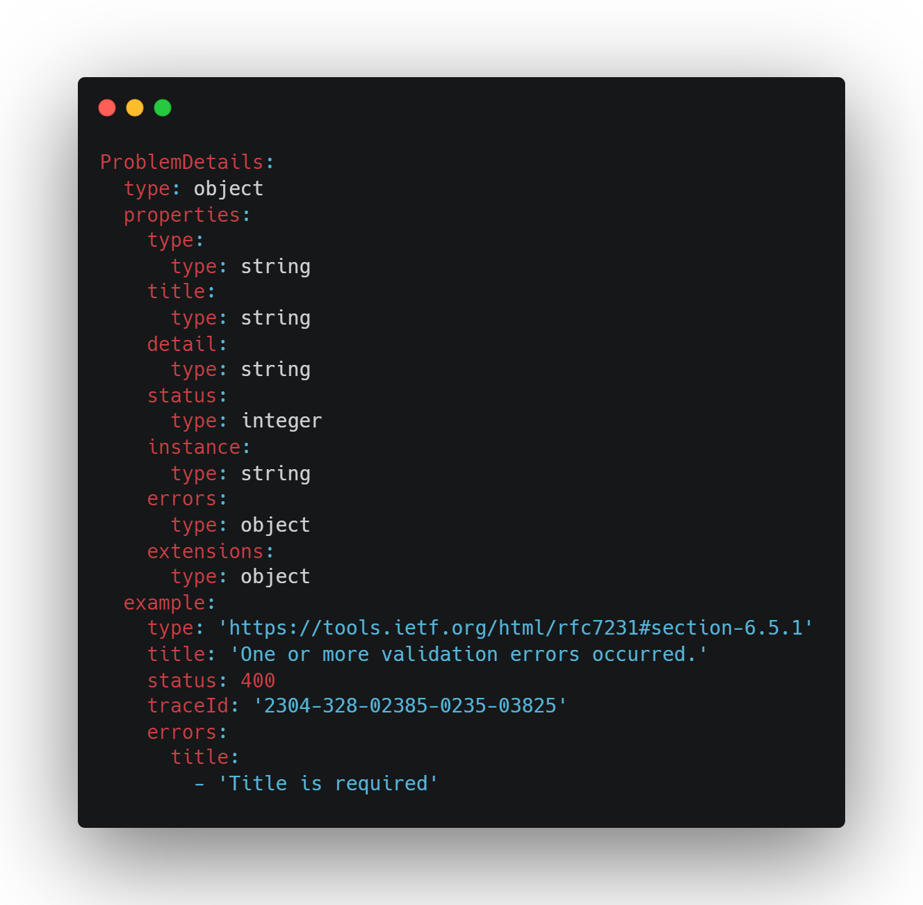

Slide 35
Moonwalk
OpenAPI 4.0?
github.com/OAI/moonwalk

Slide 36
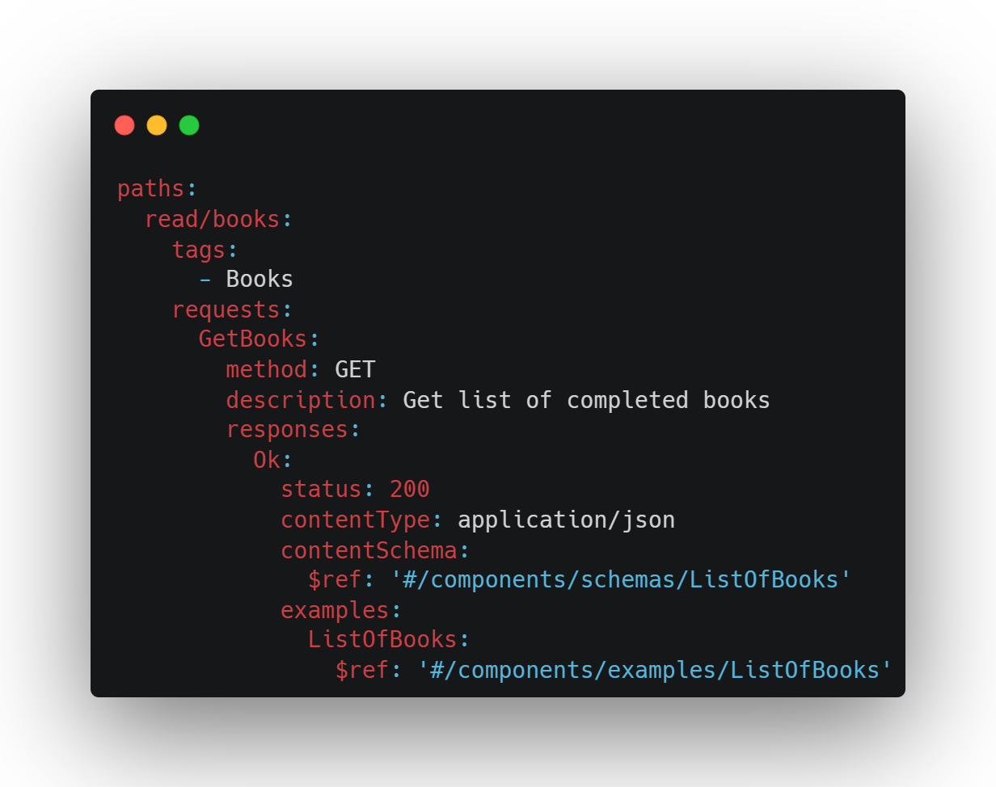
OpenAPI 4.0?

Slide 37
Tools
Swagger UI
Redoc github.com/Redocly/redoc
Elements stoplight.io/open-source/elements

Slide 38
Plugins
VS Code: OpenAPI (Swagger) Editor marketplace.visualstudio.com/items?itemName=42Crunch.vscode-openapi
Rider: OpenAPI Specifications Built-in

Slide 39
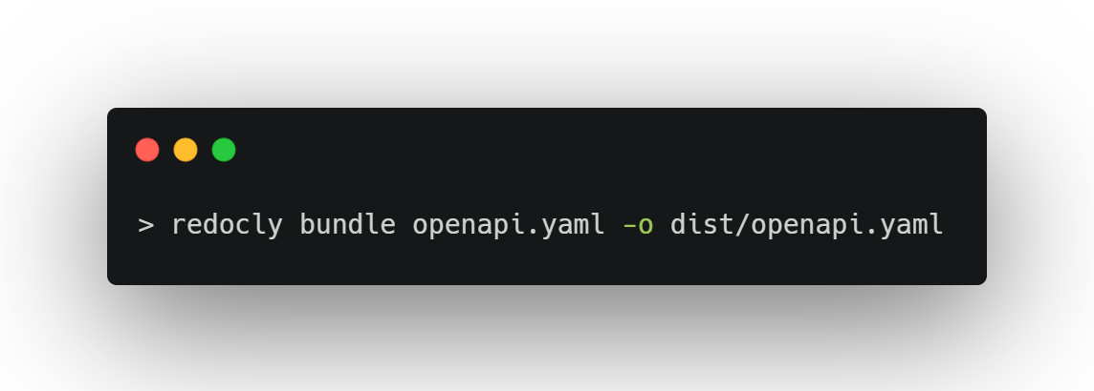
Bundling

Slide 40
Packages
RendleLabs.OpenApi.Web
RendleLabs.OpenApi.Analyzers
RendleLabs.OpenApi.Bundle
RendleLabs.OpenApi.Test

Slide 41

FIN

Slide 42
Resources
openapis.org
swagger.io
openapi.tools
www.asyncapi.com
github.com/RendleLabs/BuildStuff2023

