Slide 1
OpenAPI: You're Doing It Wrong
@markrendle
Build Stuff, November 2023

Slide 2
www.rendlelabs.com
WORKSHOPS
High Performance .NET
Modern APIs in ASP.NET Core
gRPC in ASP.NET Core
Effective .NET Migration

Slide 3
OpenAPI: You're Doing It Wrong
@markrendle
Build Stuff, November 2023

Slide 4
So what is it?

Slide 5
OpenAPI Versions
2.0: Swagger
3.0: Current
3.1: New & Improved!

Slide 6
OpenAPI Versions
2.0: Swagger
3.0: Current
3.1: New & Improved!
Use this one

Slide 7
Implementation

Slide 8
OpenAPI in .NET
Swashbuckle
NSwag

Slide 9
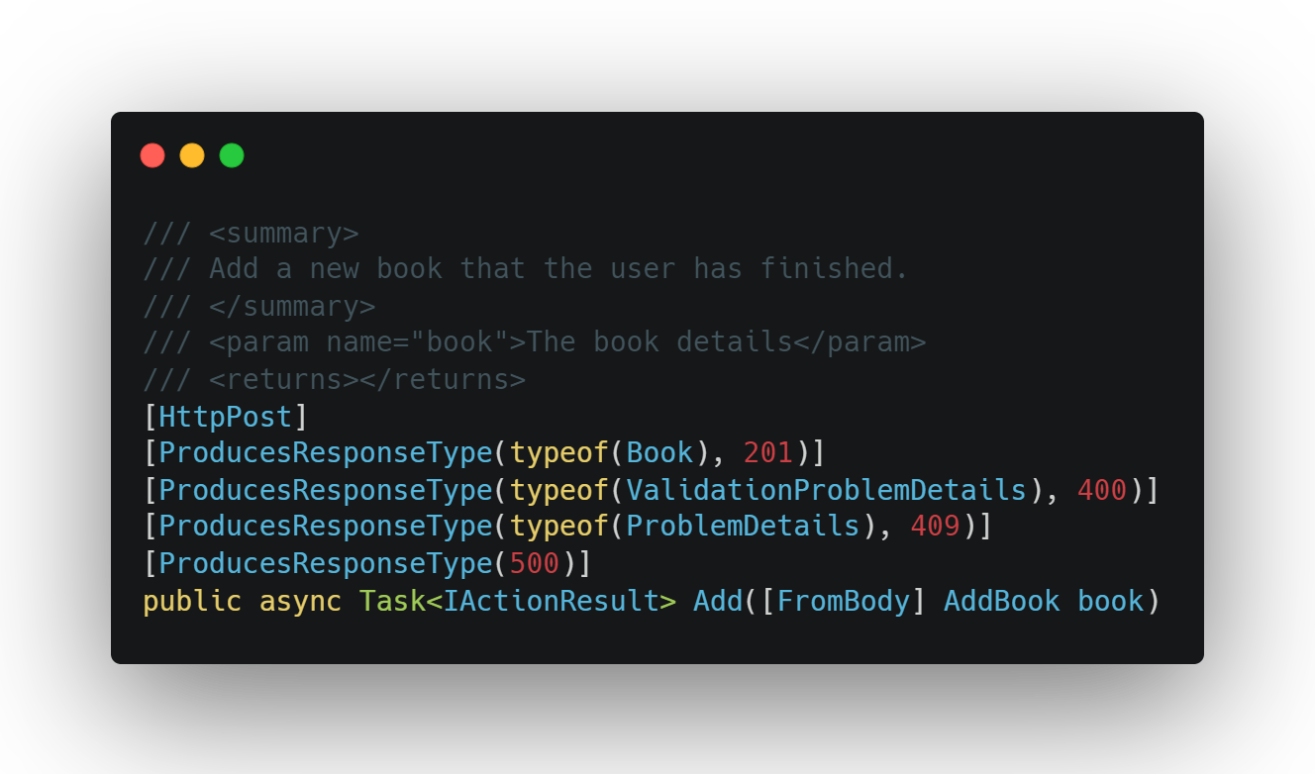
OpenAPI in .NET

Slide 10
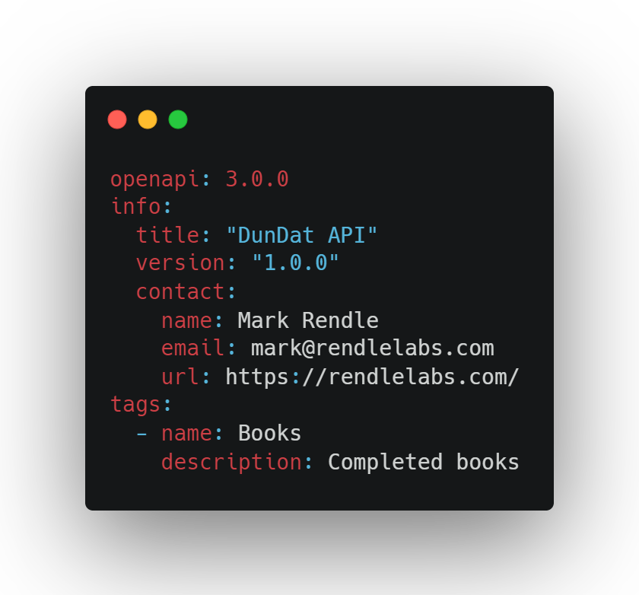
OpenAPI everywhere else

Slide 11
Hand-crafted Artisanal YAML files

Slide 12
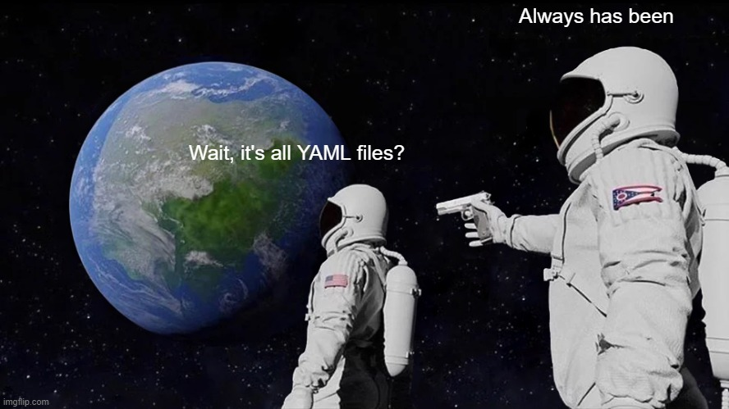

Slide 13
I am getting old

Slide 14
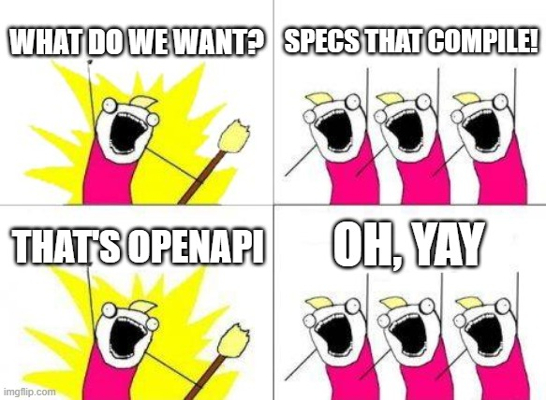

Slide 15
Why, Mark? Why?
Source of truth for your team
Separate Design and Implementation
Better description of your API
Automated documentation

Slide 16
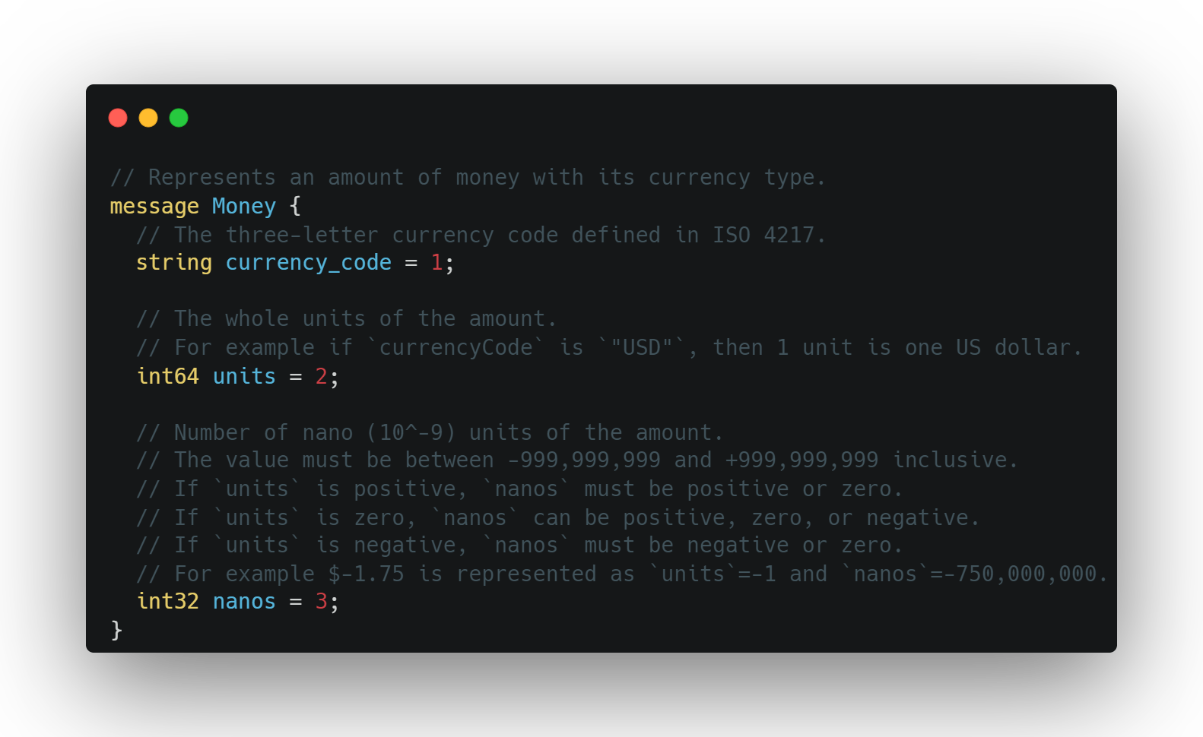
Protobuf

Slide 17
OpenAPI

Slide 18
Paths

Slide 19
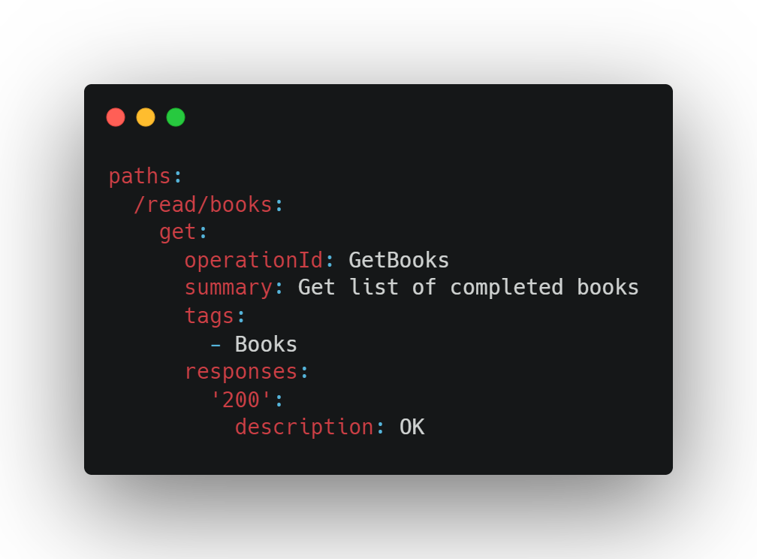

Slide 20
Responses

Slide 21
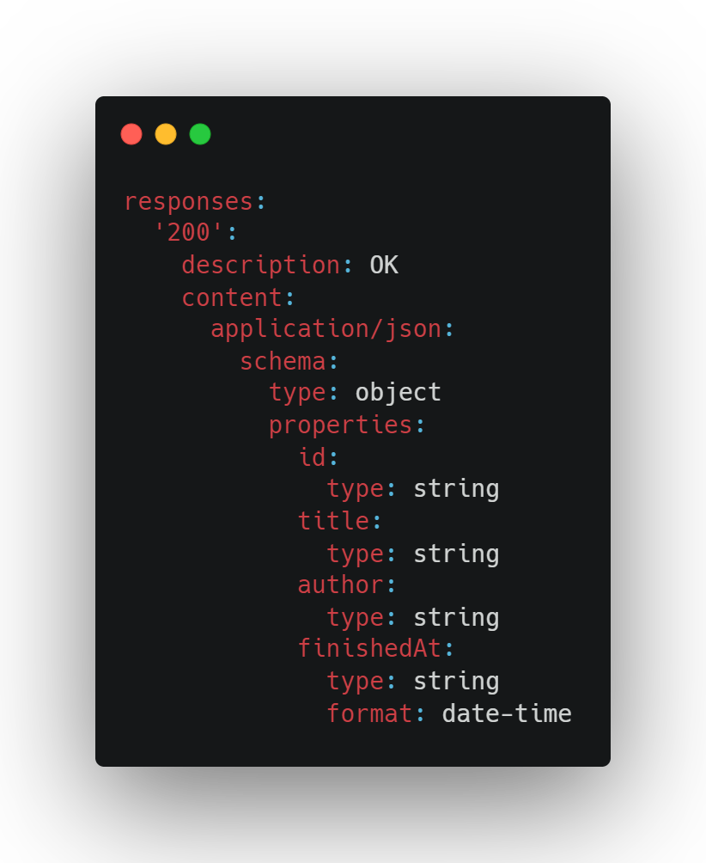

Slide 22
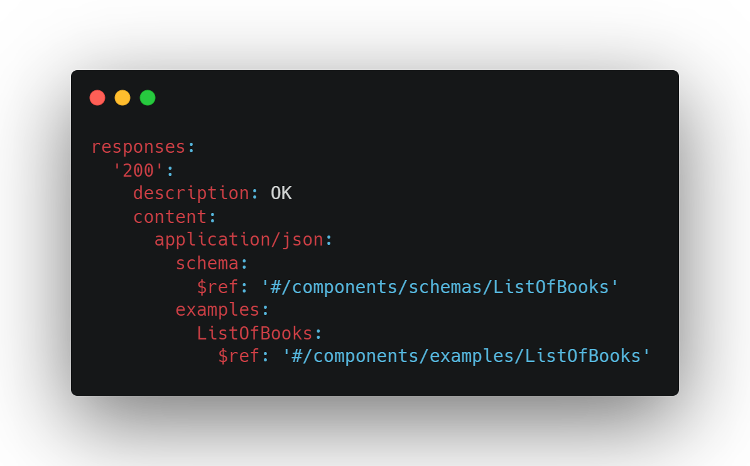

Slide 23
Parameters

Slide 24
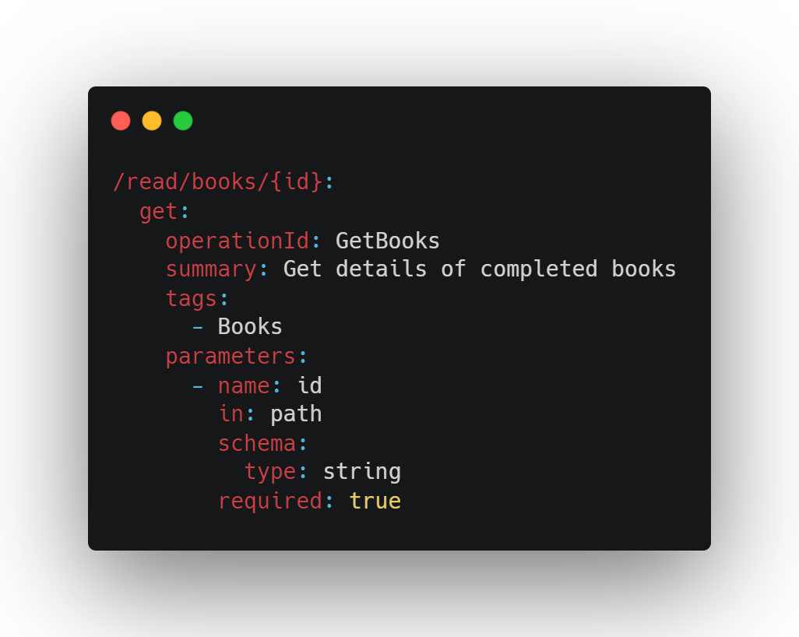

Slide 25
Requests

Slide 26
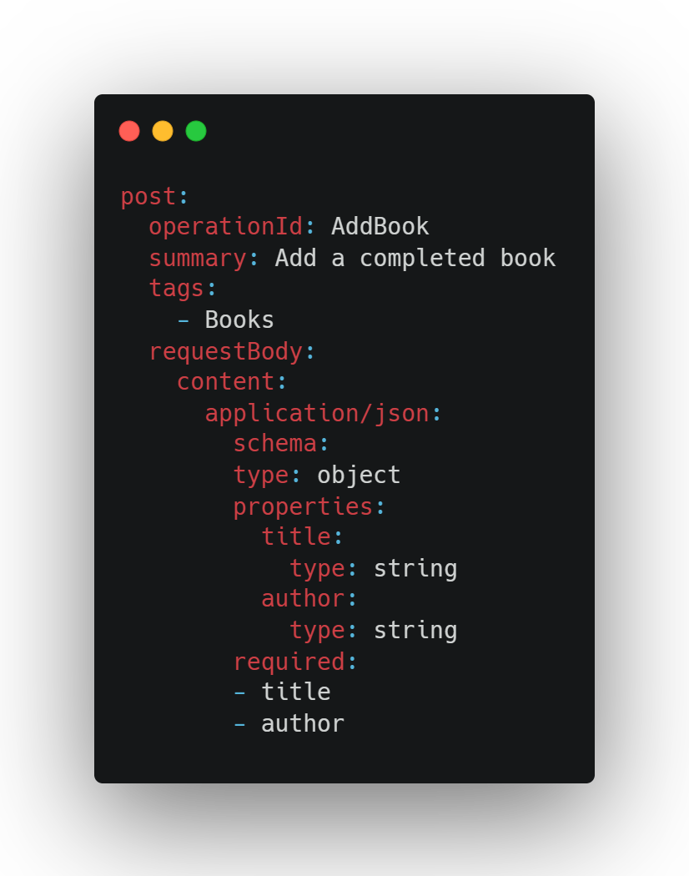

Slide 27
Components

Slide 28
Components
schemas
responses
requestBodies
parameters
headers
securitySchemes
examples
links
callbacks

Slide 29
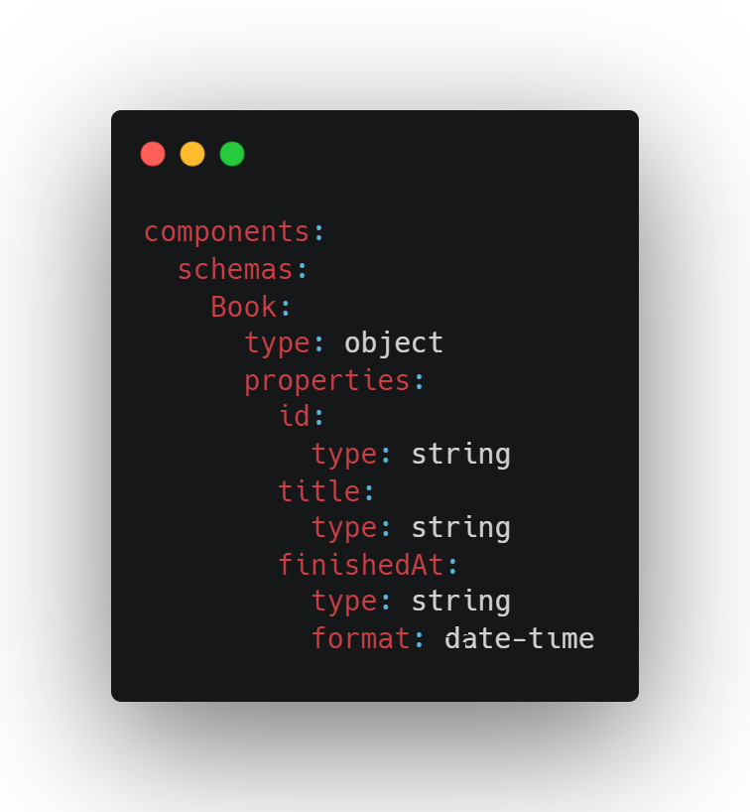

Slide 30
References

Slide 31
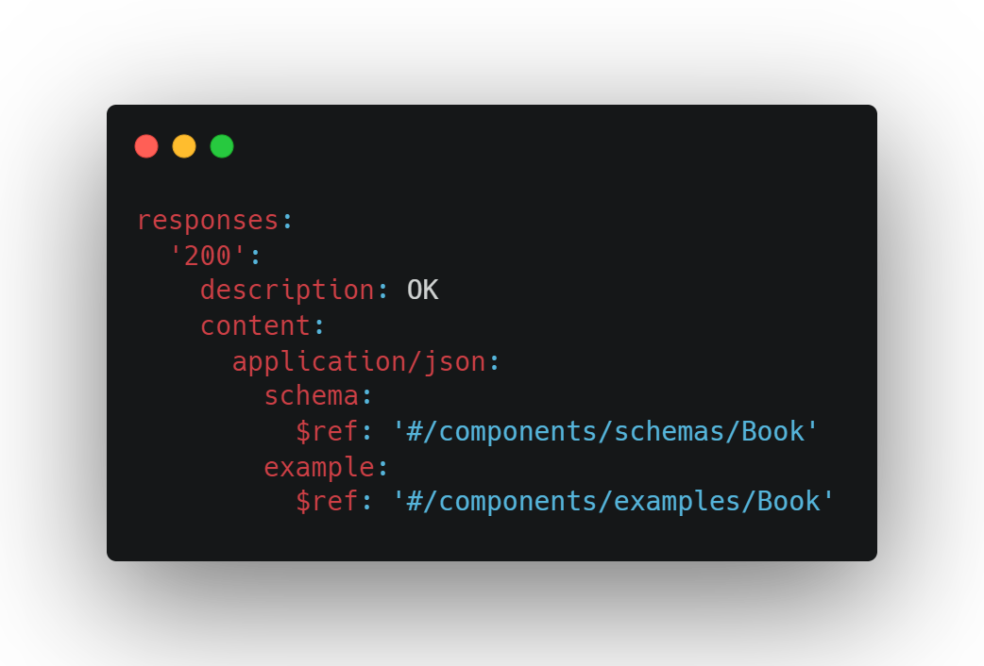

Slide 32
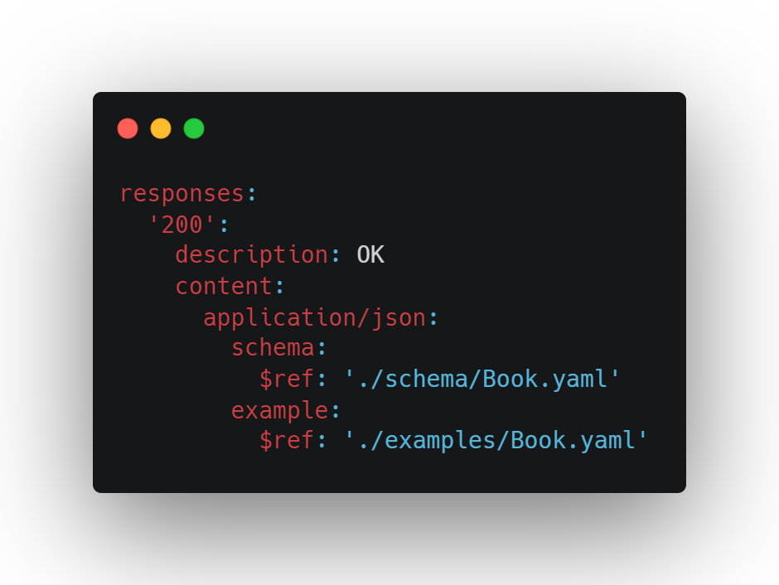

Slide 33
Security

Slide 34
Problems
application/problem+json

Slide 35
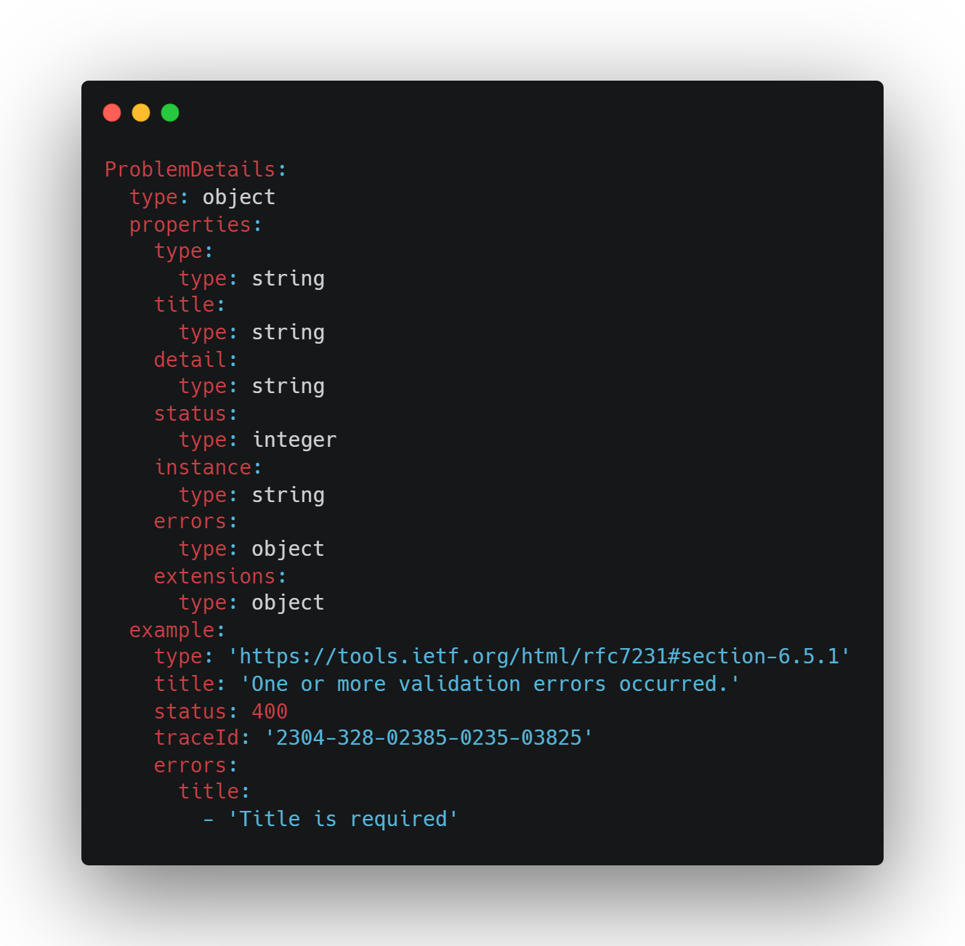

Slide 36
Moonwalk
OpenAPI 4.0?
github.com/OAI/moonwalk

Slide 37
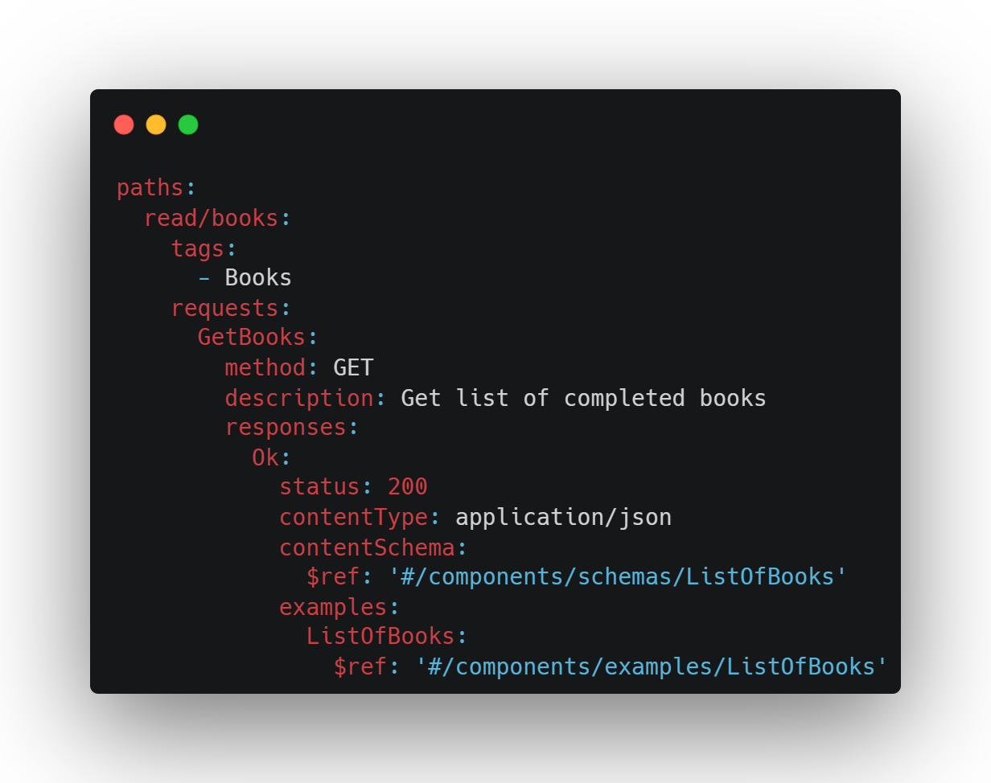
OpenAPI 4.0?

Slide 38
Tools
Swagger UI
Redoc github.com/Redocly/redoc
Elements stoplight.io/open-source/elements

Slide 39
Plugins
VS Code: OpenAPI (Swagger) Editor marketplace.visualstudio.com/items?itemName=42Crunch.vscode-openapi
Rider: OpenAPI Specifications Built-in

Slide 40
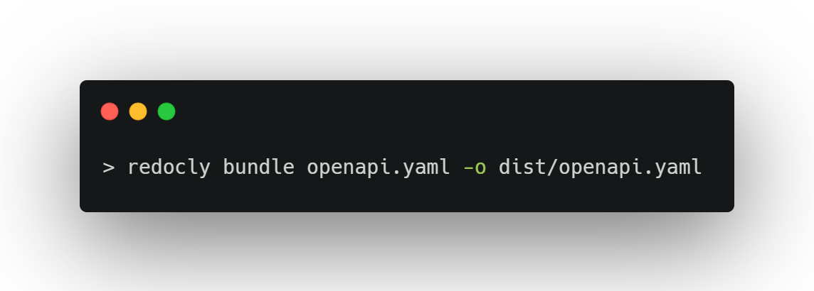
Bundling

Slide 41
Packages
RendleLabs.OpenApi.Web
RendleLabs.OpenApi.Analyzers
RendleLabs.OpenApi.Bundle
RendleLabs.OpenApi.Test

Slide 42

FIN

Slide 43
Resources
openapis.org
swagger.io
openapi.tools
www.asyncapi.com
github.com/RendleLabs/BuildStuff2023

