Slide 1
OpenAPI: You're Doing It Wrong
@markrendle

Slide 2
OpenAPI in .NET
Swashbuckle
NSwag

Slide 3
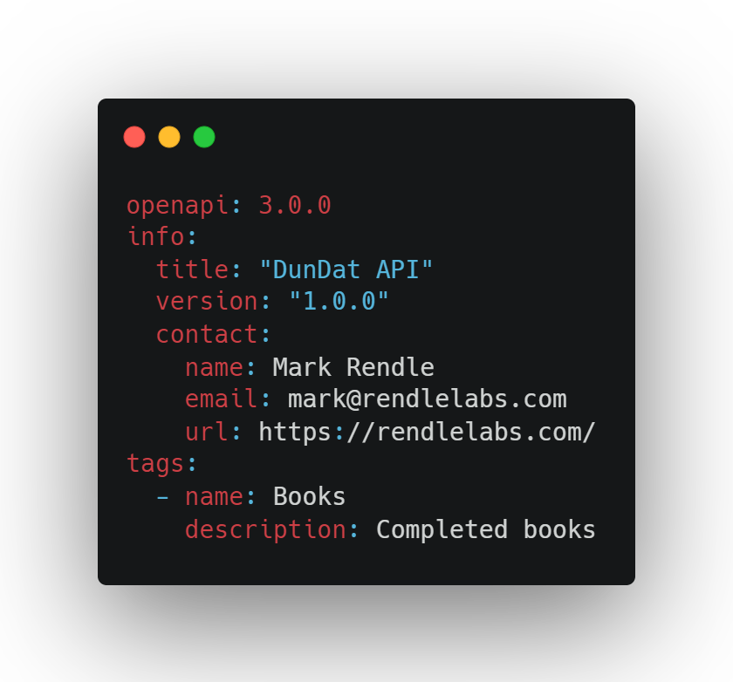
OpenAPI everywhere else

Slide 4
Hand-crafted Artisanal YAML files

Slide 5
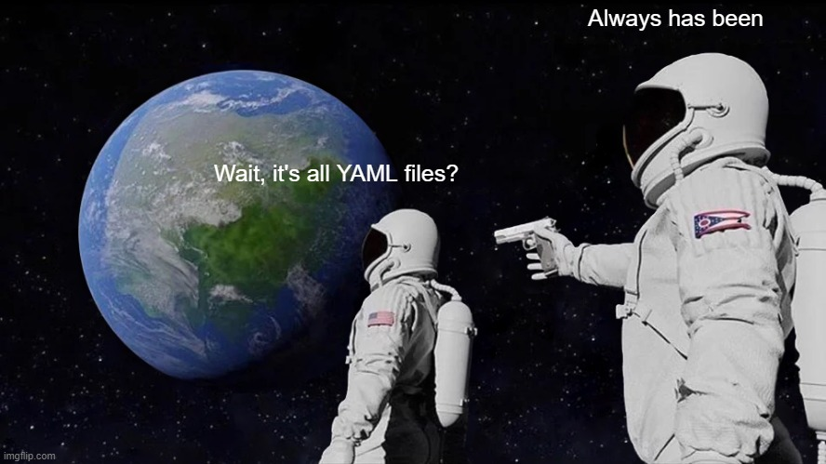

Slide 6
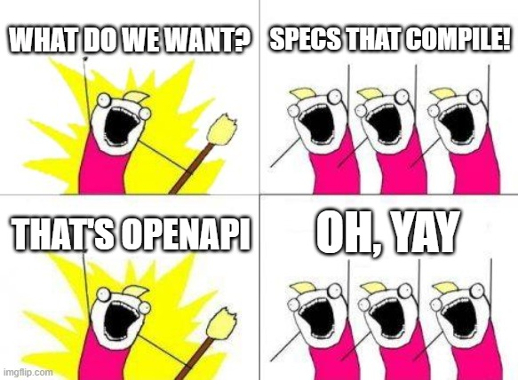

Slide 7
OpenAPI

Slide 8
Paths

Slide 9
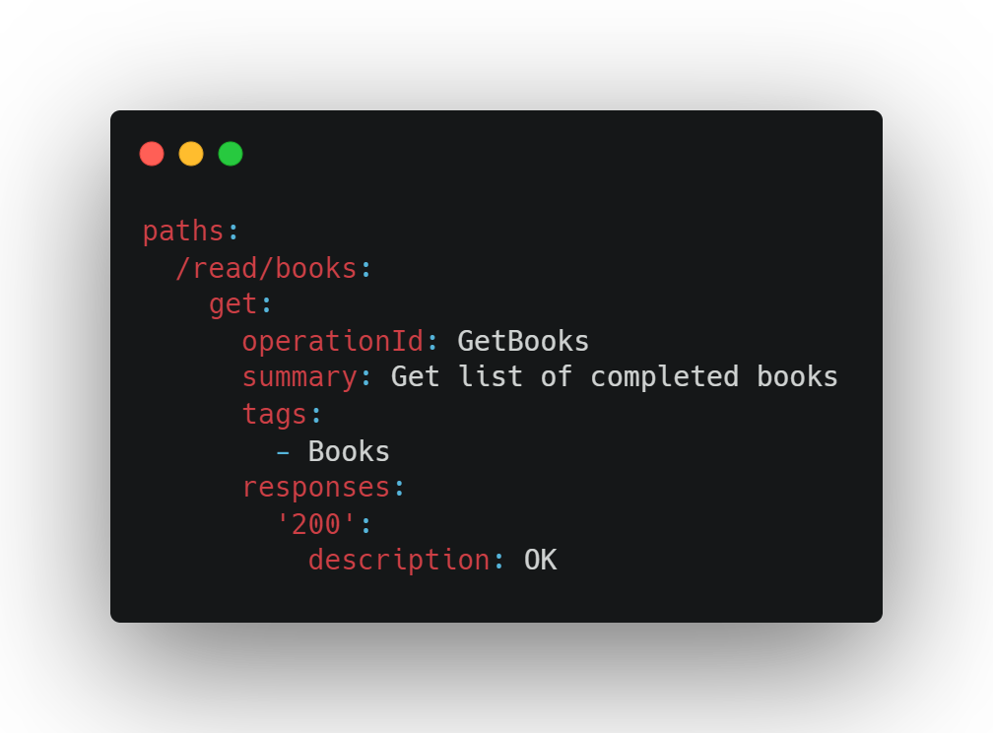

Slide 10
Responses

Slide 11
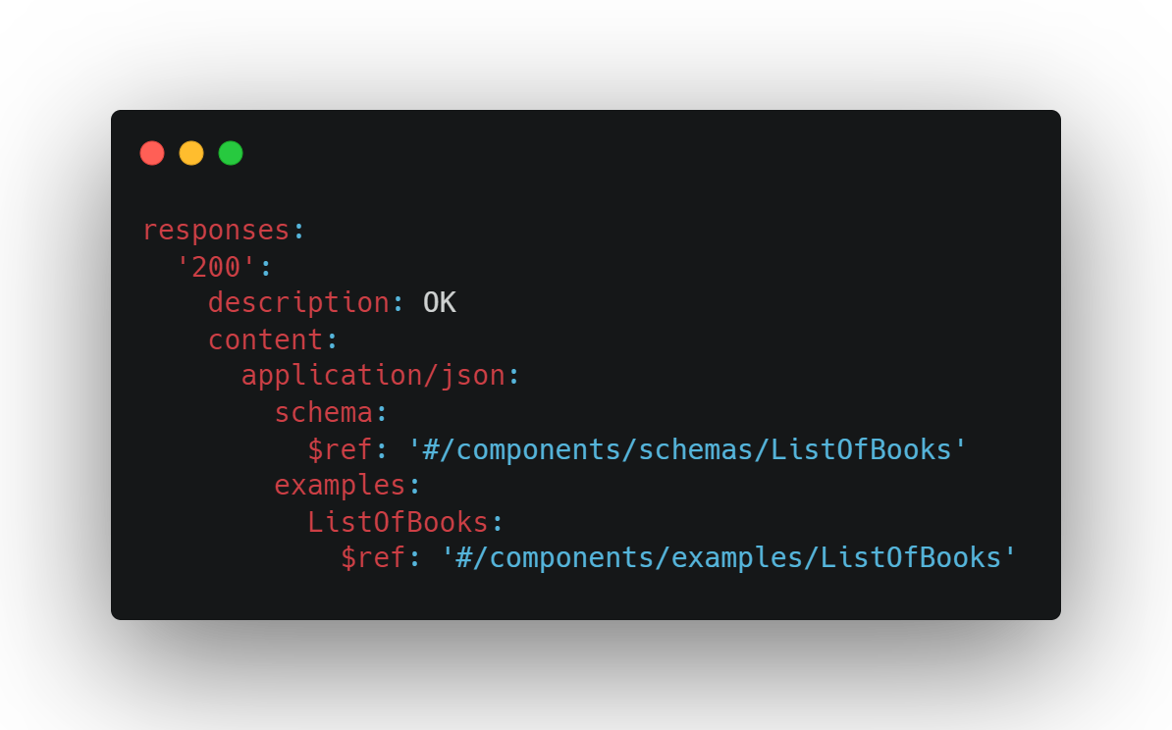

Slide 12
Schema

Slide 13
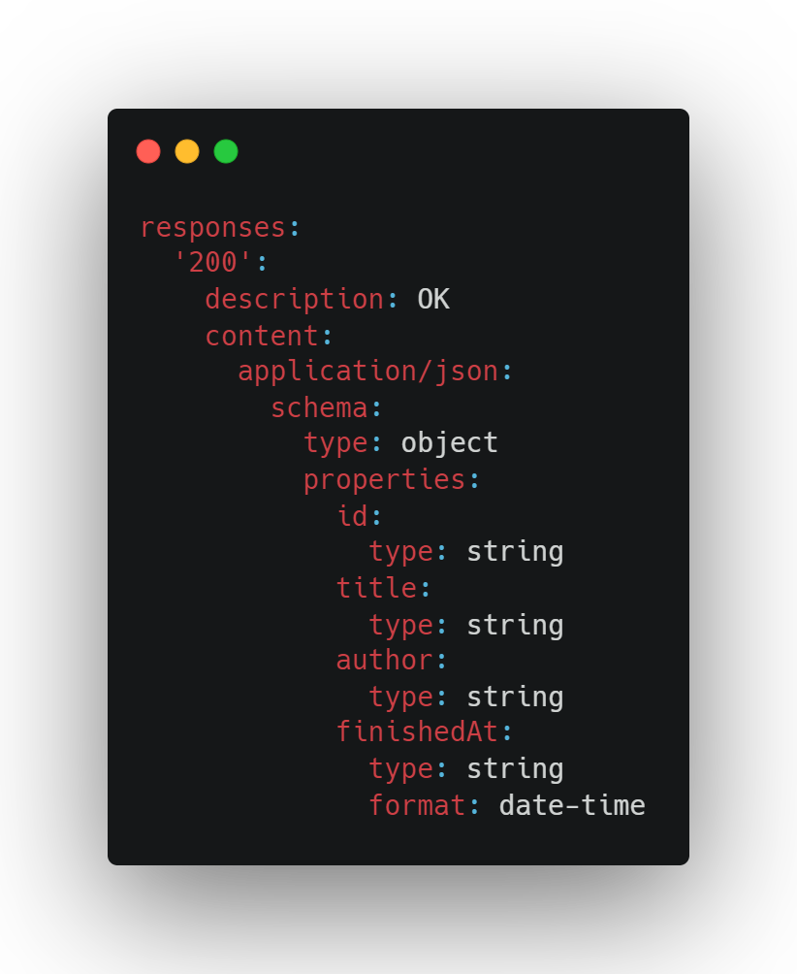

Slide 14
Parameters

Slide 15
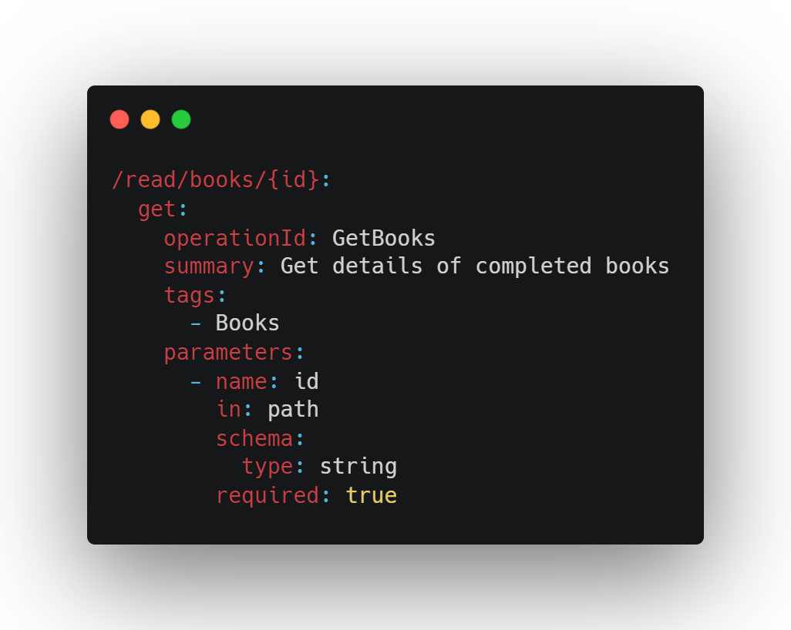

Slide 16
Requests

Slide 17
Components
schemas
responses
requestBodies
parameters
headers
securitySchemes
examples
links
callbacks

Slide 18
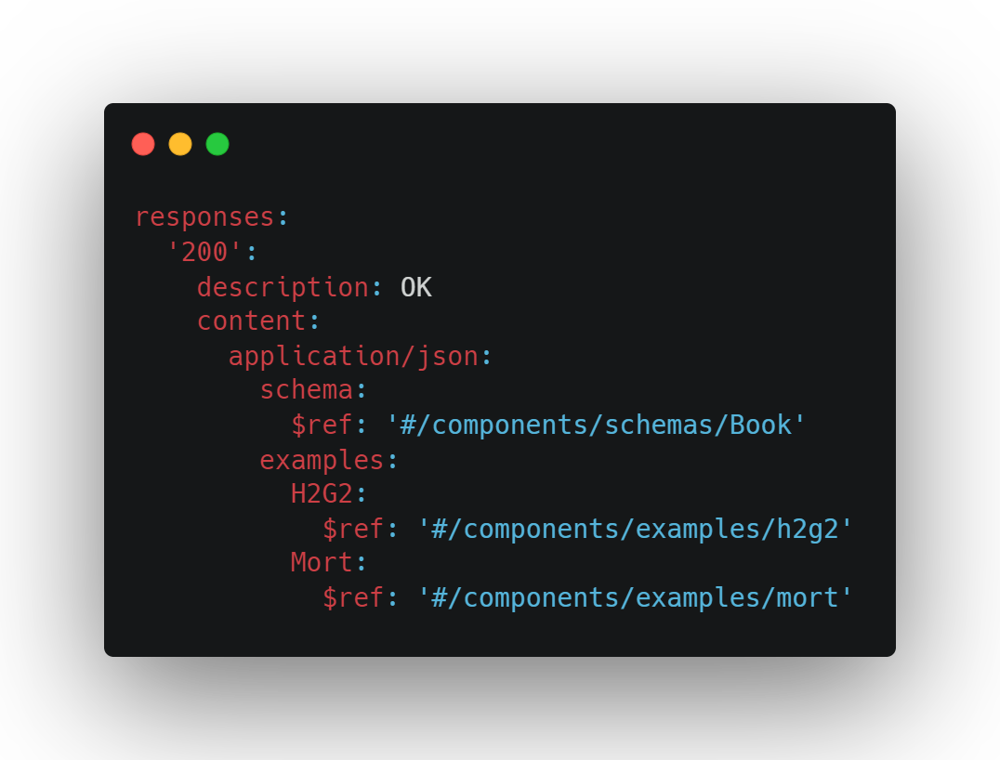
References

Slide 20
Security

Slide 21
Problems
application/problem+json

Slide 22
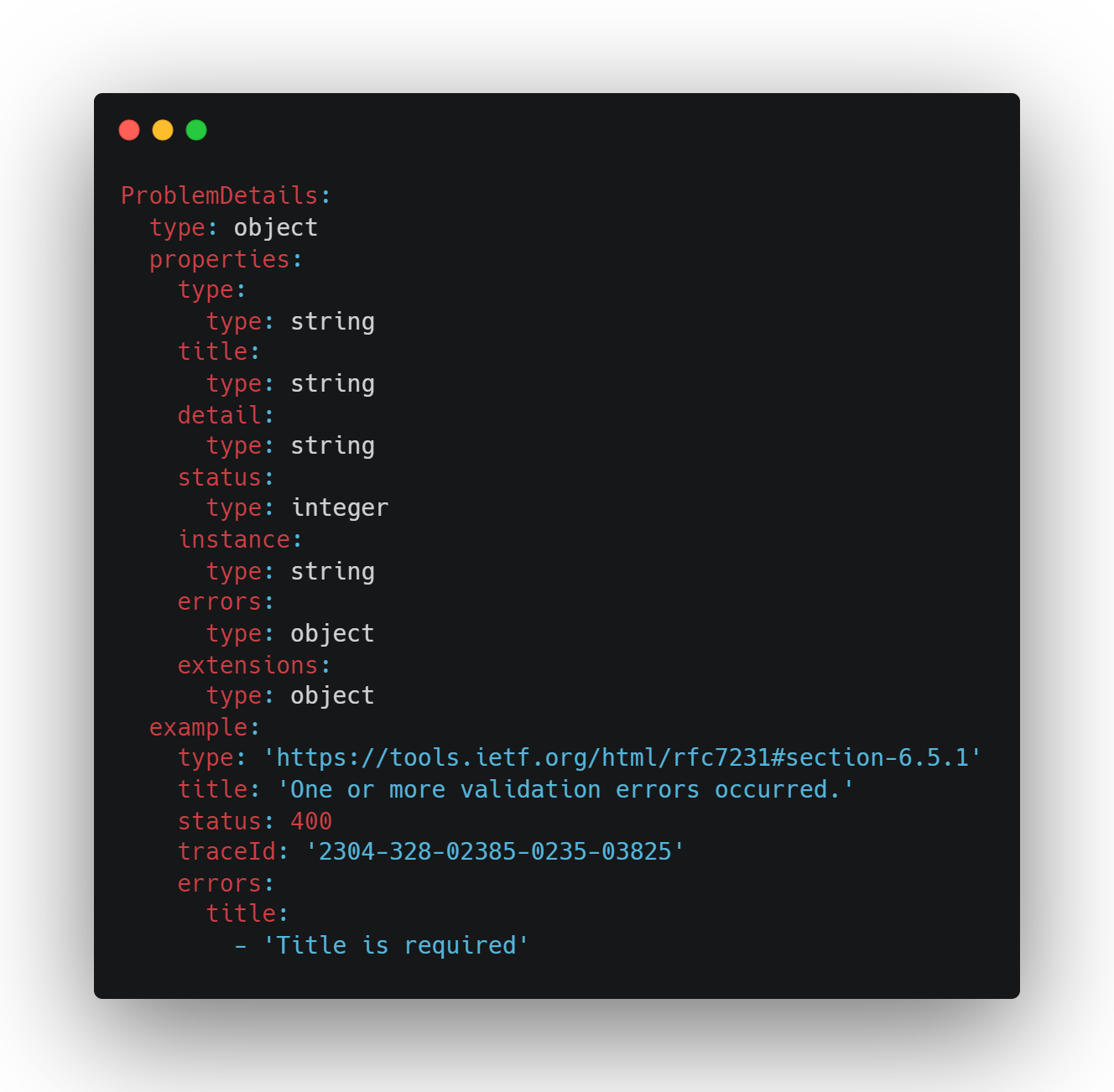

Slide 23
Tools
Swagger UI
Redoc github.com/Redocly/redoc
Widdershins + Reslate github.com/Mermade/widdershins
Elements stoplight.io/open-source/elements

Slide 24
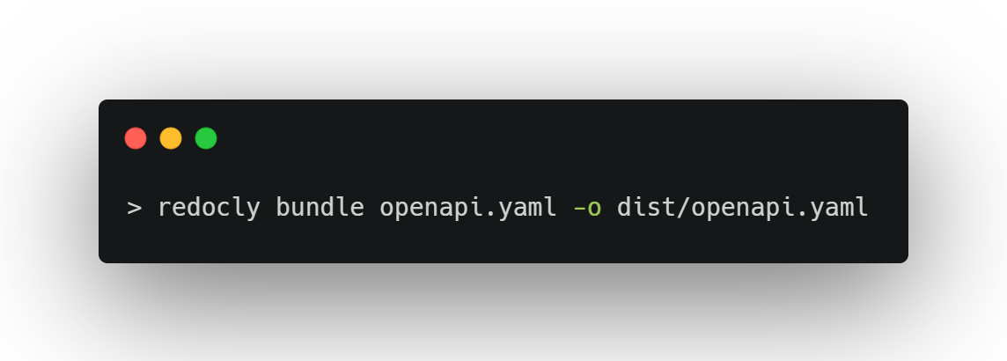
Bundling

Slide 25
Packages
RendleLabs.OpenApi.Web
RendleLabs.OpenApi.Bundle
RendleLabs.OpenApi.Test
RendleLabs.OpenApi.Doc

