Slide 1
OpenAPI: You're Doing It Wrong
@markrendle

Slide 2
OpenAPI in .NET
Swashbuckle
NSwag

Slide 3
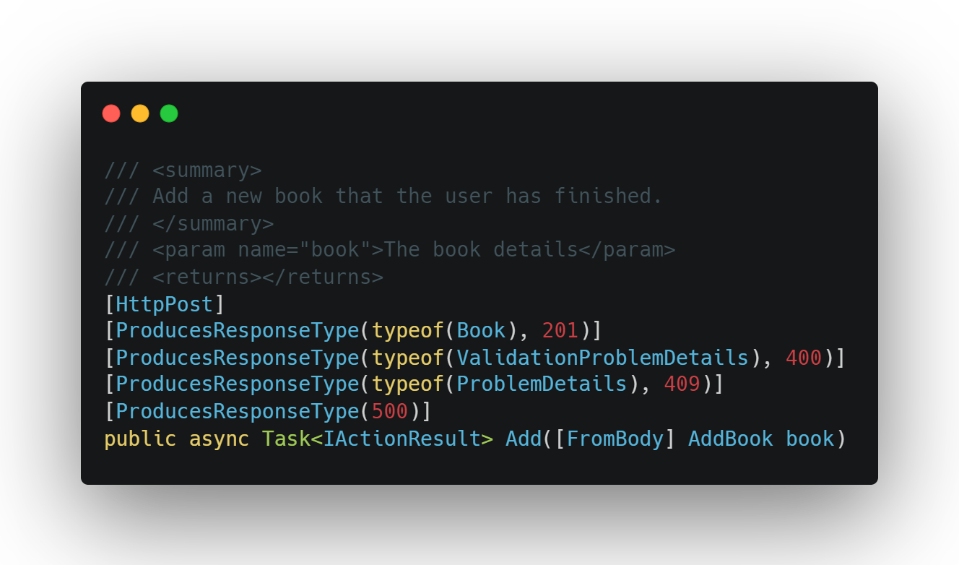
OpenAPI in .NET

Slide 4
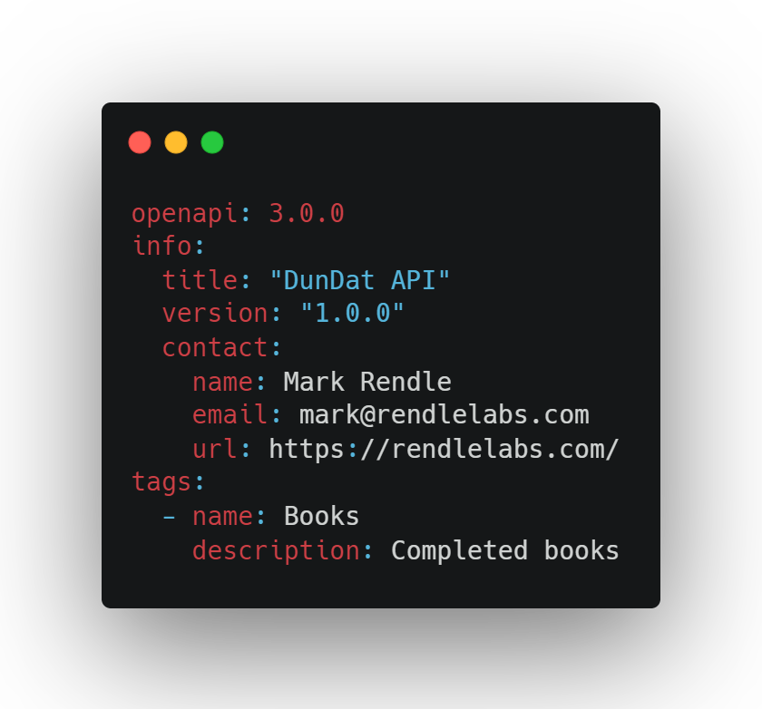
OpenAPI everywhere else

Slide 5
Hand-crafted Artisanal YAML files

Slide 6
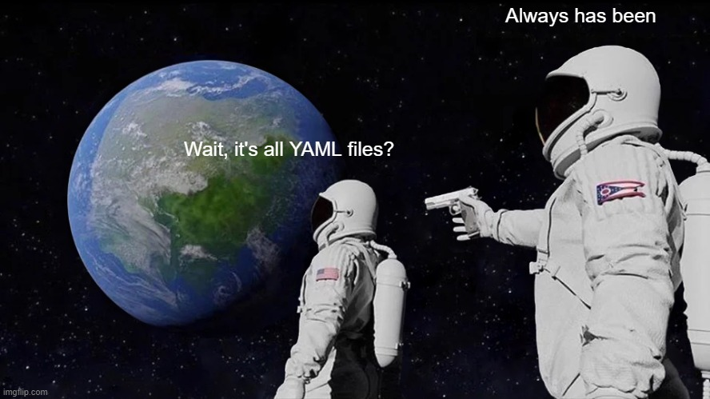

Slide 7
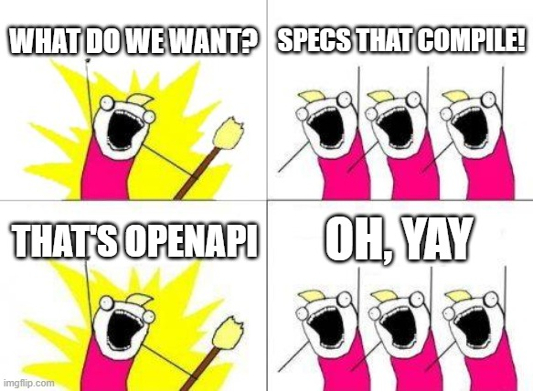

Slide 8
OpenAPI

Slide 9
Paths

Slide 10
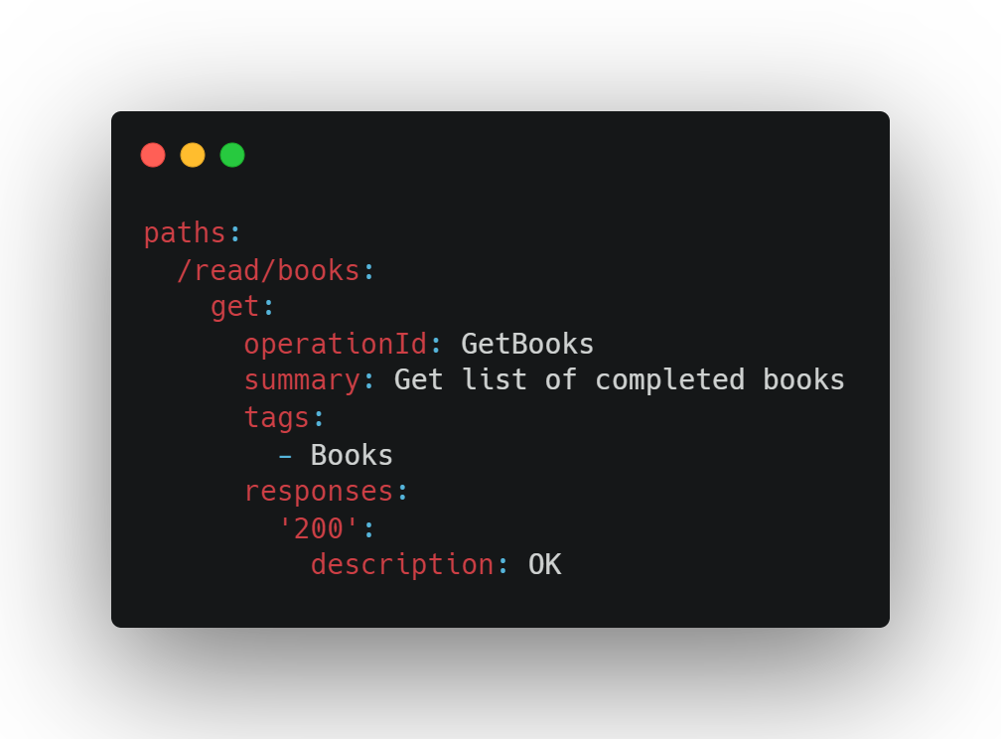

Slide 11
Responses

Slide 12
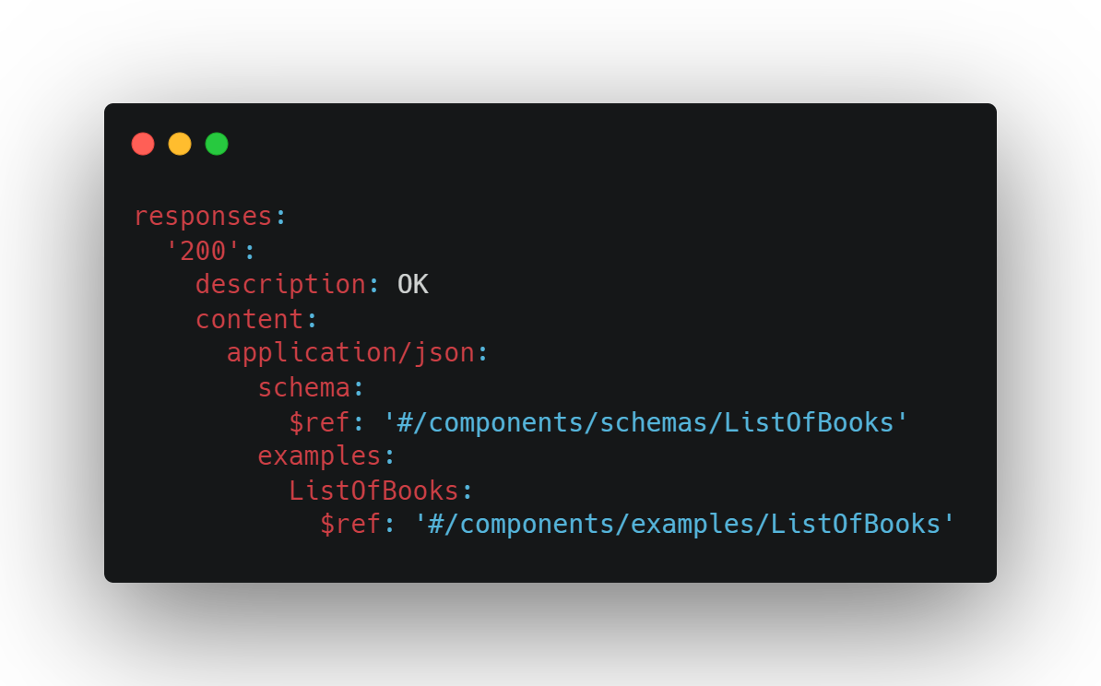

Slide 13
Schema

Slide 14
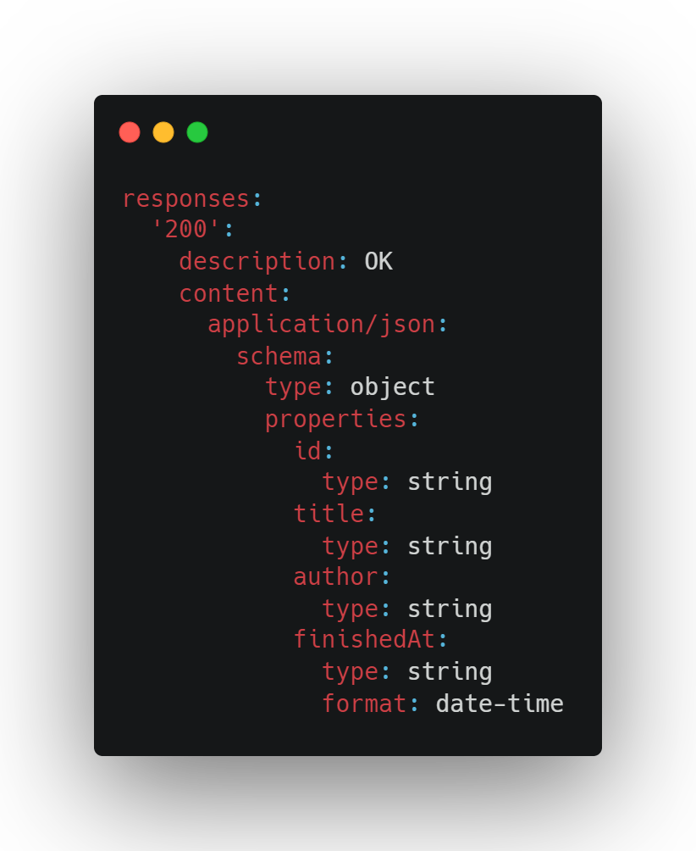

Slide 15
Parameters

Slide 16
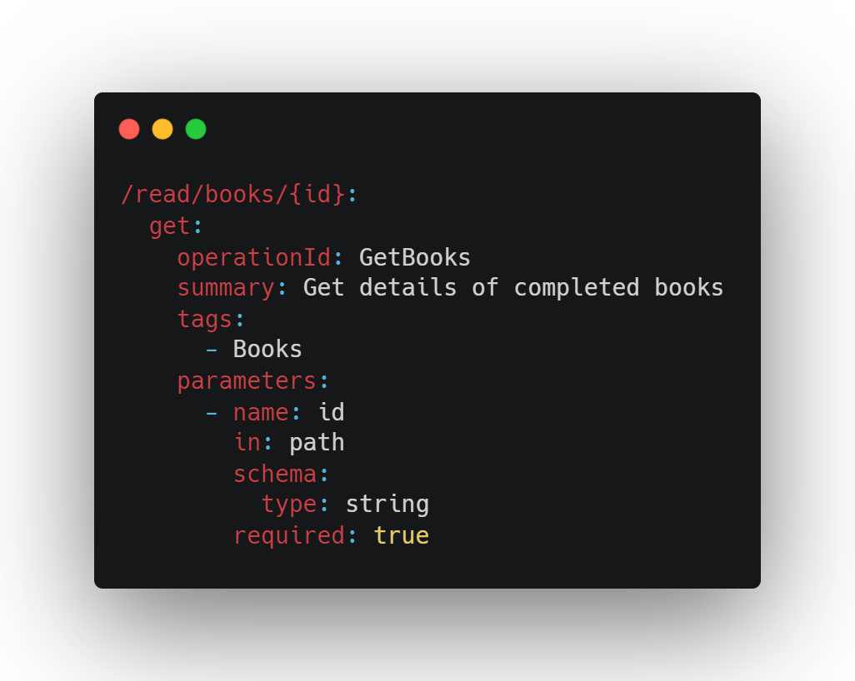

Slide 17
Requests

Slide 18
Components
schemas
responses
requestBodies
parameters
headers
securitySchemes
examples
links
callbacks

Slide 19
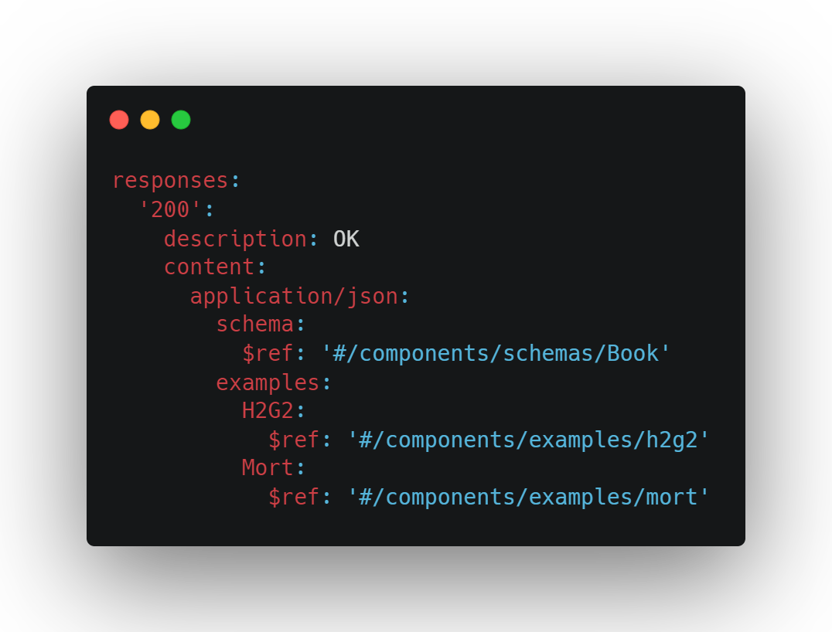
References

Slide 21
Security

Slide 22
Problems
application/problem+json

Slide 23
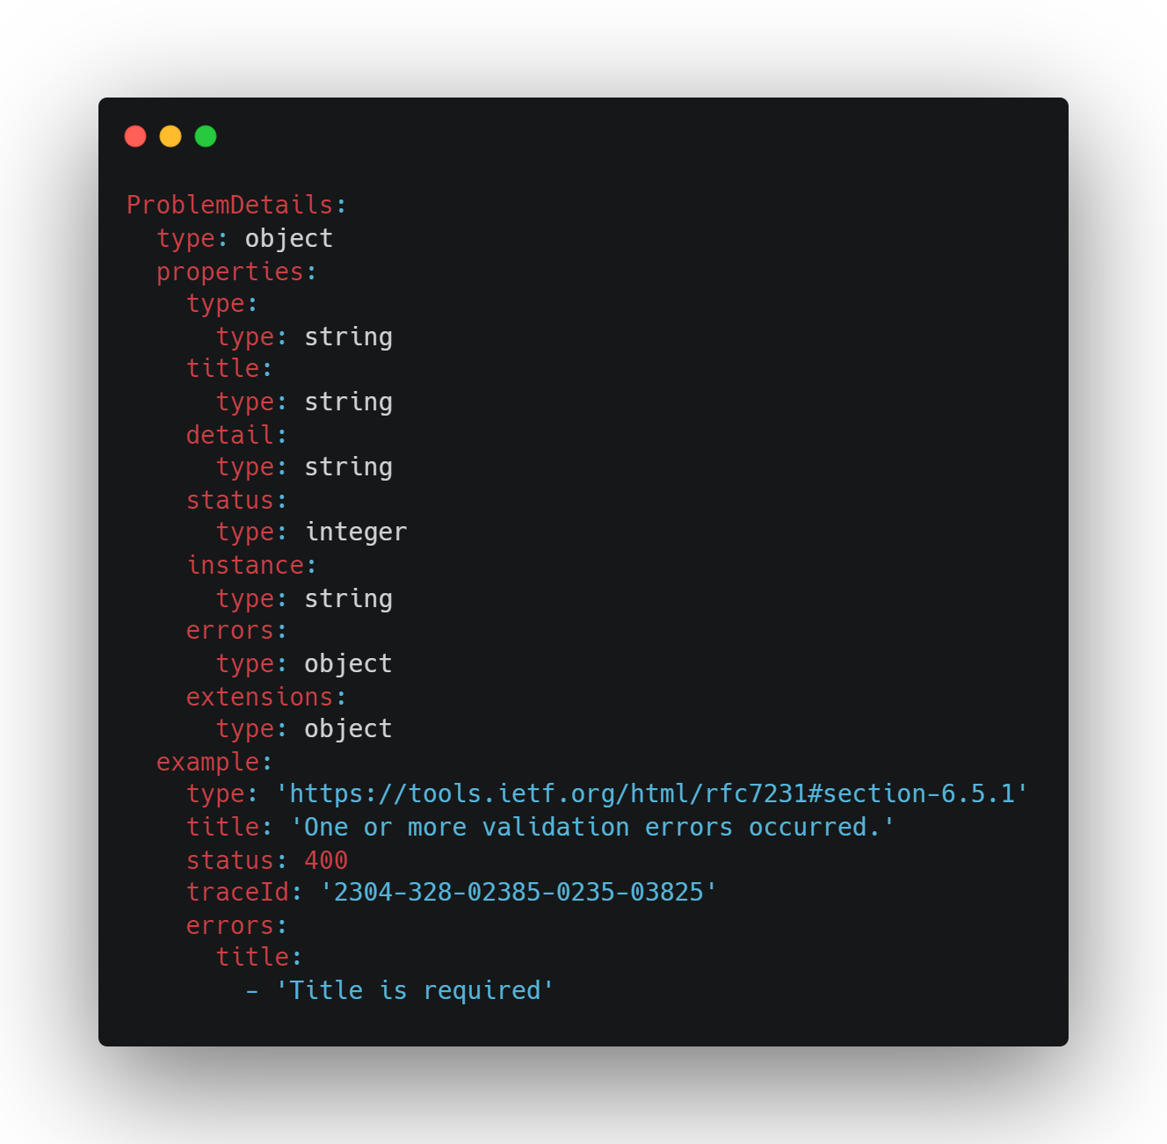

Slide 24
Tools
Swagger UI
Redoc github.com/Redocly/redoc
Widdershins + Reslate github.com/Mermade/widdershins
Elements stoplight.io/open-source/elements

Slide 25
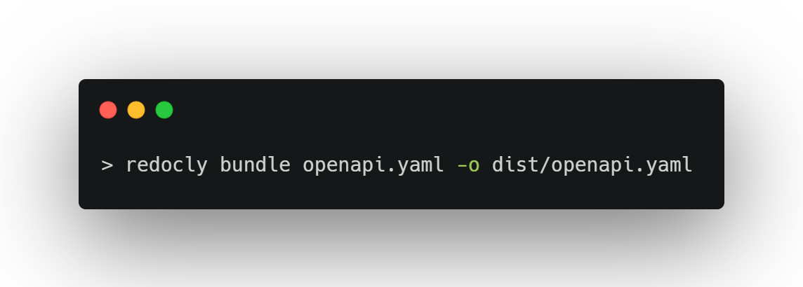
Bundling

Slide 26
Packages
RendleLabs.OpenApi.Web
RendleLabs.OpenApi.Bundle
RendleLabs.OpenApi.Test
RendleLabs.OpenApi.Doc

