Slide 1
OpenAPI: You're Doing It Wrong
@markrendle
London .NET User Group, October 2022

Slide 2
So what is it?

Slide 3
So what is it?
I've never seen one before, no one has,
but I'm guessing it's a white hole.

Slide 4
OpenAPI Versions
2.0: Swagger
3.0: Current
3.1: New & Improved!

Slide 5
OpenAPI Versions
2.0: Swagger
3.0: Current
3.1: New & Improved!
Use this one

Slide 6
Implementation

Slide 7
OpenAPI in .NET
Swashbuckle
NSwag

Slide 8
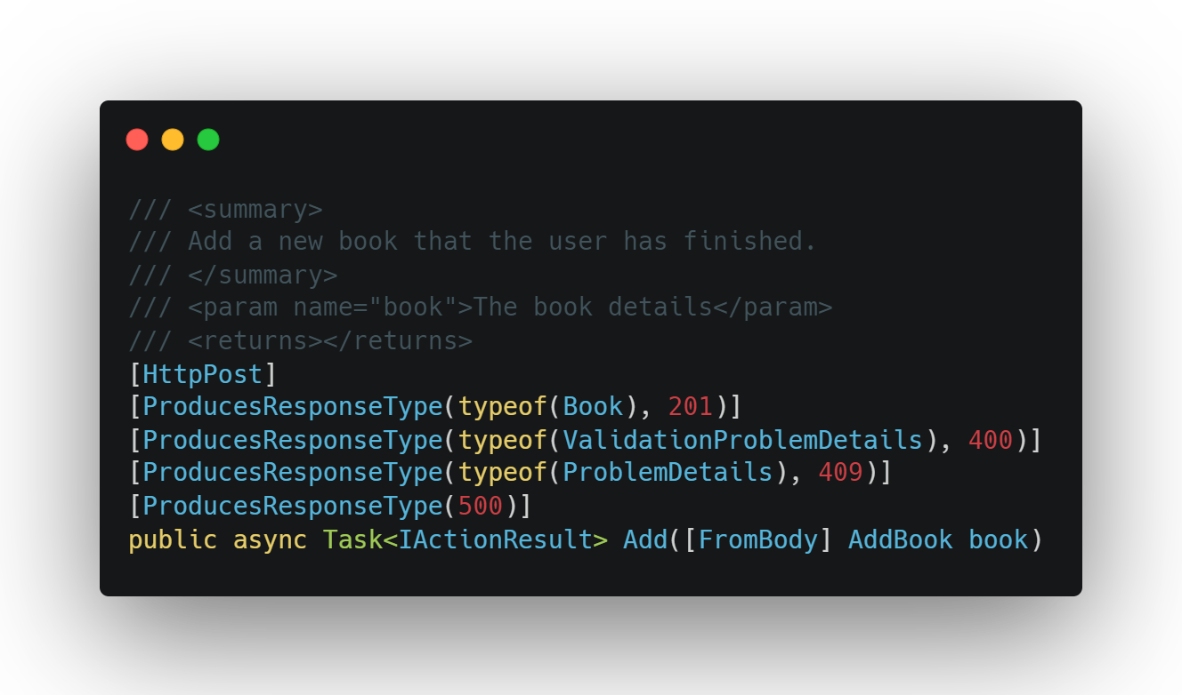
OpenAPI in .NET

Slide 9
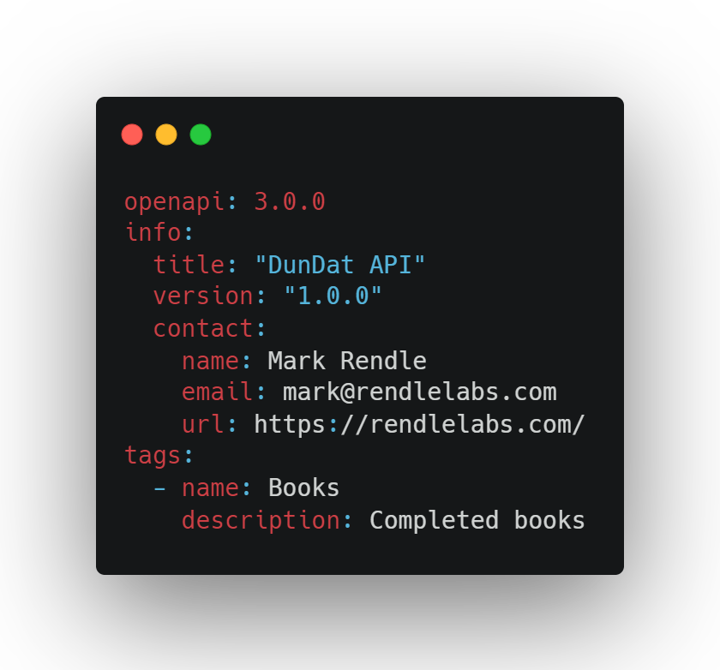
OpenAPI everywhere else

Slide 10
Hand-crafted Artisanal YAML files

Slide 11
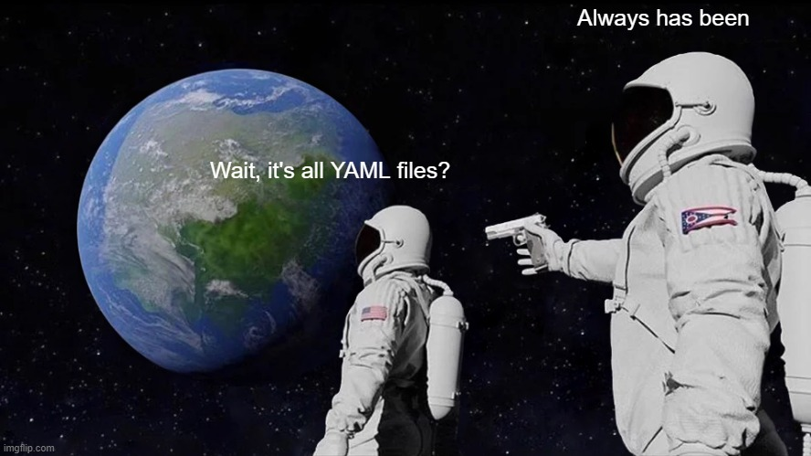

Slide 12
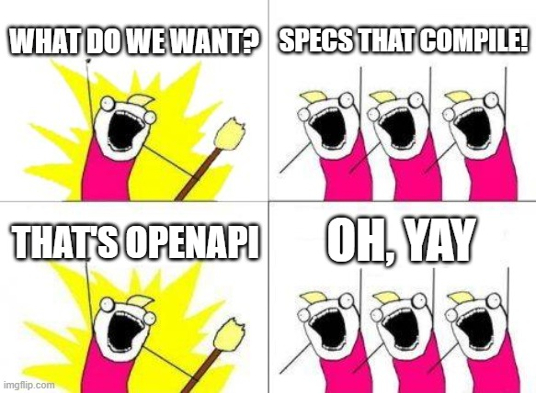

Slide 13
Why, Mark? Why?
Source of truth for your team
Separate Design and Implementation
Better description of your API
Automated documentation

Slide 14
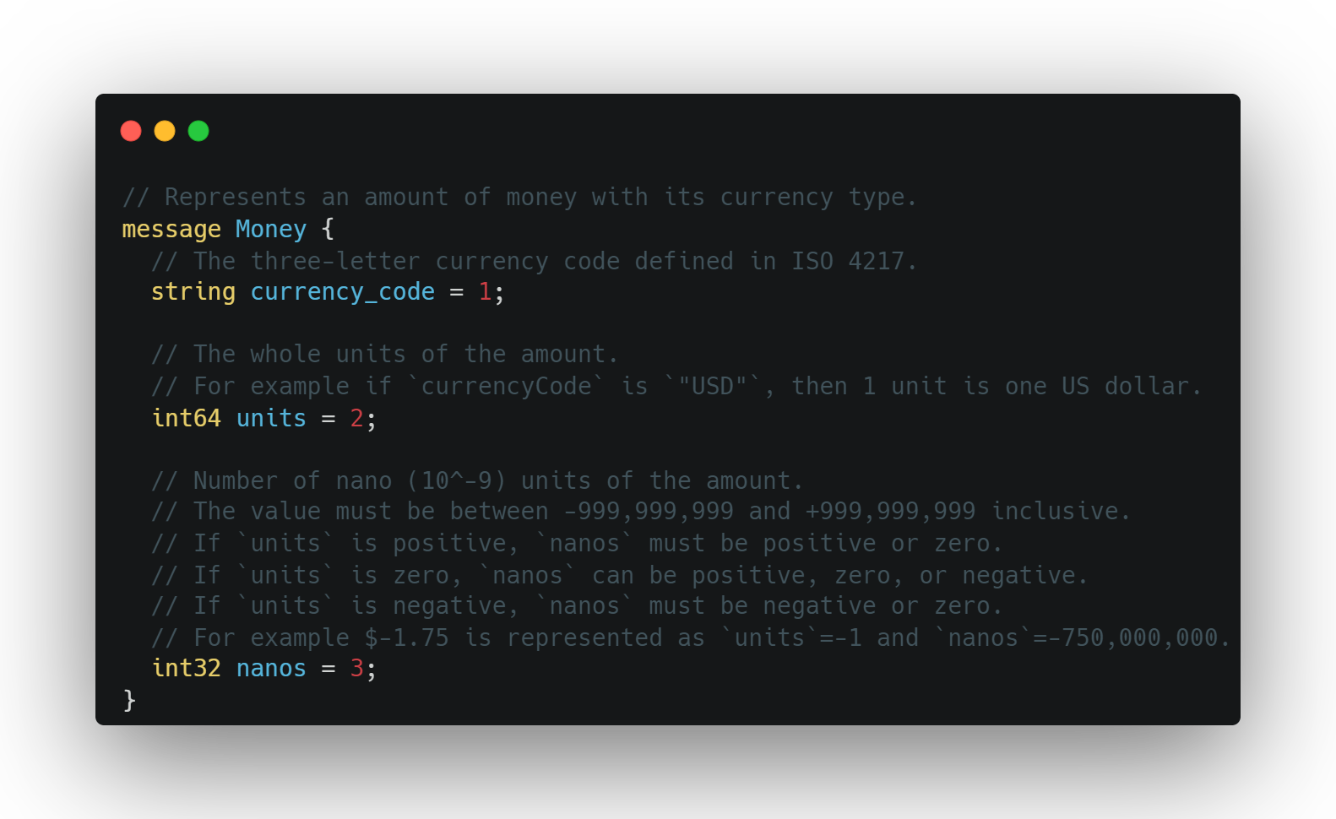

Slide 15
OpenAPI

Slide 16
Paths

Slide 17
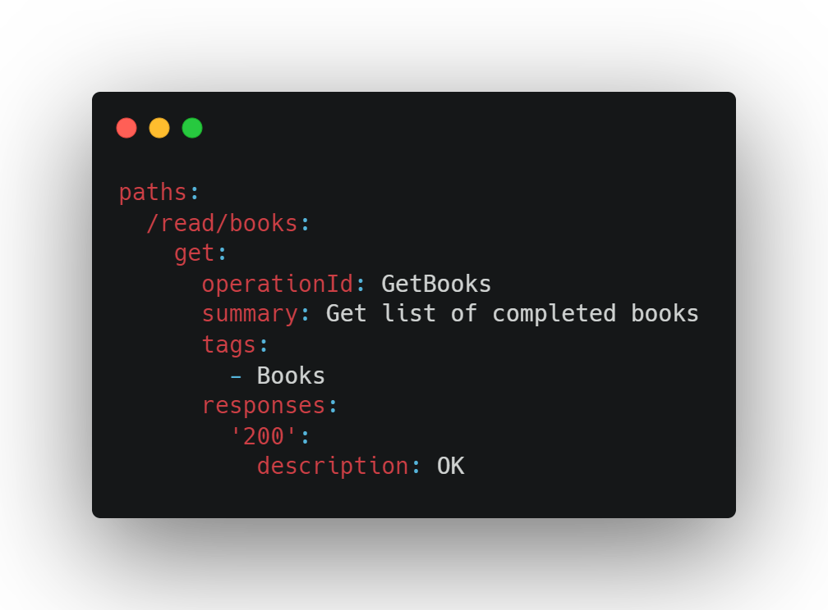

Slide 18
Responses

Slide 19
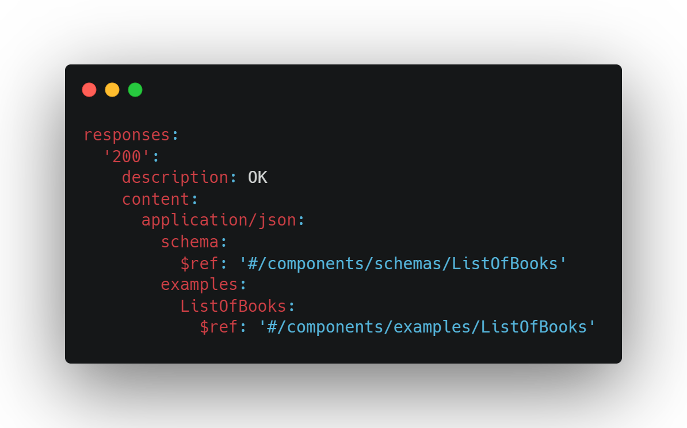

Slide 20
Schema

Slide 21
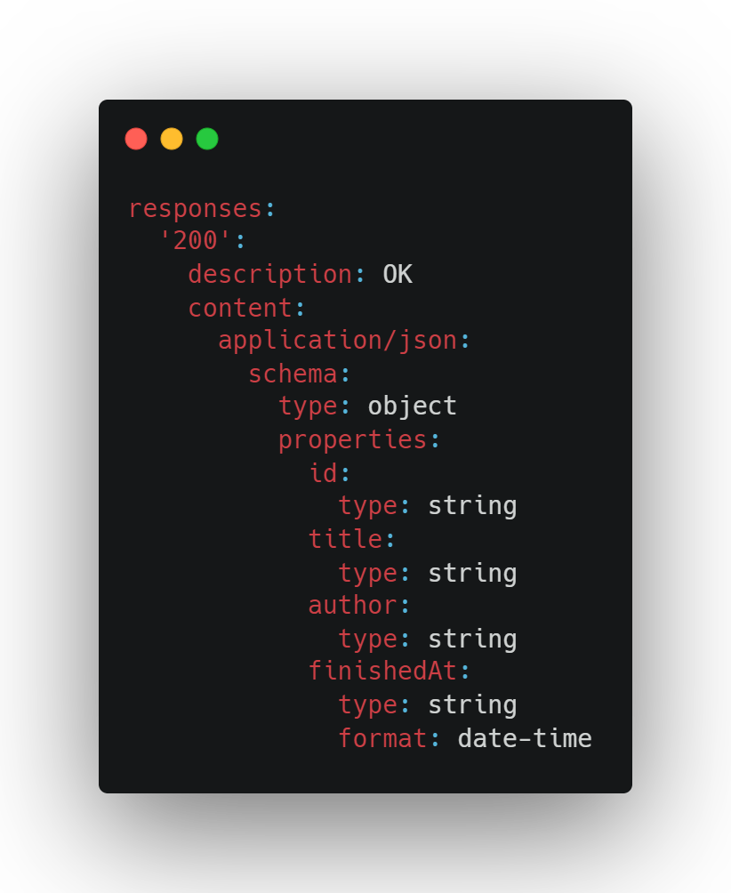

Slide 22
Parameters

Slide 23
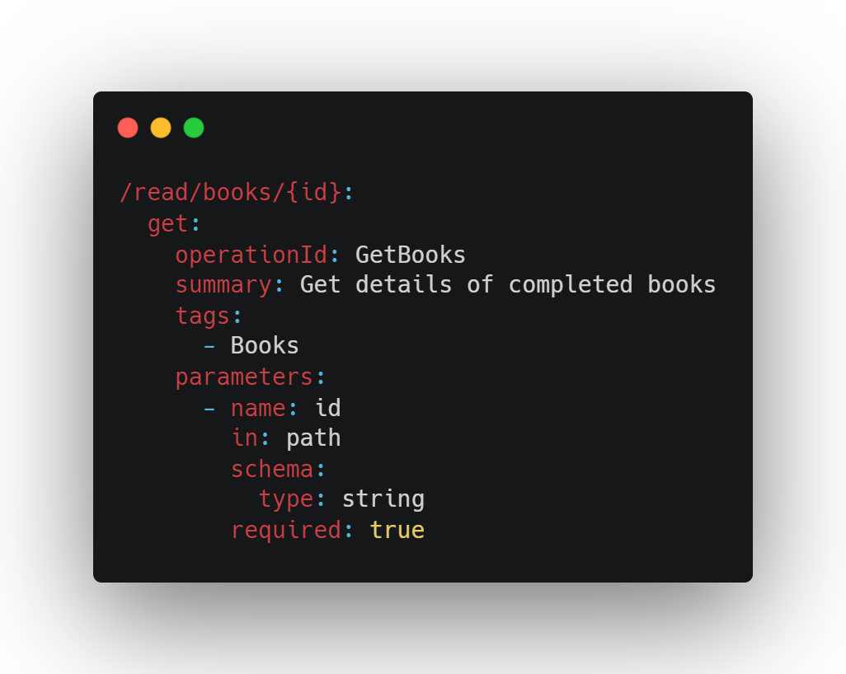

Slide 24
Requests

Slide 25
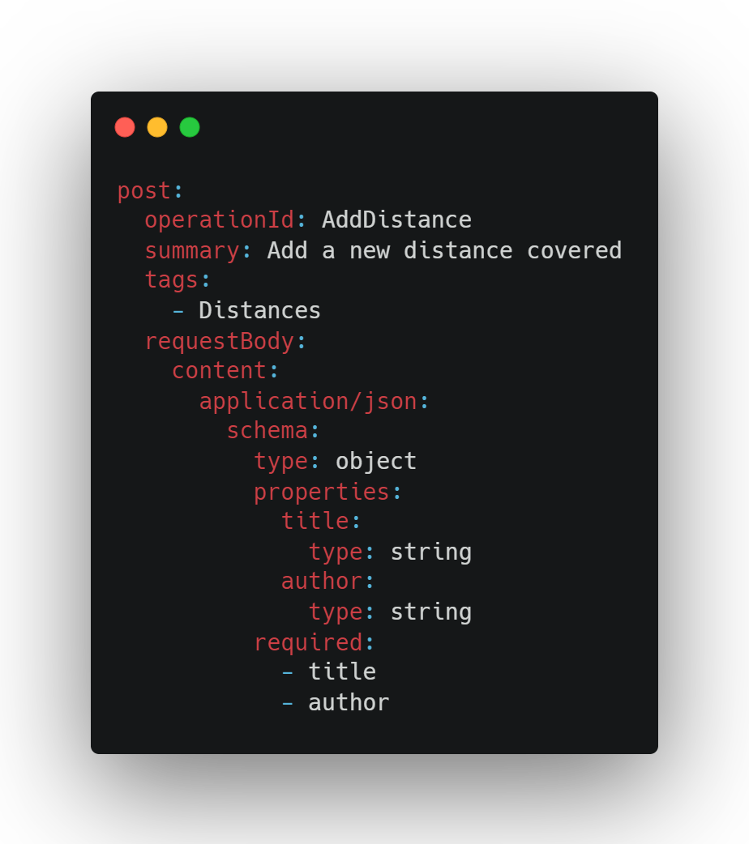

Slide 26
Components

Slide 27
Components
schemas
responses
requestBodies
parameters
headers
securitySchemes
examples
links
callbacks

Slide 28
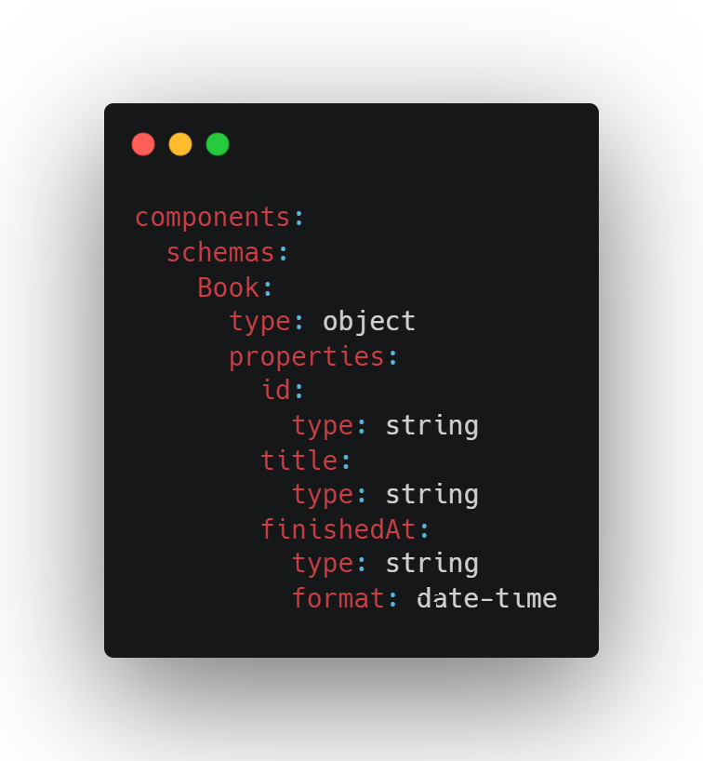

Slide 29
References

Slide 30
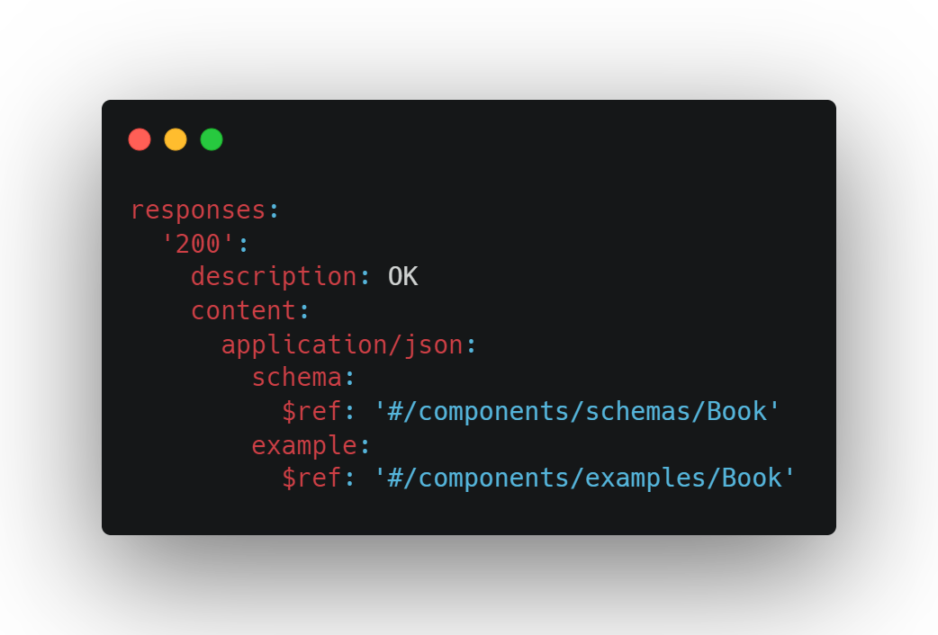

Slide 31
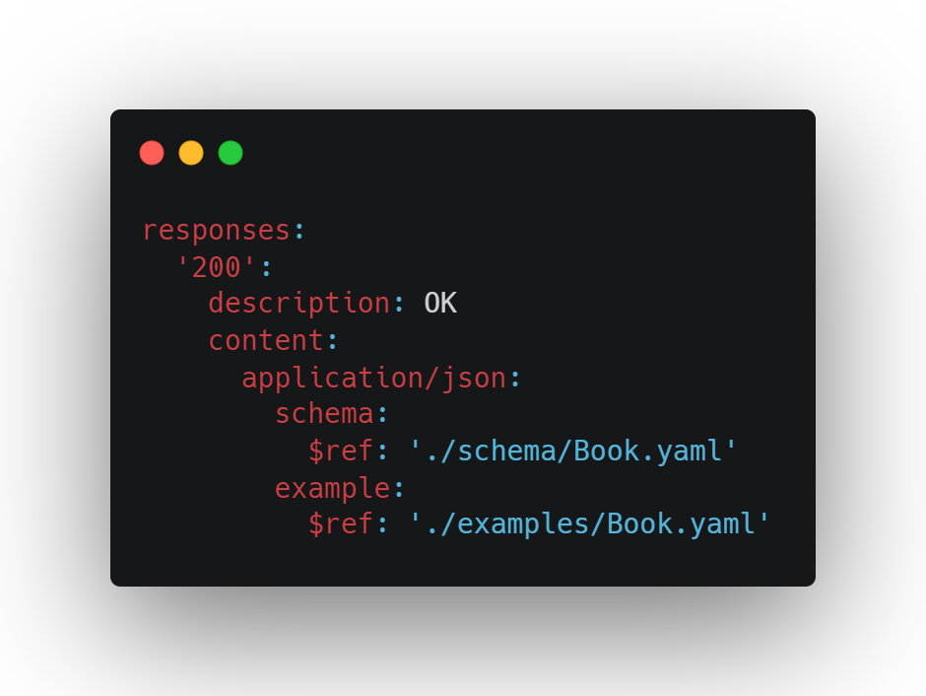

Slide 32
Security

Slide 33
Problems
application/problem+json

Slide 34
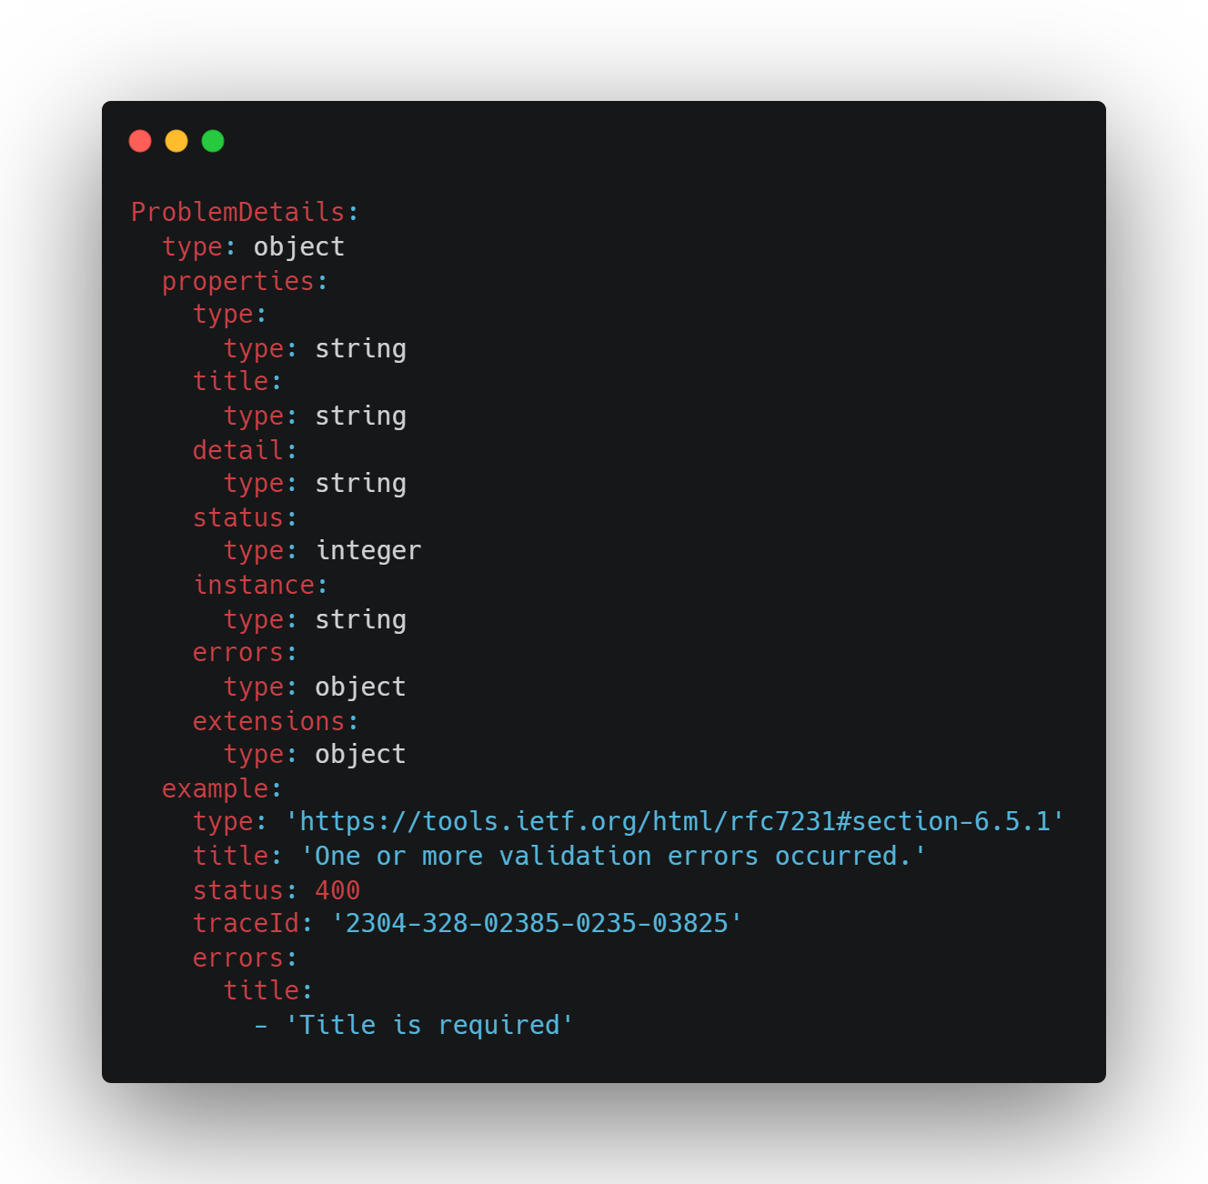

Slide 35
Tools
Swagger UI
Redoc github.com/Redocly/redoc
Widdershins + Reslate github.com/Mermade/widdershins
Elements stoplight.io/open-source/elements

Slide 36
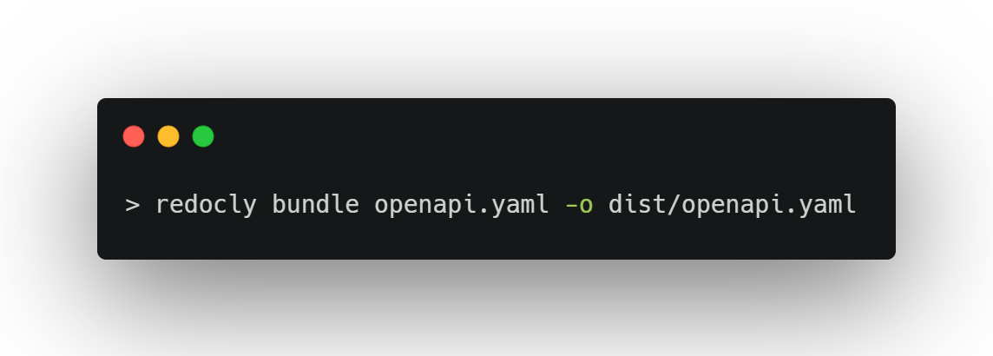
Bundling

Slide 37
Packages
RendleLabs.OpenApi.Web
RendleLabs.OpenApi.Analyzers
RendleLabs.OpenApi.Bundle
RendleLabs.OpenApi.Test

Slide 38

FIN

Slide 39
Resources
openapis.org
swagger.io
openapi.tools
www.asyncapi.com
github.com/RendleLabs/LDNUG2022

