Slide 1

Modern Distributed Systems with gRPC in NET 6.0
Mark Rendle
mark@rendlelabs.com
@markrendle

Slide 2
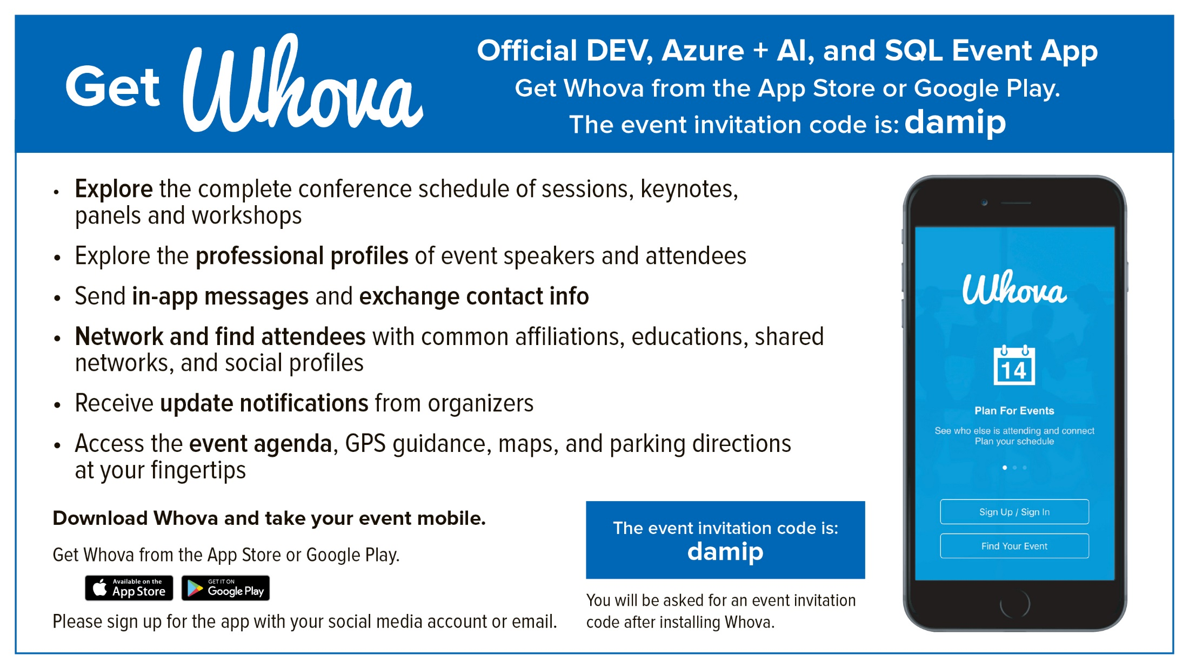

Slide 3

Coach: Mark Rendle
Visual ReCode
.NET Consultant
Chief Architect, Visual ReCode
MVP, Developer Technologies

Slide 4
Introduction
Requirements
gRPC & Protobuf 101
The App: Pizza!
First gRPC service: Ingredients
Integration Testing gRPC services
Project Tye
Second gRPC service: Orders
gRPC & Protobuf 201
Authentication

Slide 5
A Short Story
About measuring things

Slide 6
Requirements
.NET Core SDK 6.0.x
IDE / Editor
Visual Studio 2022 / VS Mac 2022 Preview / JetBrains Rider 2021.3 / VS Code latest
CLI
dotnet tool install --global Microsoft.Tye --version 0.10.0-alpha.21420.1

Slide 7
gRPC & Protobuf 101

Slide 8
Protobuf
Efficient binary format
Pre-generated serialization/deserialization code
Interface-first development
Cross-platform:
C#, Kotlin, Java, Python, Node.js, C++, Swift, Dart, Go, PHP, Ruby
Rust, Erlang, Elixir, TypeScript, Scala, Perl, Elm

Slide 9
gRPC
Remote Procedure Calls
HTTP/2 (and 3)
Streams

Slide 10
Message definition
message Employee {
int32 id = 1;
string first_name = 2;
string last_name = 3;
repeated string phone_numbers = 4;
}

Slide 11
Scalar Value Types
Protobuf | C# | Notes
bool | bool
string | string | UTF-8 encoded
float | float
double | double
bytes | byte[]

Slide 12
Integer Types
Protobuf | C# | Notes
int32 | int
int64 | long
uint32 | uint
uint64 | ulong
sint32 | int | Better when values are often negative
sint64 | long | Better when values are often negative
fixed32 | int | Fixed-length, better when values are often > 2^28
fixed64 | long | Fixed-length, better when values are often > 2^56
sfixed32 | int | Like sint32 but fixed-length
sfixed64 | long | Like sint64 but fixed-length

Slide 13
“Well-Known Types”
Protobuf | C# | Import
google.protobuf.Timestamp | DateTimeOffset | google/protobuf/timestamp.proto
google.protobuf.Duration | TimeSpan | google/protobuf/duration.proto
google.protobuf.Int32Value | Nullable<int> | google/protobuf/wrappers.proto
Etc. | Etc. | google/protobuf/wrappers.proto

Slide 14
Service definition
service Employees {
rpc GetAll(GetAllRequest) returns (GetAllResponse);
rpc Get(GetRequest) returns (GetResponse);
}

Slide 15
Pizza!
(Thinking of workshop apps is hard)

Slide 16
Starter project
https://github.com/RendleLabs/DevInt2021Workshop

Slide 17
Project Overview
Frontend:
ASP.NET Core MVC
No SPA, React, Angular, Vue, Blazor
Ingredients.Data:
DAL for ingredients data over Azure Table Storage
Orders.PubSub:
Messaging using Azure Redis
AuthHelp:
Authentication helpers

Slide 18
Ingredients
My First gRPC Service

Slide 19
Create Ingredients Project
dotnet new grpc -o src/Ingredients
dotnet sln add src/Ingredients

Slide 20
Coding

Slide 21
Consuming Toppings
Pun absolutely intended

Slide 22
Consuming the Ingredients Service
Add gRPC NuGet packages
Google.Protobuf
Grpc.AspNetCore.Server.ClientFactory
Grpc.Tools
Add <Protobuf> elements to project

Slide 23
Coding

Slide 24
Integration Testing

Slide 25
Integration Testing
Microsoft.AspNetCore.Mvc.Testing
WebApplicationFactory<T>
Mocking dependencies

Slide 26
Create Ingredients.Tests Project
dotnet new xunit -o test/ Ingredients.Tests
dotnet sln add test/ Ingredients.Tests

Slide 27
Add the Ingredients Client
Add gRPC NuGet packages
Google.Protobuf
Grpc.Net.Client
Grpc.Tools
Add <Protobuf> elements to project

Slide 28
Coding

Slide 29
Exercise
Add Crusts to the Ingredients service

Slide 30
Crusts
Add GetCrusts rpc to the IngredientsService service in ingredients.proto
Add message types in ingredients.proto
Implement GetCrusts in IngredientsImpl
Use CrustData from Ingredients.Data project
Add tests for GetCrusts in test project
Use GetCrustsAsync in Frontend project

Slide 31
Project Tye
For developing, testing and deploying
microservices and distributed applications

Slide 32
Install Tye
dotnet tool install -g --version 0.10.0-alpha.21420.1 Microsoft.Tye

Slide 33
Tye Configuration
Microsoft.Tye.Extensions.Configuration
Enable Pre-Release packages

Slide 34
Run
tye run

Slide 35
tye.yaml
name: pizza
services:
- name: frontend
project: src/Frontend/Frontend.csproj
bindings:
- protocol: https
port: 5001
- name: ingredients
project: src/Ingredients/Ingredients.csproj
bindings:
- protocol: https
port: 5003

Slide 36
Decimals
Because 4.99 * 5 ≠ 24.950000000000003

Slide 37
decimal.proto
// Adapted from https://github.com/googleapis/googleapis/blob/master/google/type/money.proto
syntax = "proto3";
package customTypes;
option csharp_namespace = "Ingredients";
// Name "DecimalValue" prevents conflict with C# Decimal type
message DecimalValue {
// The whole units of the amount.
int64 units = 1;
// Number of nano (10^-9) units of the amount.
// The value must be between -999,999,999 and +999,999,999 inclusive.
// For example $-1.75 is represented as `units`=-1 and `nanos`=-750,000,000.
int32 nanos = 2;
}

Slide 38
DecimalValue.cs
namespace Ingredients
{
internal partial class DecimalValue
{
private const decimal NanoDivisor = 1_000_000_000m;
private DecimalValue(decimal value)
{
Units = (long) decimal.Truncate(value);
Nanos = (int) ((value - Units) * NanoDivisor);
}
public static implicit operator decimal(DecimalValue value) =>
value.Units + (value.Nanos / NanoDivisor);
public static implicit operator DecimalValue(decimal value) =>
new DecimalValue(value);
}
}

Slide 39
Orders
My Second gRPC Service

Slide 40
Orders Requirements
Update Stock
Send order to pizza store

Slide 41
Coding

Slide 42
gRPC Streams

Slide 43
Server streaming
service Things {
rpc Get(GetRequest) returns (stream Thing);
}

Slide 44
Client streaming
service Things {
rpc Send(stream Thing) returns (SendResponse);
}

Slide 45
Bidirectional streaming
service Things {
rpc Exchange(stream Thing) returns (stream Thing);
}

Slide 46
Orders.ShopConsole
Consuming the Order stream

Slide 47
Coding

Slide 48
Authentication

Slide 49
Authentication Options
Bearer Tokens
Certificates (Mutual TLS)

Slide 50
Token Authentication
CallCredentials
Per-call
Server can verify Client
Uses JSON Web Tokens
MS Auth JwtBearer

Slide 51
Certificate Authentication
ChannelCredentials
Per-connection
Server can verify Client
Client can verify Server
Kestrel
MS Auth Certificate

Slide 52
AuthHelp
Helper project with useful bits

Slide 53
Coding

Slide 54
gRPC & Protobuf 201

Slide 55
Reserved fields
message Foo {
reserved 2, 3;
int32 id = 1;
string label = 4;
}

Slide 56
Nested Types
message Foo {
message Bar {
int32 id = 1;
string name = 2;
}
int32 id = 1;
repeated Bar bars = 2;
}

Slide 57
Enums
enum Color {
UNKNOWN = 0;
RED = 1;
ORANGE = 2;
YELLOW = 3;
GREEN = 4;
BLUE = 5;
PURPLE = 6;
}

Slide 58
oneof
message Notification {
oneof event {
Message message = 1;
Enter enter = 2;
Leave leave = 3;
}
google.protobuf.Timestamp time = 4;
}

Slide 59
map
message Post {
// ...
map<string, string> tags = 4;
}

Slide 60
Questions?

Slide 61
Don’t forget to complete an online evaluation
gRPC in .NET Workshop
Your evaluation helps organizers build better conferences and helps speakers improve their sessions.
Thank you!

