Slide 1
OpenAPI: You're Doing It Wrong
@markrendle
NDC Oslo, May 2023

Slide 2
Should I use Swashbuckle or NSwag?

Slide 3
No.

Slide 4
What is OpenAPI?

Slide 5
OpenAPI Versions
2.0: Swagger
3.0: Current
3.1: New & Improved!
4.0? Moonwalk

Slide 6
OpenAPI Versions
2.0: Swagger
3.0: Current
3.1: New & Improved!
4.0? Moonwalk
Use this one

Slide 7
Implementation

Slide 8
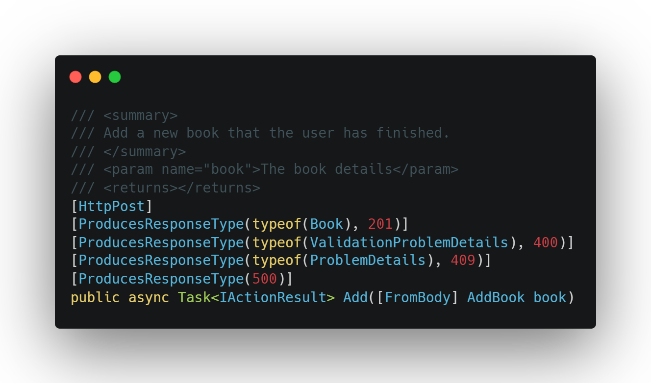
OpenAPI in .NET

Slide 9
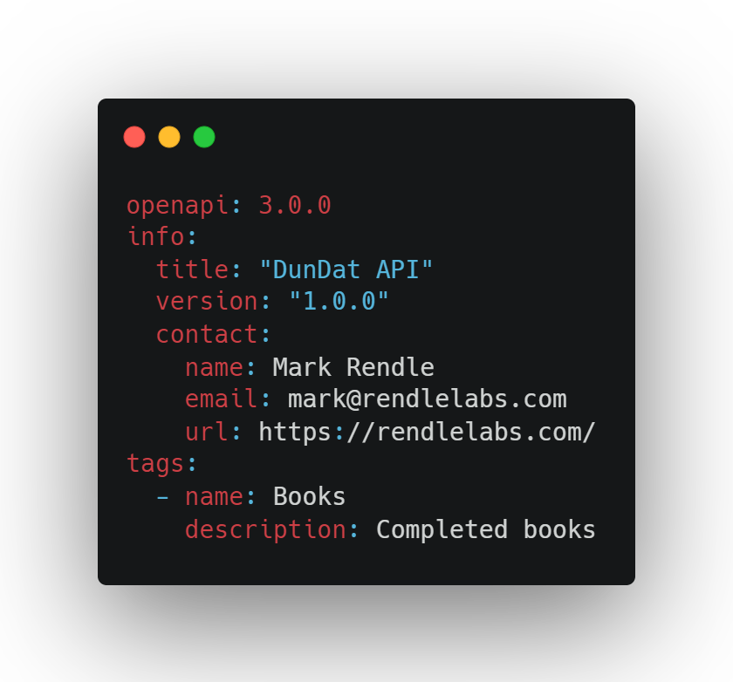
OpenAPI everywhere else

Slide 10
Hand-crafted Artisanal YAML files

Slide 11
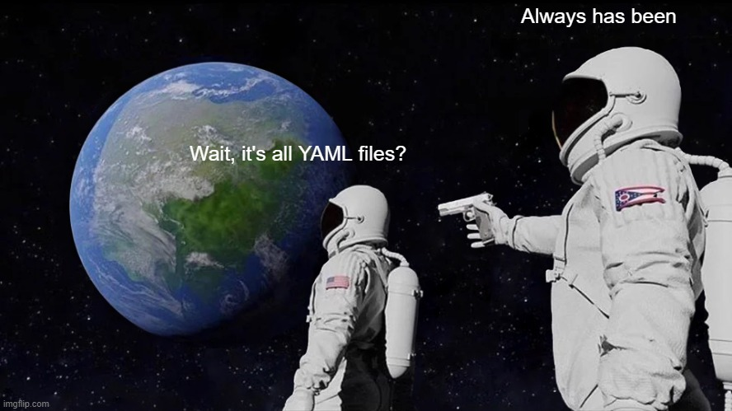

Slide 12
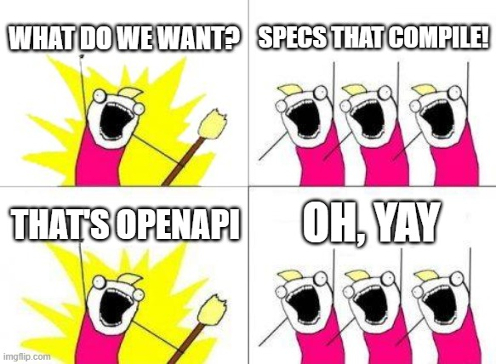

Slide 13
I blame WCF

Slide 14
<definitions name="EndorsementSearch"
targetNamespace="http://namespaces.snowboard-info.com"
xmlns:es="http://www.snowboard-info.com/EndorsementSearch.wsdl"
xmlns:esxsd="http://schemas.snowboard-info.com/EndorsementSearch.xsd"
xmlns:soap="http://schemas.xmlsoap.org/wsdl/soap/"
xmlns="http://schemas.xmlsoap.org/wsdl/"
>
<!-- omitted types section with content model schema info -->
<message name="GetEndorsingBoarderRequest">
<part name="body" element="esxsd:GetEndorsingBoarder"/>
</message>
<message name="GetEndorsingBoarderResponse">
<part name="body" element="esxsd:GetEndorsingBoarderResponse"/>
</message>
<portType name="GetEndorsingBoarderPortType">
<operation name="GetEndorsingBoarder">
<input message="es:GetEndorsingBoarderRequest"/>
<output message="es:GetEndorsingBoarderResponse"/>
<fault message="es:GetEndorsingBoarderFault"/>
</operation>
</portType>
<binding name="EndorsementSearchSoapBinding"
type="es:GetEndorsingBoarderPortType">
<soap:binding style="document"
transport="http://schemas.xmlsoap.org/soap/http"/>
<operation name="GetEndorsingBoarder">
<soap:operation
soapAction="http://www.snowboard-info.com/EndorsementSearch"/>
<input>
<soap:body use="literal"
namespace="http://schemas.snowboard-info.com/EndorsementSearch.xsd"/>
</input>
<output>
<soap:body use="literal"
namespace="http://schemas.snowboard-info.com/EndorsementSearch.xsd"/>
</output>
<fault>
<soap:body use="literal"
namespace="http://schemas.snowboard-info.com/EndorsementSearch.xsd"/>
</fault>
</operation>
</binding>
<service name="EndorsementSearchService">
<documentation>snowboarding-info.com Endorsement Service</documentation>
<port name="GetEndorsingBoarderPort"
binding="es:EndorsementSearchSoapBinding">
<soap:address location="http://www.snowboard-info.com/EndorsementSearch"/>
</port>
</service>
</definitions>

Slide 15
Why, Mark? Why?
Source of truth for your team
Separate Design and Implementation

Slide 16


Slide 17
Why, Mark? Why?
Source of truth for your team
Separate Design and Implementation
Better description of your API
Automated documentation

Slide 18
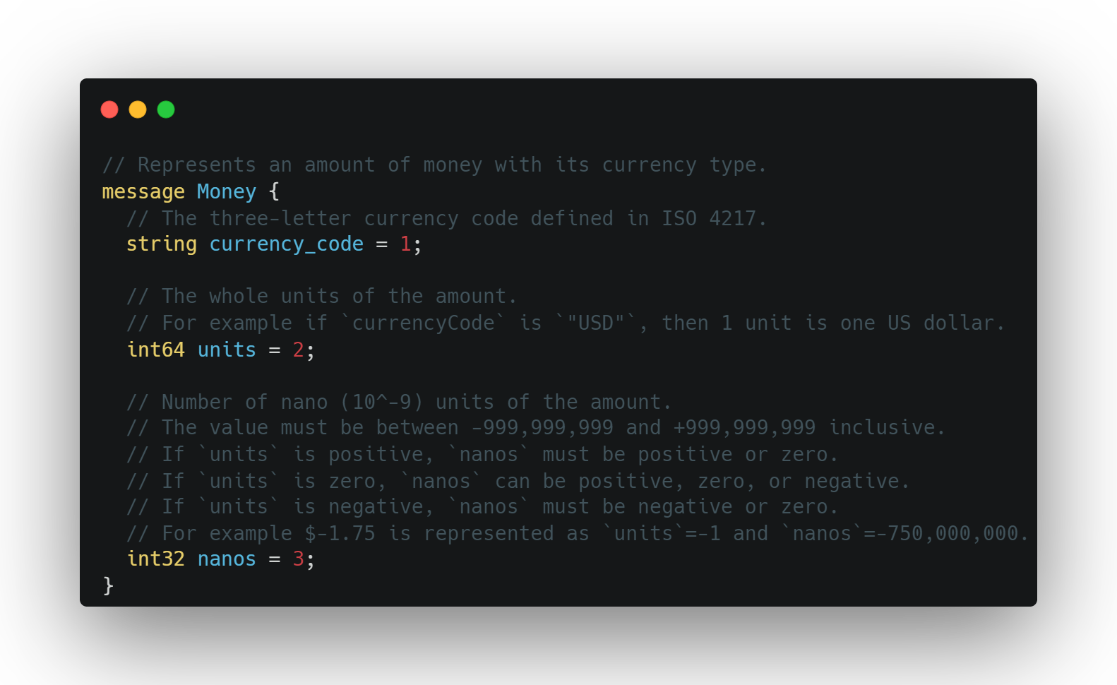

Slide 19
How OpenAPI actually works

Slide 20
OpenAPI

Slide 21
Paths

Slide 22
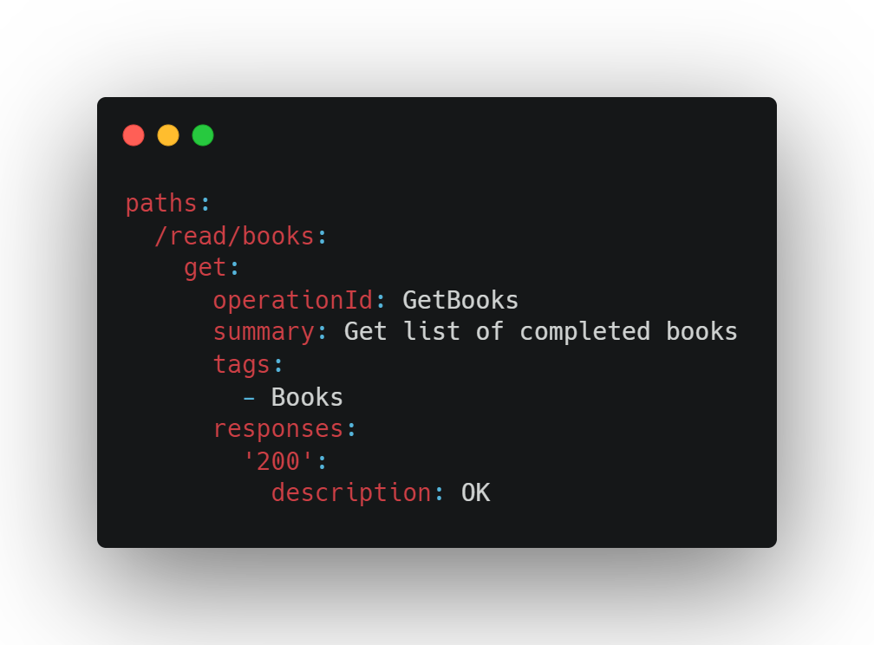

Slide 23
Responses

Slide 24
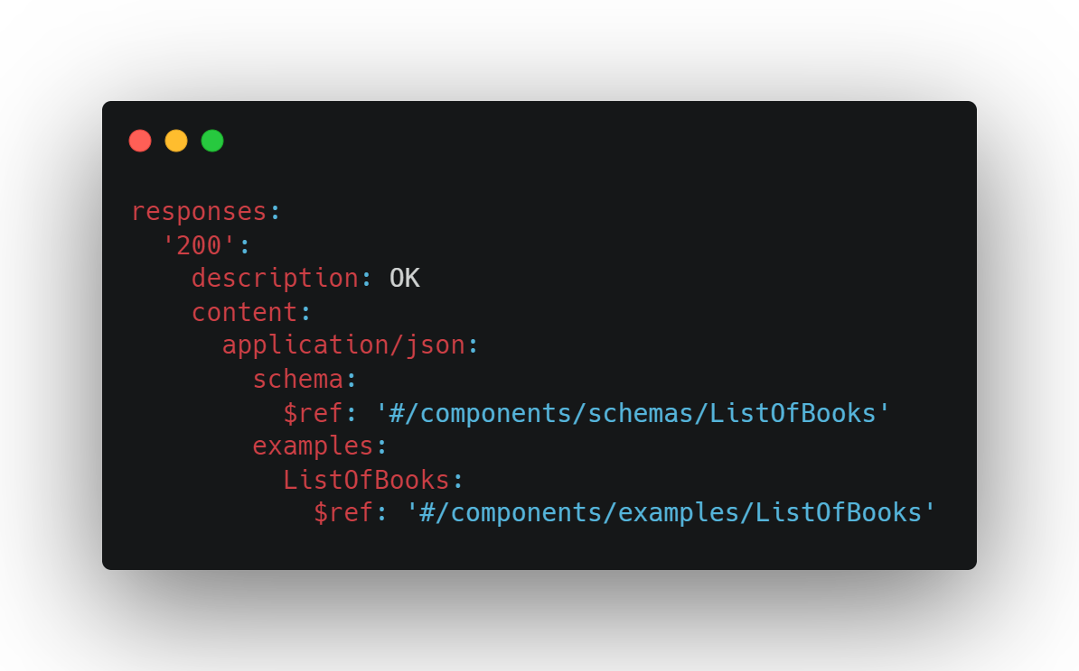

Slide 25
Schema

Slide 26
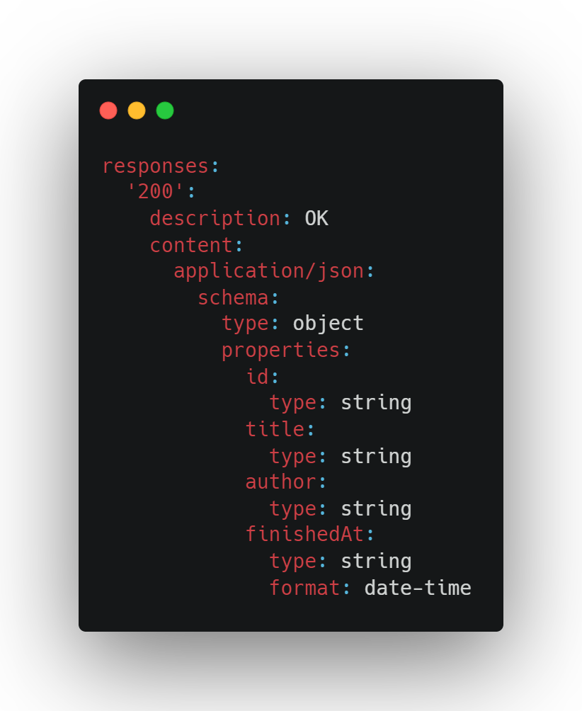

Slide 27
Parameters

Slide 28
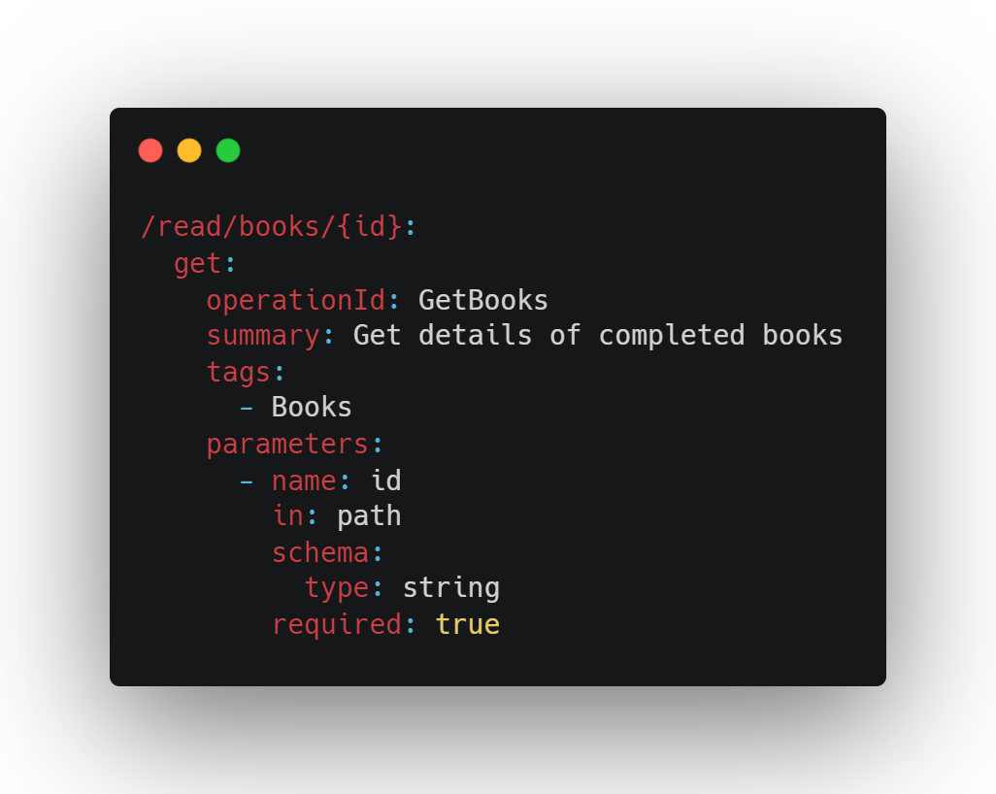

Slide 29
Requests

Slide 30
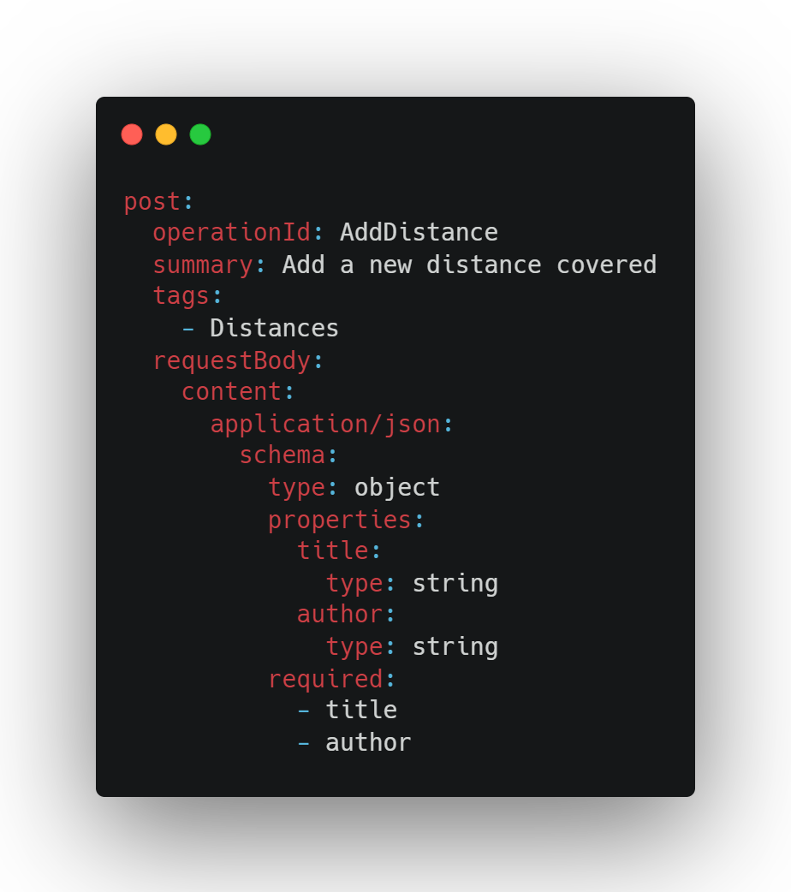

Slide 31
Components

Slide 32
Components
schemas
responses
requestBodies
parameters
headers
securitySchemes
examples
links
callbacks

Slide 33
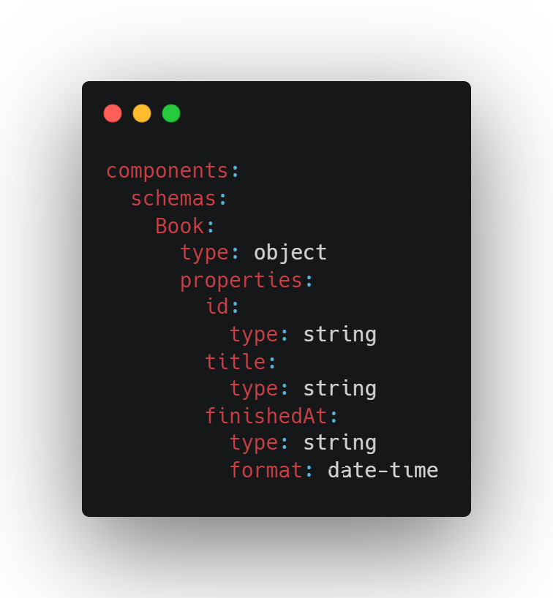

Slide 34
References

Slide 35
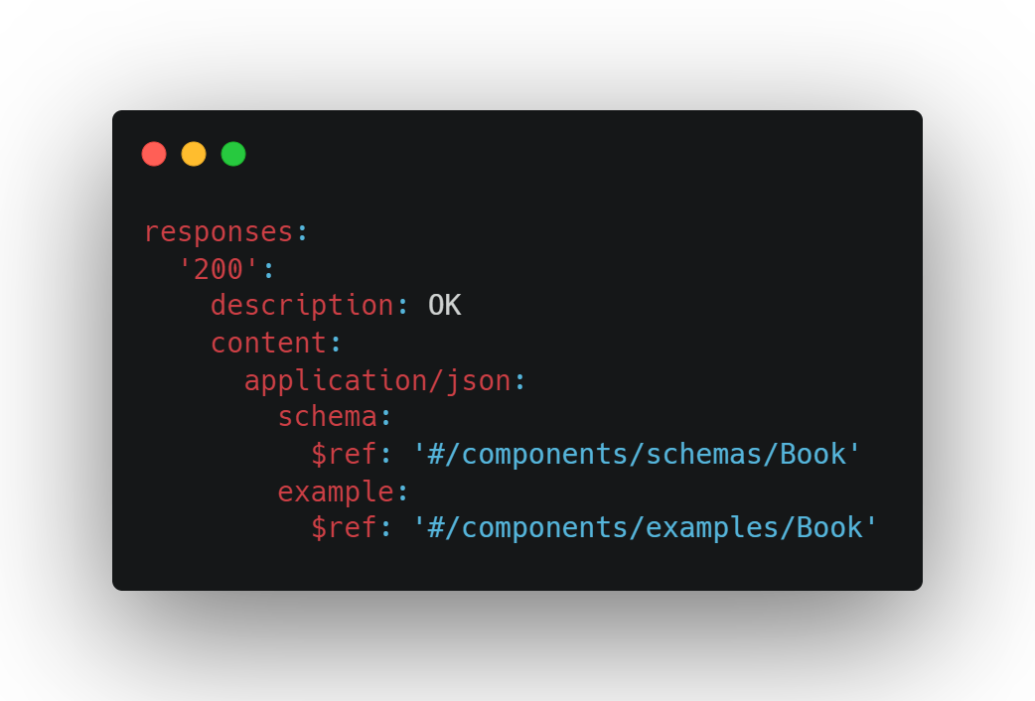

Slide 36
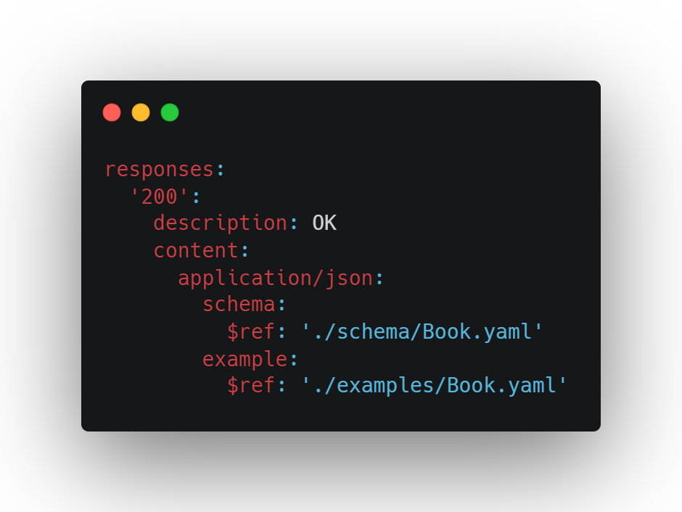

Slide 37
Security

Slide 38
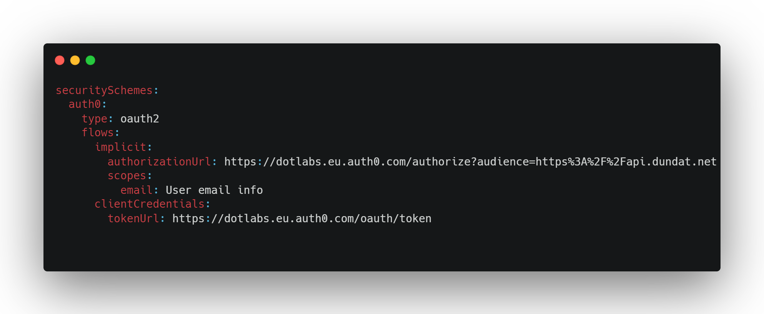

Slide 39
Problems
application/problem+json

Slide 40
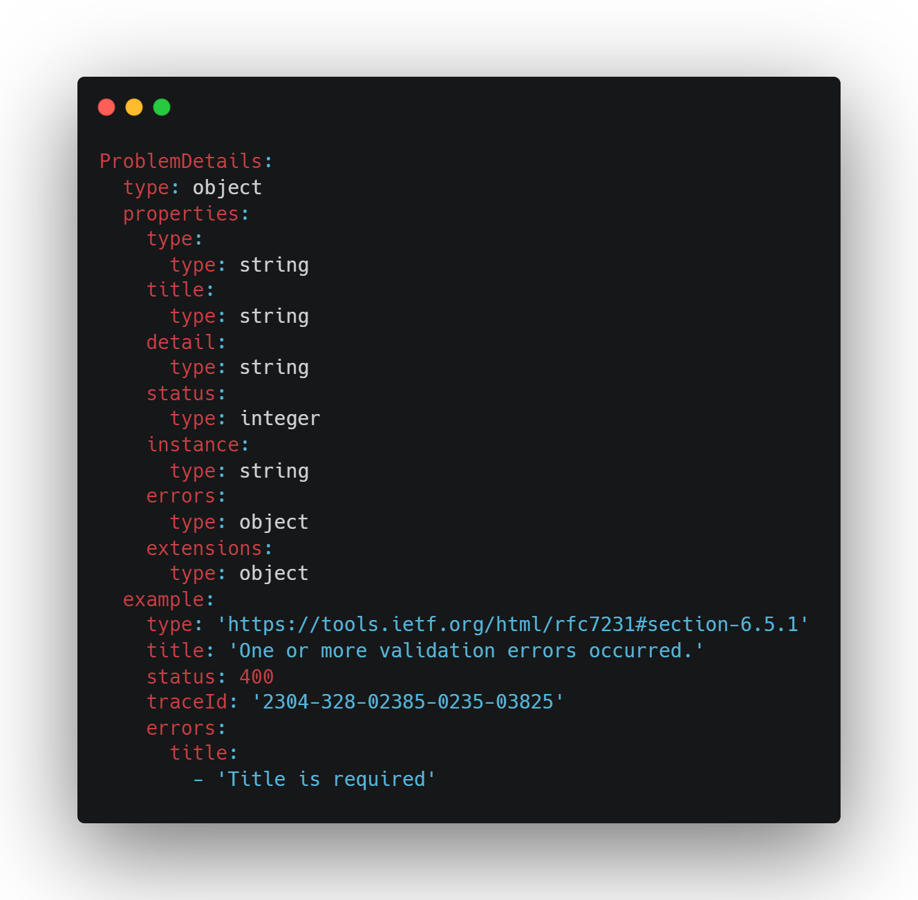

Slide 41
Moonwalk
OpenAPI 4.0?
github.com/OAI/moonwalk

Slide 42
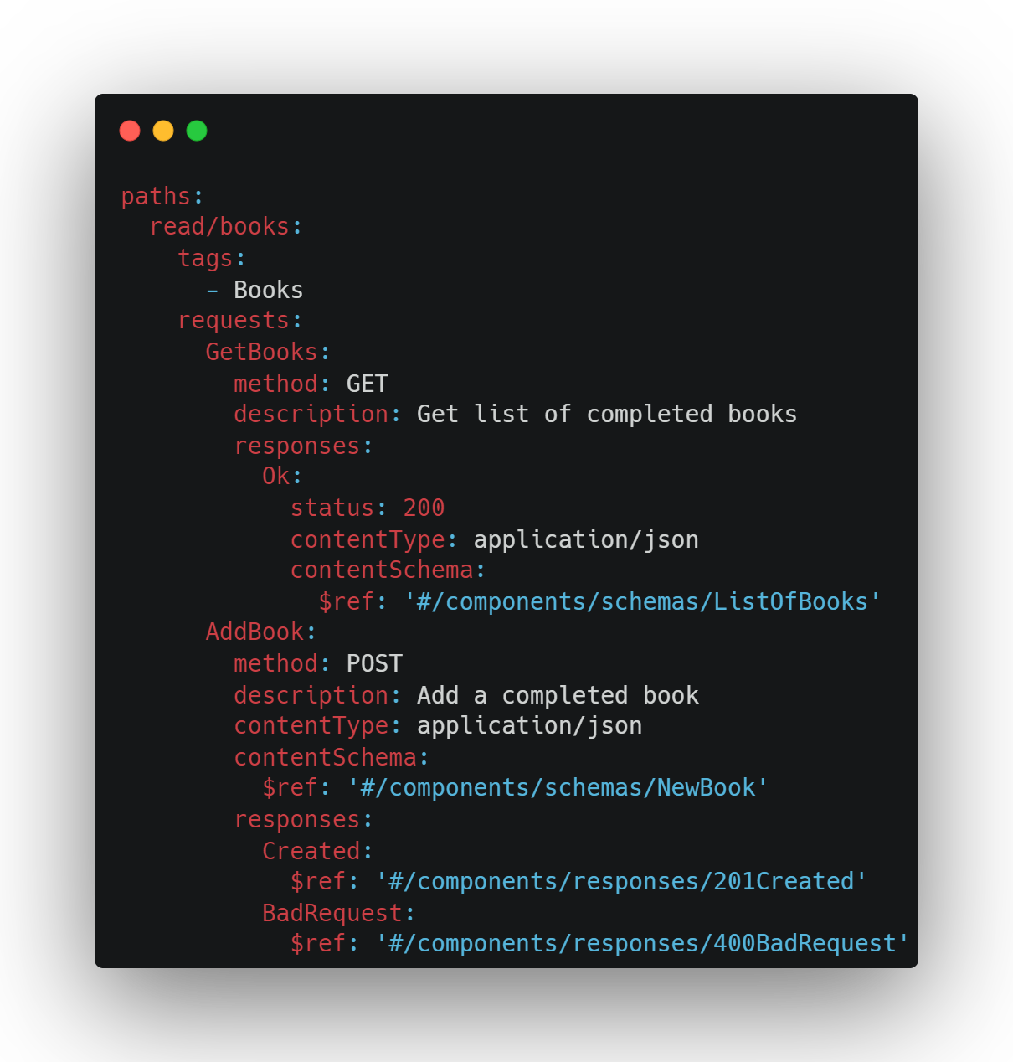

Slide 43
Tools
Swagger UI
Redoc github.com/Redocly/redoc
Widdershins + Reslate github.com/Mermade/widdershins
Elements stoplight.io/open-source/elements
Notes:
Solo: solo.io – API gateway for Kubernetes that uses OpenAPI YAML files as CRDs

Slide 44
Plugins
VS Code: OpenAPI (Swagger) Editor marketplace.visualstudio.com/items?itemName=42Crunch.vscode-openapi
Rider: OpenAPI Specifications Built-in

Slide 45
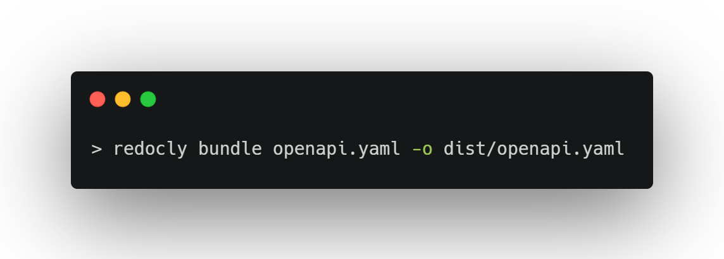
Bundling

Slide 46
Packages
RendleLabs.OpenApi.Web
RendleLabs.OpenApi.Analyzers
RendleLabs.OpenApi.Bundle
RendleLabs.OpenApi.Test
RendleLabs.OpenApi.CodeGen

Slide 47
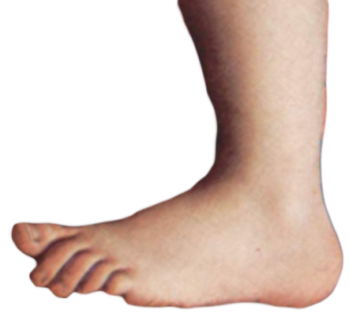
FIN

Slide 48
Resources
openapis.org
swagger.io
openapi.tools
www.asyncapi.com
github.com/RendleLabs/NDCOSLO23

