Slide 1

MUSIC RECOMMENDATION SYSTEM PROJECT 3: COMMUNITY LEARNING
By
Group 3 – Danielle Dong, Rene Dussault, Shirley Poovilingam

Slide 2



TABLE OF CONTENT
Introduction
Methodology
Conclusion

Slide 3
INTRODUCTION
In this project, we explore an What is the problem? By leveraging advanced machine learning techniques, we hope to deliver a seamless and enjoyable music experience for Spotify users How do we solve the problem ? By using unsupervised learning approach to suggest music to Spotify users (API, K-Means with Elbow Method, Clusters Visualization with Plotly) What makes our recommendations better than Spotify? Based on three features (energy, instrumentalness and speechiness,) ,we recommend songs that relates to user’s activity (studying, training or anything)

Slide 4
WHAT KIND OF MUSIC WORKS BEST FOR YOU?
Music that include lyrics can be distracting
Choosing calm and soft music
Keeping low volume while listening to music
Listening to music depending on how you feel can affect your concentration
Reference: https://www.healthline.com/health/does-music-help-you-study#best-music-for-studying

Slide 5


METHODOLOGY
Data Collection
Clustering
Data Analysis

Slide 6




METHODOLOGY
Data Collection: Using Spotipy, a python library that implements Spotify's API we were able to collect a fair amount of data.
Clustering : Breaking down on distribution of features, by using K-Mean algorithm selects audio features for clustering.
References :
https://developer.spotify.com/documentation/web-api/reference/#/operations/get-audio-features
https://pypi.org/project/spotipy/

Slide 7
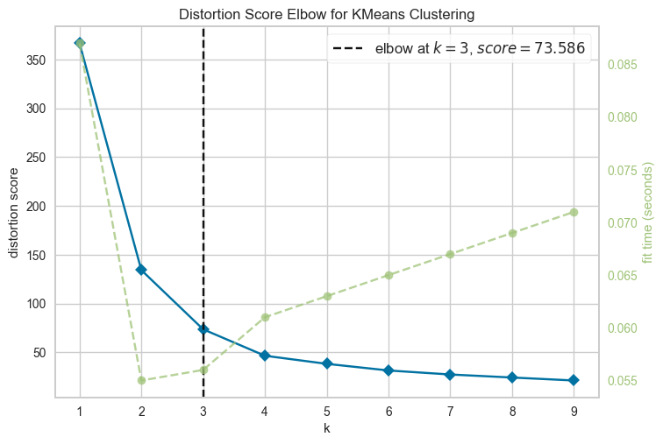

Slide 8




SPOTIFY AUDIO FEATURES
Energy: Energy is a measure from 0.0 to 1.0 and represents a perceptual measure based on intensity of tracks. Typically, energetic tracks feel fast, loud, and noisy. Instrumentalness : Predicts whether a track contains no vocals. The closer the instrumentalness value is to 1.0, the greater likelihood the track contains no vocal content and any values more than 0.5 are considered instrumental tracks. Speechiness : Speechiness detects the presence of spoken words in a track. The more exclusively speech-like the recording (e.g. talk show, audio book, poetry), the closer to 1.0 the attribute value. Values above 0.66 describe tracks that are probably made entirely of spoken words. Reference: https://developer.spotify.com/documentation/web-api/reference/#/operations/get-audio-features

Slide 9
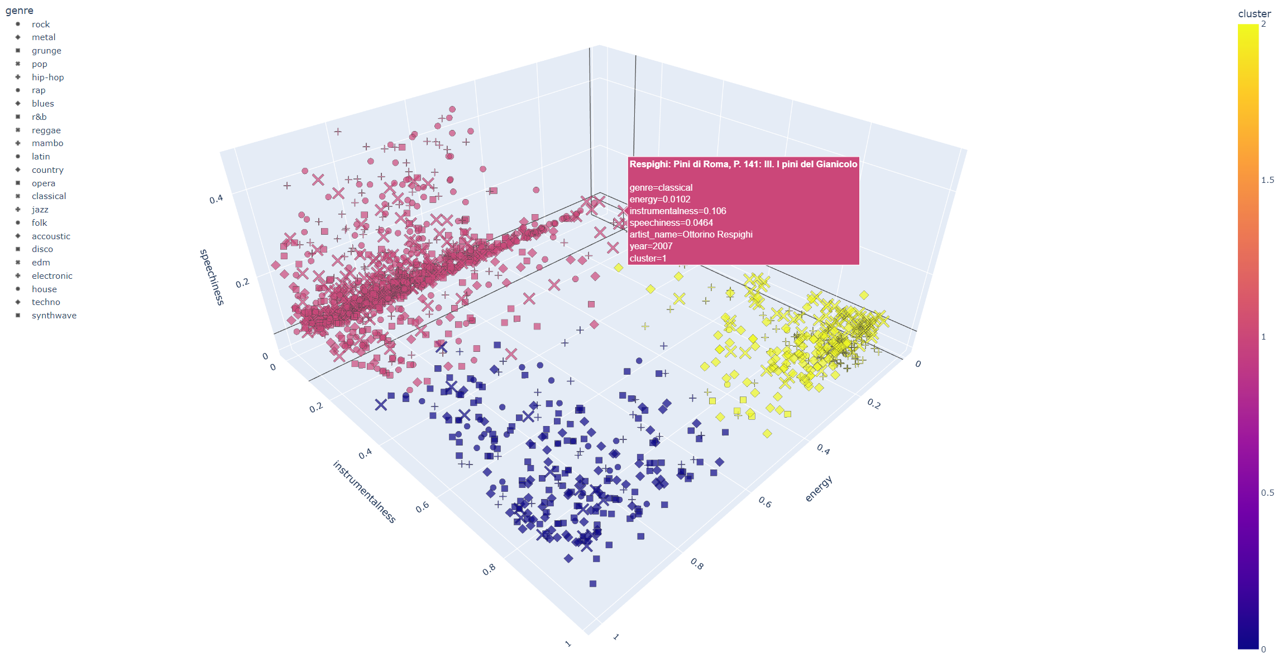
3D DATA PLOT

Slide 10


DO YOU LIKE STUDYING OR TRAINING?
Here's a list of songs for studying:
Guitar Tribute Players: Home
Sungha Jung: Englishman in New York
Jaden Berry: The Meadows
Ludwig van Beethoven: Symphony No. 6
Wolfgang Amadeus Mozart: Mozart: Clarinet Concerto in A Major, K. 622: II. Adagio
Franz Schubert: Symphony No. 8 In B Minor, D.759 - "Unfinished": 1. Allegro moderato
Grayville Trio: Strangest Sea
Tito Puente: Mambo Gozon
Foster Davies: Romancing
The Groove Trio: Barney's

Slide 11


CONCLUSION(SUMMARY)
Using Spotipy, Python’s library collects Spotify’s data Clustering using K-Means Algorithm 3D Scatter Plot Recommend songs that matches Spotify’s features

