Slide 1
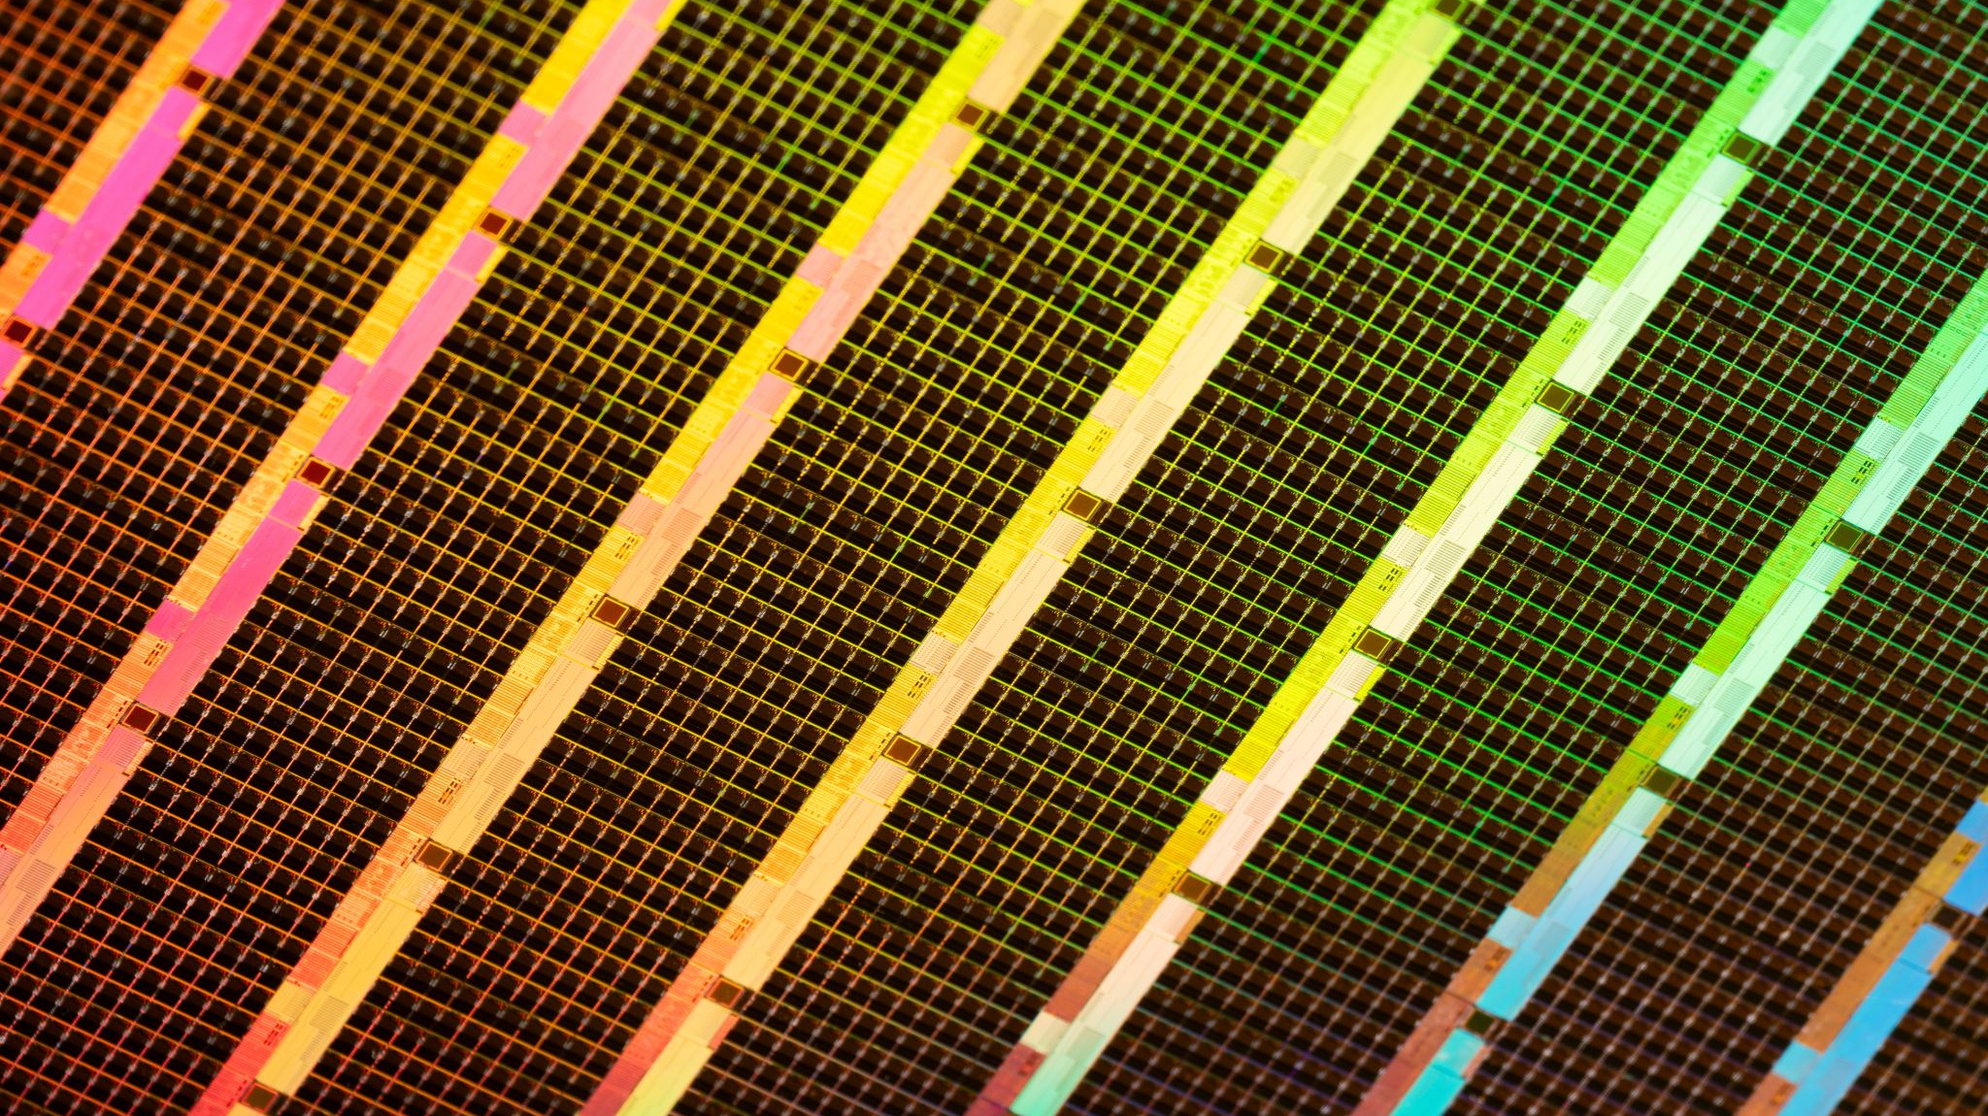
Phonetic Partitioning
Audio Transcription

Slide 2
Phonetic Partitioning
Useful for improving the accuracy of transcriptions, especially in scenarios where you have a
Align pre-existing phonetic transcription with actual audio signal.
Helps in addressing the variability in speech, such as different speaking rates and accents.
It can use any comparison metric
Is simple and straightforward

Slide 3
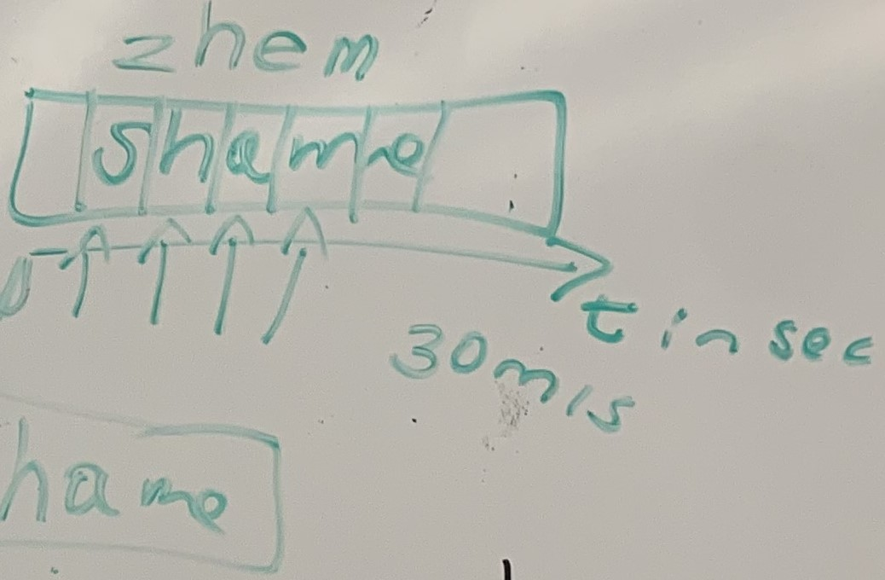
Sample

Slide 4

How it works

Slide 5
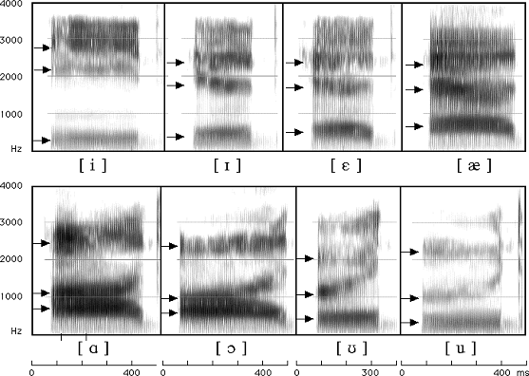
Linguistics

Slide 6
Linguistics
The bottom arrows are f1 values, middle arrows are f2, and top arrows are f3 values.
It’s best to analyze formants in terms of frequency (Hz) and time (ms).
The darkest areas of the spectrogram are the formant peaks.
Following the formant peaks of one formant gives us a formant equation.
Ideally, we’d like to compare the equation of and input frame to that of a known frame, but in this implementation, we compare the averages, how can we do this?
There are many ways to analyze and compare the formant values but the way I chose to do it was mean summation.

Slide 7
1. Slice the input by interval 2. Compare each input to a dataset of phonemes and return the closest sound

Slide 8
Euclidean distance
What’s wrong with Euclidean distance for a vector problem?
Less accurate
Bundles everything together, eliminating nuance
Blurs everything independent of context

Slide 9

Cosine Similarity

Slide 10
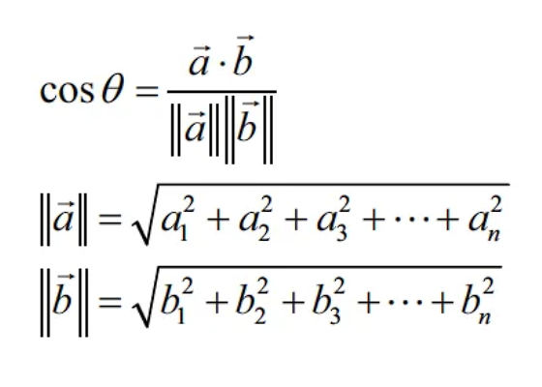
Cosine similarity

Slide 11
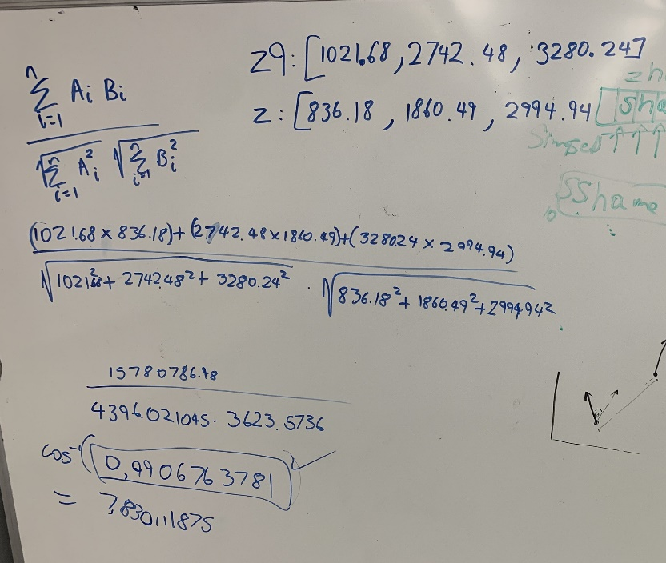
Cosine Similarity
Enables the comparison of vectors

Slide 12
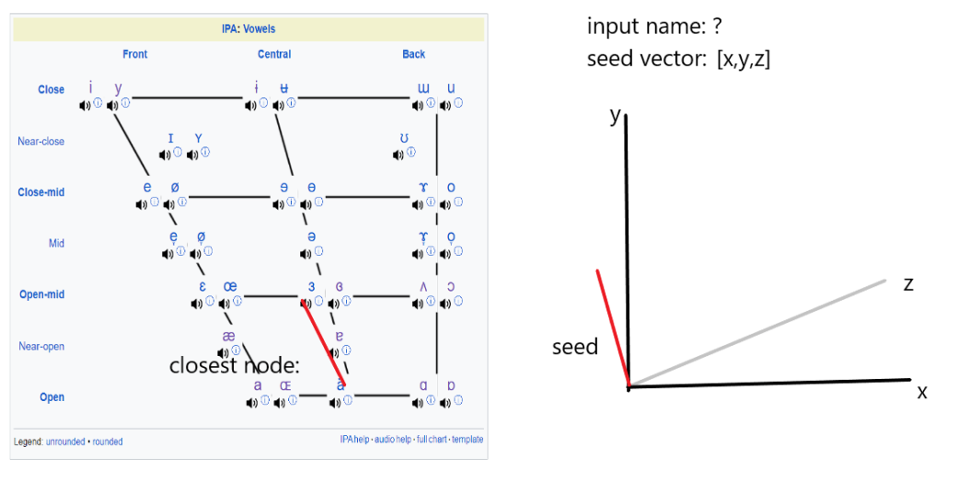
Cosine Similarity
Convoluted frame

Slide 13
Cosine Similarity
Cosine similarity has one drawback in our case that is, the vowels are primarily determined by f1
Consonants are primarily determined by f3
Cosine similarity blends the two

Slide 14

code

Slide 15
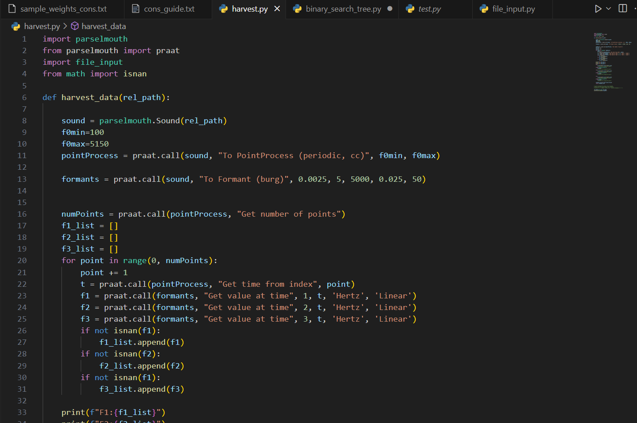
Implementation

Slide 16
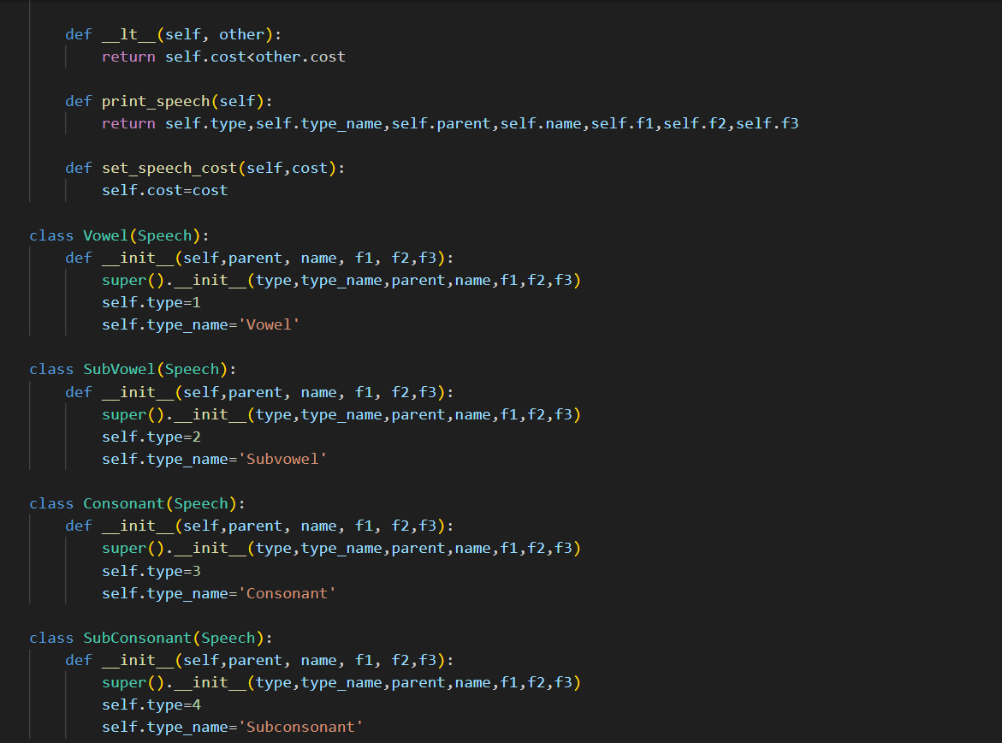

Slide 17
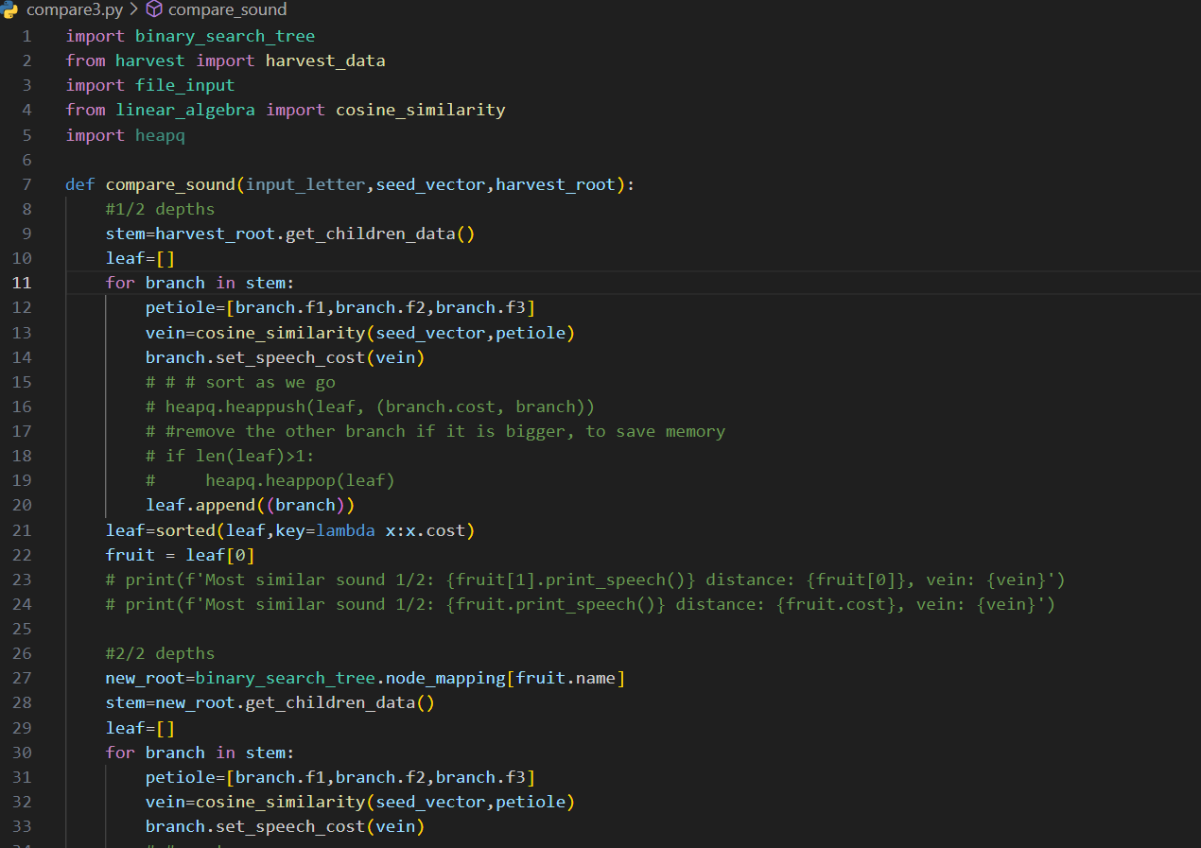
Bst.py

Slide 18
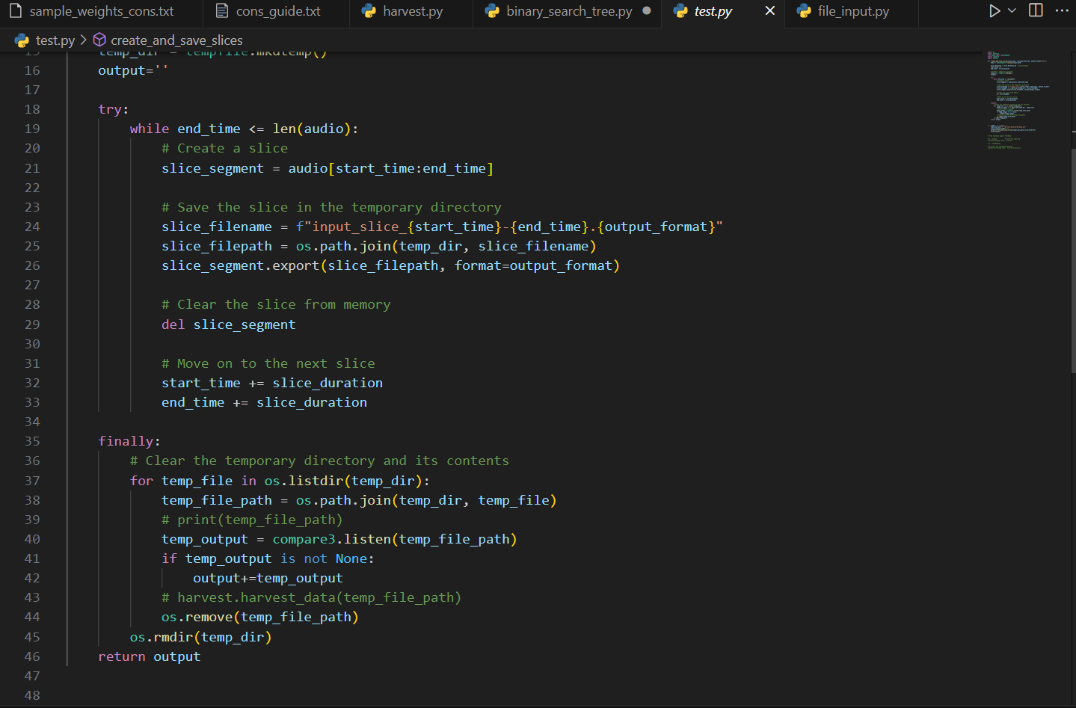
Implementation

Slide 19

output

Slide 20
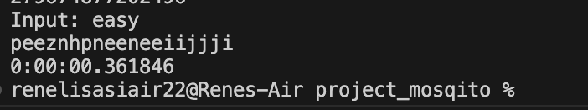
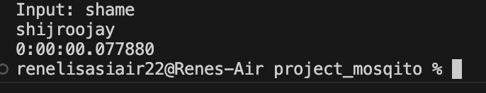
Output

Slide 21
Analysis
Slightly more accurate
Lightweight
Speed is on par
Training might be needed

Slide 22
Sources
https://www.mq.edu.au/about/about-the-university/our-faculties/medicine-and-health-sciences/departments-and-centres/department-of-linguistics/our-research/phonetics-and-phonology/speech/acoustics/speech-waveforms/the-waveforms-of-speech
https://corpus.eduhk.hk/english_pronunciation/index.php/2-2-formants-of-vowels/
https://home.cc.umanitoba.ca/~krussll/phonetics/ipa/ipa-consonants.html
http://blog.syntheticspeech.de/2021/03/10/how-to-extract-formant-tracks-with-praat-and-python/
https://www.ripublication.com/ijaer18/ijaerv13n12_107.pdf
https://www.voxforge.org/home/dev/acousticmodels/linux/create/htkjulius/tutorial
https://notebook.community/loredanacirstea/ai-algos/DNN%20Speech%20Recognizer/vui_notebook
https://www.inf.ed.ac.uk/teaching/courses/asr/2019-20/asr01-intro.pdf
https://maelfabien.github.io/machinelearning/speech_reco/#
https://maelfabien.github.io/machinelearning/GMM/#
https://www.researchgate.net/post/How-can-I-estimate-a-persons-vocal-tract-length-using-a-recorded-audio-file#:~:text=The%20first%20formant%20F1%20is,is%20the%20speed%20of%20sound.

