Slide 1

Model-Based Neuroscience & Cognition Summer School 2025

Slide 2
Formal Generative Models: Definitions
Generative Model: A mathematical structure (typically instantiated as a computer program) that generates simulated data.
Model Parameters: Variables whose values determine the data generated by the model. They can be either fixed a priori (constants) or determined based on empirical data (estimated parameters).
Model Estimation: Choosing a set of parameter values that provide a best match between some observed data and the data generated by the model.
Fit Metric / Objective Function: a measure of the quality of the data-model match, goodness-of-fit or deviance (badness-of-fit, e.g., sum-square-error).
Model Selection: a method of selecting from a set of estimated models the one that is “best” in the sense of matching both that data from which it was estimated and potential future data it aims to explain.
Parameter-based inference: Inferences about (latent) psychological processes made based on parameters that describe them rather than indirectly based on observed (manifest) behaviour.

Slide 3
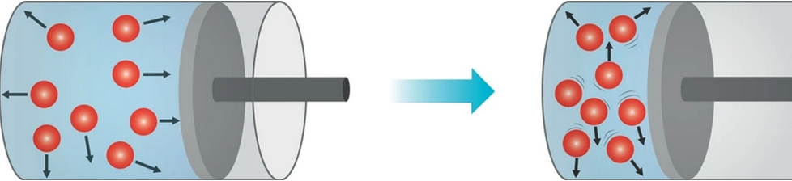
“All models are wrong, but some are useful”¹
Models of complex systems are necessarily approximations that ignore some aspects a system, e.g., the Gas Law
Pressure x Volume = n x R x Temperature (n: # molecules, R: gas constant)
Such approximate models can be useful in two key senses.
Foregrounding the main constants and variables that determine how a complex system acts, promoting understanding and explanation.
Accurately predicting new data (i.e., “out-of-sample” data).
¹Box, G. E. P. (1979), "Robustness in the strategy of scientific model building", in Launer, R. L.; Wilkinson, G. N. (eds.), Robustness in Statistics, Academic Press, pp. 201–236, doi:10.1016/B978-0-12-438150-6.50018-2, ISBN 9781483263366.

Slide 4
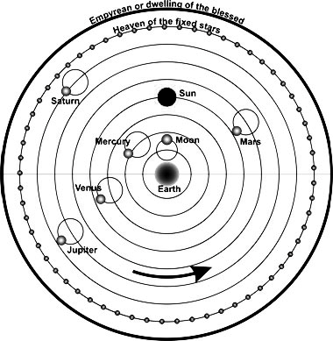
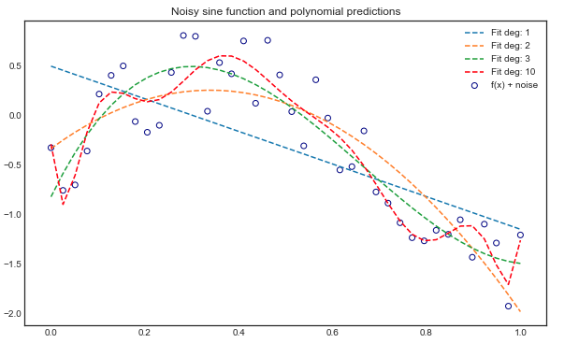
Model Complexity
¹Probably not his actual words: https://www.irishphilosophy.com/ 2014/
05/27/who-sharpened-occams-razor/
Useful models tend to be parsimonious
Occam’s Razor: “entities should not be multiplied beyond necessity”¹ e.g., Ptolemaic epicycles.
Overfitting: adjusting many parameters to get a very accurate fit causes poor prediction
Model Selection Metrics
Out-of-sample prediction
deviance + complexity penalty
Observed data = structure + noise

Slide 5
Likelihood: The key to Bayesian cognitive modeling
Likelihood = probability of the parameters given the data.
We will focus on cases in which the likelihood can be computed directly.
When this is not the case you can use simulation-based methods if your model is generative.
The most straightforward approaches use functions like R’s “density” to get an approximate likelihood, as in these papers (we will look at such approximations in the lab).
Turner, B. M., Sederberg, P. B., & McClelland, J. L. (2016). Bayesian analysis of simulation-based models. Journal of Mathematical Psychology, 72, 191–199.
Holmes, W. R. (2015). A practical guide to the Probability Density Approximation (PDA) with improved implementation and error characterization. Journal of Mathematical Psychology, 68, 13–24.
More recently there are also methods based on neural networks (e.g., ”BayesFlow”, see https://arxiv.org/abs/2003.06281)

Slide 6
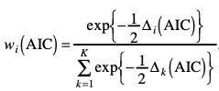
Likelihood and Model Selection
Rather than the likelihood we often work with its logarithm (more numerically stable) and:
Deviance = - 2 x Log Likelihood
Measure of misfit, smaller = better fit
Point-estimate complexity penalties:
AIC (Akaike Information Criterion)
Minimum Deviance + 2 x # parameters
BIC (Bayesian Information Criterion)
Minimum Deviance + # parameters x log(# data points)
ICs can be turned into weights (0-1 scale)

Slide 7
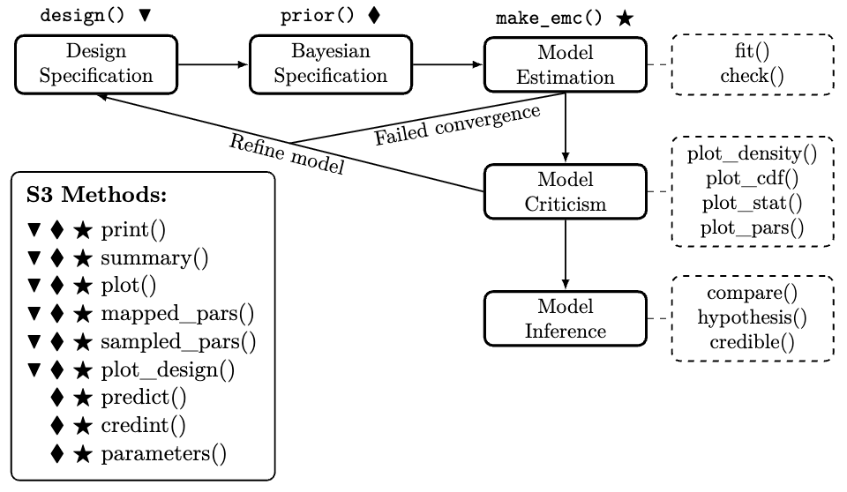
EMC2 Workflow
https://osf.io/preprints/psyarxiv/2e4dq_v4

Slide 8
Linear Designs
We will make extensive use of R’s linear model language for specifying designs, e.g., two main effects and an interaction:
y ~ A + B + A:B
which is the same as y ~ A*B
Wilkinson, G. N., & Rogers, C. E. (1973). Symbolic description of factorial models for analysis of variance. Journal of the Royal Statistical Society: Series C (Applied Statistics), 22, 392–399.
Marginality: a higher order term can only be included if its constituents are also included.
e.g., y ~ A + B is OK but y ~ A + A:B is not
My take on marginality
Heathcote, A. & Matzke, D. (2023). The limits of marginality. Computational Brain & Behavior, 6, 28–34. https://link.springer.com/content/pdf/10.1007/s42113-021-00120-3.pdf
The wider debate
https://link.springer.com/article/10.1007/s42113-021-00113-2
https://link.springer.com/article/10.1007/s42113-022-00160-3

Slide 9
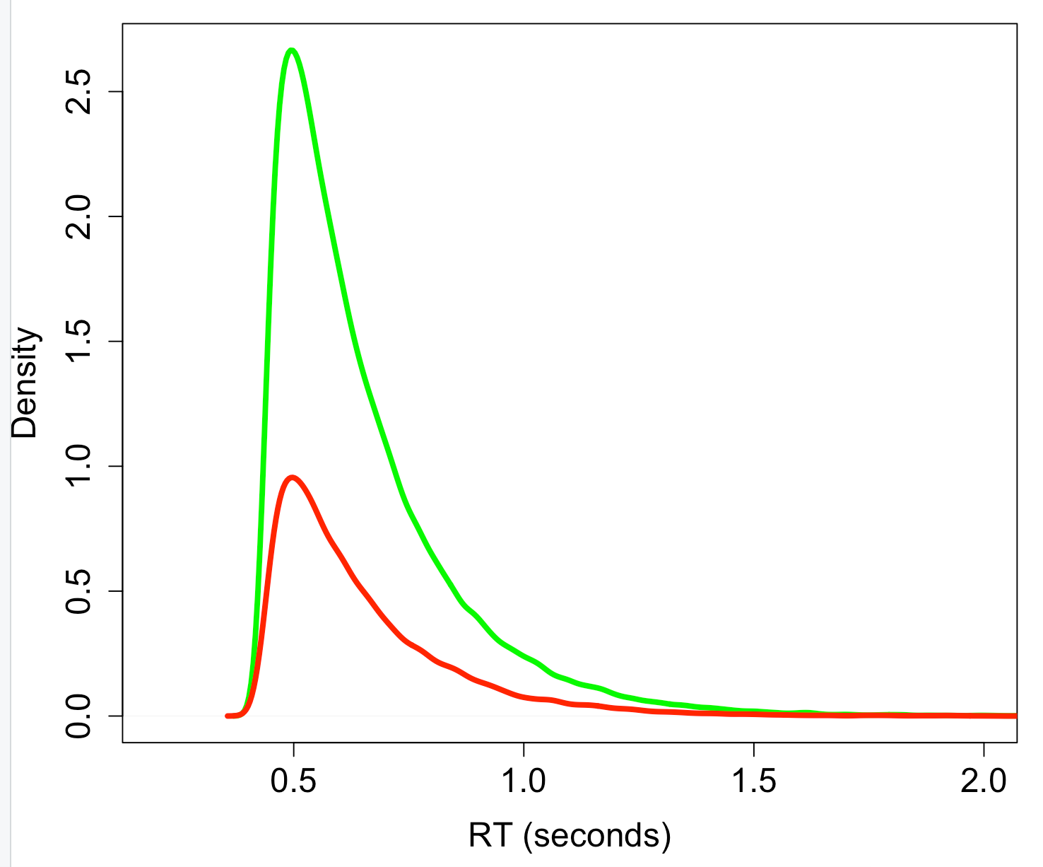
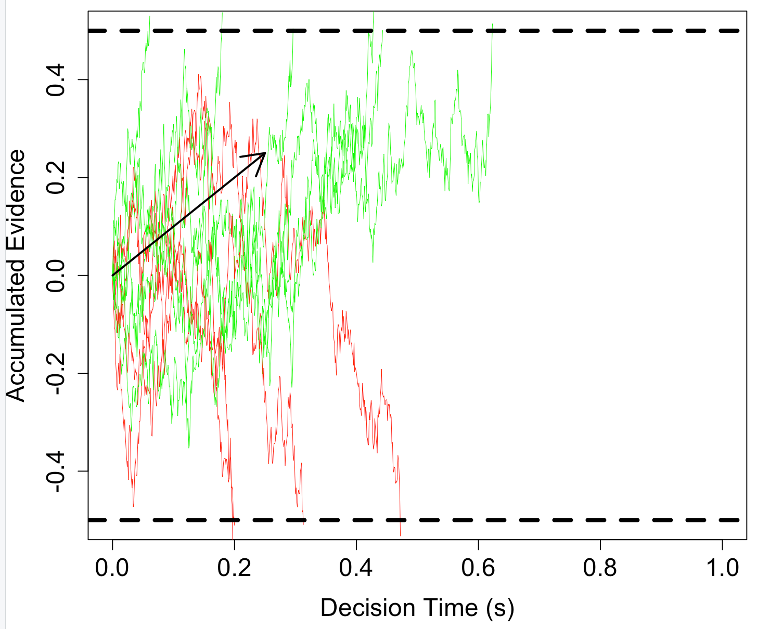
Uncertainty & Noise in Dynamic Models of Choice
Aleatoric data: Response time (RT) distribution, the time to make a choice varies randomly over repeated measurement occasions even with identical stimuli (defective for choice).
This is explained by a process that seeks to reduce epistemic uncertainty about which stimulus is present by summing samples from the stimulus (Wiener Decision Model, WDM).
We will also use Bayesian methods to estimate these Evidence Accumulation Models (EAMSs) from data and quantify our uncertainty about their parameters.
First, we will do some exercises in the 1-BasicEAMs.R script.
1) Simulating the WDM
2) Look at the Flanker experiment, which will be used to illustrate individual-participant model fitting in the first two EMC2 lessons.

