Slide 1



BBC Article Classification Using Neural Networks
CSCI 460 - Dr. Chang
April 1, 2026
By Renee Guldi

Slide 2


Project Overview:
Q1. – Built a 3-layer Neural Network classifier with fixed weights
Q2. – Classified BBC articles using Doc2Vec and an FNN
Q2 Bonus. – Implemented TF-IDF (Term Frequency-Inverse Document Frequency) from scratch using NumPy
Dataset: 2,225 BBC articles across 5 categories

Slide 3
Neural Network Structure:
Three Layer Network: Input → Hidden → Output
Fixed weights: weight1 = [1, -3]
weight2 = [-10, 1]
Sigmoid activation applied at outer layer
Decision boundary set at Y = 0.5
Input grid: 1,600 points (a 40x40 grid, X1 and X2 from -5 to 5

Slide 4
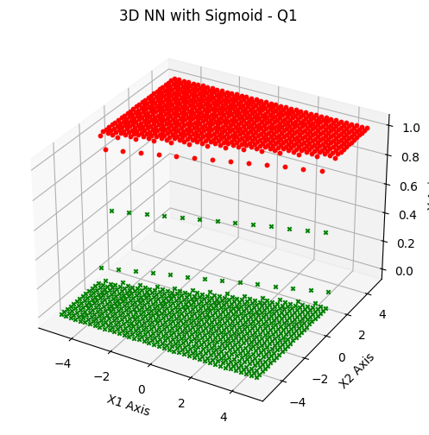
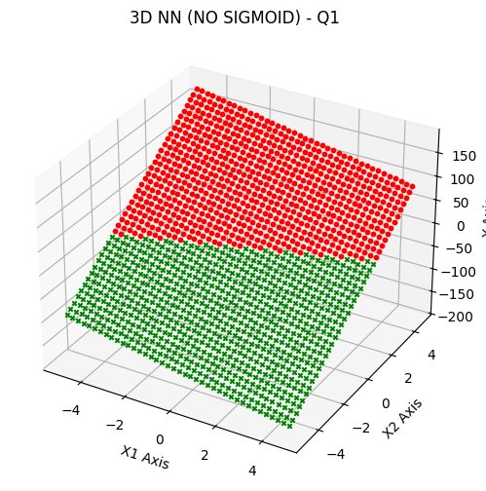
3D Plots

Slide 5
Key Findings:
Q1 – Sigmoid vs. Linear
Sigmoid → Figure One
Output: 0 to 1
Curved decision boundary
Non-linear classification
Clear classes visible
Linear → Figure Two
Output: unbounded (-200 to 150)
Flat tilted plane
Linear classification only
Less flexible boundary

Slide 6
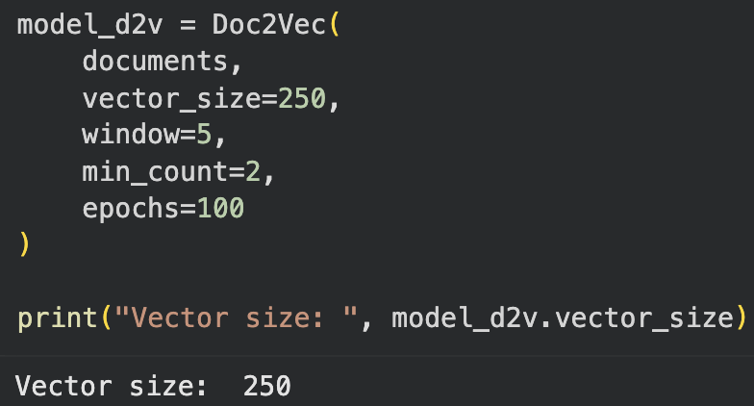
Q2 – Why Doc2Vec?
The Problem:
Neural Networks only understand numbers, not words
You are not able to multiply a strong by a weight in nn.Linear
Raw text like “sport” or “politics” means nothing to a network
Solution:
Doc2Vec converts each article into a fixed-size vector of numbers
It assigns similar articles to similar vectors
Unlike simple word counting, Doc2Vec is able to understand context
Each of our 2,225 articles become a 250-dimensional number vector

Slide 7
Q2 Pipeline:
BBC Articles (2,225)
Doc2Vec (vector_size=250, epochs=100)
Train/Test Split (80/20 → 1,780 train, 445 test)
StandardScaler (normalize vectors)
FNN Classifier (3 layers: 250 → 128 → 64 → 5)
Predicted Category

Slide 8
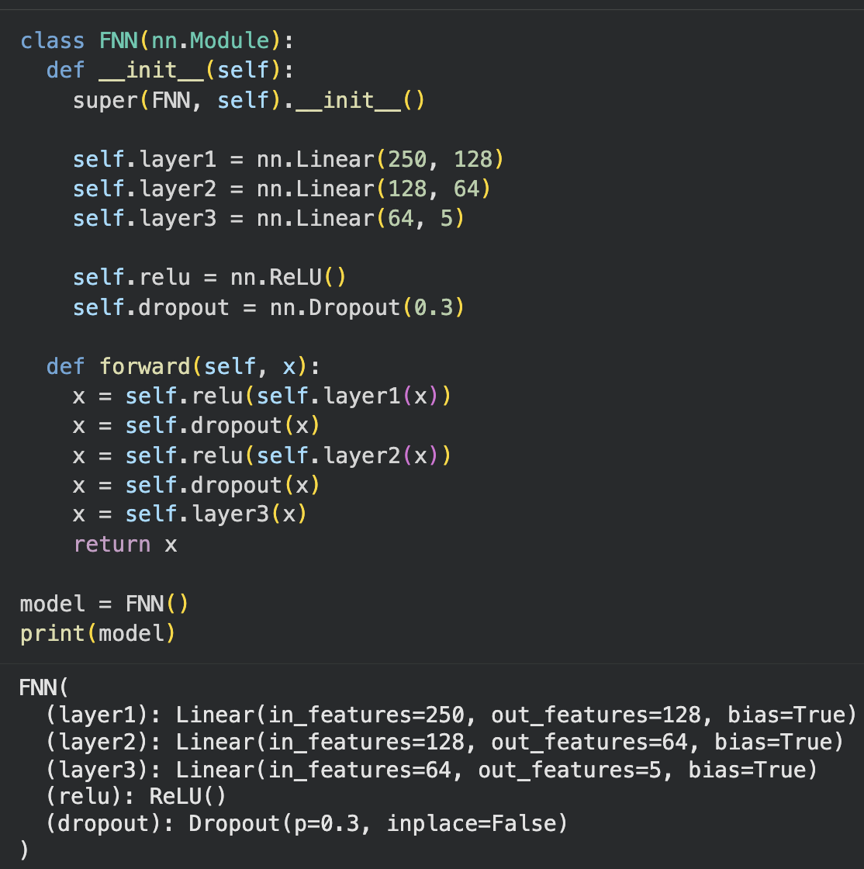
Feedforward Neural Network (FNN) Architecture Model:
Layer 1: Linear(250 → 128) + ReLU + Dropout(0.3)
Layer 2: Linear(128 → 64) + ReLU + Dropout(0.3)
Layer 3: Linear(64 → 5) → Output
Loss Function: CrossEntropyLoss
Optimizer: Adam (LearningRate=0.001)
Epochs: 100

Slide 9
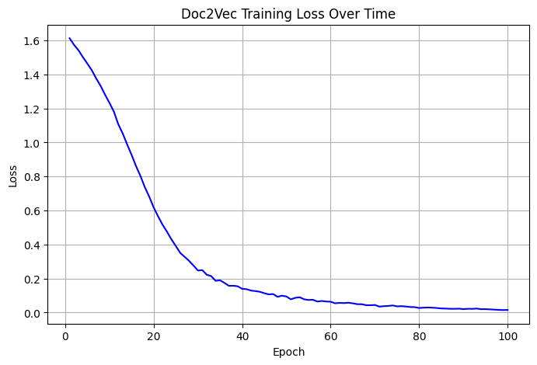
Training Results:
Doc2Vec Final Accuracy
95.51%

Slide 10
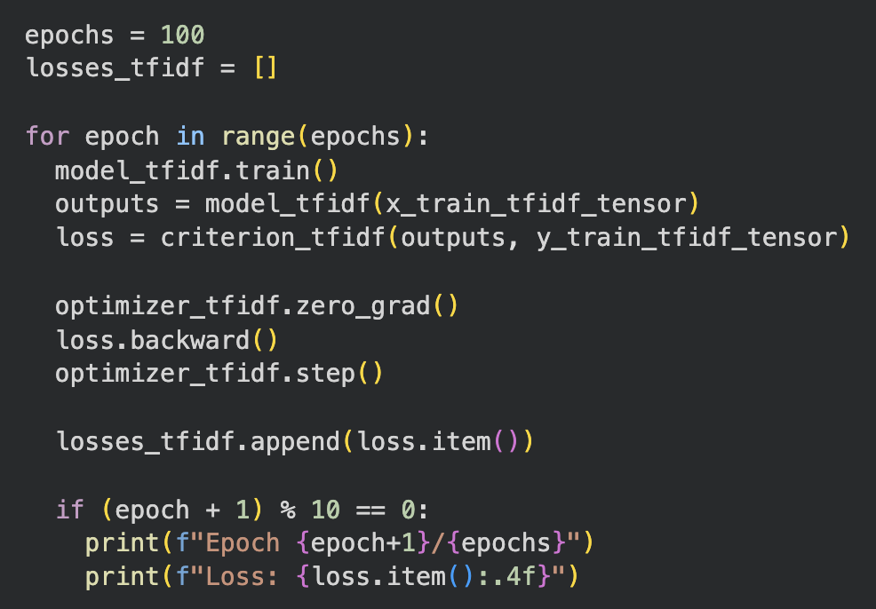
Q2 – BONUS - TF-IDF
Implemented TF-IDF using NumPy
TF: Used to measure how often a word appears in one article
IDF: Penalizes common words, rewards distinctive words)
→ Produced a 29,088 dimensional-vector (one per unique word)
Processed through the same FNN as Doc2Vec

Slide 11
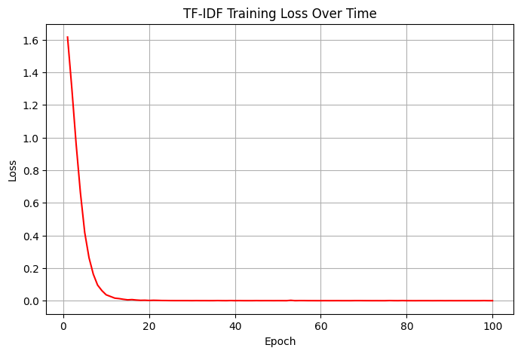
Training Results:
TF-IDF Final Accuracy
92.81%

Slide 12
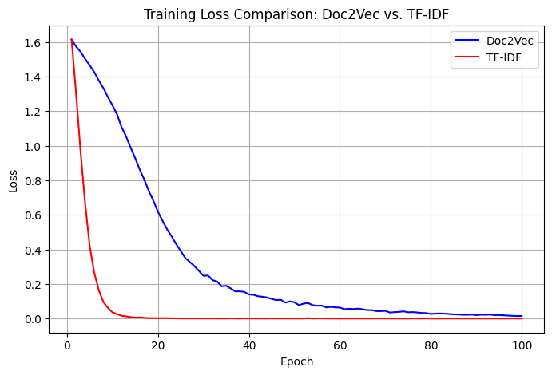
Comparison:
MODEL || VECTOR SIZE || TEST ACCURACY
Doc2Vec → 29,088 → 95.51%
TF-IDF → 250 → 92.81%

Slide 13
Improving Accuracy:
Doc2Vec starting Accuracy == 85.17%
Changes made:
Doc2Vec vector_size: 50 → 250 (richer article representation)
Doc2Vec Epochs: 20 → 100 (better trained embeddings)
Tested SGD optimizer → dropped accuracy to 46% → returned to Adam Optimizer
Learning Rate: back to 0.001 (Adam Optimizer)
Final Accuracy == 95.51% (+10.34%)

Slide 14
Overall Conclusions:
Sigmoid activation adds non-linearity
Doc2Vec is necessary to convert text to numerical vectors
FNN with Doc2Vec achieved 95.51% accuracy on BBC articles
TF-IDF is a valid alternative, but slightly less efficient than Doc2Vec
Small tuning changes to vector_size and epochs had a big impact on model accuracy

Slide 15
Code
Homework 3 - Renee Guldi

