Slide 1

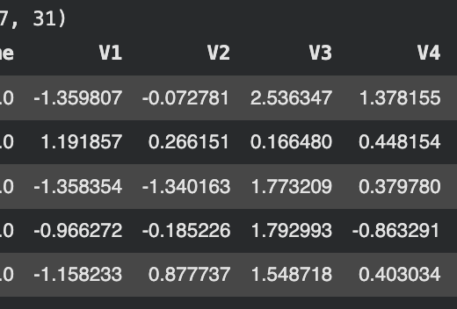

Credit Card Fraud Detection
Project One
Presentation
By Renee Guldi

Slide 2

Why is this important?
Fraud Transactions are rare
Goal:
Detect fraudulent credit card transactions automatically.
Fraud causes billions in financial loss each year.
Manual detection is a lot more tedious and difficult
Notes:
The goal of my project was to try and accurately detect fraudulent credit card transactions. This is important because fraud can lead to significant financial losses, and manual detection through thousands of lines of data is difficult. Machine Learning can help us automate this process by identifying patterns in transaction data.

Slide 3
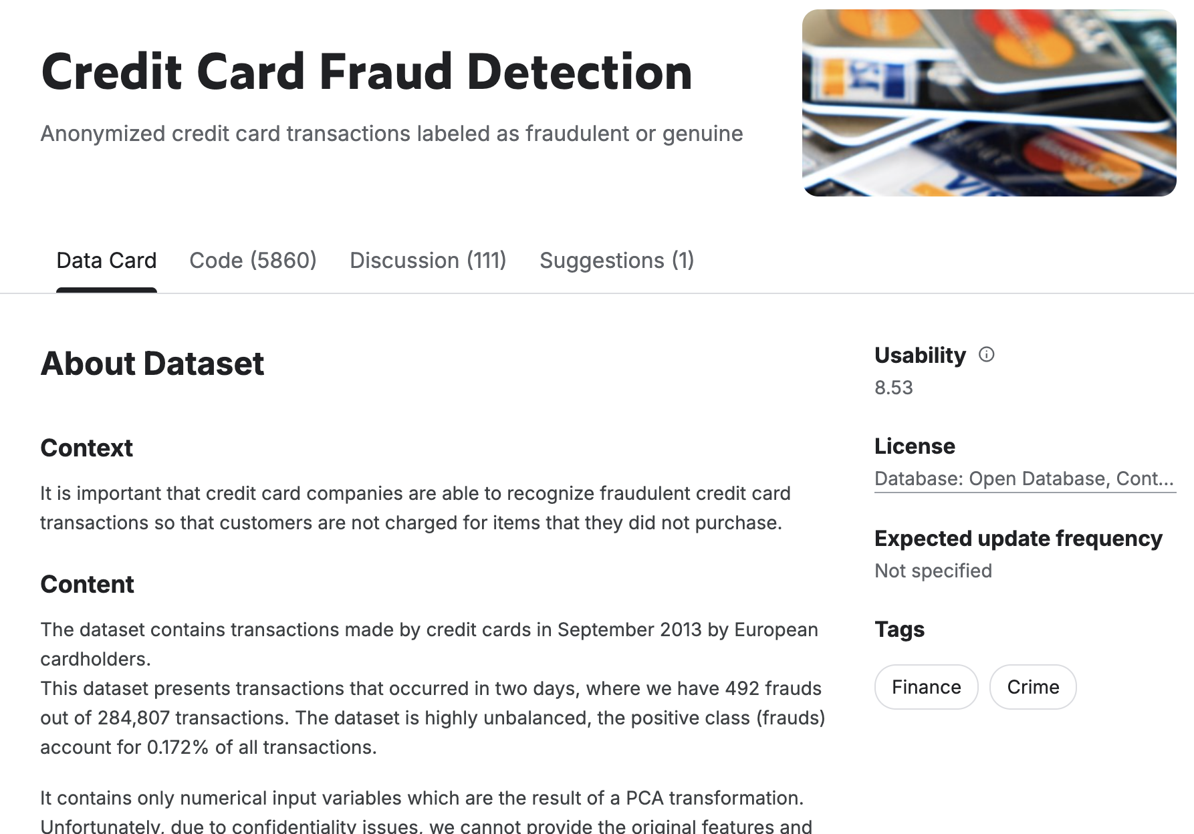
Chosen Dataset
This dataset was found on Kaggle.com
It contained:
284,807 transactions
30 input features
And 1 target label.
Class:
0 means Normal Transaction
1 means Fraud Transaction.
Notes:
The dataset that I used was a real-world list of transactions made by credit cardholders in 2013 by European cardholders. The target variable indicates whether a transaction is fraudulent or not. One of the biggest challenges was that in the dataset’s descriptions was that fraud only makes up about 0.17% of the data, making it largely imbalanced.

Slide 4
Data Preprocessing
Performed in 5 steps:
Loaded the sample dataset using pandas and gdown.
Separated features and labels.
Train/Test split (80/20)
Feature Scaling using StandardScalar
Converted data to PyTorch tensors
Notes:
I started by separating the features from the target variable, then split the data into training and testing sets using an 80/20 split. I also applied feature scaling using a standard scaler to normalize the data, which helps improve the overall model performance. Finally, the data was then converted into PyTorch Tensors for training.

Slide 5
Input Layer
(30 Features)
Models Used
{
Two models were trained:
Hidden Layer 1
64 neurons, ReLU activation
Logistic Regression
Neural Network
Hidden Layer 2
32 neurons, ReLU activation
Linear Classifier
Uses Sigmoid Activation
Predicts fraud probability.
Outer Layer
1 neuron, fraud / not fraud
Notes:
I implemented two models, with the first being Logistic Regression, which is a simple linear classifier used for binary classification. The second is a neural network with two hidden layers, which I used to have it learn more complex patterns within the data.

Slide 6
Model Training
Training Method Mini-Batch Gradient Descent
Training Steps:
Forward Pass
Compute Loss
Backpropagation
Update model weights
Optimizer: Adam
Loss Function: Binary Cross Entropy
Notes:
Both Models were trained using gradient descent. During each training set, the model is set to make predictions, computes the loss, and updates its parameters using backpropagation. The Neural Network Model was trained using a mini-batch gradient descent, while the Logistic Regression was trained using full-batch updates.

Slide 7
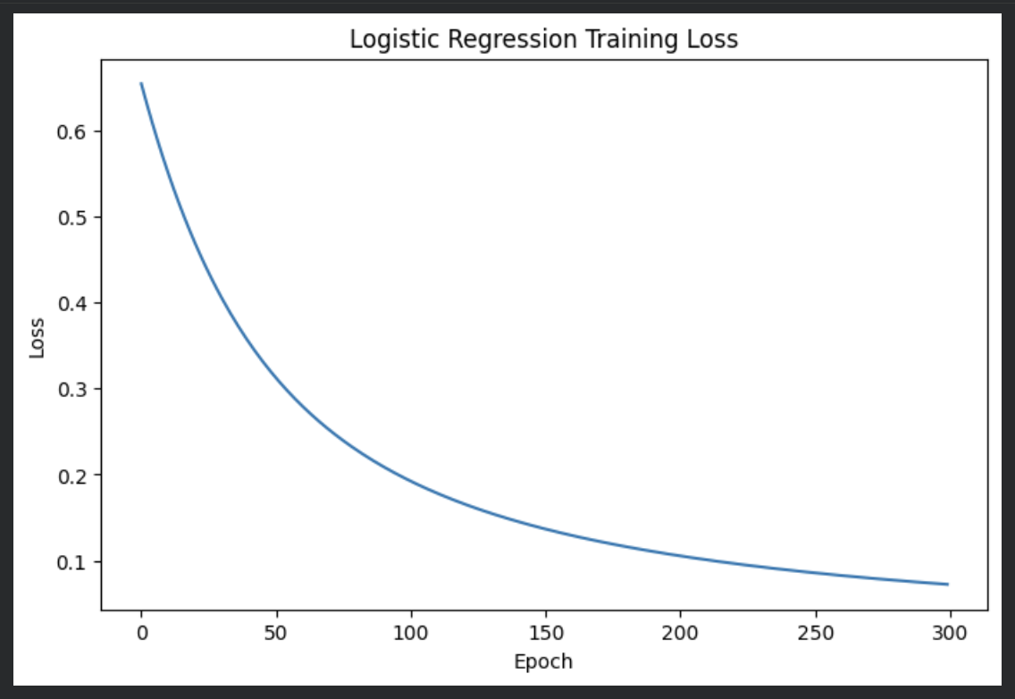
Logistic Regression Training Loss
Notes:
This graph shows the overall training loss for the logistic regression model over time. The loss decreases steadily, which indicates that the model is learning and improving its predictions. However, since the dataset is already highly imbalanced, a decreasing loss does not necessarily mean the model is good at detecting fraud.

Slide 8
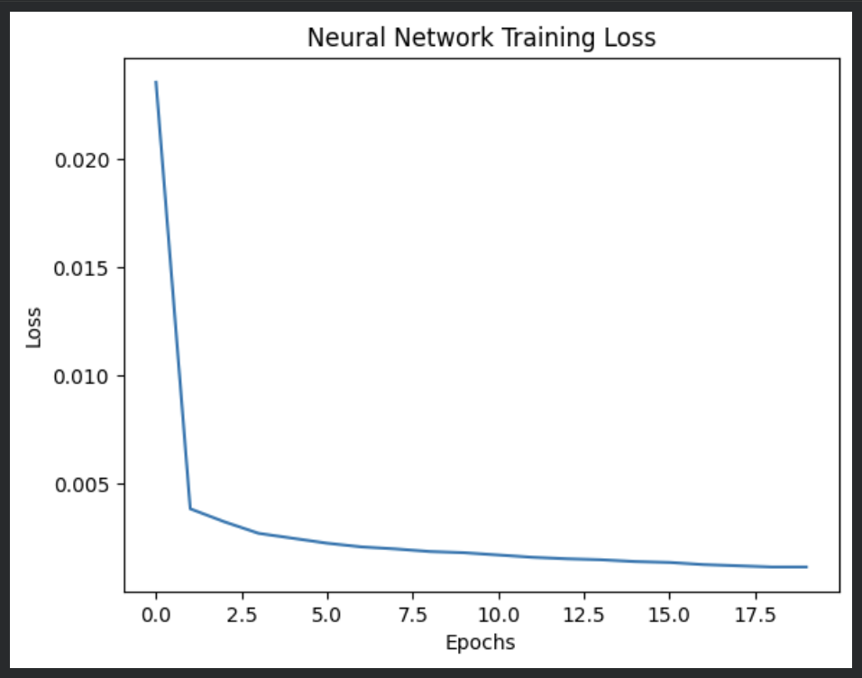
Neural Network
Training Loss
Notes:
This graph shows the neural network training loss. Similar to logistic regression, the loss decreases rapidly and then stabilizes, indicating that the model is converging. The Neural network model is able to learn more complex relationships compared to the logistic regression model.

Slide 9
Results
Logistic Regression → 99.91% (0.9991)
(8 seconds)
Neural Network (Confusion Matrix) → Accuracy = 0.9994
(46 seconds) Precision = 0.8810
Recall = 0.7551
F1 Score = 0.8132
Notes:
The Neural network achieved very high accuracy overall, but since there is a drastic class imbalance, accuracy alone is not sufficient. Precision shows how often predicted fraud cases are correct, and recall shows how many actual fraud cases were detected. The F1 score balances both metrics, giving a better overall evaluation of the data.

Slide 10
Overall Conclusions:
Key Takeaways:
Machine Learning CAN detect fraudulent transactions.
Neural Networks are well-suited for capturing complex patterns.
A large class imbalance makes fraud detection challenging.
Potential Future Improvements:
Oversampling fraud cases,
Adjusting decision thresholds,
And crafting more advanced models.
Notes:
In conclusion, both models were able to learn from the data, but the neural network performed better at capturing complex patterns within the information. However the class imbalance remains a major challenge, so I primarily focused on precision, recall, and F1 score rather than accuracy, and where future improvements could use techniques like oversampling fraud cases or adjusting classification thresholds.

