Slide 1



Paper ID :347
Satellite Image Segmentation and Classification using a Deep learning Model

Slide 2




Abstract
Satellite imagery plays a vital role in applications such as urban planning, agriculture, environmental monitoring, and disaster management. This project proposes a deep learning - based system for satellite image segmentation and object recognition optimized for edge computing. Using CNN(ResNet) and U-Net models with sequential approach, where the system performs semantic segmentation and object detection on satellite images after preprocessing techniques like normalization, resizing. Model optimization methods such as quantization and pruning enable efficient deployment , reducing latency and cloud dependency. The proposed system achieves high accuracy and efficient performance, making it suitable for real-time satellite image analysis in remote and resource-constrained environments.
Technology and Innovation Conference (TIC-2026), Malaysia

Slide 3
Objective
To design a deep learning based system for satellite image segmentation and object recognition.
To accurately classify and segment land cover regions such as urban areas, vegetation, water bodies, and roads.
To detect and localize key objects like buildings and agricultural fields in satellite images.
To optimize deep learning models for efficient deployment on edge computing devices.
To enable real-time, accurate, and scalable satellite image analysis with reduced latency and cloud dependency.
Technology and Innovation Conference (TIC-2026), Malaysia

Slide 4
Literature Review
Category 1 : Survey and Review
[1] Sudha,S.P.(2026) Addressed the challenges while integrating ML and IoT data-driven precision agriculture.
[2] Ahmad et al.(2026) proposed the UAV based remote sensing combined with Deep learning precise weed detection
[3] Adegun et al.(2022) proposed the Survey on recent DL based object detection methods and dataset and highlighting the challenges
[4] Wei, Junyong(2016), proposed the Surveys state-of-the-art SAR automatic target recognition methods and benchmarking approaches from an end-to-end perspective
.
Technology and Innovation Conference (TIC-2026), Malaysia

Slide 5
Category 2 : Experimental analysis
[5]Ahmad et al.(2026) proposed a study shows that combining UAV-based RGB image segmentation (K-means and GMM) with NDVI analysis effectively maps spatial variability in mature wheat crops, but RGB segmentation alone has limited reliability during early growth stages.
[6]Yuan et al.(2026) proposed a comparative study evaluates deep learning models for small object detection in satellite imagery
[7] Zhu et al.(2023)proposed a study compares deep learning object detection models on satellite images and shows that YOLOv8 provides highly accurate and extremely fast detection for real-world remote sensing applications.
[8] Y.Liu(2015) proposed a study that compares classical and sub-look SAR ship detection algorithms using multi-polarization and multi-frequency data
Technology and Innovation Conference (TIC-2026), Malaysia

Slide 6
Category 3 : Deep Learning Algorithm based analysis
[10] Yammanauru (2026) proposed a dual attention–enhanced YOLO model is proposed for accurate small-object detection in satellite imagery. The model preserves contextual and spatial information with minimal parameters, achieving high accuracy on challenging datasets.
[11] Othman(2023) proposed HB-YOLO, an improved YOLO framework with advanced feature extraction and attention mechanisms to enhance tiny object detection and tracking in satellite videos.
Technology and Innovation Conference (TIC-2026), Malaysia

Slide 7
Category 3 : Deep Learning Algorithm based analysis
[10] Yammanauru (2026) proposed a dual attention–enhanced YOLO model is proposed for accurate small-object detection in satellite imagery. The model preserves contextual and spatial information with minimal parameters, achieving high accuracy on challenging datasets.
[11] Othman(2023) proposed HB-YOLO, an improved YOLO framework with advanced feature extraction and attention mechanisms to enhance tiny object detection and tracking in satellite videos.
Technology and Innovation Conference (TIC-2026), Malaysia

Slide 8
Category 3 : Deep Learning Algorithm based analysis
[16] Ghandorh et al.(2021)proposed a lightweight fully convolutional neural network is proposed for real-time object recognition in multispectral satellite imagery.The model achieves high accuracy with fast prediction speed, supporting latency-sensitive satellite image analysis.
[17] Yeung et al.(2021) proposed a ResNet, an end-to-end model that jointly performs building segmentation and damage assessment from satellite/UAV imagery, achieving superior performance over traditional multi-stage methods
Technology and Innovation Conference (TIC-2026), Malaysia

Slide 9
Category 3 : Deep Learning Algorithm based analysis
[18] Wei et al.(2017) proposed an SLS-CNN-based framework combining sea–land segmentation and deep learning to achieve robust and accurate ship detection in SAR imagery.
[20] Wang(2019)proposed a study that uses deep learning CNN models for satellite image classification and shows that ResNet50 achieves the highest accuracy across multiple datasets.
Technology and Innovation Conference (TIC-2026), Malaysia

Slide 10
Category 3 : Deep Learning Algorithm based analysis
[13] Kang et al.(2022) proposed an attention-based residual image fusion network that achieves superior infrared–visible fusion quality and outperforms traditional methods across multiple datasets.
[14] Pang(2022) proposed an attention-enhanced semantic segmentation and edge detection approach for accurate road detection in high-resolution satellite images, producing sharp road boundaries and robust performance on imbalanced, real-world datasets.
[15] Hernandz et al.(2021) proposed a machine learning-based framework using CGAN and semantic segmentation to achieve automatic 3D building reconstruction and vectorization from satellite imagery
Technology and Innovation Conference (TIC-2026), Malaysia

Slide 11
Category 4 : Hybrid methods
[13] Pang(2022) proposed an attention-based residual image fusion network that achieves superior infrared–visible fusion quality and outperforms traditional methods across multiple datasets.
[15] Ghandorh et al(2021)proposed a machine learning-based framework using CGAN and semantic segmentation to achieve automatic 3D building reconstruction and vectorization from satellite imagery
[17] Wang(2021) proposed ResNet, an end-to-end model that jointly performs building segmentation and damage assessment from satellite/UAV imagery, achieving superior performance over traditional multi-stage methods
Technology and Innovation Conference (TIC-2026), Malaysia

Slide 12
Category 4 :Hybrid methods
[10]nYammanuru(2026) proposed a dual attention–enhanced YOLO model is proposed for accurate small-object detection in satellite imagery. The model preserves contextual and spatial information with minimal parameters, achieving high accuracy on challenging datasets.
[11] Sedeh(2026) proposed a EdgePVM, a server-less satellite edge-computing framework that performs efficient onboard change detection using a parallel Siamese Vision MAMBA model to reduce latency and reliance on ground-based processing.
[19] Othman(2023) proposed HB-YOLO, an improved YOLO framework with advanced feature extraction and attention mechanisms to enhance tiny object detection and tracking in satellite videos
Technology and Innovation Conference (TIC-2026), Malaysia

Slide 13
Research Gap
[Lack of unified End to End models
Limited generalization across diverse datasets and conditions
High computational cost and resource dependency
Inefficiency in detecting small and complex objects
Technology and Innovation Conference (TIC-2026), Malaysia

Slide 14
Problem Statement
To design and implement a system for accurate image segmentation and object detection from satellite imagery with reduced latency using lightweight Deep Learning models
Technology and Innovation Conference (TIC-2026), Malaysia

Slide 15
Proposed solution
To overcome the limitations of cloud-based satellite image analysis, this project aims to design a lightweight deep learning framework using Sequential approach(U-net & ResNet) to perform efficient image segmentation, object detection, and classification with reduced latency and improved performance.
Technology and Innovation Conference (TIC-2026), Malaysia

Slide 16
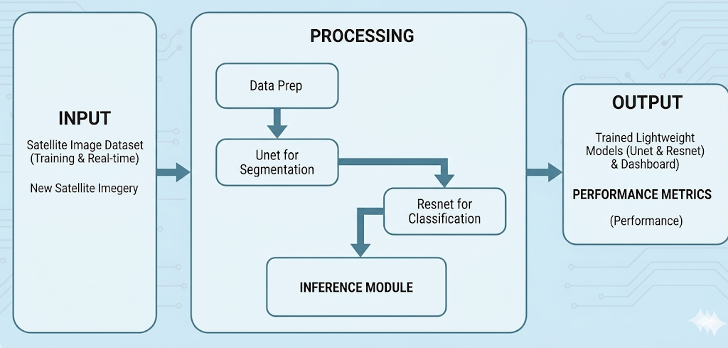
Flow Diagram
Technology and Innovation Conference (TIC-2026), Malaysia

Slide 17
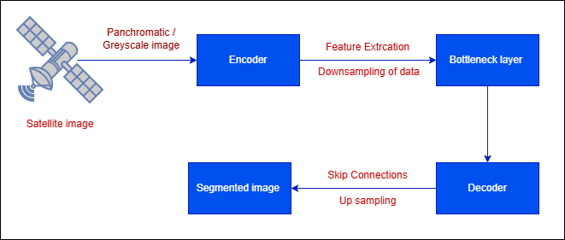
U-Net Architecture
Technology and Innovation Conference (TIC-2026), Malaysia

Slide 18
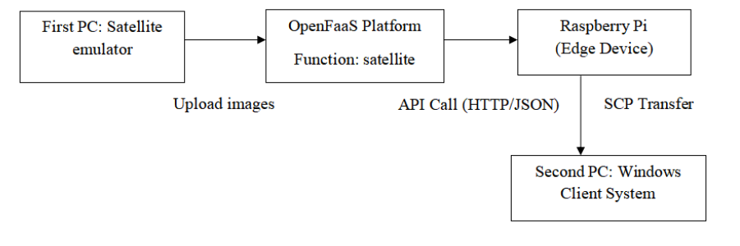
System Architecture
Technology and Innovation Conference (TIC-2026), Malaysia

Slide 19
Implementation of modules
Satellite Image Emulator Module
Processing Server Module
Image Segmentation Module
Image Classification Module
Edge Display Module
Technology and Innovation Conference (TIC-2026), Malaysia

Slide 20
Tools and Technologies
Python-High-level programming language widely used for machine learning and data analysis.
TensorFlow-Open-source deep learning framework used for training and deploying neural networks.
OpenFAAS - An open-source platform that lets you run and scale functions in a serverless way using containers.
OpenCV-Computer vision library used for image processing and feature extraction.
Frontend – HTML , Cloud Database –Supabase , Edge Processing –Raspberry Pi
Technology and Innovation Conference (TIC-2026), Malaysia

Slide 21
Conclusion
This project proposes an Deep Learning based framework for image segmentation and object detection satellite imagery to identify aerial objects efficiently. By integrating lightweight Deep learning models with edge devices, the system aims to overcome limitations of traditional cloud-based approaches such as high latency, bandwidth dependency, and delayed decision-making. The proposed solution enhances real-time processing capability, improves detection accuracy for small and fast-moving objects, and ensures energy-efficient computation. Overall, this work contributes to intelligent space object monitoring and supports advanced space research, satellite safety, and sustainable space infrastructure development.
Technology and Innovation Conference (TIC-2026), Malaysia

Slide 22
Sudha, S. P., and J. B. Loret. "A review on machine learning-based precision agriculture techniques for crop farming monitoring with IOT." Discover Environment 4.1 (2026): 10.
Ahmad, Muhammad Nasar, et al. "Advancements in deep learning methods for precise weed and rice classification from UAV imagery: a comprehensive review." Discover Agriculture 4.1 (2026): 8.
Kang, Junhyung, et al. "A survey of deep learning-based object detection methods and datasets for overhead imagery." Ieee Access 10 (2022): 20118-20134.
K. El-Darymli, E. W. Gill, P. Mcguire, D. Power, and C. Moloney, “Automatic target recognition in synthetic aperture radar imagery: A state-of-the-art review,” IEEE Access, vol. 4, pp. 6014–6058, Sep. 2016.
Ahmad, Muhammad Nasar, et al. "Advancements in deep learning methods for precise weed and rice classification from UAV imagery: a comprehensive review." Discover Agriculture 4.1 (2026): 8.
Technology and Innovation Conference (TIC-2026), Malaysia

Slide 23
6. Yuan, Xiaohui, et al. "An Empirical Analysis of Deep Learning Methods for Small Object Detection from Satellite Imagery." Expert Systems with Applications (2026): 131061.
7. Zhu, Botao, et al. "Collaborative hyperspectral image processing using satellite edge computing." IEEE Transactions on Mobile Computing 23.3 (2023): 2241-2253. .
8. Y. Liu, M.-H. Zhang, P. Xu, and Z.-W. Guo, “SAR ship detection using sea-land segmentation-based convolutional neural network,” in Proc. Int. Workshop Remote Sens. Intell. Process. (RSIP), May 2017, pp. 1–4.
9. K. El-Darymli, E. W. Gill, P. Mcguire, D. Power, and C. Moloney, “Automatic target recognition in synthetic aperture radar imagery: A state-of-the-art review,” IEEE Access, vol. 4, pp. 6014–6058, Sep. 2016. Bui
, 10. Yammanuru, Likhit, Nikhil Tom Jose, and Rimjhim Padam Singh. "Leveraging Small-Object Detection in Satellite Imagery Using Dual Attention-Augmented Single-Stage CNN Model." International Conference on Applied Algorithms. Cham: Springer Nature Switzerland, 2026.
Technology and Innovation Conference (TIC-2026), Malaysia

Slide 24
11. Sedeh, Mahdi Amini, and Saeed Sharifian. "EdgePVM: A serverless satellite edge computing constellation for changes detection using onboard parallel siamese vision MAMBA." Future Generation Computer Systems 174 (2026): 107985.
12. Kang, Junhyung, et al. "A survey of deep learning-based object detection methods and datasets for overhead imagery." Ieee Access 10 (2022): 20118-20134.
13. Pang, Y., Cheng, S., Hu, J., Liu, Y.: Robust satellite image classification with Bayesian deep learning. In: 2022 Integrated Communication, Navigation and Surveillance Conference (ICNS), pp. 1–8 (2022)
14. Hernández, Daniel, et al. "Flood detection using real-time image segmentation from unmanned aerial vehicles on edge-computing platform." remote Sensing 14.1 (2022): 223..
15. Ghandorh, Hamza, et al. "Semantic segmentation and edge detection-Approach to road detection in very high resolution satellite images." Remote Sensing 14.3 (2022): 613.
Technology and Innovation Conference (TIC-2026), Malaysia

Slide 25
11. Sedeh, Mahdi Amini, and Saeed Sharifian. "EdgePVM: A serverless satellite edge computing constellation for changes detection using onboard parallel siamese vision MAMBA." Future Generation Computer Systems 174 (2026): 107985.
12. Kang, Junhyung, et al. "A survey of deep learning-based object detection methods and datasets for overhead imagery." Ieee Access 10 (2022): 20118-20134.
13. Pang, Y., Cheng, S., Hu, J., Liu, Y.: Robust satellite image classification with Bayesian deep learning. In: 2022 Integrated Communication, Navigation and Surveillance Conference (ICNS), pp. 1–8 (2022)
14. Hernández, Daniel, et al. "Flood detection using real-time image segmentation from unmanned aerial vehicles on edge-computing platform." remote Sensing 14.1 (2022): 223..
15. Ghandorh, Hamza, et al. "Semantic segmentation and edge detection-Approach to road detection in very high resolution satellite images." Remote Sensing 14.3 (2022): 613.
Technology and Innovation Conference (TIC-2026), Malaysia

Slide 26
16. Yeung, Henry Wing Fung, et al. "Deep-learning-based solution for data deficient satellite image segmentation." Expert Systems with Applications 191 (2022): 116210.
17. Wang, Y., Zorzi, S., Bittner, K.: Machine-learned 3D building vectorization from satellite imagery (2021)
18. Wei, Shunjun, et al. "HRSID: A high-resolution SAR images dataset for ship detection and instance segmentation." Ieee Access 8 (2020): 120234-120254.
19. Othman, Mohamed Ahmed Mohamed Hassan. "Detecting Spatial Information from Satellite Imagery using Deep Learning for Semantic Segmentation." Detecting Spatial Information from Satellite Imagery using Deep Learning for Semantic Segmentation (2023).
20. Kadhim, Mohammed Abbas, and Mohammed Hamzah Abed. "Convolutional neural network for satellite image classification." Asian Conference on Intelligent Information and Database Systems. Cham: Springer International Publishing, 2019.
Technology and Innovation Conference (TIC-2026), Malaysia

Slide 27
Thank You
Technology and Innovation Conference (TIC-2026), Malaysia

